Slide 1

Lending Club Case Study
Saurabh Dugdhe

Slide 2
Problem Statement
You work for a consumer finance company which specialises in lending various types of loans to urban customers. When the company receives a loan application, the company has to make a decision for loan approval based on the applicant’s profile. Two types of risks are associated with the bank’s decision:
If the applicant is likely to repay the loan, then not approving the loan results in a loss of business to the company
If the applicant is not likely to repay the loan, i.e. He/she is likely to default, then approving the loan may lead to a financial loss for the company
The company wants to understand the driving factors (or driver variables) behind loan default, i.e. the variables which are strong indicators of default. The company can utilise this knowledge for its portfolio and risk assessment.

Slide 3
Objective
Using Exploratory data analysis, find out what factors drive the defaulter rate in the loan applicants.

Slide 4
EDA Approach
1. Data Understanding
2. Data Cleaning and Manipulation
3. Univariate Analysis
4. Segmented Univariate Analysis
5. Bivariate/Multivariate Analysis

Slide 5
Data understanding
We have been provided 2 files
Loan.csv – This files has the dataset of loan applications from the period 2007-2011
Data_Dictionary.xls – This is metadata for the loan.csv file. This contains meanings of all the columns present in the dataset.
Upon looking into the dataset we can conclude below:
Dataset contains 39717 rows and 111 columns
‘loan_status’ is the target variable for the analysis
Multiple columns have null values
There are some similar columns like ‘purpose’ and ‘title’

Slide 6
Data Cleaning/Manipulation
Drop unnecessary columns
Removed columns that do not help us in identifying defaulter status of an applicant. E.g. url, desc, zip_code, id, member_id, last_pymnt_d, last_pymnt_amnt, last_credit_pull_d, out_prncp, out_prncp_inv, total_pymnt, total_pymnt_inv, total_rec_int, total_rec_late_fee, total_rec_prncp
Removed columns that had only one unique value through out the table. E.g. pymnt_plan, policy_code.
Removed columns with mean, min, max are all same.
Standardize columns
% sign is removed from int_rate and revol_util and type-casted to float
‘term’ column is standardized by removing keyword ‘months’ from it.
‘emp_length’ is standardized as per the requirements in data dictionary and has values ranging from 0-10 and removing “+”, “<“ from the values.
Standardized home_ownership column by removing ‘None’ value as it is not mentioned as a valid value in the data dictionary.
Renamed emp_title to job_title as the data dictionary defines it to be job title that is supplied during application.
Standardized top 15 entries of job_title as there are multiple values pointing to the same applicant. E.g. Us Army, U.S. Army, us army are basically the same applicant
Excluded value “Current” from ‘loan_status’, as it does not imply the defaulter status.

Slide 7
Data Cleaning/Manipulation
Handle null values
Dropped columns with more than 60% of null values
Replaced null values in ‘emp_length’ and ‘revol_util’ with corresponding median values
Derived metrics
‘issue_month’ and ‘issue_year’ are derived from issue date i.e ‘issue_d’
Outlier treatment
Outliers are treated by removing 5% of data from columns ‘annual_inc’ and ‘revol_bal’

Slide 8
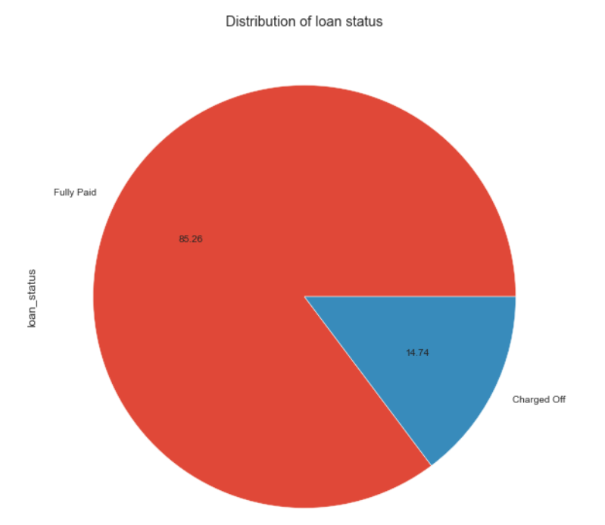
Univariate Analysis
Distribution of target variable
The dataset consists of 86.26% of Fully paid the loan and 14.74% have been charged off.

Slide 9
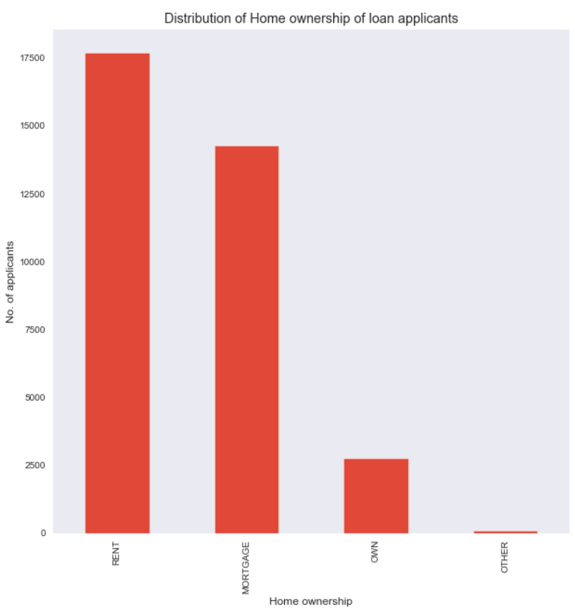
Univariate Analysis
Distribution of Home Ownership
Applicants with rented housing are more likely to request for a loan than the ones who own a property.

Slide 10
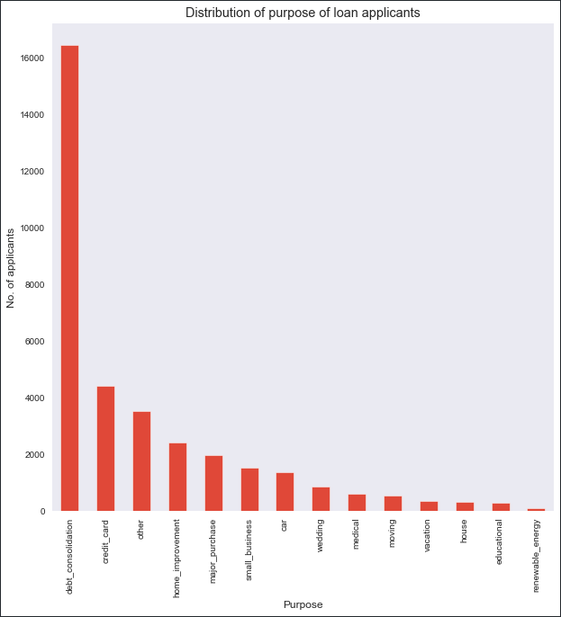
Univariate Analysis
Distribution of purpose
Debt consolidation is the major reason driving people to apply for loan, followed by credit card payments. The least driving reason is education and renewable energy.

Slide 11
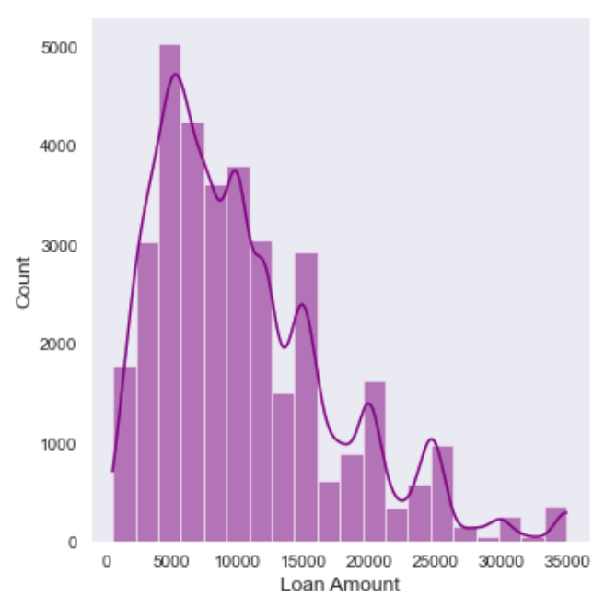
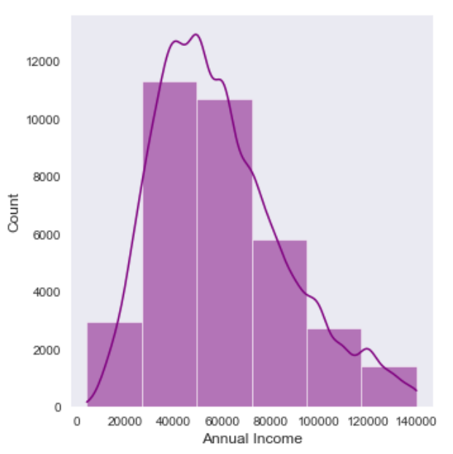
Univariate Analysis
Distribution of loan amount and Annual income
Highest number of loan applicants tend to apply a loan of amount in the range of 5000-10000
Major loan applicants fall in the annual salary bracket of 30000 - 80000

Slide 12
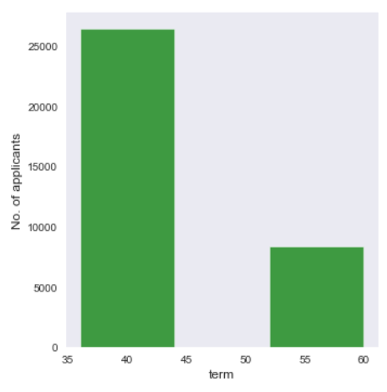
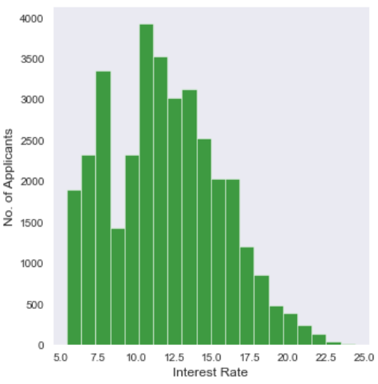
Univariate Analysis
Distribution of Term and Interest rate
Majority of people apply for a loan of term of 36 month.
Most applicants fall in the interest range of 10%-12%.

Slide 13
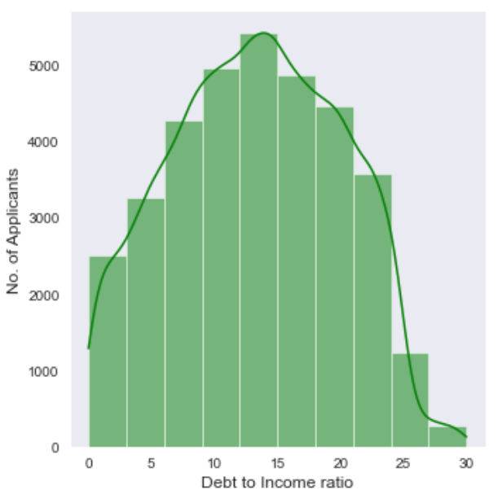
Univariate Analysis
Distribution of debt to income ratio
Majority of Debt to income ratio of applicants lies between 10-20%.

Slide 14
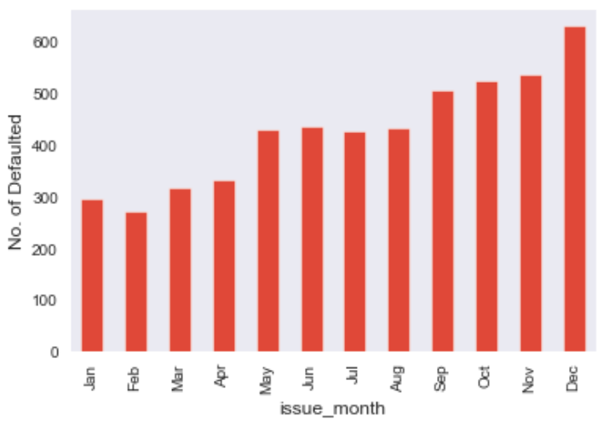
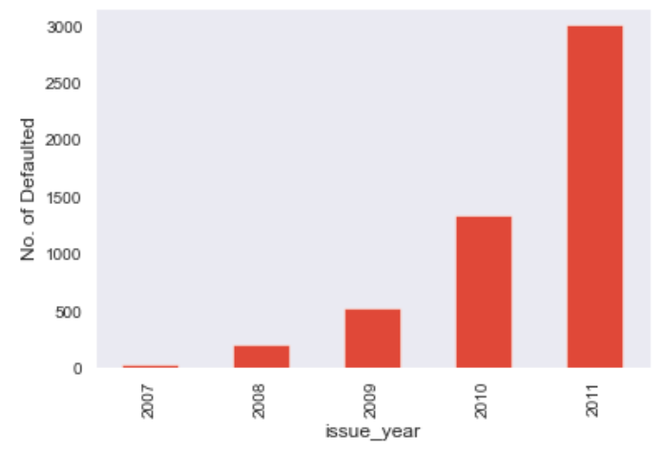
Segmented Univariate Analysis
Defaulting rate as per issue month and year
1. Loans issued at the start of the year are less likely to default than the ones issued in the last quarter.
2. Loan defaulting rate is increasing every year

Slide 15
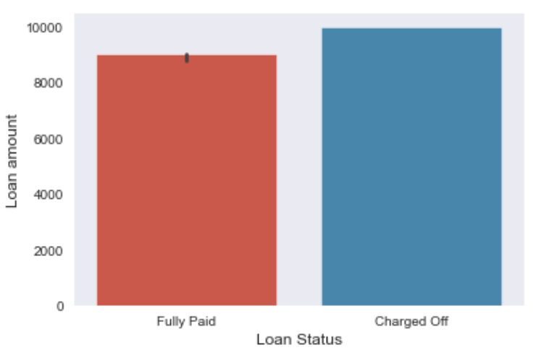
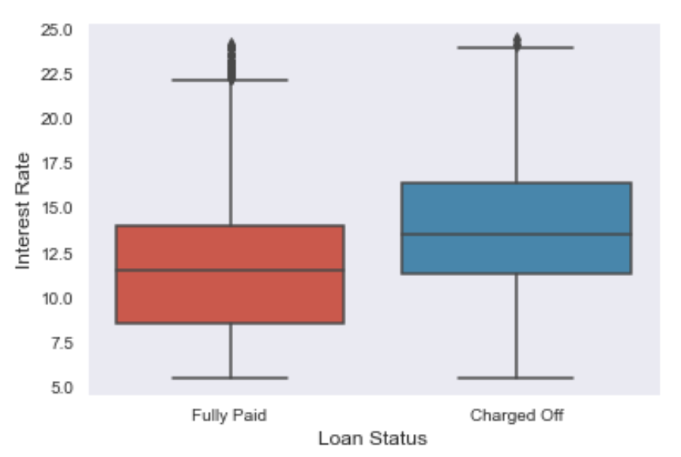
Bivariate/Multivariate Analysis
Impact of loan amount and interest rate on loan status
Loans with higher amount and higher interest rate tend to be defaulted.

Slide 16
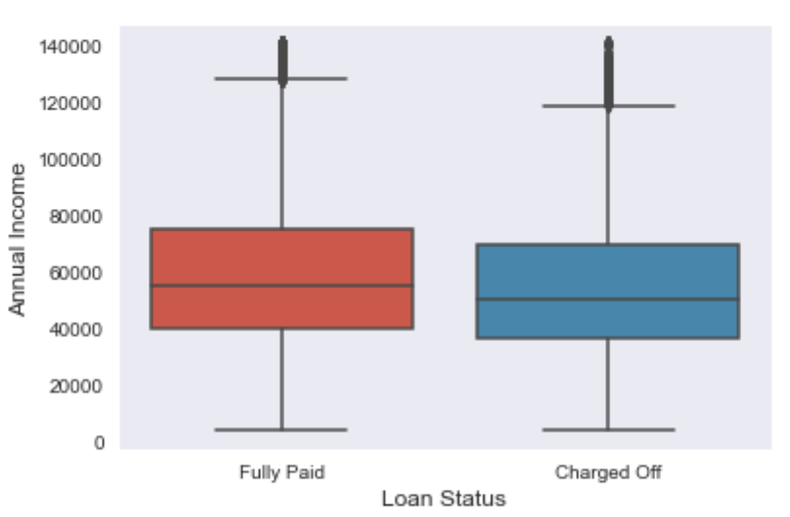
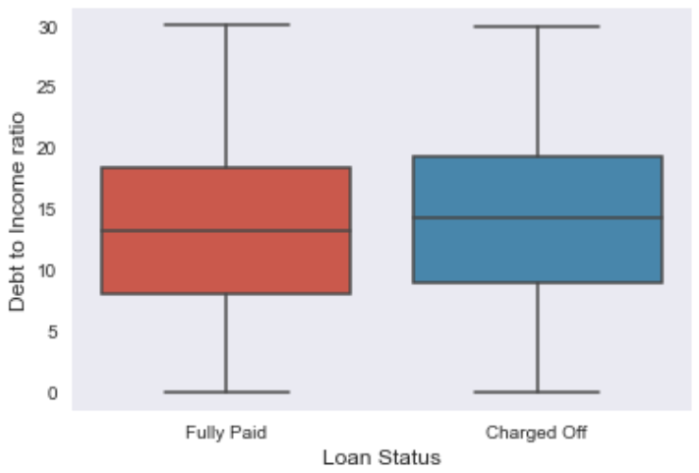
Bivariate/Multivariate Analysis
Impact of annual income and DTI
1. Applicants with lower income tend to default the loans. While, applicants with higher annual income will fully pay the loan back.
2. Applicants with higher DTI tend to default than the applicants with lower DTI.

Slide 17
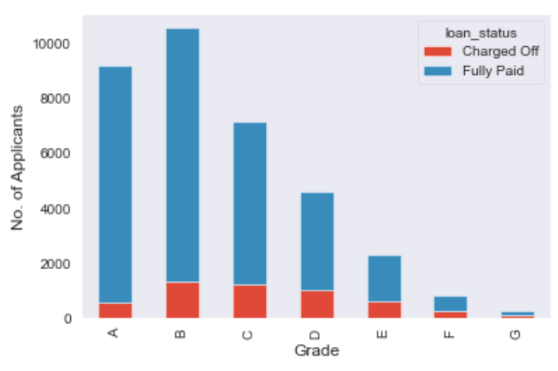
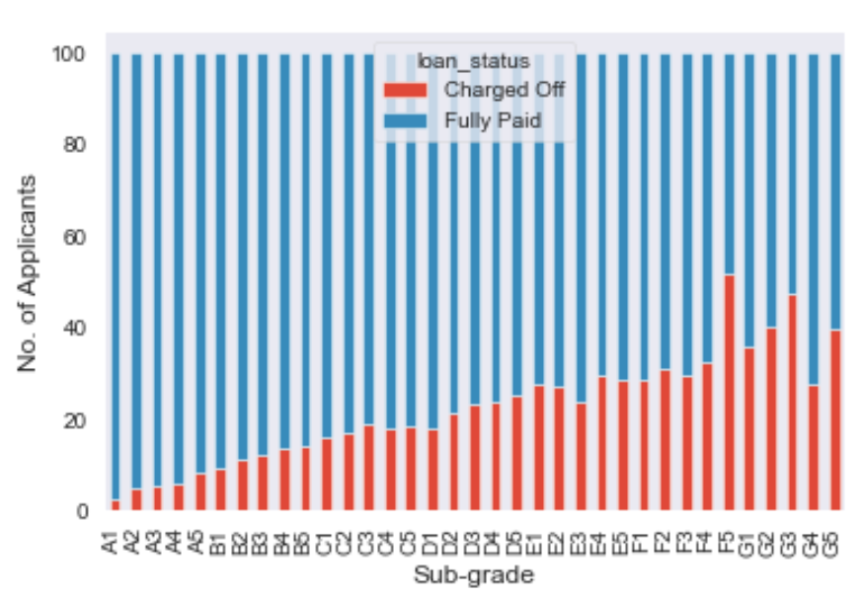
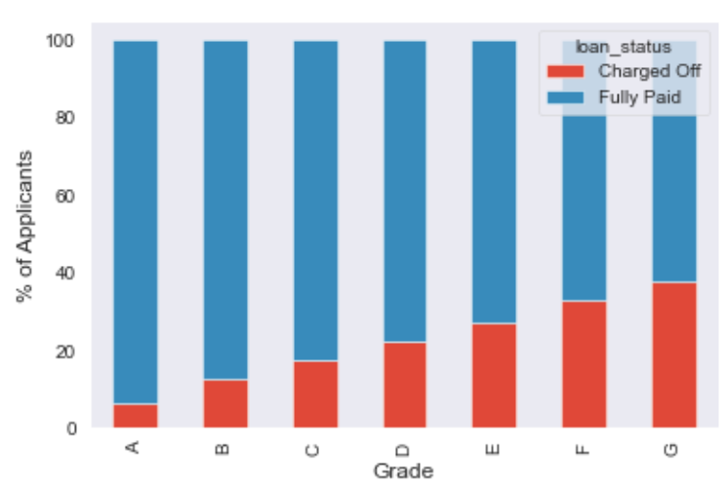
Bivariate/Multivariate Analysis
Impact of grade on loan status
1. Maximum number of people fall in group B followed by A. The least number of people have grade G.
2. Grade A has the least percentage of defaulters. While, grade G has the highest percentage of defaulting rate
3. Likewise, sub grades of A have low defaulting rate. While subgrades of F & G have high defaulting rate.

Slide 18
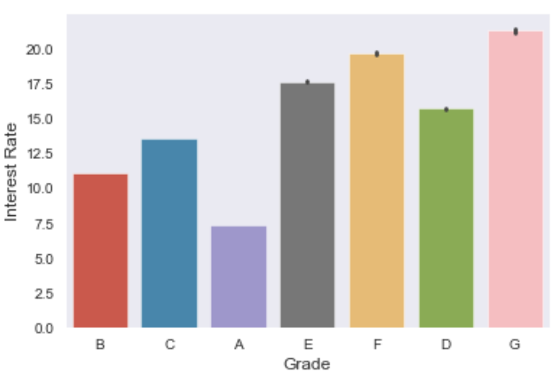
Bivariate/Multivariate Analysis
Variation of interest as per grades
1. Grades G and F have high interest rates, this could be the reason of higher defaulting rate for these grades.
2. Grade A has the least interest rate and hence the defaulting rate.

Slide 19
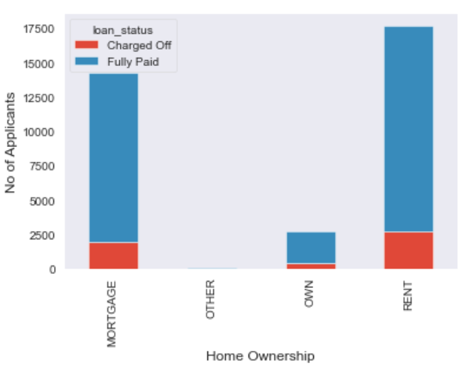
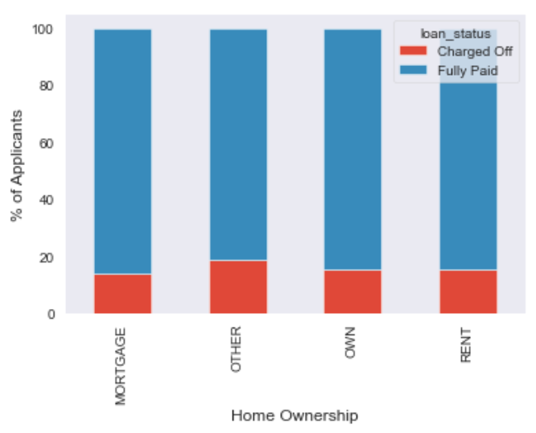
Bivariate/Multivariate Analysis
Impact of Home Ownership on loan status
1. Applicants from rent and mortgage categories are the highest.
2. Defaulting rate of other and owners is higher than that of rent and mortgage.

Slide 20
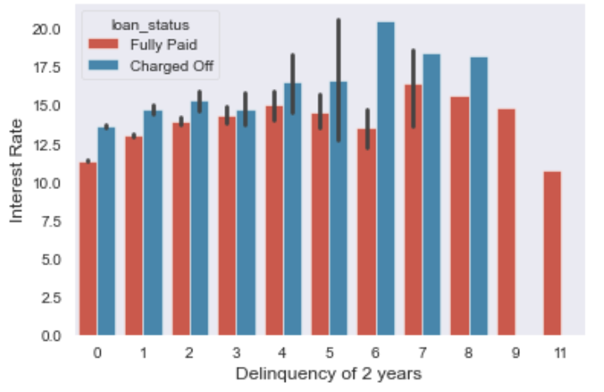
Bivariate/Multivariate Analysis
Variation of loan status on interest rate and delinquency of 2 years
Defaulted applicants with delinquency in past 2 years have higher interest rates.

Slide 21
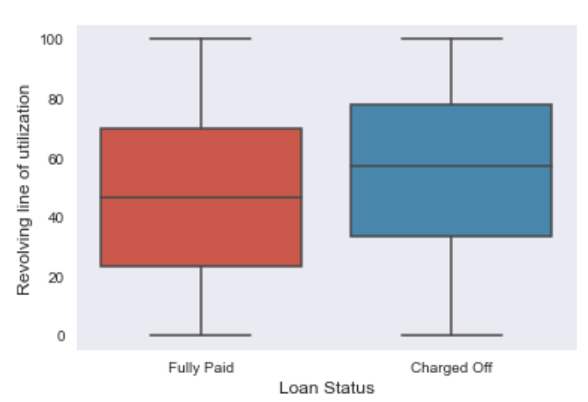
Bivariate/Multivariate Analysis
Impact of revolving rate of utilization on loan status
Applicants with revolving rate of utilization of more than ~50% are likely to default their loans

Slide 22
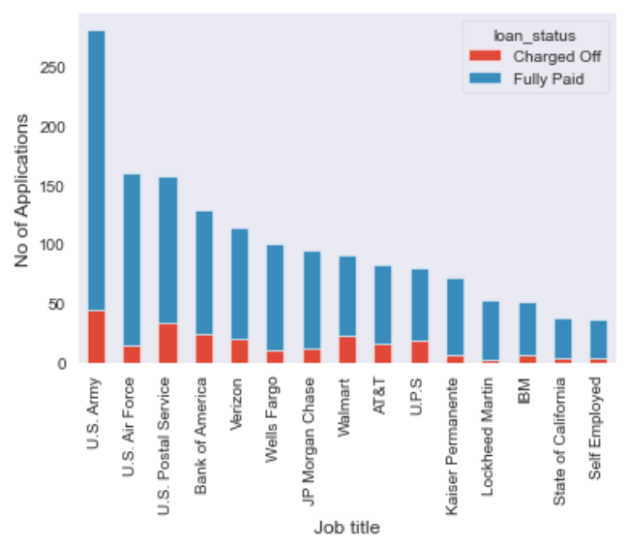
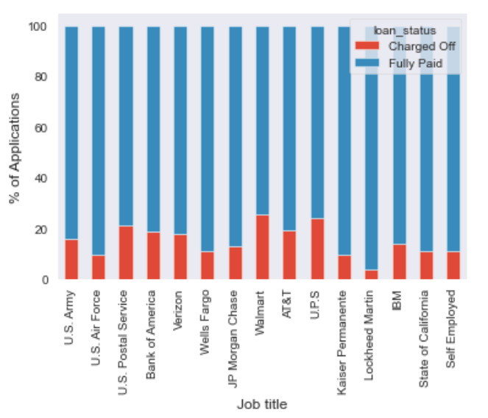
Bivariate/Multivariate Analysis
Defaulting rate as per job title of the applicant
1. We can see that U.S. Army is the most frequent loan applicant, while self-employed are the least.
2. Out of the top 15 applicants Walmart is the top defaulter, while Lockheed Martin generally pays the loan fully.

Slide 23
Conclusion
Following variables drive the defaulter rate.
Loan Amount: With increase in loan amount the defaulting rate increases.
Interest Rate: With the increase in interest rate, defaulting rate also increases.
Annual Income: Defaulting rate increases with lower annual income.
DTI: With higher DTI, the defaulting rate increases.
Grade: Defaulting rate increases as we move from grade ‘A’ to grade ‘G’.
Revolving rate of utilization: With increase in the revolving line of utilization, the defaulting rate increases

Slide 24
Recommendations/Proposals
Sanction loans of small amounts
Extremely high interest rates must be avoided
Decrease loans for applicants with low annual income
Approve loans for applicants with lower debt
Consider loaning often to grades A, B, C over F, G
Decrease loaning to applicants with high revolving line of utilization

