Slide 1
Book Recommendation Chatbot
Using IBM Watson Assistant
Presented by: Saurabh Kumar Gautam
Second-Year B.Tech Student in Computer Science and Engineering from Lloyd Institute of Engineering and Technology
Mentor: Abhishek Singh
Notes:
1

Slide 2
Presentation Outline
This presentation will explain our Conversational Book Recommendation Chatbot project.
Project Overview
How the Chatbot Works
We'll start with the chatbot's goals, what it needs to do, and its main purpose.
We'll dive into the design and flow of the conversation, built using IBM Watson Assistant.
Project Benefits
Overcoming Challenges
See the positive impact and value this chatbot brings.
Learn about the technical problems we faced during development and how we solved them.
Key Takeaways and Future Plans
Thanks and Resources
A summary of what we achieved and what's next for the project.
Acknowledge the people, tools, and research that helped make this project possible.
Notes:
2

Slide 3
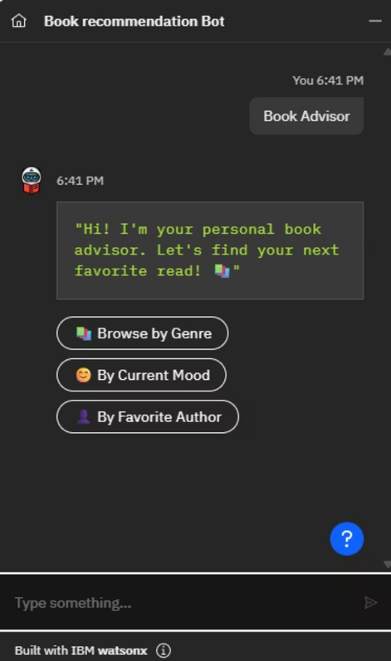
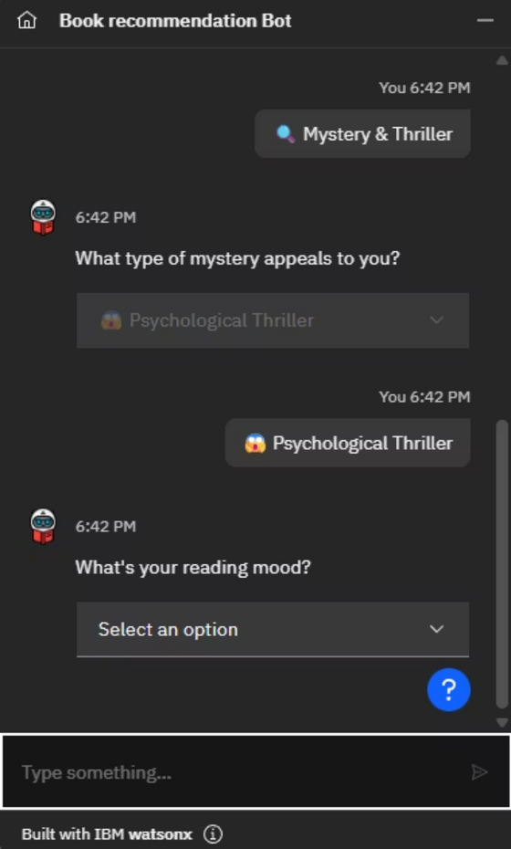
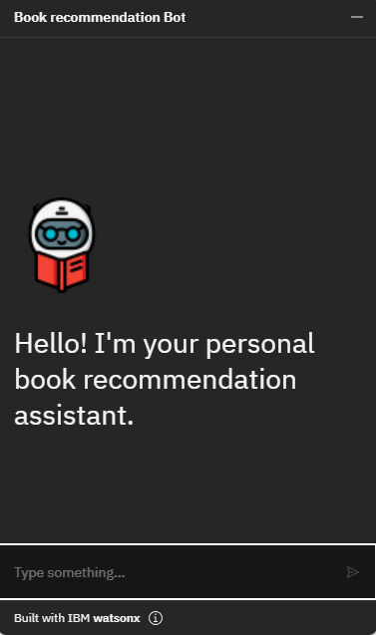
PROJECT OVERVIEW
This project aims to build a smart, chatbot that recommends books based on the user's preferences.
The chatbot interacts using natural language and recommends books using the selected genre, mood, and author.
Built using IBM Watson Assistant with Dialog Skills and AI-powered intent/entity understanding.
Notes:
3

Slide 4
Benefits
Books just for you
Easy to find books
Get book ideas just for you. They fit what you like, how you feel, and your favorite kinds of books. So every book could be a new favorite!
Our smart chatbot quickly knows what you want. It helps you easily find your next good book, without any trouble.
No more too many choices
Save time, find books
Stop looking forever! The chatbot finds books you'll love, making it simple to pick one. No more feeling confused by too many choices.
Find new books fast! This saves you time and makes finding your next great story fun and quick.
Notes:
5

Slide 5
Challenges Faced
Problem: Ensuring the bot remains engaging and keeps the conversation going to refine the recommendations.
🤖 NLU Training
Problem: Users phrase queries in many ways; bot may misclassify intents.
Solution: Use follow-up questions to maintain the conversation, such as asking for more preferences after an initial book recommendation is made.
Solution: Add diverse training examples; use entities for genres/authors; and retrain regularly.
Notes:
6

Slide 6
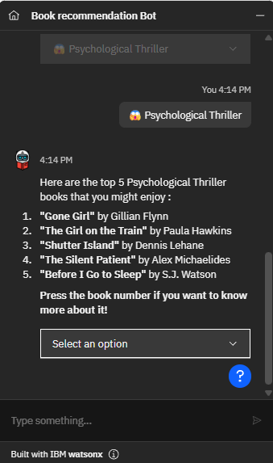

Conclusion
1
The Chatbot Works!
I built a chatbot that helps people find books they'll love. It was made using IBM Watson Studio.
2
IBM Watson Is Smart
This project showed how good IBM Watson is at understanding language and making helpful AI chats.
3
AI Can Change Things
This work proved that AI has huge power to change how we discover things, especially books and other content.
4
Ready for More Books
We made sure the chatbot can work on different devices and easily handle a lot more books later on.
Notes:
7

Slide 7

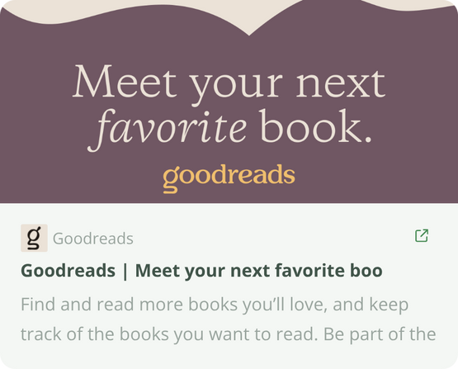
References
IBM Watson Assistant Documentation
Academic Supervision
Project guidance and technical mentorship provided by Abhishek Singh.
Comprehensive documentation for utilizing IBM Watson Assistant functionalities.
https://cloud.ibm.com/docs/assistant
Data Source for Book Recommendations
Book recommendation data acquired from the following web resource.
Notes:
8

