Slide 1
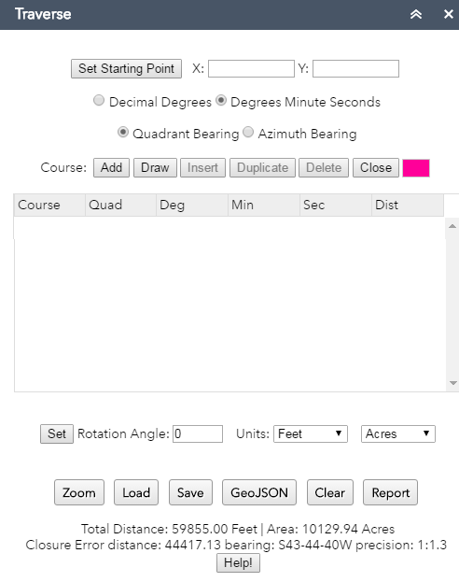
Traverse Tool
The simple traverse measurement tool allows you to create, edit and save a geographic shape based on bearing and distance measurements. Course degrees can be entered in decimal degrees or degree minute second formats. Course angles can be quadrants or north azimuth angles. Course distances can be in a variety of units. The traverse can be rotated around the start point. Traverse areas and closures will always be calculated. Once created the traverse can be saved a GeoJSON shape or saved in a structure compatible with ArcMap CoGo or ParcelFabric. Saved traverse files can be loaded and used at a later time.
Set starting point using the mouse or keypunching in coordinates
Option for degree format
Option for angle format
Change color of courses
Add a closing course
Delete a course
Insert a duplicate course
Insert a blank course
Add single or multiple course with mouse (double click to end)
Add a course (keypunch)
Set traverse rotation around the start point
Set units for courses and area calculations
Zoom to the
traverse
Create a traverse report
Export the traverse as standard GeoJSON shape.
Save and load traverse in a ArcMap traverse
export format
Clear the traverse

Slide 2

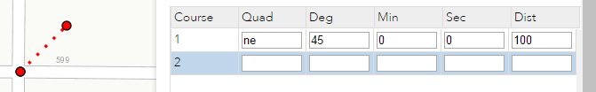
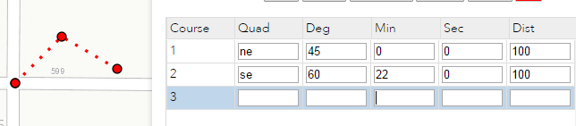
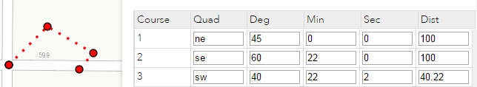
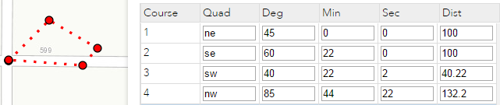
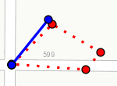

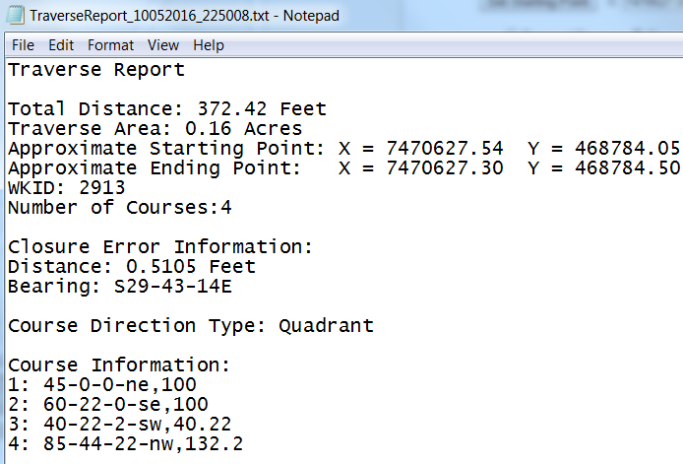
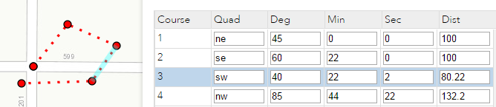


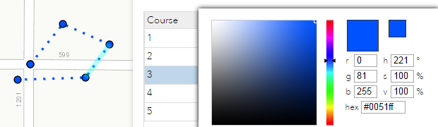
Traverse Basic Steps
1. Enter the start point with mouse
2. Add your first course
3. Add your second course
(enter in line 2)
4. Add your third course
(enter in line 3)
5. Add your fourth course
(enter in line 4)
6. Check your closure and area
at the bottom of tab
7. Change the rotation and press
the mouse on an blue angle
point and move it or type an
angle in than press done
8. View and save a traverse
report
9. Edit a course. Select a course with
the mouse and change any value and
press the enter or + key
10. Save the traverse to use later
11. Change the traverse color

Slide 3
Traverse Notes
Editing Courses: In addition to editing a single course you can also duplicate a course, delete a single course, or insert a course before the selected course.
Close a Traverse: You can add a last closing course to a traverse which will automatically close the traverse using the closure bearing and distance. This tool does not have any other closure methods.
Moving a traverse: You can move the traverse by simply selecting a new start point.
Drawing Courses: You can quickly measure inverses of lines and add courses on the map with the mouse. Double click to end or press (done).
Blank Course: Blank courses (rows) are ignored when calculating closure, running reports, or saving to a file.
Units: All courses in a traverse MUST have the same angle, bearing, and unit formats.
The Keypad: This application supports a standard 10key keypad. The + key works like the enter key.
GeoJSON: You can save multiple courses to multiple GeoJSON shapes that can be easily displayed in most web applications as sketches.
Curves: This tool does not support curves. Enter curves as straight lines using the long cord bearing and distance.
Rotation: You can ONLY rotate a traverse around the start point.
What this tool is and is not: This tool is a simple traverse tool. This tool is NOT a property management system or a CoGo package.
Who developed this tool: This tool was developed in collaboration by the City of Yakima, Washington and Polk County, Oregon.

