Slide 1
KUBERNETES.

Slide 2
CONTAINERS INTRODUCTION.
A container is a standard unit of software that packages up code and all its dependencies so the applications run quickly and reliably from one computing environment to another.
Containers provide a standard way to package your applications code, configurations and dependencies into a single object.

Slide 3
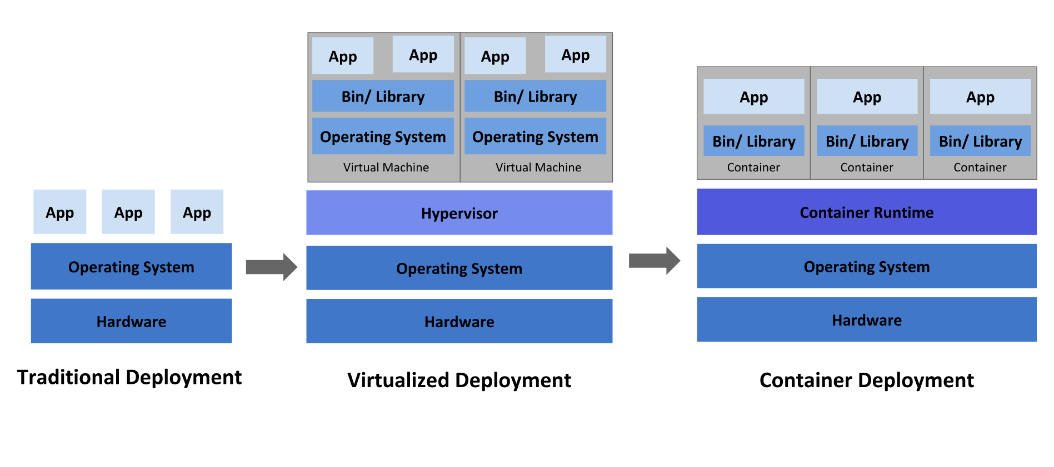
VIRTUAL MACHINES VS CONTAINERS.

Slide 4
KUBERNETES INTRODUCTION.
Kubernetes is an open source orchestration system for docker containers.
So what does orchestration mean?
orchestration means automated arrangement, coordination and management of computer systems, middleware and services.
orchestration takes advantage of multiple tasks that are automated in order to automatically execute a larger workflow or process.

Slide 5
KUBERNETES INTRODUCTION.
It lets you schedule containers on a cluster of machines.
You can run multiple containers on one machine.
You can run long running services like web applications.
Kubernetes will help you to manage the state of these containers.
Kubernetes can help you start the containers on specific nodes.
Kubernetes will also help you restart a container when it gets killed.
Can move containers from one node to another node.

Slide 6
KUBERNETES INTRODUCTION.
Instead of just running a few docker containers on one host manually, Kubernetes is a platform that will manage the containers for you.
Kubernetes clusters can start from one node and can go upto thousands of nodes.
Some other popular docker orchestartions are :
Docker Swarm
Mesos

Slide 7
KUBERNETES ADVANTAGE.
You can run kubernetes anywhere.
On-premise in your own datacenter.
Public in any cloud like AWS.
Hybrid with a combination of public and private
Highly modular, meaning you can make changes at any time when necessary.
Open source
Great community
Backed by google

Slide 8
DOCKER.
Docker is the most popular container software.
An alternative to docker is rkt(rocket) - which also works with kubernetes.
Docker engine
The docker runtime.
Software to run docker images.
Docker hub
Online repository to store and fetch docker images.
Consists of both public and private repository. So you can choose what fits your need.
Also allows you to build docker images online.

Slide 9
DOCKER BENEFITS.
Isolation : You ship a binary with all the dependencies.
No more saying it works on my machine but not in production.
Closer parity between dev, QA and production environments.
Docker makes development teams able to ship faster.
You can run the same docker image, unchanged, on laptops, VMs, data center and cloud providers.
Docker uses Linux containers which is a kernel feature for operating system level isolation.

Slide 10
KUBERNETES SETUP.
There are multiple ways that you can setup the kubernetes on your machine.
Kubernetes should really be able to run anywhere.
But there are more integrations for certain cloud provides like AWS, GCP.
Things like volumes and external load balancers work only with supported cloud providers.
I will first use minikube to quickly spin up a local single machine with a kubernetes cluster.
We will then see how to spin up a cluster on AWS using Kops.
Kops can be used to spin up a highly available production cluster.

Slide 11
MINIKUBE SETUP.
Minikube is a tool that makes it easy to setup and run kubernetes locally.
Minikube runs a single-node kubernetes cluster inside a linux VM.
It is aimed at users who want to just test out or use it for development.
It cannot spin up a production cluster and it is a one node machine with no high availability.
It works on windows, linux and macOS.
You will need virtualization software installed to run minikube.
Virtual box is free and can be downloaded from https://www.virtualbox.org/
You can download minikube from https://github.com/kubernetes/minikube
To launch your cluster you just need to pass the below command in shell/terminal/powershell.
minikube start

Slide 12
MINIKUBE SETUP.
First run the following command - grep -E --color 'vmx|svm' /proc/cpuinfo
apt install docker.io -y
Then you will need to install kubectl
curl -LO https://storage.googleapis.com/kubernetes-release/release/`curl -s https://storage.googleapis.com/kubernetes-release/release/stable.txt`/bin/linux/amd64/kubectl
chmod +x ./kubectl
sudo mv ./kubectl /usr/local/bin/kubectl
kubectl
sudo snap install kubectl --classic
kubectl
Then you will need to install a hypervisor like virtualbox.
sudo apt-get update
sudo apt-get install virtualbox

Slide 13
MINIKUBE SETUP.
curl -Lo minikube https://storage.googleapis.com/minikube/releases/latest/minikube-linux-amd64 \ && chmod +x minikube
sudo mkdir -p /usr/local/bin/
sudo install minikube /usr/local/bin/
minikube start --vm-driver=virtualbox

Slide 14
RUNNING KUBERNETES LOCALLY VIA MINIKUBE.
Once the minikube installation is done, you can run “minikube start --vm-driver=virtualbox” to start the kubernetes environment.
Now you can interact with kubectl with the below commands.
kubectl create deployment hello-minikube --image=k8s.gcr.io/echoserver:1.10
kubectl expose deployment hello-minikube --type=NodePort --port=8080
minikube service hello-minikube --url
kubectl delete services hello-minikube
kubectl delete deployment hello-minikube
minikube stop
minikube delete

Slide 15
KUBERNETES SETUP USING DOCKER CLIENT.
Go to https://hub.docker.com/editions/community/docker-ce-desktop-windows

Slide 16
INTRODUCTION TO KOPS.
To setup kubernets on AWS, you can use a tool called kops.
kops stands for kubernetes operations.
This tool allows you to do production grade kubernetes installation, upgrades and management.
We will use this tool to setup kubernetes on AWS.
There is also a legacy tool called kube-up.sh
This was a simple tool to bring up a cluster, but is now deprecated. It does not create a production ready environment.
kops only works on mac/linux.
If you are on windows then you will need to boot a virtual machine first.
You can use vagrant to quickly boot up a linux box.
You can download virtual box from https://www.virtualbox.org/ and vagrant from `https://www.vagrantup.com/ (You will need both to work)

Slide 17
KUBERNETES SETUP ON AWS USING KOPS.
Go to the link https://github.com/kubernetes/kops
Install pip.
Install aws cli
Create a user with admin access in AWS to access the AWS resources.
Create an S3 bukcet where all your kubernetes state files will be saved.
Create a hosted zone in Route53 that will be used by kubernetes.
Install kubectl

Slide 18
KUBERNETES SETUP ON AWS USING KOPS.
curl -LO https://storage.googleapis.com/kubernetes-release/release/`curl -s https://storage.googleapis.com/kubernetes-release/release/stable.txt`/bin/linux/amd64/kubectl
chmod +x ./kubectl
sudo mv ./kubectl /usr/local/bin/kubectl
Before creating a cluster, you will need to create ssh keys and these keys will be used to login to the servers.
ssh-keygen -f .ssh/id_rsa
kops create cluster --name=kubernetes.cloudtechiez.tech --state=s3://dgruploads-kube-kops --zones=us-east-1a --node-count=2 --node-size=t2.micro --master-size=t2.micro --dns-zone=kubernetes.cloudtechiez.tech
kops update cluster --name kubernetes.cloudtechiez.tech --state=s3://dgruploads-kube-kops --yes

Slide 19
DELETING THE KUBERNETES CLUSTER ON AWS.
To delete the cluster on AWS, follow the below commands.
kops delete cluster kubernetes.cloudtechiez.tech --state=s3://dgruploads-kubernetes-kops
kops delete cluster kubernetes.cloudtechiez.tech --state=s3://dgruploads-kubernetes-kops --yes

Slide 20
KUBERNETES SETUP ON AWS - KOPS.
kubectl run hello-minikube --image=k8s.gcr.io/echoserver:1.4 --port=8080
kubectl expose pod hello-minikube --type=NodePort
kubectl config view
kubectl config use-context kubernetes
Update the security group to allow the traffic for the kubernetes cluster.
kops delete cluster kubernetes.cloudtechiez.tech --state=s3://dgruploads-kubernetes-kops
kops delete cluster kubernetes.cloudtechiez.tech --state=s3://dgruploads-kubernetes-kops --yes

Slide 21
DELETING THE KUBERNETES CLUSTER ON AWS.
To delete the cluster on AWS, follow the below commands.
kops delete cluster kubernetes.cloudtechiez.tech --state=s3://dgruploads-kubernetes-kops
kops delete cluster kubernetes.cloudtechiez.tech --state=s3://dgruploads-kubernetes-kops --yes

Slide 22
BUILDING CONTAINERS.
To build containers, you can use docker engine.
You can download docker engine for Windows, Linux and MacOS. Below are the urls.
Linux : https://docs.docker.com/install/linux/docker-ce
You can choose the installation dependin on your flavour for linux.
Windows : https://docs.docker.com/docker-for-windows/install/
MacOS : https://docs.docker.com/docker-for-mac/install/

Slide 23
DOCKERFILE.
A Dockerfile is a text document that contains all the commands a user could call on the command line to assemble an image. Using docker build users can create an automated build that executes several command-line instructions in succession.

Slide 24
DOCKERFILE.
To build the dockerfile, docker build command can be used.
Docker build can be executed manually or by CICD software like jenkins.
You can use “docker build .” to build the dockerfile into an image.
After the docker build process you have built an image that can run the nodejs app.

Slide 25
BUILDING DOCKER IMAGES.
https://github.com/wardviaene/docker-demo.git
You can use the command “docker build .” to build a docker image.
Once the image is built, you can run it as a container by running “docker run -it -p 3000:3000 <image name>
Then open up another terminal session and run “curl localhost:3000”
You should see the output of your app running as a container.

Slide 26
DOCKER REGISTRY.
A Docker registry stores Docker images. Docker Hub and Docker Cloud are public registries that anyone can use, and Docker is configured to look for images on Docker Hub by default. You can even run your own private registry.
To make an image available for kubernetes, you need to push the image to a docker registry, like a docker hub.
The first step will be to create a docker hub account byu going to “http://hub.docker.com”.
Then you can push any image that is built locally to the docker registry which is going to be docker hub in our case.

Slide 27
DOCKER REGISTRY.
To push an image to docker hub, you can run the below commands one after the other.
docker login.
Here you will be prompted for your docker hub login credentials.
docker tag <image name> <user-id>/<image-name>
docker push <user-id>/<image-name>

Slide 28
DOCKER.
You can build and deploy any application you want using docker and kubernetes. However, there are certain limitations that you should keep in mind.
You should only run one process in one container.
Do not try to create one huge docker image for your app but split them if required.
All the data in the container is not preserved. When you stop a container, all the changes within the container is lost.
You can still preserve this data using volumes which we will discussing later in the course.

Slide 29
RUNNING FIRST APP ON KUBERNETES.
Let us now run our newly built application on the kubernetes cluster.
Before we can launch a container based on a image, you will need to create a pod definition.
A pod describes an application running on kubernetes.
A pod can contain one or more tightly coupled containers that make up your app.
Those apps can easily communicate with each other using the local port numbers.
Our app right now has only one container.

Slide 30
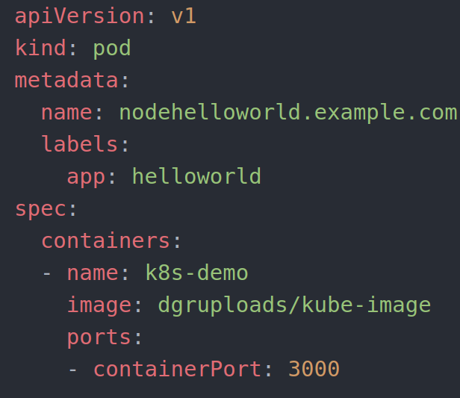
CREATING A POD.
Create a file name pod-hello.yml with the pod definition.
You can use kubectl to create a pod on kubernetes cluster.
kubectl create -f
k8s-demo/pod-hello.yml

Slide 31
SOME USEFUL COMMANDS IN KUBECTL.
kubectl get pod | Get information about all the running pods.
kubectl describe pod <pod> | Describe one pod.
kubectl expose pod <pod> --port=444 --name=frontend | Expose the port of a pod. This will create a new service.
kubectl port-forward <pod> 8080 | Port forward the exposed pod port to your local machine.
kubectl attach <podname> -i | Attach to a pod.
kubectl exec <pod> --command | Execute a command on a pod.
kubectl label pods <pod> mylabel=awsome | Add a new label to a pod.
kubectl -i --tty busybox --image=busybox --restart=Never -- sh | Run a shell in a pod. This is very useful for debugging.

Slide 32
BY USING MINIKUBE.
https://github.com/Dgruploads/kubernetes-course.git
kubectl create -f first-app/helloworld.yml
kubectl get pods
kubectl describe pod nodehelloworld.example.com
kubectl port-forward nodehelloworld.example.com 8081:3000
Then you can test it out by running localhost:8081 in a new shell.

Slide 33
BY USING KOPS ON AWS.
This is one way. You can do this in another way by creating this as a service.
kubectl expose pod nodehelloworld.example.com --type=NodePort --name=nodehelloworld-service
kubectl get svc
Remember to open the port in SG.

Slide 34
USEFUL KUBECTL COMMANDS.
kubectl exec nodehelloworld.example.com -- ls /app
kubectl exec nodehelloworld.example.com -- touch /app/touch.txt
kubectl get service / svc
kubectl describe service <Servie name>
kubectl run -i --tty busybox --image=busybox --restart=Never -- sh
telnet ip port
GET /

Slide 35
EXPOSING THE SERVICE WITH A LOAD BALANCER.
In real world, you will always have to access the application from outside the cluster.
On AWS, you can do this by using load balancers.
This load balancer will then route the traffic to the correct pod in kubernetes.
There are other solutions available for other cloud providers that do not have a load balancer.
You can use your own haproxy or nginx load balancer in front of your cluster.
Expose the ports directly.
We are going to look at how we can do this in AWS.
For this we will need to create a pod and a service.
Pod will be your container application and service will be the load balancer.

Slide 36
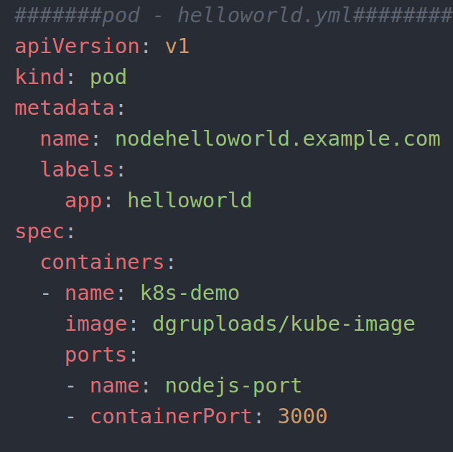
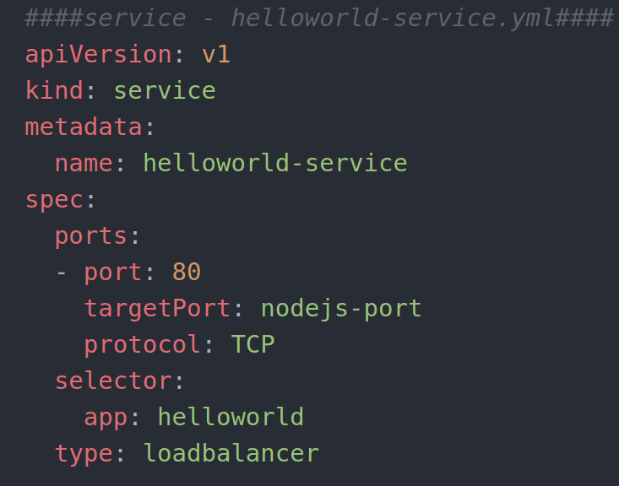
EXPOSING THE SERVICE WITH A LOAD BALANCER.

Slide 37
EXPOSING THE SERVICE WITH A LOAD BALANCER.
Once you are done writing you pod definition file, you can run the below commands to start the pods.
kubectl create -f first-app/helloworld
This will create the app pod.
kubectl create -f first-app/helloworld-service.yml
This will create the load balancer pod.

Slide 38
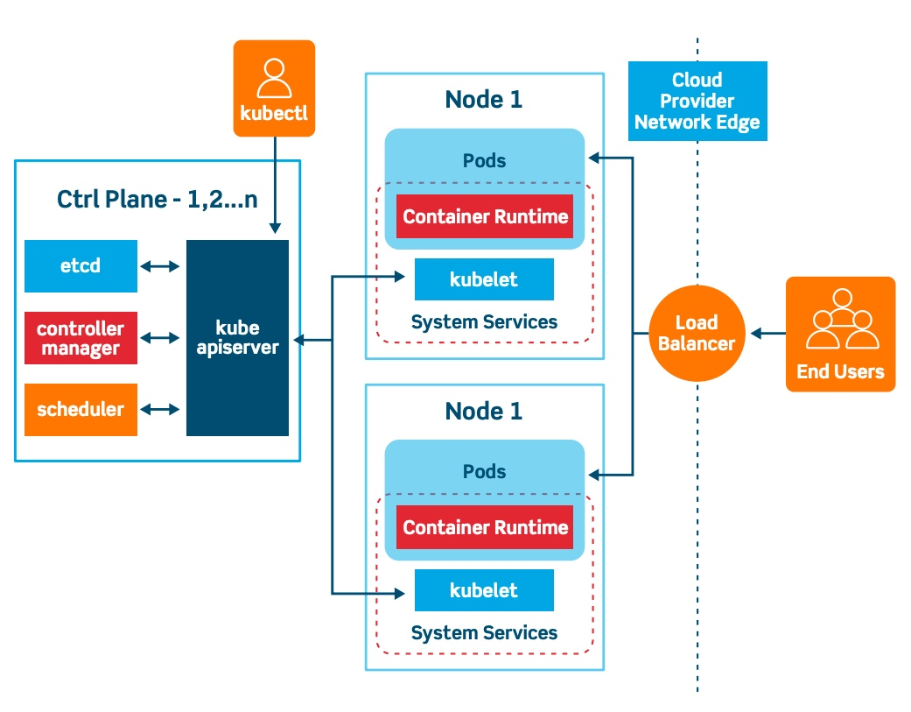
KUBERNETES ARCHITECTURE.

Slide 39
REPLICATION CONTROLLER / SCALING PODS.
If your application is stateless, you can horizontally scale it.
Stateless : Your application does not have a state, it does not write any local file or keeps any local sessions.
All traditional databases (Mysql, postgres) are stateful, they have databases files that cannot be split over multiple instances.
Most web applications can be made stateless.
Session management needs to be done outside the container.
Any files that needs to be saved, cannot be saved locally on the container
Our example app is stateless, if the same app would run multiple times, it does not change the state.
Later in the course, we will see how to use volumes to still run stateful apps.
Those stateful apps cannot scale horizontally but you can run them in a single container and vertically scale (Allocate more CPU / memory / Disk)

Slide 40
REPLICATION CONTROLLER / SCALING PODS.
Scaling in kubernetes can be done using the replication controller feature.
The replication controller will ensure a specified number of pod replicas will run at a time.
A pods created with the replica controller will automatically be replaced if they fail, get deleted or are terminated.
Using the replication controller is also recommended if you just want to make sure 1 pod is always running even if there is a reboot.
You can then run a replication controller with just one replica.
This makes sure that the pod is always running.

Slide 41
REPLICATION CONTROLLER / SCALING PODS.
To replicate our example app 2 times, you can use the below yaml file.

Slide 42
REPLICATION CONTROLLER / SCALING PODS.
kubectl create -f kubernetes-course/replication-controller/helloworld-replication/yml
kubectl get pods
kubectl describe pod <pod name>
kubectl delete pod <pod name>
kubectl scale --replicas=4 -f kubernetes-course/replication-controller/helloworld-replication/yml
kubectl get pods
kubectl get rc
kubectl scale --replicas=1 -f rc/<rc name>
kubectl delete rc/<rc name>

Slide 43
DEPLOYMENTS.
Replication set :
Replica set is the next generation replication controller.
It supports a new selector that can do selection based on filtering according to a set of values.
Eg : "environment" either "Dev" or "Qa"
Not only based on equality, like the replication controller.
Eg : "environment" == "Dev"
This replica set, rather than the replication controller, is used by the deployment object.

Slide 44
DEPLOYMENTS.
Deployment:
A deployment declaration in kubernetes allows you to do app deployment and updates.
When using the deployment object, you can define the state of the application.
Kubernetes will then make sure the clusters matches your desired state.
Just using the replication controller or replication set might be cumbersome to deploy apps.
The deployment object is easier to use and gives you more possibilities.
With a deployment object you can:
Create a deployment (Deploying an app)
Update a deployment (Deploying a newer version)
Do rolling updates (Zero downtime deployment)
Roll back to a previous version.
Pause/resume a deployment (To roll-out only a certain percentage of the deployment)

Slide 45
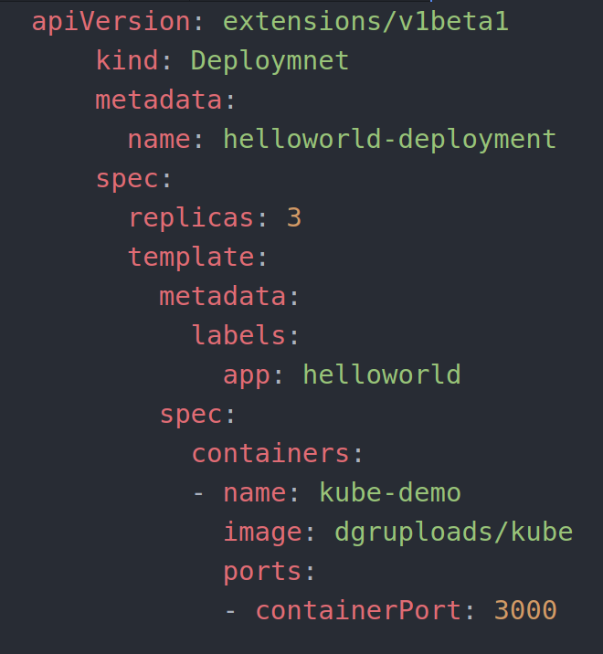
DEPLOYMENTS.
Below is an example for a deployment:

Slide 46
USEFUL COMMANDS IN DEPLOYMENTS.
kubectl get deployments | Get information on current deployments.
kubectl get rs | Get information about the replica sets.
kubectl get pods --show-labels | Get pods, and also how the labels attached to those pods.
kubectl rollout status deployment/<deplyment name> | Get deployment status.
kubectl set image deployment/<deployment name> kube-demo=kube-demo:2 | Run kube-demo with the image label version 2.
kubectl edit deployment/<deployment name> | Edit the deployment object.
kubectl rollout status deployment/<deployment name> | Get the status of the object.
kubectl rollout history deployment/<deployment name> | Get the rollout history.
kubectl rollout undo deployment/<deployment name> | Rollback to the previous version.
kubectl rollout undo deployment/<deployment name> --to-revision=n | Rollback to any previous version.

Slide 47
DEPLOYMENTS.
kubectl create -f kubernetes-course/deployment/helloworld.yml
kubectl get deployments
kubectl get rs
kubectl get pods
kubectl get pods --show-labels
kubectl rollout status deployment/helloworld-deployment
kubectl expose deployment helloworld-deployment --type=NodePort
kubectl get svc
kubectl describe service <servie name>

Slide 48
DEPLOYMENTS.
kubectl set image deployment/<deployment name> kube-demo=kube-demo:2
kubectl rollout status deployment/helloworld-deployment
kubectl rollout history deployment/<deployment name
kubectl rollout undo deployment/<deployment name>
kubectl rollout status deployment/helloworld-deployment
kubectl get pods
kubectl rollout history deployment/<deployment name
kubectl edit deployment/<deployment name

Slide 49
DEPLOYMENTS.
Under spec add revisionHistoryLimit: 10 and then save the file.
kubectl set image deployment/<deployment name> kube-demo=kube-demo:2
kubectl rollout history deployment/<deployment name
kubectl rollout undo deployment/<deployment name> --to-revision=n

Slide 50
SERVICES.
Pods are very dynamic as they come and go on to the kubernetes cluster.
When using Replication Controller, pods are terminated and created during scaling operations.
When using deployments, when updating the image version, pods are terminated and new pods take the place of the older pods.
That's why pods should never be accessed directly but always through a service.
A service is a logical bridge between the "mortal" pods and other srevices or end-users.

Slide 51
SERVICES.
When using the "kubectl expose" command earlier, you created a new service for the pod so that it could be accessed externally.
Creating a service will create a endpoint for your pods:
ClusterIp : A virtual IP address only reachable from within the cluster (This is the default).
NodePort : A port that is the same on each node that is also reachable externally.
LoadBalancer : A LoadBalancer created by the cloud provider that will route the external traffic to every node on the NodePort.

Slide 52
SERVICES.
This is an example of a service definition (This can also be create using the "kubectl expose" command)
Note : By default, service can only run between ports 30000-32767 but you can change this behaviour by adding the "--service-node-port-range=" argument to the kube-apiserver (in the init scripts).

Slide 53
SERVICES.
kubectl create -f first-app/helloworld.yml
kubectl create -f first-app/helloworld.yml
kubectl get pods
kubectl describe pod nodehelloworld.example.com
kubectl describe pod nodehelloworld.example.com
cat first-app/helloworld-nodeport-service.yml
kubectl create -f first-app/helloworld-nodeport-service.yml
kubectl get pods
kubectl get svc
kubectl describe svc helloworld-service
kubectl delete svc helloworld-service
kubectl create -f first-app/helloworld-nodeport-service.yml
kubectl describe svc helloworld-service

Slide 54
LABELS.
Labels are key/value pairs that can be attached to objects.
Labels are like tags in AWS or other cloud providers used to tag resources.
You can label your objects, for instance your pods, following an organizational structure.
Key: environment
value : dev/staging/qa/prod
key: department
value: engineering/finance/marketing
We have already seen the use of labels in our previous examples to tag pods.

Slide 55
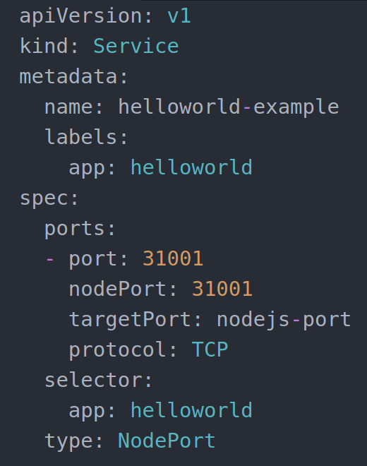
LABELS.

Slide 56
LABELS.
Labels are not unique and multiple labels can be added to one object.
Once labels are attached to an object, you can filter to narrow down the results.
This is called as Label Selectors
Using Label Selectors, you can use matching expressions to match labels.
For instance, a particular pod can only run on a node labelled with key "environment" and has a value "development".
More complex matching is also possible, for intance "environment" in "development" or "qa".
You can also use labels to tag nodes.
Once nodes are tagged, you can use Label Selectors to let pods run only on specific nodes.

Slide 57
LABELS.
There are 2 steps required to run a pod on a specific set of nodes.
First you will have to tag the node.
Then you will have to add a NodeSelector to your pod configuration.
First step will be to add a label or multiple labels to your nodes.
kubectl label nodes node1 environmnet=dev
kubectl label nodes node2 environmnet=prod
Second step will be to add a pod that will use this label.

Slide 58
LABELS.

Slide 59
LABELS.
cat deployment/helloworld-nodeselector.yml
kubectl get node --show-labels
kubectl create -f deployment/helloworld-nodeselector.yml
kubectl get deployments
kubectl get pods
kubectl describe pods helloworld-deployment-5d67794cf5-nwqrp
kubectl get nodes
kubectl label nodes ip-172-20-35-34.ec2.internal hardware=high-spec
kubectl get nodes --show-labels
kubectl get pods
kubectl describe pod helloworld-deployment-5d67794cf5-nwqrp
kubectl describe pod helloworld-deployment-5d67794cf5-t2zsk
kubectl describe pod helloworld-deployment-5d67794cf5-zgpwg

Slide 60
HEALTHCHECKS.
When you put your app in production, you will definitely want to set up healthchecks for the app.
If you application malfunctions, the pod and the container will still be running but the application might not work anymore.
To detect and resolve problems with your application, you can run health checks.
You can run the health checks in 2 different way.
Running a command in the container periodically.
Periodic checks on a url (HTTP)
The typical production application behind a load balancer should always have health checks implemented in some way to ensure availability and resiliency of the app.

Slide 61
HEALTHCHECKS.
This is how the health check looks in our example container.

Slide 62
HEALTHCHECKS.
cat deployment/helloworld-healthcheck/yml
kubectl create -f deployment/helloworld-healthcheck.yml
kubectl get pods
kubectl describe pod helloworld-deployment-dc96556db-4sssq
kubectl get pods
kubectl edit deployment/helloworld-deployment

Slide 63
READINDESS.
Besides livenessProbes, you can also use readinessProbes on a container within a pod.
livenessProbes indicates whether a container is running or not.
If the check fails, the container will be restarted.
readinessProbes indicates whether the container is ready to serve requests.
If the check fails, the container will not be restarted, but the pods IP address will be removed from the service so that it will not serve any requests anymore.
The readiness test will make sure that at startup, the pod will only receive traffic when the test succeeds.
You can use these probes ib conjunction and you can configure different tests for them.

Slide 64
READINDESS.
If the container always exit when something goes wrong, you do not need a liveness probe.
In general, you configure both the livenessProbes and readinessProbes when you are working with containers in a pod.
cat deployment/helloworld-healthcheck.yml
kubectl get pods
kubectl get deployments
kubectl delete deployments helloworld-deployment
kubectl get deployments
kubectl get pods

Slide 65
READINDESS.
kubectl create -f deployment/helloworld-healthcheck.yml && watch -n1 kubectl get pods
cat deployment/helloworld-liveness-readiness.yml
kubectl create -f deployment/helloworld-liveness-readiness.yml && watch -n1 kubectl get pods

Slide 66
POD STATE.
Lets look at the different statuses and states of pods and containers.
Pod status field : High level status.
Pod condition : The condition of the pod.
Container state : State of the container itself.
Pods have a status field which you see when you run the "kubectl get pods" command.
kubectl get pods -n kube-system.
This output indicates,
All the pods are in the running status.
The pod has been bound to a node.
All containers have been created.
At least one container is running or is starting/restarting.

Slide 67
POD STATE.
Other valid statuses are :
Pending : Pod has been accepted but is not running.
Heppens when the container image is still downloading.
It the pod cannot be scheduled because of resource constraints, it will also be in this status.
Succeeded : All containers within this pod have been terminated successfully and will not be restarted.
Failed : All containers within this pod have been terminated, and at least one container returned a failure code.
The failure code is the exit code of the process when a container terminates.

Slide 68
POD STATE.
Unknown : The state of the pod cannot be determined.
A network error might have been occurred. For example the node where the pod is running is down.
You can get the pod conditions by using the "kubectl describe pod <pod name> -n kube-system" command.
There are 5 different types of PodConditions:
PodScheduled : The pod has been scheduled to a node.
Ready : Pod can serve requests and is going to be added to matching services.
Initialized : The initialization containers have been started successfully.
Unschedulable : The pod cannot be scheduled. Could be due to resource constraints.
ContainersReady : All the containers in the pod are ready.

Slide 69
POD STATE.
There is also a container state and you see the state by running the below command.
kubectl get pod <podname> -n kube-system -o yaml
Container state can be,
Running.
Terminated.
Waiting

Slide 70
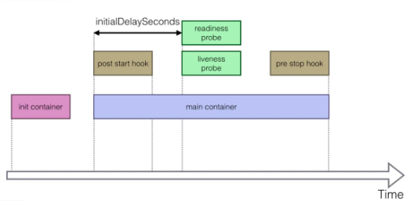
POD LIFECYCLE.

Slide 71
POD LIFECYCLE.
cat pod-lifecycle/lifecycle.yaml
watch -n1 kubectl get pods
kubectl create -f lifecycle.yaml
kubectl exec -it lifecycle-86977b4c47-bmlw2
kubectl exec -it lifecycle-86977b4c47-bmlw2 -- cat /timing
kubectl exec -it lifecycle-86977b4c47-bmlw2 -- tail /timing -f

Slide 72
SECRETS.
Secretes provides a way in kubernetes to distribute credentials keys, passwords or “secret data” to the pods.
Kubernetes itself uses this secrets mechanism to provide the credentials to access the internal API.
You can also use the same mechanism to provide secrets to your application.
Secrets is one way to provide secrets, native to kubernetes.
There are still other ways your container can get its secrets if you do not want to use secrets like using an external vault services to your application.

Slide 73
SECRETS.
Secrets can be used in the following ways,
Use secrets as environment variable.
Use secrets as a file in a pod.
This setup uses volumes to be mounted in a container.
In this volume you have files.
Can be used for instance for dotenv files or your application can just read this file.
Use an external image to pull secrets like from a private image registry.

Slide 74
SECRETS.
To generate secrets using files :
echo -n "root" > ./username.txt
echo -n "password" > ./password.txt
kubectl create secret generic db-user-pass --from-file=./username.txt --from-file=./password.txt
kubectl get secrets
A secret can also be an SSH key or an SSL certificates.
kubectl create secret generic my-secret --from-file=ssh-privatekey=path/to/id_rsa --from-file=ssh-publickey=path/to/id_rsa.pub

Slide 75
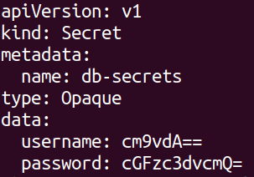
SECRETS.
To generate secrets using yaml definitions.
echo -n “root” | base64
echo -n “password” | base64

Slide 76
SECRETS.
After creating the yaml file, you can use kubectl create :
kubectl create -f helloworld-secrets.yml
You can create a pod that exposes the secrets as environment variables.

Slide 77
SECRETS.
Alternatively, you can provide the secrets in a file.

Slide 78
SECRETS.
kubectl create -f helloworld-secrets.yml
cat deployment deployment/helloworld-secrets-volumes.yml

Slide 79
SECRETS.
kubectl create -f helloworld-secrets-volumes.yml
kubectl get pods
kubectl describe pod helloworld-deployment-6b6585d49c-2pfkx
kubectl exec helloworld-deployment-6b6585d49c-2pfkx -i -t -- /bin/bash
cat /etc/creds/username
cat /etc/creds/password
Exit from the container
mount
ls /run/secrets/kubernetes.io/serviceaccount

Slide 80
RUNNING WORDPRESS USING SECRETS.
cat wordpress/wordpress-secrets.yml
cat wordpress/wordpress-single-deployment-no-volumes.yml
kubectl create -f wordpress-secrets.yml
kubectl create -f wordpress-single-deployment-no-volumes.yml
kubectl describe pod <pod name>
cat wordpress/wordpress-service.yml
kubectl create -f wordpress/wordpress-service.yml
kubectl get svc
kubectl get pods
kubectl delete pod <pod name>

Slide 81
WEB UI.
Kubernetes comes with a web UI that you can use instead of the kubectl commands.
You can use it to,
Get an overview of runnign applications on the cluster.
Creating and modifying individual kubernetes resources and workloads like kubectl create and delete.
Retrieve information on the state of resources like kubectl describe pod.
In general, you can access the kubernetes web UI at https://kubernetes-master</ui
If you cannot access it, for instance if it is not enables on your deploy type, you can install it manually using,
kubectl create -f https://raw.githubusercontent.com/kubernetes/dashboard/v1.10.1/src/deploy/recommended/kubernetes-dashboard.yaml

Slide 82
WEB UI.
If a password is asked, you can retrieve the password by entering the below command.
kubectl config view
If you are using minikube, you can use the following command to the launch the dashboard.
minikube dashboard
If you just want to get the url
minikube dashboard --url
cat dashboard/README.md
kubectl apply -f https://raw.githubusercontent.com/kubernetes/dashboard/v1.10.1/src/deploy/recommended/kubernetes-dashboard.yaml

Slide 83
WEB UI.
cat sample-user.yaml
kubectl create -f sample-user.yaml
kubectl -n kube-system get secret | grep admin-user
kubectl -n kube-system describe secret admin-user-token-<id displayed by previous command>
cat ~/.kube/config
kubectl config view
https://api.example.cloudtechiez.tech/api/v1/namespaces/kubernetes-dashboard/services/https:kubernetes-dashboard:/proxy/#/overview?namespace=default

Slide 84
ADVANCED TOPICS - SERVICE DISCOVERY.
As of kubernetes 1.3, DNS is a built-in service launched automatically using the addon manager.
The addons are in the /etc/kubernetes/addons directory on the master node.
The DNS service can be used within the pods to find other services running on the same cluster.
Multiple containers within one pod do not need this service as they can contact each other directly.
A container in the same pod can connect to the port of the other container directly using localhost:port.
To make your DNS work, you will need to create a service definition in your pod.

Slide 85
DNS - SERVICE DISCOVERY.

Slide 86
DNS - HOW DOES IT WORK ?

Slide 87
DNS - HOW DOES IT WORK ?
cat service-discovery/secrets.yml
kubectl create -f service-discovery/secrets.yml
cat service-discovery/database.yml
cat service-discovery/database-service.yml
kubectl create -f service-discovery/database.yml
kubectl create -f service-discovery/database-service.yml
cat service-discovery/helloworld-db.yml
kubectl create -f service-discovery/helloworld-db.yml
cat service-discovery/helloworld-db-service.yml
kubectl create -f service-discovery/helloworld-db-service.yml

Slide 88
DNS - HOW DOES IT WORK ?
kubectl get pods
kubectl logs helloworld-deployment-5464ff8c48-b9vmg
Hit the app in the browser
kubectl get svc
kubectl exec database -it -- mysql -u root -p
show databases;
use helloworld;
show tables;
select * from visits;

Slide 89
DNS - HOW DOES IT WORK ?
kubectl run -i --tty busybox --image=busybox --restart=Never -- sh
nslookup helloworld-db-service
kubectl get svc
kubectl delete pod busybox
kubectl run -i --tty busybox --image=busybox --restart=Never -- sh
nslookup database-service
nslookup helloworld-db-service
telnet helloworld-db-service 3000
GET /

Slide 90
CONFIGMAP.
Configmap can be used to put in the configuration parameters that are not secrets.
The input is again key-value pairs.
The ConfigMap key-value pairs can then be read by the application using,
Environment variables
Container commandline arguments in the pod configuration.
Using volumes.
A configmap can also contain full configuration files
Eg : a webserver config file
This file can then be mounted using volumes where the application expects its configuration file.

Slide 91
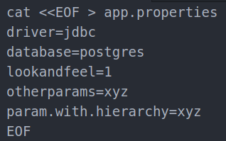
CONFIGMAP.
This way you can “inject” configuration settings into containers without changing the container itself.
To generate config file using files,
kubectl create configmap app-config --from-file=app.properties

Slide 92
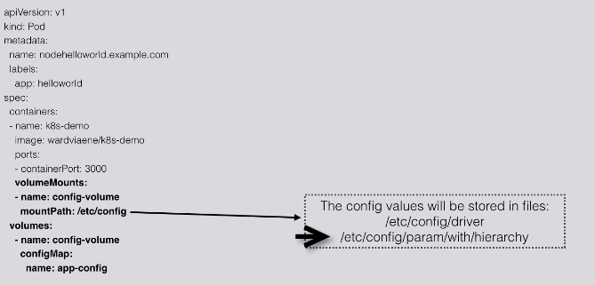
USING CONFIGMAP.
You can create a pod that exposes the configmap using a volume.

Slide 93
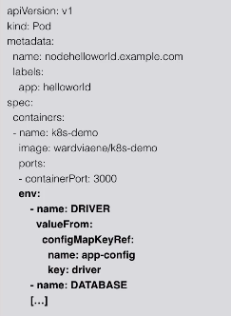
USING CONFIGMAP.
You can create a pod that exposes the configmap as environment variables.

Slide 94
CONFIGMAP COMMANDS.
cat configmap/reverseproxy.conf
kubectl create configmap nginx-config --from-file configmap/reverseproxy.conf
kubectl get config
kubectl get configmap nginx-config -o yaml
cat configmap/nginx.yml
kubectl create -f configmap/nginx.yml
kubectl create -f configmap/nginx-service.yml
kubectl get svc

Slide 95
CONFIGMAP COMMANDS.
kubectl get pods
curl http://ipaddress:portnumber -vvvv
kubectl exec -it helloworld-nginx -c nginx -- bash
ps x
cat /etc/nginx/config/reverseproxy.conf

Slide 96
INGRESS CONTROLLER.
Ingress is a solution available since kubernetes 1.1 that allows inbound connections to the cluster.
It is an alternative to the external load balancer and nodeports.
Ingress allows you to easily expose services that needs to be accessible from outside the cluster.
With ingress, you can run your own ingress controller which is basically a load balancer within the kubernetes cluster.
There are default ingress controller available or you can write your own ingress controller.

Slide 97
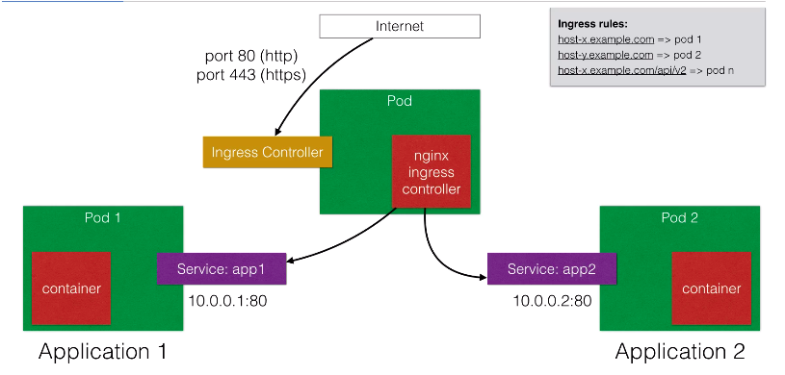
INGRESS CONTROLLER.

Slide 98
INGRESS CONTROLLER.
You can create ingress rules using the ingress object.

Slide 99
INGRESS CONTROLLER COMMANDS.
cat ingress/nginx-ingress-controller.yml
cat ingress/ingress.yml
kubectl create -f ingress/ingress.yml
kubectl create -f ingress/nginx-ingress-controller.yml
kubectl create -f ingress/echoservice.yml
kubectl create -f ingress/helloworld-v1.yml
kubectl create -f ingress/helloworld-v2.yml
kubectl get pods
curl <ec2-ip-address>

Slide 100
INGRESS CONTROLLER COMMANDS.
curl <ec2-ip-address> -H 'Host:helloworld-v1.yml'
curl <ec2-ip-address> -H 'Host:helloworld-v2.yml'
kubectl get svc

Slide 101
EXTERNAL DNS.
On public cloud providers, you can use the ingress controller to reduce th cost of your load balancers.
You can use one load balancer that captures all the external traffic and sends it to the ingress controller.
The ingress controller can be configured to route the different traffic to all your applications based on HTTP rules (host and prefixes).
This only works with HTTP and HTTPS based applications.
One great tool to enable such approach is external DNS.
This tool will automatically create the necessary DNS records in your external DNS server like route53
For every hostname that you use in ingress, it will create a new record to send traffic to your load balancer.

Slide 102
EXTERNAL DNS.
The major DNS providers are supported by Google cloudDNS, Route53, AzureDNS, Cloudflare, DigitalOcean, etc.
Other setups are also possible without ingress controller for example directly on hostport.
Nodeport is still work in progress but will be out soon.

Slide 103
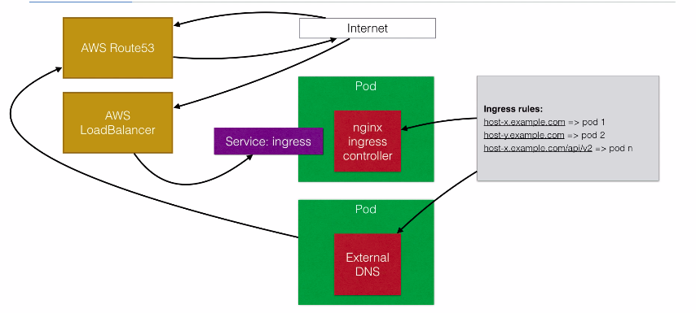
EXTERNAL DNS.

Slide 104
EXTERNAL DNS - COMMANDS.
cat external-dns/README.md
cat external/put-node-policy.sh
kubectl apply -f ../ingress/
vi ../ingress/nginx-ingress-controller.yml
kubectl apply -f service-l4.yaml
kubectl get svc
kubectl get svc -o wide
kubectl apply -f external-dns.yaml
kubectl apply -f ingress.yaml

Slide 105
EXTERNAL DNS - COMMANDS.
nano ingress.yml
kubectl get pods
kubectl logs <external dns name>
vi service-l4.yaml

Slide 106
VOLUMES.
Volumes in kubernetes allow you to store data outside the container.
When a container stops, all the data on the container itself will be lost.
That is why up until now we have been using stateless applications, applications that do not maintain a local state but store their state in an external service.
External service like a database, caching service like mysql, s3, etc.
Persistent volumes in kubernetes allow you to attach a volume to a container that will exists even when the container is stopped.

Slide 107
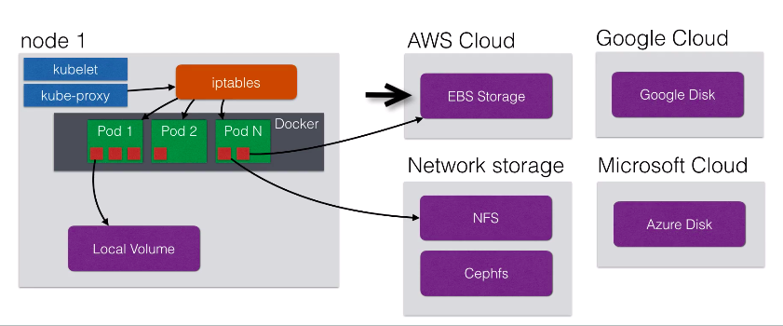
VOLUMES.
Volumes can be attached using different volume plugins.

Slide 108
VOLUMES.
Using volumes, you can deploy applications with state on your cluster.
Those applications need to read/write to files on that local file system that need to be persistent in time.
You could run a mysql database using persistent volumes.

Slide 109
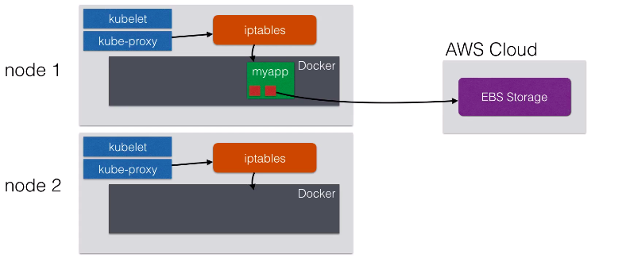
VOLUMES.
If your node stops working, the pod can be rescheduled on another node and the volume can be attached to the new node.

Slide 110
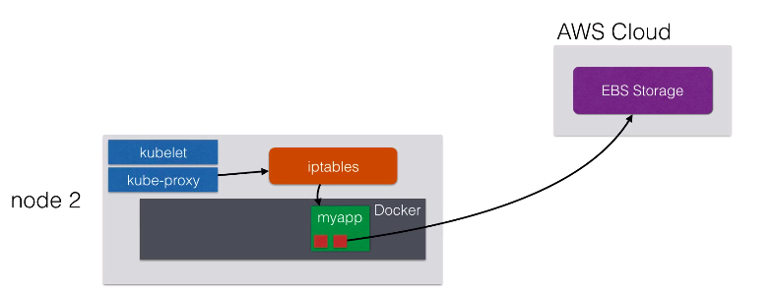
VOLUMES.

Slide 111
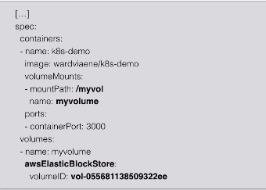
VOLUMES.
To use volumes, you will need to create the volume first.
To use volumes, create a pod with a volume definition.

Slide 112
VOLUME - COMMANDS.
vi volumes/helloworld-volume.yml
kubectl get nodes
kubectl create -f volumes/helloworld-with-volume.yml
kubectl get pods
kubectl exec -it <podname> -- bash
ls -alh /myvol/
echo “test in volumes” > /myvol/test.txt
echo “another test in volumes” > /test.txt

Slide 113
VOLUME - COMMANDS.
Exit from the container.
kubectl get nodes
kubectl drain <node-ip> --force
kubectl get pod
kubectl describe pod <podname>
kubectl exec -it <pod name> -- bash

Slide 114
VOLUMES AUTO PROVISIONING.
The kubernetes plugins have the ability to provision the storage for you.
The “AWS plugin” can for instance provision storage for you by creating the volumes in AWS before attaching them to a node.
This is done using the “StorageClass” object.

Slide 115
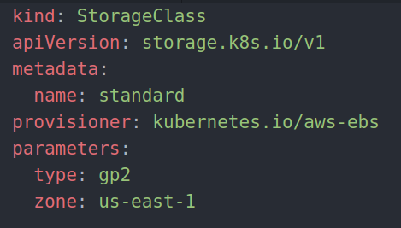
VOLUMES AUTO PROVISIONING.
To use auto provisioned volumes, you can create the following yaml file.
This will allows you to create volumes claims using the aws-ebs provisioner.
Kubernetes will provision volumes of the type gp2 for you which is the general purpose - SSD.

Slide 116
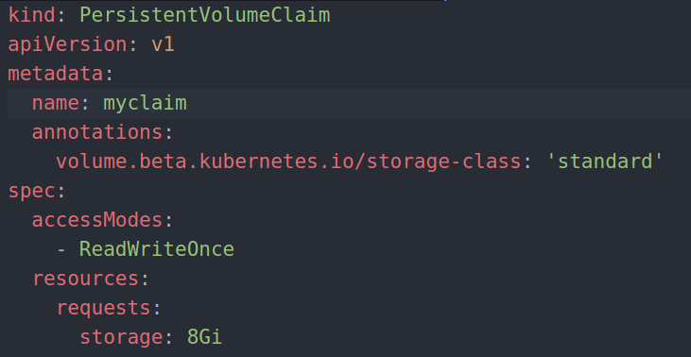
VOLUMES AUTO PROVISIONING.
Next, you can create a volume claim and specify the size using the below yaml file.

Slide 117
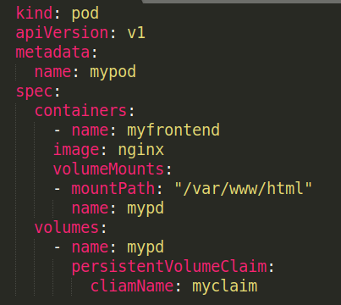
VOLUMES AUTO PROVISIONING.
Finally you can launch a pod using a volume.

Slide 118
WORDPRESS WITH VOLUMES.
ls wordpress-volumes/
cd wordpress-volumes/
cat storage.yml
cat pv-claim.yml
cat wordpress-db.yml
cat wordpress-db-service.yml
cat wordpress-secrets.yml
cat wordpress-web.yml
cat wordpress-web-service.yml
aws efs create-file-system --creation-token 1
aws efs create-mount-target --file-system-id <efs id> --subnet-id <subnet> --security-groups <sg>

Slide 119
WORDPRESS WITH VOLUMES.
aws ec2 describe-instances
Replace the efs value in wordpress-web.yml
kubectl create -f storage.yml
kubectl create -f pv-claim.yml
kubectl create -f wordpress-secrets.yml
kubectl create -f wordpress-db.yml (Change the image name)
kubectl create -f wordpress-db-service.yml
kubectl get pvc
kubectl get pods
kubectl describe pod <pod name>
kubectl get pods

Slide 120
WORDPRESS WITH VOLUMES.
kubectl create -f wordpress-web.yml
kubectl create -f wordpress-web-service.yml
Show the working of the wordpress.
Delete all the pods - kubectl delete pod <pod name>
kubectl get pods
kubectl logs <pod name> - See the logs for wordpress.
kubectl exec <wordpress> -it -- bash
ls wp-contents/uploads
exit
Access the wordpress again to make sure that the data is available.

Slide 121
POD PRESETS.
Pod presets can be used to inject information into pods at runtime.
Pod presets are used to inject kubernetes resources like secrets, configmap, volumes and environment variables.
Imagine you have 20 appplications you want to deploy, and they all need to get a specific credentials.
You can edit the 20 specifications and add the credential or,
You can use presets to create one preset object, which will inject an environment variable or config file to all the matching pods.
When injecting environment variables and VolumeMounts, the pod preset will apply the changes to all containers within the pod.

Slide 122
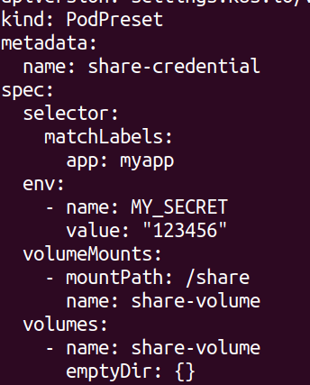
POD PRESETS.
This is an example of a pod preset.

Slide 123
POD PRESETS.
You can use more than one pod-preset and they will all be applied to the matching pods.
If there is a conflict, the pod preset will not be applied to the pod.
Pod presets can match zero or more pods.
It is possible that no pods are currently matching, but that matching pods will be launched at a later time.

Slide 124
POD PRESETS.
cd pod-presets/
cat README.md
kops edit cluster <clustername>
Copy and paster the “kubeAPIServer” to the cluster definition.
Save and exit the file.
kops update cluster <clustername>
kubectl get nodes
cat pod-presets.yaml
cat deployments.yaml

Slide 125
POD PRESETS.
kubectl create -f pod-presets.yaml
kubectl get podpresets
kubectl create -f deployments.yaml
kubectl get pods
kubectl describe pod <podname>
kubectl describe pod <podname>

Slide 126
STATEFULSETS.
Petsets was a new feature starting from kubernetes 1.3 and it got renamed to statefulsets which is stable since kubernetes 1.9
It is introduced to be able to run stateful applications.
That need a stable pod hostname instead of random <podname-randomstring>
Your pod name will have a sticky identity, using an index. Eg: podname-0, podname-1, podname-2 and when a pod gets rescheduled, it will keep that identity.
Statefulsets allows stateful applications stable storage with volumes based on their ordinal number (podname-x).
Deleting and/or scaling a statefulset down wull not delete the volumes associated with the statefulsets preserving the data.

Slide 127
STATEFULSETS.
A statefulset will allow your stateful applications to use DNS to find other peers.
Cassandra clusters, Elasticsearch clusters, use DNS to find other members of the cluster.
For eg: Cassandra-0.cassandra for all pods to reach the first node in the cassandra cluster.
Using statefulset you can run, for instance, 3 cassandra nodes on kubernetes named cassandra-0 until cassandra-2.
If you wouldn't use statefulset, you would get a dynamic hostname, which you wouldn't be able to use in your configuration files, as the name can always change.
A statefulset will also allow your stateful application to order the startup and teardown.

Slide 128
STATEFULSETS.
Instead of randomly terminating one pod, one instance of your application, you will know one that will go down.
When scaling up, it goes from o to n-1 where n is the replication factor.
When scaling down it starts with the highest number (n-1) to zero.
This is useful if you first need to drain the data from a node before it can be shutdown.

Slide 129
STATEFULSETS.
cat statefulset.yaml
kubectl create -f statefulset.yaml
kubectl get pods
kubectl get pvc
watch kubectl get pod
kubectl get pods
kubectl run -i --tty --image busybox:1.28 dns-test --restart=Never --rm
nslookup web-0.nginx
nslookup web-1.nginx

Slide 130
STATEFULSETS.
kubectl get pod -w -l app=nginx
kubectl delete pod -l app=nginx
kubectl get pod -w -l app=nginx
kubectl run -i --tty --image busybox:1.28 dns-test --restart=Never --rm /bin/sh

Slide 131
DAEMON SETS.
Daemon sets are used to ensure that every single node in the kubernetes cluster runs the same pod resource.
This is useful if you want to ensure that a certain pod is running on every single kubernetes node.
When a node is added to the cluster, a new pod will be started automatically.
Same when a node is removed, the pod will not be rescheduled on another node.
Typical uses cases includes :
Logging aggregators
Monitoring
Load balancer / Reverse proxies / API gateways
Running a daemon that only needs one instance per physical instance.

Slide 132
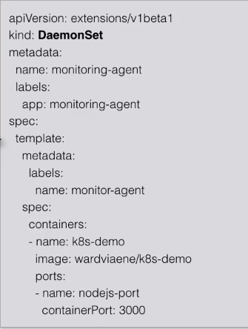
DAEMON SETS.
This is an example for daemon set specification.

Slide 133
RESOURCE USAGE MONITORING.
Heapster enables container cluster monitoring and performance analysis.
It provides a monitoring platform for kubernetes.
It is a pre-requisite if you want to do pod auto-scaling in kubernetes.
Heapster exports clusters metrics via REST endpoints.
You can use different backends with heapster.
Visualizations / graphs can be shown using grafana.
The kubernetes dashboard will also show graphs once monitoring is enabled.

Slide 134
RESOURCE USAGE MONITORING.
All these technologies (heapster, influxDB and Grafana) can be started in pods.
The yaml files can be found on the github repositories of heapster.
After downloading the repository, the whole platform can be deployed using the addon system or by using “kubectl create -f <directory with yaml files>”
https://github.com/kubernetes-retired/heapster/tree/master/deploy/kube-config/influxdb

Slide 135
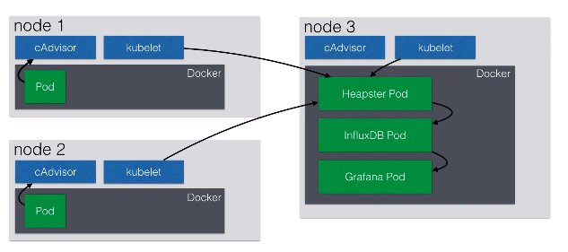
RESOURCE USAGE MONITORING.

Slide 136
RESOURCE USAGE MONITORING USING METRIC SERVER.
cd metrics-server
kubectl create .
kubectl top node
kubectl top pod
kubectl run hello-kubernetes --image=<image> --port=8080
kubectl get pod
kubectl top node
kubectl top pod

Slide 137
AUTO SCALING.
Kubernetes has the possibility to automatically scale pods based on metrics.
Kubernetes can automatically scale a deployment, replication controller or replicaset.
In kubernetes 1.3, scaling based on CPU usage is possible out of the box.
With alpha support , application based metrics are also available like queries per second or average request latency.
To enable this, the cluster has to be started with the env var “ENABLE_CUSTOM_METRICS” to true.

Slide 138
AUTO SCALING.
Auto scaling will periodically query the utilization for the targeted pods.
By default 30sec, but can be changed using the “--horizontal-pod-autoscaler-sync-period” when launching the controller-manager.
Autoscaling will use the heapster, the moniroting tool, to gather its metrics and make scaling decisions.
Heapster must be installed and running before autoscaling will work.

Slide 139
AUTO SCALING.
An example :
You run a deployment with a pod with a cpu resource request of 200m.
200m = 200 millicpu or also 200 millicores
200m = 0.2, which is 20% of a cpu core of the running node.
If the node has 2 cores, it is still 20% of a single core.
You introduce auto-scaling at 50% of the cpu usage.

Slide 140
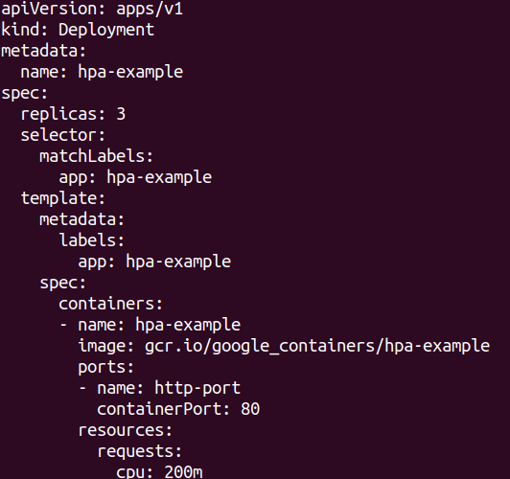
AUTO SCALING.
Horizontal pod auto scaling will increase or decrease pods to maintain a target cpu utilization of 50% or 100m/10% of a core within this pod.
This is a pod that you can use to test autoscaling.

Slide 141
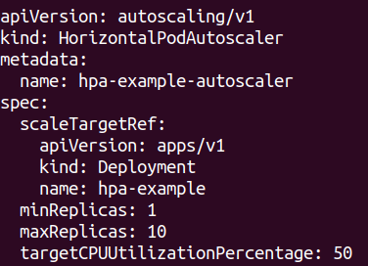
AUTO SCALING.
This is an example for autoscaling specification.

Slide 142
AUTO SCALING.
cd autoscaling
cat hpa-example.yml
kubectl create -f hpa-example.yml
kubectl get hpa
kubectl run -it load-generator --image=busybox /bin/sh
wget <hostname>:31001
cat index.html
rm index.html

Slide 143
AUTO SCALING.
while true; do wget -q -O- http://54.88.127.162:31001; done
As the load on the CPU increases, you will see a increase in the number of pods that you defined in yout hpa.
And as the load decreases, the pods will start getting terminated.

Slide 144
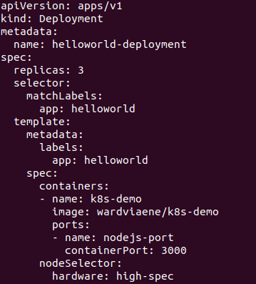
AFFINITY AND ANTI-AFFINITY.
In our previous example we saw how to use “nodeselectors” to make sure pods get scheduled on specific nodes.

Slide 145
AFFINITY AND ANTI-AFFINITY.
The affinity/anti-affinity feature allows you to do more “complex scheduling” than the “nodeSelector” and also works on pods.
The language is more expressive.
You can create rules that are not hard requirements but rather a preferred rule, meaning that the scheduler will still be able to schedule your pod, even if the rules cannot be met.
You can create rules that take other pod labels into account.
For eg: a rule that makes sure 2 different pods will never be on the same node.

Slide 146
AFFINITY AND ANTI-AFFINITY.
Kubernetes can do node affinity and pod affinity/anti-affinity.
Node affinity is similar to the nodeSelector.
Pod affinity/anti-affinity allows you to create rules how pods should be scheduled taking into account other running pods.
Affinity/anti-affinity mechanism is only revelant during scheduling, once pod is running, it will need to be recreated to apply the rules again.

Slide 147
AFFINITY AND ANTI-AFFINITY.
We will first look at node affinity and will then cover pod affinity/anti-affinity.
There are currently 2 types you can use for node affinity.
requiredDuringSchedulingIgnoredDuringExecution
preferredDuringSchedulingIgnoredDuringExecution
The first one sets a hard requirement (like the nodeSelector).
The rules must be met before the pod can be scheduled.
The second type wil try to enforce the rule, but it will not guarantee it.
Even if the rules is not met, the pod can still be scheduled, it is a soft requirement, a preference.

Slide 148
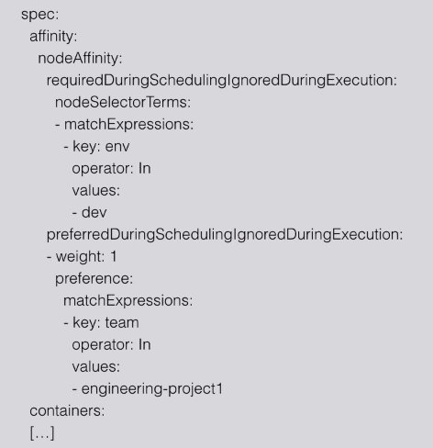
AFFINITY AND ANTI-AFFINITY.

Slide 149
AFFINITY AND ANTI-AFFINITY.
We also supplied a “weighting” to the “preferredDuringSchedulingIgnoredDuringExecution” statement.
The higher the weighting, the more weight will be given to that rule.
When scheduling, kubernetes will score every node by summerizing the weightings per node.
For example, if you have 2 different rules with weights 1 and 5.
If both rules match, the node will have a score of 6.
If only the rule with weight 1 matches, then the score will only be 1.

Slide 150
AFFINITY AND ANTI-AFFINITY.
The node that has the highest total score, that is where the pod will be scheduled on.
In addition to the labels that you can add yourself to nodes, there are pre-populated labels that you can use.
kubernetes.io/hostname
failure-domain.beta.kubernetes.io/zone
failure-domain.beta.kubernetes.io/region
beta.kubernetes.io/instance-type
beta.kubernetes.io/os
beta.kubernetes.io/arch

Slide 151
AFFINITY AND ANTI-AFFINITY.
We will be using a cluster with 3 nodes for this example.
kubectl describe node <node-ip-of-master>
Check out the label information.
cd affinity
cat node-affinity.yaml
kubectl create -f node-affinity.yaml
kubectl get pods
You will need to create the labels to work with your pods.
kubectl label node ip-172-20-44-18.ec2.internal env=dev
kubectl label node ip-172-20-55-129.ec2.internal env=dev

Slide 152
AFFINITY AND ANTI-AFFINITY.
kubectl get pods -o wide
kubectl label node ip-172-20-55-129.ec2.internal team=engineering-project1
kubectl delete pod --all
kubectl get pods -o wide

Slide 153
INTERPOD AFFINITY AND ANTI-AFFINITY.
This mechanism allows you to infuence scheduling based on the labels of other pods that are already running on the cluster.
Pods belong to a namespace, so your affinity rules will apply to a specific namespace. If no namespace is given in the specification, it defaults to the namespace of the pod.
Similar to node affinity, you have 2 types of pod affinity/anti-affinity.
requiredDuringSchedulingIgnoreDuringExecution
preferredDuringSchedulingIgnoreDuringExecution
The required type creates rules that must be met for the pod to be scheduled, the preferred type is a “soft” type and the rules may be met.

Slide 154
INTERPOD AFFINITY AND ANTI-AFFINITY.
A good use case for pod affinity is co-located pods.
You might want that 1 pod is always co-located on the same node with another pod.
For example, you have an app that uses redis as cache and you want to have the redis pod on the same node as the pod itself.
Another use case is the locate pods within the same availability zone.
When writing your pod affinity and anti-affinity rules, you need to specify a topology domain called “topologyKey” in the rules.
The “topologyKey” refers to a label.

Slide 155
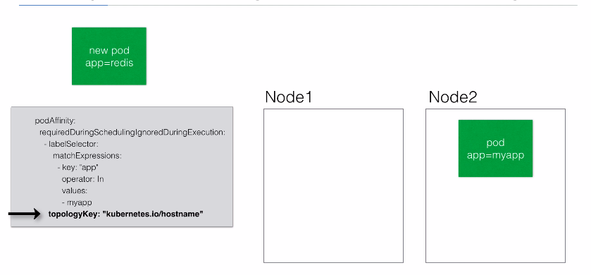
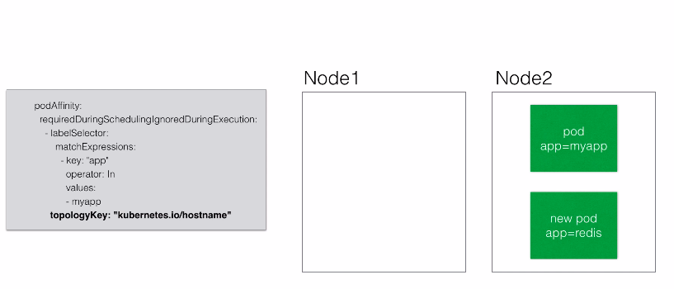
INTERPOD AFFINITY AND ANTI-AFFINITY.
If the affinity rule matches, the new pod will only be scheduled on nodes that have the same topologyKey value as the current running pod.

Slide 156
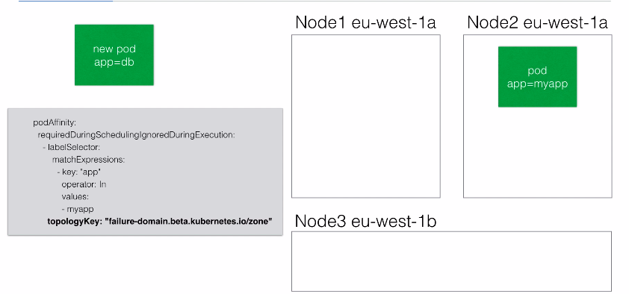
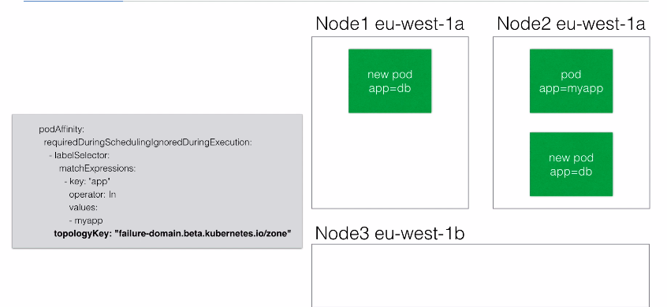
INTERPOD AFFINITY AND ANTI-AFFINITY.

Slide 157
INTERPOD AFFINITY AND ANTI-AFFINITY.
Contrary to affinity, you might want to use pod anti-affinity.
You can use anti-affinity to make sure a pod is only scheduled once in a node.
For example, you have 3 nodes and you want to schedule 2 pods, but they should not be scheduled on the same node.
Pod anti-affinity allows you to create a rule that says to not schedule on the same host if a pod label matches.

Slide 158
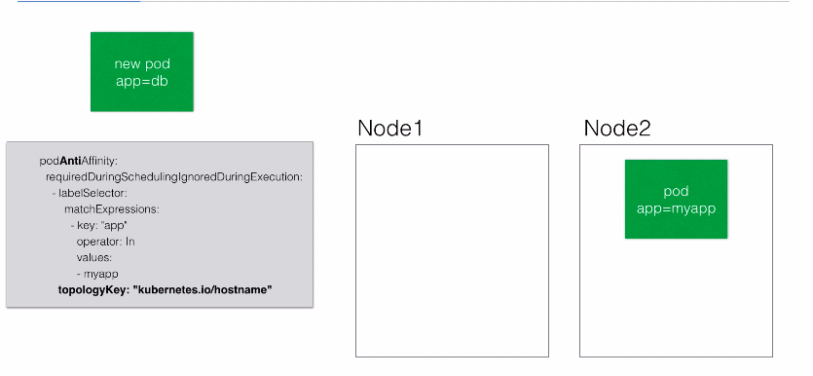
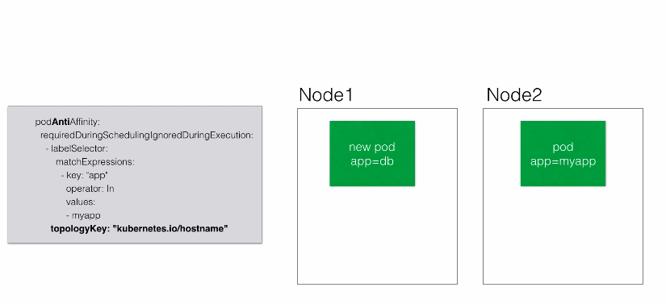
INTERPOD AFFINITY AND ANTI-AFFINITY.

Slide 159
INTERPOD AFFINITY AND ANTI-AFFINITY.
When writing pod affinity rules, you can use the following operators.
In, NotIn : Does a label have one of the values.
Exists, DoesNotExist : Does a label exist or not.
Interpod affinity and anti-affinity currently requires a substantial amount of processing.
You might have to take this into account if you have a lot of users or a larger cluster like 150+ users.

Slide 160
INTERPOD AFFINITY AND ANTI-AFFINITY.
cd affinity
cat pod-affinity.yaml
kubectl create -f pod-affinity.yaml
kubectl get pods -o wide
kubectl scale --replicas=4 deployment pod-affinity-2
kubectl delete -f pod-affinity.yaml
kubectl describe nodes | less
Change the “topologyKey” to “failure-domain.beta.kubernetes.io/zone”
kubectl get pods -o wide

Slide 161
INTERPOD AFFINITY AND ANTI-AFFINITY.
kubectl scale --replicas=5 deployment pod-affinity-2
Now you should be able to see that the pods are getting scheduled on different nodes because we are using the “failure” label and not the “hostname” label.
Example for Anti-affinity:
cd affinity
nano pod-anti-affinity.yaml
kubectl create -f pod-anti-affinity.yaml
kubectl get pods -o wide
kubectl get nodes

Slide 162
INTERPOD AFFINITY AND ANTI-AFFINITY.
kubectl describe pod pod-affinity-4-6f5569f9fd-bbxw9
nano pod-anti-affinity-5.yaml
kubectl create -f pod-anti-affinity-5.yaml
kubectl get pods -o wide

Slide 163
TAINTS AND TOLERATIONS.
Tolerations is the opposite of node affinity.
Tolerations allow a node to repel a set of pods.
Taints mark a node, tolerations are applied to pods to influence the scheduling the pods.
One use case for taints is to make sure that when you create a new pod, they are not scheduled on the master.
The master has a taint : node-role.kubernetes.io/master:NoSchedule
To add a new taint to a node, you can use kubectl taint
kubectl taint nodes node1 key=value:NoSchedule
This will make sure that no pods will be scheduled on node1, as long as they do not have a matching toleration.

Slide 164
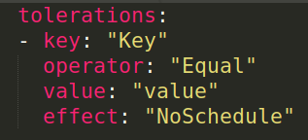
TAINTS AND TOLERATIONS.
The following toleration would allow a new pod to be scheduled on the tainted node1.
You can use the following operators,
Equal : Providing a key and a value.
Exists : Only providing a key, checking whether a key exists.

Slide 165
TAINTS AND TOLERATIONS.
Just like the affinity, taints can also be a preference or soft rather than a requirement.
NoSchedule: A hard requirement that a pod will not be scheduled unless there is a matching toleration.
PreferNoSchedule: Kubernetes will try and avoid placing a pod that does not have a matching toleration, but it is not a hard requirement.
If the taint is applied while there are already running pods, they will not be evicted, unless the following taint type is used.
NoExecute: Evict the pods with non-matching tolerations.

Slide 166
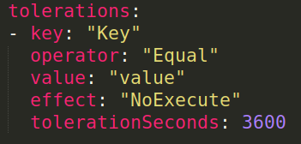
TAINTS AND TOLERATIONS.
When using “NoExecute”, you can specify within your toleration how long the pod can run on a tainted node before being evicted.
If you do not specify the “tolerationSeconds”, the toleration will match and the pod will keep running on the node.
In this example, the toleration will only match for 1 hour (3600 seconds) , after that the pod will be evicted from the node.

Slide 167
TAINTS AND TOLERATIONS.
Example use cases are:
The existing node taints for master nodes.
Taint nodes that are dedicated for a team or a user.
If you have a few nodes with specific hardware (for example GPUs), you can taint them to avoid running noon-specific applications on the nodes.
This will automatically taint nodes that have node problems, allowing you to add tolerations to time the eviction of pods from nodes.

Slide 168
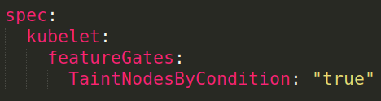
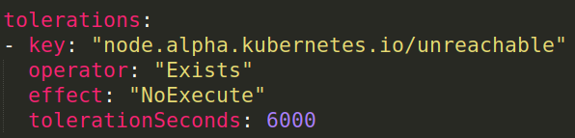
TAINTS AND TOLERATIONS.
You can enable alpha features by passing the “--feature.gates” to the kubernetes controller manager or in kops, you can use kops edit to add.
This is an example of a toleration that could be used.

Slide 169
TAINTS AND TOLERATIONS.
Below are the other “keys” that you can use with your tolerations.
node.kubernetes.io/not-ready : Node is not ready
node.kubernetes.io/unreachable : Node is unreachable from the node controller.
node.kubernetes.io/out-of-disk : Node becomes out of disk
node.kubernetes.io/memory-pressure : Node has memory pressure.
node.kubernetes.io/disk-pressure : Node has disk pressure.
node.kubernetes.io/network-unavailable : Nodes network is unavailable.
node.kubernetes.io/unschedulable : Node is unschedulable

Slide 170
TAINTS AND TOLERATIONS.
kubectl get nodes
kubectl get nodes ip-172-20-59-55.ec2.internal -o yaml
kubectl get nodes ip-172-20-59-55.ec2.internal -o yaml | less
search for “taint” using “/taint”
cd tolerations
cat README.md
kubectl get nodes
kubectl taint nodes ip-172-20-54-33.ec2.internal type=specialnode:NoSchedule

Slide 171
TAINTS AND TOLERATIONS.
nano tolerations.yaml
kubectl create -f tolerations.yaml
kubectl get pods -o wide
kubectl taint nodes ip-172-20-54-33.ec2.internal type2=specialnode2:NoSchedule
kubectl get pods -o wide
kubectl delete pod tolerations-2-66c58c896d-5qq7k
kubectl taint nodes ip-172-20-54-33.ec2.internal testkey=testvalue:NoExecute
kubectl taint nodes ip-172-20-54-33.ec2.internal testkey-

Slide 172
CUSTOM RESOURCE DEFINITIONS (CRDs).
Custom Resource Definition lets you extend the kubernetes API.
Resources are the endpoints in the kubernetes API that store collections of API objects.
For example, there is a built-in Deployment resource, that you can use to deploy applications.
In the yaml files, you describe the object using the Deployment resource type.
You create the object on the cluster by using “kubectl”.
A custom resource is a resource that you might add to your cluster, it is not available on every cluster.

Slide 173
CUSTOM RESOURCE DEFINITIONS (CRDs)
It is an extension of the kubernetes API.
Custom resources are also described in the yaml files.
As an administrator, you can dynamically add CRDs to add extra functionality to your cluster.
Operators, explained in the next lecture, use these CRDs to extend the kubernetes API with their own functionality.

Slide 174
OPERATORS.
An operator is a method of packaging, deploying and managing a kubernetes application.
It puts operational knowledge into an application.
It brings the user closer to the experience of managed cloud services, rather than having to know all the specifics of an application deployed to kubernetes.
Once an operator is deployed, it can be managed using CRDs.
It also provides a great way to deploy stateful services on kubernetes because a lot of complexities can be hidden from the end-user.
Any 3rd party can create operators that you can start using.

Slide 175
OPERATORS.
There are operators for prometheus, vault, rook(storage), mysql, postgresql and so on.
We will look at an example for postgresql.
If you would just deploy a postgresql container, it would only start the database.
If you are going to use this postgresql operator, it would allow you to also create replicas, initiate a failover, create backups, scale, etc.
An operator contains a lot of the management logic that you as an administrator or user might want, rather than having to implement it yourself.

Slide 176
OPERATORS.
cd kubernetes-course/postgres-operator/
nano storage.yml
kubectl create -f storage.yml
./quickstart-for-gke.sh
Enter “yes”, then type “standard” for the storage, then type “yes”. Then the postgres must be installed.
To access the operator, you will need to do the port forwarding. You will run a command similar to the below one in a new terminal.
kubectl port-forward postgres-operator-6b54696f78-hbzpp 18443:8443
Then you will need to set the path by running the script “set-path.sh”.
Logout and then login again.
Run “pgo version” command and you should be able to see the cli tool for pg.

Slide 177
OPERATORS.
pgo create cluster mycluster
pgo show cluster all
kubectl get pods
pgo show cluster mycluster --show-secrets=true
kubectl run -it --rm --image=postgres:10.4 pgsql -- psql -h mycluster -U postgres -W
Provide the password that you will get from the previous command and you will be connected to the postgres cluster.
pgo scale mycluster
kubectl get pods -o wide
pgo show cluster mycluster
pgo failover mycluster --query

Slide 178
OPERATORS.
pgo failover mycluster --target=mycluster-cubq
pgo show cluster mycluster
kubectl get pods -o wide
kubectl get pgtasks mycluster-failover -o yaml
kubectl get crd
kubect get pods -o wide
pgo show cluster mycluster

Slide 179
KUBERNETES ADMINISTRATION.

Slide 180
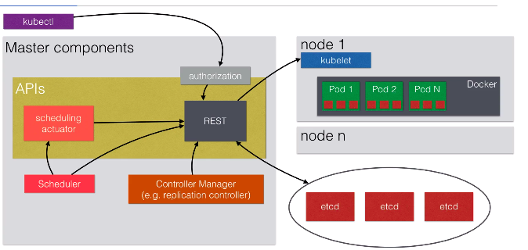
THE KUBERNETES MASTER SERVICES.

Slide 181
RESOURCE QUOTAS.
When a kubernetes cluster is used by multiple people or teams, resource management becomes more important.
You want to be able to manage the resources you give to a person or a team.
You do not want one person or team taking all the resources (cpu, memory, etc) of the cluster.
You can divide your cluster in namespaces and enable resource quotas on it.
You can do this using the “Resource Quota” and “ObjectQuota” objects.
Each container can specify “request capacity” and capacity limits”

Slide 182
RESOURCE QUOTAS.
Request capacity is an explicit request for resources.
The scheduler can use the “request capacity” to make decisions on where to put the pod on.
You can see it as an “minimum amount of resources the pod needs”.
“Resource limit” is a limit imposed on the container.
The container will not be able to utilize more resources than specified.

Slide 183
RESOURCE QUOTAS.
Example of resource quota :
You run a deploymen with a pod with a resource request of 200m.
200m = 200 millicpu or also 200 millicores.
200m - 0.2, which is 20% of a cpu core of the running code.
If the node has 2 cores, it is still 20% of a single node.
You can also put a limit, eg: on 400m.
Memory quotas are defined by MiB or GiB.

Slide 184
RESOURCE QUOTAS.
If a capacity quota (eg : mem/cpu) has been specified by the administrator, then each pod needs to specify capacity quota during creation.
The administrator can specify default request values for pods that do not specify any values for capacity.
The same is valid for limit quotas.
If a resource is requested more than the allowed capacity, the server API will give an error “403 FORBIDDEN” and kubectl will show an error.

Slide 185
RESOURCE QUOTAS.
The administrator can set the following resource limits within a namespace.
requests.cpu | The sum of CPU requests of all pods cannot exceed this value.
requests.mem | The sum of MEM requests of all pods cannot exceed this value.
requests.storage | The sum of storage requests of all persistent volume claims cannot exceed this value.
limits.cpu | The sum of CPU limits of all pods cannot exceed this value.
limits.memory | The sum of MEM limits of all pods cannot exceed this value.

Slide 186
RESOURCE QUOTAS.
The administrator can also set the following object limits,
configmaps | Total number of configmaps that can exist in a namespace.
persistentvolumeclaims | Total number of persistent volume claims that can exist in a namespace.
pods | Total number of pods that can exist in a namespace.
replicationcontrollers | Total number of replicationcontrollers that can exist in a namespace.
resourcequotas | Total number of resourcequotas that can exist in a namespaces.
services | Total number of services that can exist in a namespace.
services.loadbalancer | Total number of load balancer that can exist in a namespace.
services.nodeports | Total number of nodeports that can exist in a namespace.
secrets | Total number of secrets that can exist in a namespace.

Slide 187
NAMESPACES.
Namespaces allow you to create virtual clusters within the same physical clusters.
Namespaces logically separates your cluster.
The standard namespace is called “default” and that is where all resources are launched in by default.
There is also namespace for kubernetes specific resources called kube-system.
Namespaces are intended when you have multiple teams/projects using the kubernetes cluster.

Slide 188
NAMESPACES.
The name of resources needs to be uniyue within a namespace, but not across namespaces.
Example: You have the deployment “helloworld” multiple times in different namespaces but not twice in one namespace.
You can divide resources of a kubernetes cluster using namespaces.
You can limit resources on a per namespace basis.
Eg: The marketing team can only use a maximum of 10 GiB of memory, 2 load balancers and 2 CPU cores.

Slide 189
NAMESPACES.
First you will need to create a new namespace.
You can list namespaces using the below command.
You can also set a default namespace to launch resouces in.

Slide 190
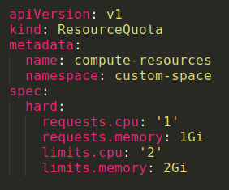
NAMESPACES.
You can then create resource limits within that namespace.

Slide 191
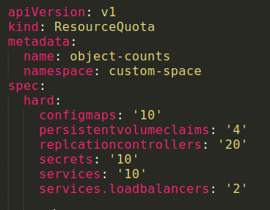
NAMESPACES.
You can also create object limits.

Slide 192
NAMESPACES.
cd resourcequotas
nano resourcequota.yml
kubectl create -f resourcequota.yml
nano helloworld-no-quotas.yml
kubectl create -f helloworld-no-quotas.yml
kubectl get deployments --namespace=myspace
kubectl get rs --namespace=myspace
kubectl delete deployments helloworld-deployment --namespace=myspace
nano helloworld-with-quotas.yml
kubectl create -f helloworld-with-quotas.yml
kubectl get pods --namespace=myspace

Slide 193
NAMESPACES.
kubectl get rs --namespace=myspace
kubectl describe rs helloworld-deployment-588cb4f97b --namespace=myspace
kubectl get quota --namespace=myspace
kubectl describe quota compute-quota --namespace=myspace
kubectl delete deployments helloworld-deployment --namespace=myspace
nano defaults.yml
kubectl create -f defaults.yml
kubectl describe limits limits --namespace=myspace
kubectl create -f helloworld-no-quotas.yml
kubectl get pods --namespace=myspace -o wide

Slide 194
USER MANAGEMENT.
There are 2 types of users you can create.
A normal user, which is used to access the user externally.
Eg: through kubectl
This user is not managed using objects.
A service user, which is managed by an object in kubernetes.
This type of user is used to authenticate within the cluster.
Eg: From inside a pod, or from a kubelet.
These credentials are managed like secrets.

Slide 195
USER MANAGEMENT.
There are multiple authentication strategies for normal users.
Client certificates.
Bearer tokens.
Authentication proxies.
HTTP basic authentication.
OpenID
Webhooks.

Slide 196
USER MANAGEMENT.
Service users are using service account tokens.
They are stored as credentials using secrets.
Those secrets are also mounted in pods to allow communication between the services.
Service users are specific to a namespace.
They are created automically by the API or manually using objects.
Any API call not authenticated is considered as an anonymous user.

Slide 197
USER MANAGEMENT.
Independentally from the authentication mechanism, normal users have the following attributes.
A username (user123 or user@email.com)
A UID
Groups
Extra fields to store extra information.

Slide 198
USER MANAGEMENT.
After a normal user authenticates, it will have access to everything.
To limit access, you need to configure authorizations.
There are again multiple offerings to choose from,
AlwaysAllow / AlwaysDeny
ABAC - Attribute Based Access Control
RBAC - Role Based Access Control
Webhooks - authorization by remote service.

Slide 199
USER MANAGEMENT.
openssl genrsa -out kubernetes.pem 2048
openssl req -new -key kubernetes.pem -out kubernetes-csr.pem -subj "/CN=kubernetes/O=myteam/"

Slide 200
RBAC.
After authentication, authorization controls what the user can do, where does the user have access to.
The access controls are implemented on an API level using kube-apiserver.
When an API request comes in, eg: when you enter “kubectl get nodes”, it will be checked to see whether you have access to execute this command.
There are multiple authentication module available.

Slide 201
RBAC.
Node: A special purpose authorization node that authorizes API requests made by kubelets.
ABAC: Attribute Based Access Control
Access rights are controlled by policies that combine attributes.
Eg: User “example” can do anything in namespace “development”.
ABAC does not allow very granular permission control.
RBAC: Resource Based Access Control.
Regulates access using roles.
Allows admins to dynamically configure permission policies.

Slide 202
RBAC.
Webhooks: Sends authorization request to an external REST interface.
Interesting option if you want to write your own authentication server.
You can parse the incoming payload which is JSON and reply with access granted or access denied.
To enable an authorization mode, you need to pass “--authorization-mode=” to the API server at startup.
For example, to enable RBAC, you pass “--authorization-mode=RBAC”

Slide 203
RBAC.
Most tools now provision a cluster with RBAC enabled by default like kops and kubeadm.
If you are using minikube, you can add a parameter when starting minikube.
minikube start --extra-config=apiserver.Authorization.Mode=RBAC.
You can add RBAC resources with kubectl to grant permissions.
You first describe them in yaml format, then apply them to the cluster.

Slide 204
RBAC.
First you define a role, then you can assign users/groups to that role.
You can create roles limited to a namespace or you can create roles where the access applies to all namspaces.
Role (Single namespace) and ClusterRole (Cluster-wide)
RoleBinding (Single namespace) and ClusterRoleBinding(cluster-wide)

Slide 205
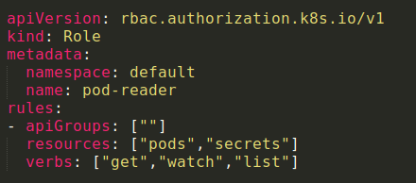
RBAC.
RBAC role granting read access to pods and secrets within default namespace.

Slide 206
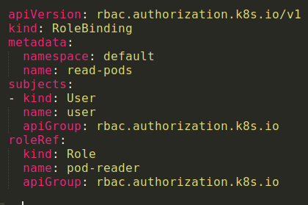
RBAC.
Next step is to assign users to the newly created role.

Slide 207
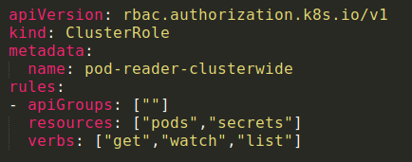
RBAC.
If you want to create a role that spans all namespaces, you can use ClusterRole.

Slide 208
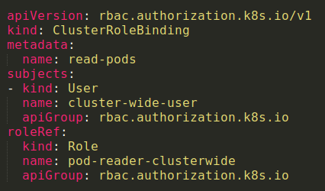
RBAC.
If you need to assign a user to a cluster-wide role, you need to use ClusterRoleBinding.

Slide 209
NETWORKING.
The approach in networking is quite different than in a default docker setup.
We have already covered,
Container to container communication within a pod.
Through localhost and port number.
Pod-to-service communication.
Using Nodeport and DNS.
External-to-service.
Using loadbalancer, NodePort.

Slide 210
NETWORKING.
In kubernetes, pods itself should always be routable.
This is pod-to-pod communications.
Kubernets assumes that pods should be able to communicate to other pods, regardless of which node they are running.
Every pod has its own IP addresses.
Pods on different nodes need to be able to communicate to each other using those IP addresses.
This is implemented differntly depending on your networking setup.

Slide 211
NETWORKING.
On AWS, kubenet networking is used which is default networking setup.
Every pod can get an IP that is routable using the AWS VPC.
The kubernetes master allocates a /24 subnet to each node.
This subnet is added to the VPCs route table.
There is a limit of 50 entries, which means you cannout have more than 50 nodes on a single AWS cluster.
Although, AWS can raise this limit to 100, but it might have a performance impact.

Slide 212
NETWORKING.
Not every cloud provider have VPC technology, although GCP and Azure provides it.
There are alternatives available.
Container network interface (CNI).
Software that provides libraries and plugins for network interfaces within containers.
Popular solutions are calico, weave (standalone or with CNI).
An overlay network,
Flannel is an easy and popular way.

Slide 213
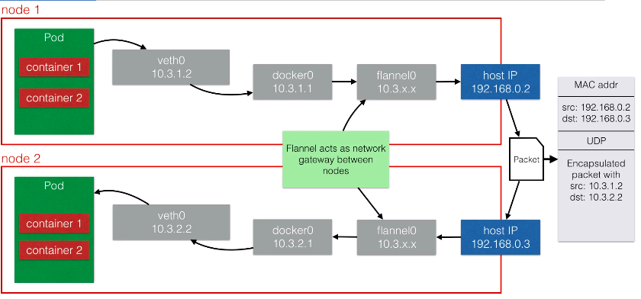
NETWORKING.

Slide 214
NODE MAINTENANCE.
It is the node controller that is responsible for managing the node objects.
It assigns IP space to the node when a new node is launched.
It keeps the node list up to date with the available machines.
The node controller is also monitoring the health of the node.
If a node is unhealthy it gets deleted.
Pods running on the unhealthy node will then get rescheduled.

Slide 215
NODE MAINTENANCE.
When adding a new node, the kubelet will attempt to register itself.
This is called self-registration and is the default behaviour.
It allows you to easily add more nodes to the cluster without making API changes yourself.
A new node object is automatically created with,
The metadata (with a name: IP or hostname).
Labels (eg: cloud region/ availability zone/ instance size)
A node also has a condition (eg: ready, OutOfDisk)

Slide 216

NODE MAINTENANCE.
When you want to decommission a node, you want to do it gracefully.
You drain a node before you shut it down or take it out of the cluster.
To drain a node, you can use the following command.
If the node runs pods that are not manaaged by a controller, but is just a single pod, then you can use the below command.

Slide 217
NODE MAINTENANCE.
We are going to run this example using the minikube.
kubectl get nodes
kubectl create -f deployment helloworld.yml
kubectl get pods
kubectl drain minikube
kubectl drain minikube --force
kubectl get nodes
kubectl get pods

Slide 218
HIGH AVAILABILITY.
If you are going to run your cluster in production, you are going to want to have all your master services in a “high availability (HA)” setup.
The setup looks like this:
Clustering etcd : At least run 3 etcd nodes.
Replicated API servers with a loadbalancer.
Running multiple instances of the scheduler and the controllers.
Only one of them will be the leader, the other ones are on stand-by.

Slide 219
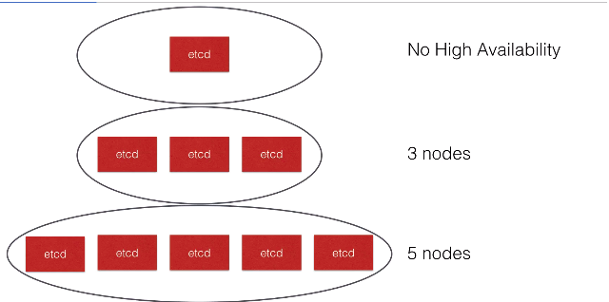
ARCHITECTURE OVERVIEW - HA.

Slide 220
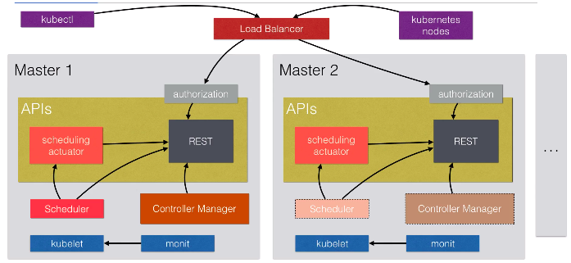
ARCHITECTURE OVERVIEW - HA.

Slide 221
HIGH AVAILABILITY.
A cluster like minikube does not need HA - it is only one node cluster.
If you are going to use a production cluster like AWS, kops can do the heavy lifting for you.
If you are running on other cloud platform, have a look at the kube deployment tools for that platform.
kubeadm is a tool that is in alpha that can set up a cluster for you.
If you are on a platform without any tooling, have a look at http://kubernetes.io/docs/admin/high-availability/ to implement it yourself.
We will look at using the kops setup to run multiple master nodes.

Slide 222
HIGH AVAILABILITY.
kops create cluster --name=example.cloudtechiez.tech --state=s3://dgruploads-test --zones=us-east-1a,us-east-1b,us-east-1c

Slide 223
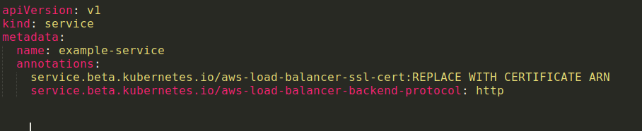
TLS ON ELB USING ANNOTATIONS.
You can setup cloud specific features like TLS on AWS load balancers that you create in kubernetes using services of type load balancer.
You can do this using annotations.

Slide 224
TLS ON ELB USING ANNOTATIONS.
We will look at the possible annotations for the AWS ELBs.
ANNOTATION | DESCRIPTION
service.beta.kubernetes.io/aws-load-balancer-log-emit-interval | Used to enable access logs to the load balancer.
service.beta.kubernetes.io/aws-load-balancer-access-log-enabled | Used to enable access logs to the load balancer.
service.beta.kubernetes.io/aws-load-balancer-access-log-s3-bucket-name | Used to enable access logs to the load balancer.
service.beta.kubernetes.io/aws-load-balancer-access-log-s3-bucket-name-prefix | Used to enable access logs to the load balancer.

Slide 225
TLS ON ELB USING ANNOTATIONS.
ANNOTATION | DESCRIPTION
service.beta.kubernetes.io/aws-load-balancer-additional-resource-tags | Add tags
service.beta.kubernetes.io/aws-load-balancer-backend-protocol | Backend protocol to use.
service.beta.kubernetes.io/aws-load-balancer-ssl-cert | Certificate ARN
service.beta.kubernetes.io/aws-load-balancer-connection-draining-enabled | Connection draining
service.beta.kubernetes.io/aws-load-balancer-connection-draining-timeout | Timeout when backend node stops during scaling
service.beta.kubernetes.io/aws-load-balancer-connection-idle-timeout | Connection idle timeout
service.beta.kubernetes.io/aws-load-balancer-cross-zone-load-balancing-enabled | Cross availability zone load balancing
service.beta.kubernetes.io/aws-load-balancer-extra-security-groups | Extra security groups

Slide 226
TLS ON ELB USING ANNOTATIONS.
ANNOTATION | DESCRIPTION
service.beta.kubernetes.io/aws-load-balancer-internal | Set internal load balancer
service.beta.kubernetes.io/aws-load-balancer-proxy-protocol | Enable proxy protocol
service.beta.kubernetes.io/aws-load-balancer-ssl-ports | What listener to enable HTTPS on (Default to all)

Slide 227
TLS ON ELB USING ANNOTATIONS.
To work with TLS, you will need to create a certificate in AWS.
Go to certificate manager in AWS.

Slide 228
ADMISSION CONTROLLER.
An admission controller can intercept requests sent to the kubernetes API server.
For eg: when you create a pod, a request will be sent to the kubernetes API server and this can be intercepted by an admission controller.
This interception happens after the user is authenticated (eg: Using token or certificate) and authorized (using RBAC) and before the object is persisted (saved) in the backend in the etcd.
Admission controllers can be enabled by the administrator.
They are typically added at cluster creation by passing an argument to the kube-apiserver.

Slide 229
ADMISSION CONTROLLER.
When using kops, it can be configures using yaml or with minikube by passing an argument after minikube starts.
ADMISSION CONTROLLER | DESCRIPTION
NamespaceLifecycle | Enforces that no new objects can be created when a namespace is in the terminating state.
LimitRanger | Using the “LimitRange” object type, you set the default and limit cpu memory resources in a namespace. The LimitRanger admission controller will ensure these defaults and limits are applied.
ServiceAccount | Implements the ServiceAccount feature.

Slide 230
ADMISSION CONTROLLER.
ADMISSION CONTROLLER | DESCRIPTION
DefaultStorageClass | If a PersistentVolumeClaim is created and it does not specify any specific storage, then this admission controller will add the default storage class to the PersistentVolumeClaim.
DefaultTolerationSeconds | Sets a default toleration in seconds if not explicitly defined in the pod specification.
NodeRestriction | Makes sure that kubelets that run on every node can only modify their own node/pod objects that run on that specific node.
MutatingAdmissionWebhook | You can setup a webhoook that can modify the object being sent to the kube-apiserver. The MutatingAdmissionWebhook ensures that matching objects will be sent to this webhook for modification.
ResourceQuota | Will check incoming requests to see if it does not voilate constraints defined in the ResourceQuota object in a namespace.

Slide 231
ADMISSION CONTROLLER.
ADMISSION CONTROLLER | DESCRIPTION
ValidatingAdmissionWebhook | You can setup a webhook that can validate the objects
PodSecurityPolicy | Enables you to control the security aspects of the pods creation and updates.

Slide 232
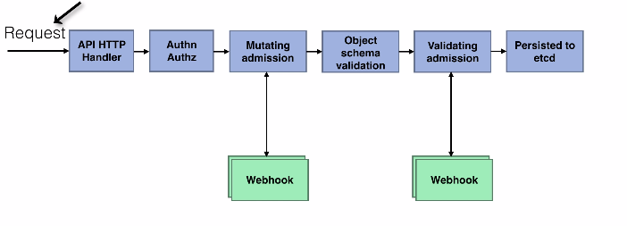
ADMISSION CONTROLLER.

Slide 233
POD SECURITY POLICIES.
Pod security policy enables you to control the security aspects of the pod creation and updates.
For eg:
Deny using privileged node in pods.
Control what volumes can be mounted.
Make sure containers only run within a UID/GID range or make sure that containers cannot run as root.
The pod security policy is an admission controller that can be enabled at cluster startup.
The pod security admission controller will be invoked at pod creation or modification.

Slide 234
POD SECURITY POLICIES.
It will determine whether the pods meet the pod security policy based on the security context defined within the pod specification.
The pod security admission controller is currently not enabled by default since kubernetes 1.16. It probably will be in the future.
We will look at how to enable it and create a PodSecurityPolicy to implement some extra security controls for new pods that are created.
You will typically need at least 2 PodSecurityPolicy.

Slide 235
POD SECURITY POLICIES.
One for the system processes because some of them need to run with privileged/as root.
One of the pod users want to schedule which should be tighter than the system policy for eg: deny privileged pods.

