Slide 1
E-COMMERCE
ANALYTICS
ORDERS
113,000
Power BI Project | From Orders to Decisions
REVENUE
107,239,297
Interactive storytelling • Sales • Customers • Products • Delivery • Satisfaction
Presented by: SAURABH Gupta
CUSTOMERS
113,000
WHAT HAPPENED → WHY → WHAT NEXT?
E-Commerce Analytics | Power BI Project • 1

Slide 2
Executive Overview
A concise view of the business story
TOTAL REVENUE
CUSTOMERS
PRODUCTS
107,239,297
113,000
44
AVG RATING
AVG WAIT
LOW-RATING RATE
2.73/5
9.5 days
47.2%
• Revenue is spread across multiple product categories.
• Delivery type is a clear operational differentiator for waiting time.
• Low ratings require a multi-factor customer-experience response.
E-Commerce Analytics | Power BI Project • 2

Slide 3
Data Foundation
Available Orders fields support sales, product, delivery and satisfaction analysis
• OrderDate, DeliveryDate, CustomerID, Location, Zone, DeliveryType
• ProductCategory, SubCategory, Product, UnitPrice, OrderQuantity, SalePrice
• Status, Reason and Rating for customer experience and returns
• Available CSV is described as May–June 2020; prior-year comparisons require historical data.
Customer
Orders
Product
Delivery
Rating / Returns
E-Commerce Analytics | Power BI Project • 3

Slide 4
Business Questions → Decision Paths
The report is organized around stakeholder decisions
GROWTH
Where is revenue coming from?
Category • Product • Location
Every visual should answer a business question.
CUSTOMER
Why are ratings low?
Wait • Delivery • Quality
OPERATIONS
Where are delays?
Delivery • Location • Zone
PRODUCT
Which items need attention?
Price • Sales • Rating
E-Commerce Analytics | Power BI Project • 4

Slide 5
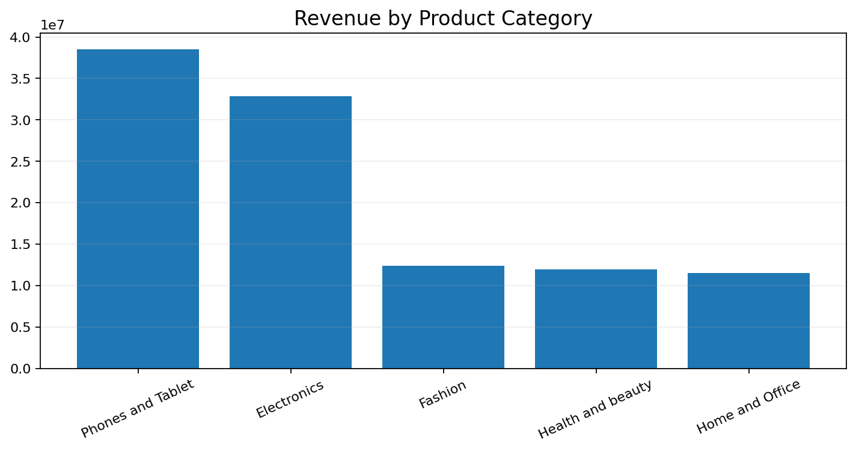
1 | Revenue by Product Category
Category-level revenue reveals the portfolio mix
TOP CATEGORY
Phones and Tablet
REVENUE
38,535,343
• Protect strong categories.
• Use targeted growth tactics for weaker contributors.
E-Commerce Analytics | Power BI Project • 5

Slide 6
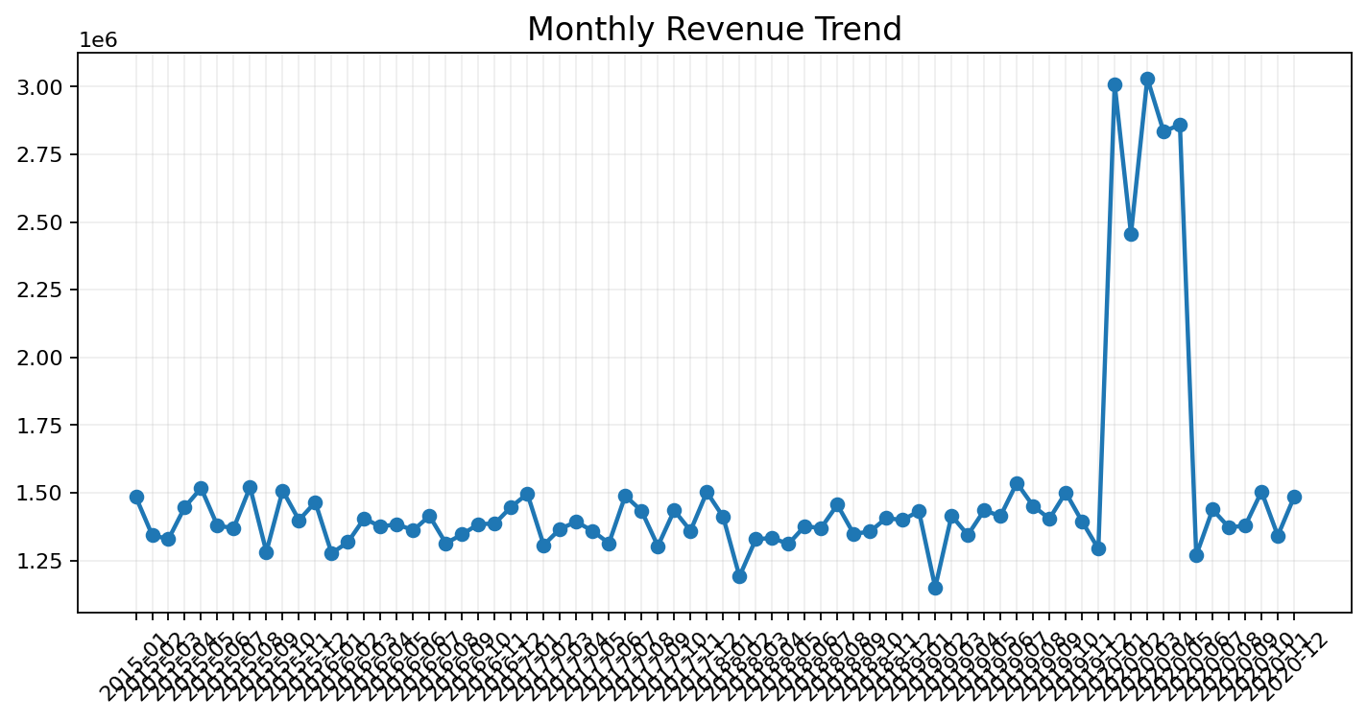
2 | Monthly Revenue Trend
A starting point for promotion and planning
• Identify peaks and weaker periods.
• Promotion should be focused where demand needs stimulation.
• More historical data is needed for strong seasonality and YoY conclusions.
E-Commerce Analytics | Power BI Project • 6

Slide 7
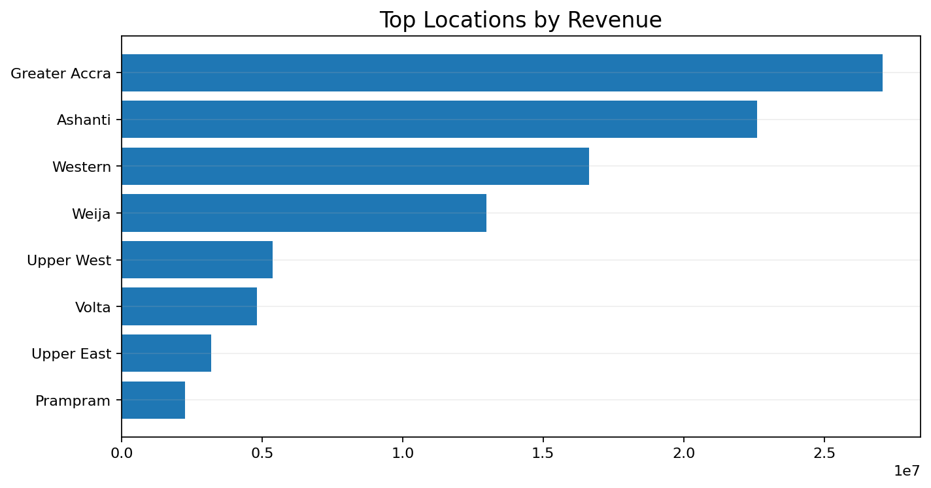
3 | Geographic Revenue
Location concentration can guide regional marketing and distribution
• Use Location as a slicer.
• Compare revenue with order volume.
• Layer Zone to identify operational pockets.
• Prioritize high-value markets for retention and capacity.
E-Commerce Analytics | Power BI Project • 7

Slide 8
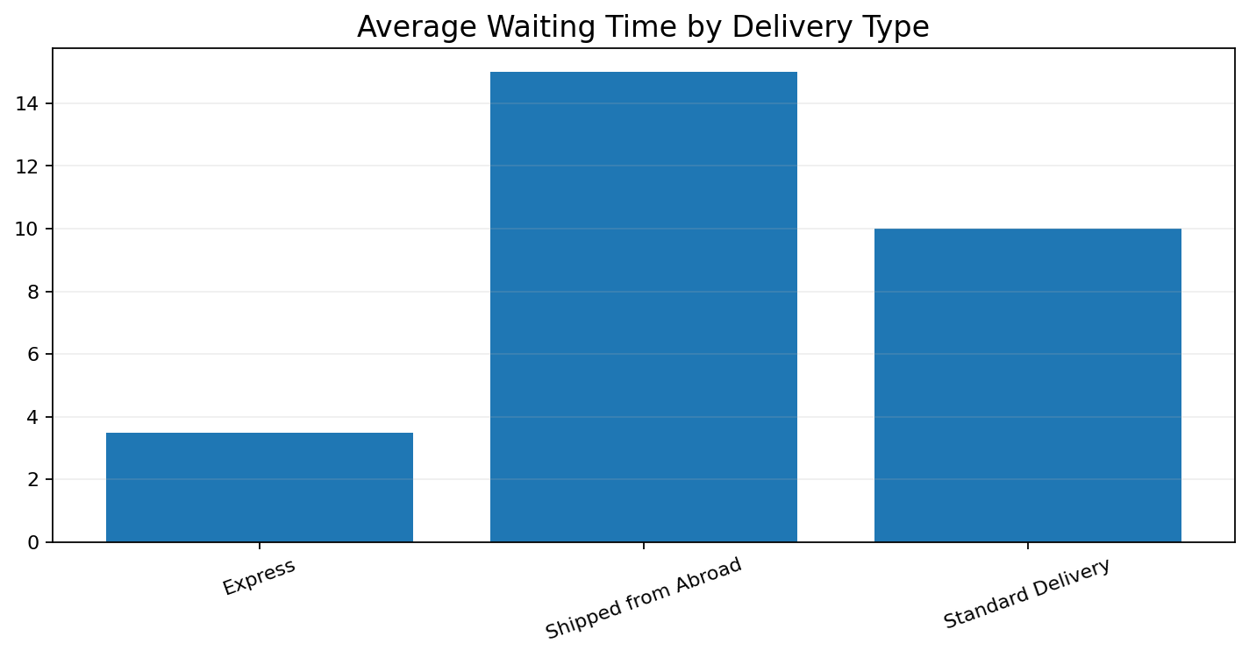
4 | Delivery Type vs Waiting Time
Delivery method shows a strong operational difference
FASTEST
3.5 days
LONGEST
15.0 days
Decision cue
Use delivery-type performance to
set realistic promises and improve logistics.
E-Commerce Analytics | Power BI Project • 8

Slide 9
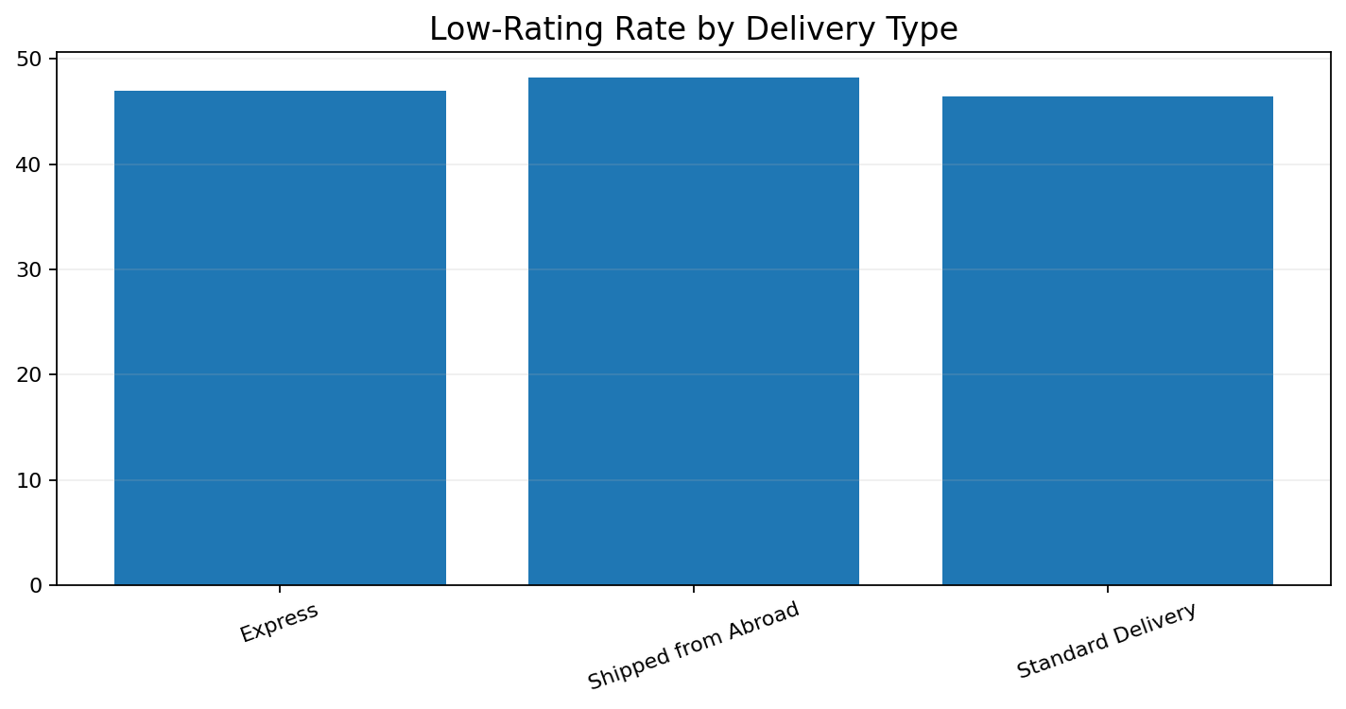
5 | Low-Rating Rate by Delivery Type
Customer experience is not explained by price alone
OVERALL LOW RATING
47.2%
• Treat ratings 1–2 as low ratings.
• Compare delivery with waiting time and reasons.
• Use reason-level analysis to prioritize action.
E-Commerce Analytics | Power BI Project • 9

Slide 10
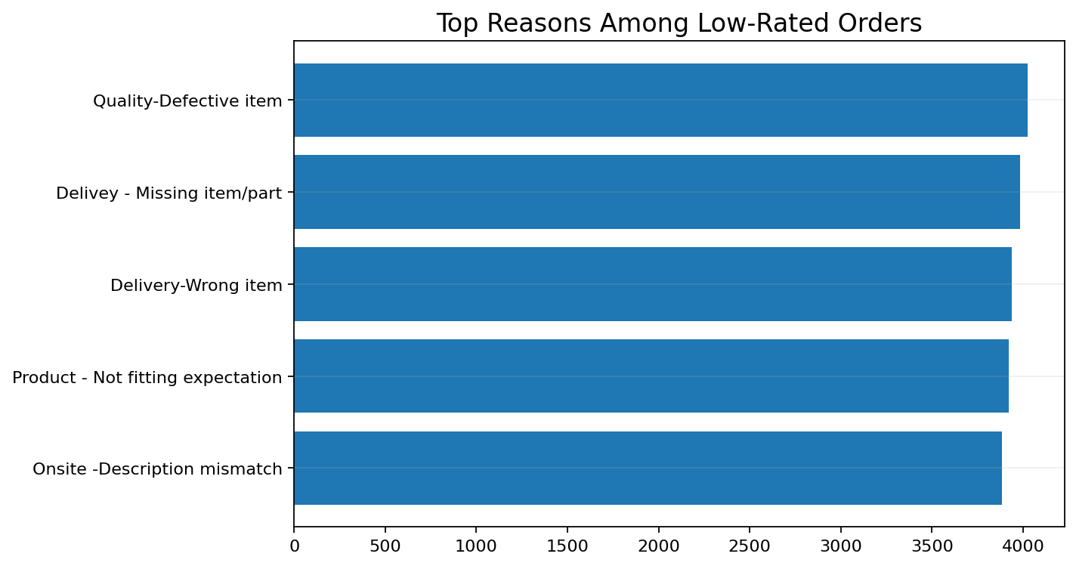
6 | Why Are Customers Unhappy?
Reason-level analysis points to actionable experience problems
• Strengthen product quality control.
• Improve picking and packing accuracy.
• Improve product descriptions and expectation setting.
• Track recurring issues by product and supplier.
E-Commerce Analytics | Power BI Project • 10

Slide 11
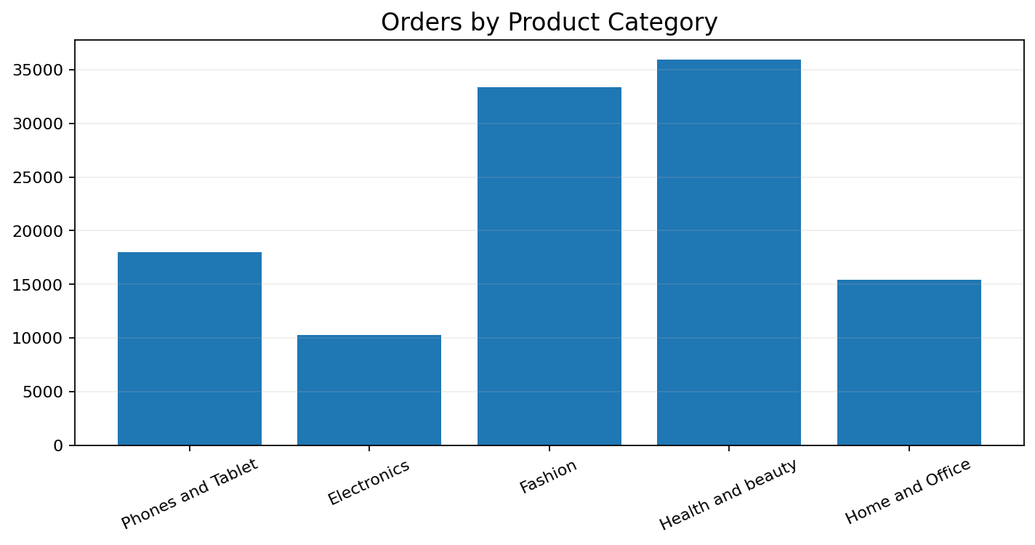
7 | Shipping Charges vs Product Type
Average shipping fee is more useful than total shipping spend
• Total shipping cost is influenced by order volume.
• Average shipping differences across categories are small.
• Investigate delivery type, location, zone and quantity for stronger cost drivers.
E-Commerce Analytics | Power BI Project • 11

Slide 12
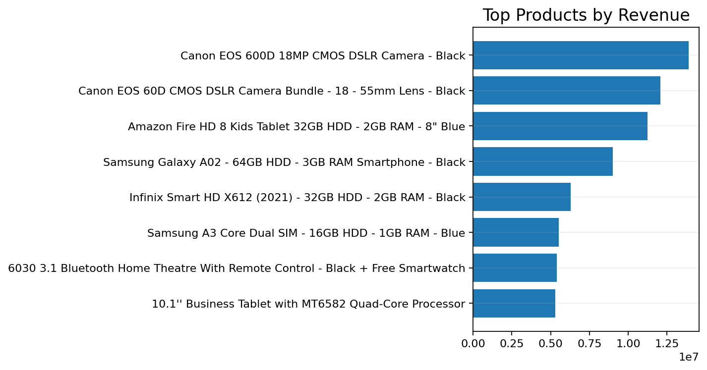
8 | Product Winners
Top products are the starting point for assortment and promotion
• Track revenue and order volume together.
• Validate rating and return reasons before scaling promotion.
• High revenue does not automatically mean high profitability.
E-Commerce Analytics | Power BI Project • 12

Slide 13
9 | Customer Loyalty Framework
Turn transaction behavior into differentiated benefits
CHAMPIONS
LOYAL
GROWTH
AT RISK
High value
High frequency
Emerging value
Low engagement
• Champions: premium benefits and early access.
• Growth: bundles and threshold incentives.
• At-risk: personalized reactivation offers.
• Use revenue, order frequency and average order value as customer signals.
E-Commerce Analytics | Power BI Project • 13

Slide 14
10 | DAX Analytics Engine
Reusable measures turn the model into a decision system
CALCULATE
SUM / AVERAGE
DATEDIFF
Context-aware measures
Core aggregation
Waiting-time logic
SAMEPERIODLASTYEAR
FILTER / ITERATORS
DISTINCTCOUNT
Time intelligence
Targeted analysis
Unique entities
Model → Measures → Visuals → Decisions
E-Commerce Analytics | Power BI Project • 14

Slide 15
11 | Time Intelligence
Previous-year comparison requires a complete date context
Current month
SAMEPERIODLASTYEAR()
Same month / prior year
• Required output: Year | Month | Total Sales | Previous_Years_Sales.
• The available file is described as May–June 2020; 2019 comparison needs historical data.
• Blank prior-year values can be a data-availability result, not a DAX error.
E-Commerce Analytics | Power BI Project • 15

Slide 16
12 | Interactive Power BI Experience
Three stakeholder-focused tabs
MAIN
PRODUCT
INDIVIDUAL PRODUCT
Sales • Revenue • Satisfaction
Category • Customer • Improvement
Purchase • Rating • Revenue
• Main: product category + date slicers.
• Product: gender + delivery type + category + age group.
• Individual Product: product-level profile and performance.
• Use cross-filtering, tooltips and bookmarks for guided exploration.
E-Commerce Analytics | Power BI Project • 16

Slide 17
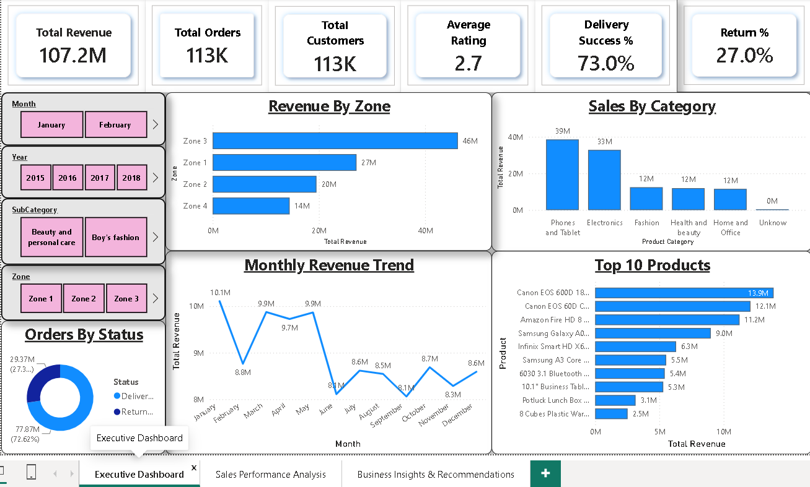

12.1 | Main Dashboard
High-level KPI tracking, Sales, regional revenue mix, and monthly order trajectory
E-Commerce Analytics | Power BI Project • 16

Slide 18
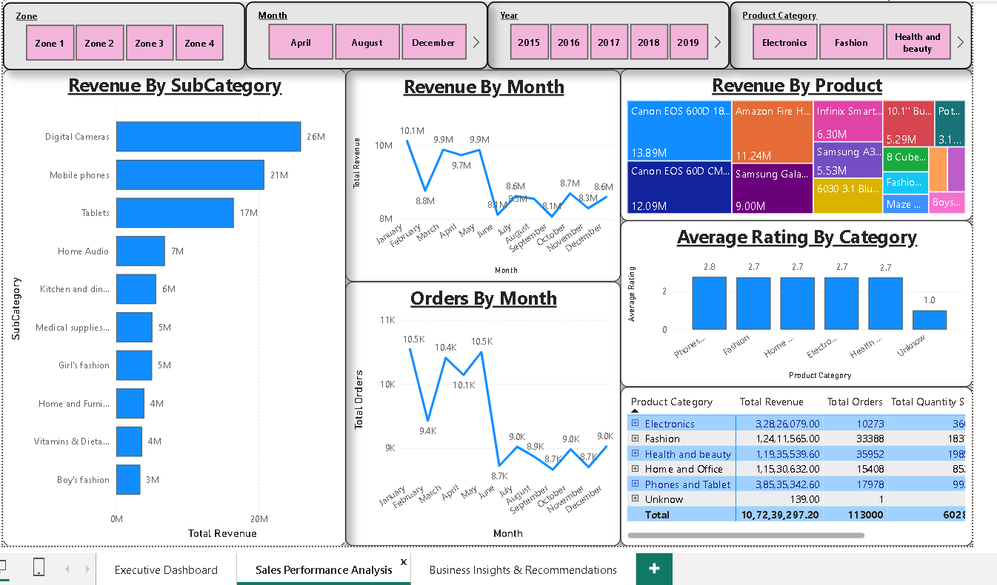

12.2 | Product Dashboard
Product Performance | Sales, Category, Product ranking & Rating
E-Commerce Analytics | Power BI Project • 16

Slide 19
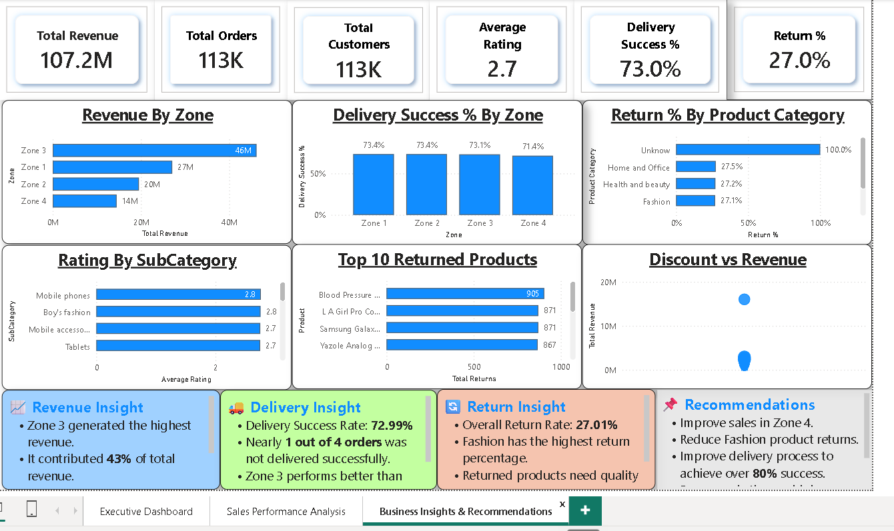
12.3 | Individual Product Dashboard
Drill-down view | Selected product profile and Customer experience
E-Commerce Analytics | Power BI Project • 16

Slide 20
13 | Storytelling Blueprint
Guide the audience from performance to action
01
02
03
04
WHAT?
WHERE?
WHY?
NEXT?
Revenue • Customers • Products
Location • Category
Delivery • Wait • Rating • Reasons
Promotion • Quality • Logistics • Loyalty
One page = one story. Keep the most important information prominent.
E-Commerce Analytics | Power BI Project • 17

Slide 21
14 | Action Plan
Translate analytical signals into operational actions
CUSTOMER EXPERIENCE
Reduce defects, wrong items and missing parts; improve descriptions.
DELIVERY
Improve international logistics and set realistic promises.
PRODUCT
Review high-price/low-sales items before targeted incentives.
GROWTH
Use location, trends and customer value to focus promotions.
E-Commerce Analytics | Power BI Project • 18

Slide 22
15 | Project Takeaways
What the analysis says
• Revenue, products, customers, delivery and satisfaction can be brought into one decision framework.
• Delivery type is a strong operational lever for waiting time.
• Low ratings require a multi-factor response; quality and fulfillment reasons are highly actionable.
• Interactive pages should move stakeholders from performance → diagnosis → action.
• Historical data expansion is the next step for stronger year-over-year and predictive analysis.
FOCUS
Growth + CX
OPERATE
Delivery
IMPROVE
Quality
E-Commerce Analytics | Power BI Project • 19

Slide 23
CONCLUSION
From dashboard metrics to business decisions
• Build the report around stakeholder decisions, not just available columns.
• Use clean KPIs and the right chart for each question.
• Prioritize delivery, fulfillment quality and customer experience interventions.
• Use targeted promotions and loyalty strategies instead of blanket discounts.
• Keep the Power BI report interactive, consistent and easy to navigate.
PROJECT SCOPE
E-Commerce
DECISION FOCUS
Growth + CX
NEXT STEP
Act + measure
E-Commerce Analytics | Power BI Project • 20

