Slide 1
The final project will require four programs running separately over a network, emulating four routers with predefined connections and route costs, that communicate with each other to update Distance Vector Routing Tables at each router, while displaying changes and resulting tables for Router 0.

Slide 2
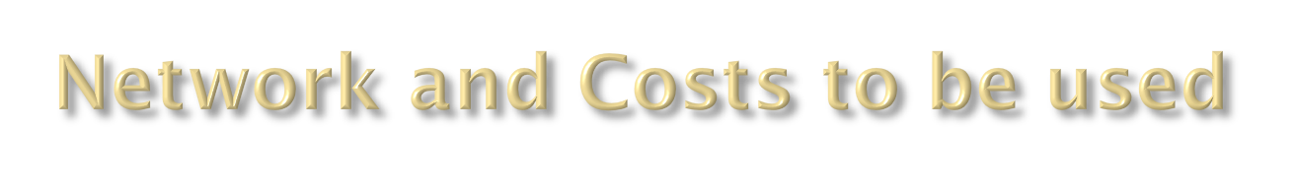
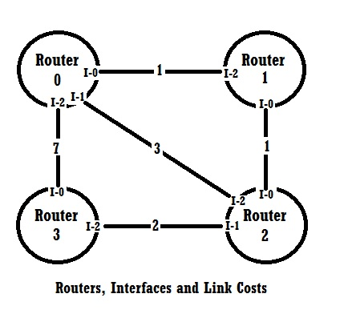
Stage 1 and 2:
Client is Router 0
Server is Router 1
Final Project:
Each Router is represented by a separate program running independently and communicating across a network.

Slide 3
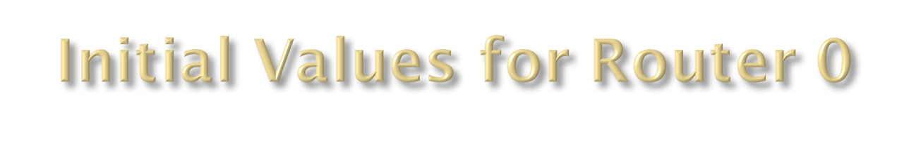
Destination Router | Interface | Link Cost
0 | Local | 0
1 | 0 | 1
2 | 1 | 3
3 | 2 | 7
This table represents the initial least cost known path from Router 0
to each of the other three routers. Initially, each router knows only the
direct cost on each of its directly connected interfaces.
The initial table for each of the other routers can be obtained by
examining the network diagram on the preceding page.
After routers exchange information, new paths will be discovered and
the tables will be updated with new least costs using the Bellman –
Ford distance vector algorithm.

Slide 4

Create a client and a server, communicating over a network, and pass the following information.
Client displays its initial known least cost to each other router.
Client sends its own Router number, and its initial known least cost to each other router.
Server sends its own Router number, and its initial known least cost to each other router.
Client displays information received from server.

Slide 5

Listings of all code
Screen shots that prove code compiled and ran correctly without errors
Output from client, as specified.
If possible, a screen shot from Wireshark showing the socket data passing across the network. Otherwise, use screen shots of client and server to prove that information was on different hosts and passed across a network.

Slide 6

Routers 0 and 1 will maintain a least cost table to all routers (0, 1, 2, 3).
Router 0 will display the initial table.
Routers 0 and 1 represented by separate communicating programs will exchange information as specified in stage one.
Using the information received from the other program, the least cost to the other routers will be updated using the Bellman-Ford distance vector algorithm.
Router 0 will display its updated table.

Slide 7

Listings of all code
Screen shots that prove code compiled and ran correctly without errors
Before and after tables for Router 0, as specified.
If possible, a screen shot from Wireshark showing the data passing across the network. Otherwise, use screen shots of each router program to prove that information was on different hosts and passed across a network.

Slide 8
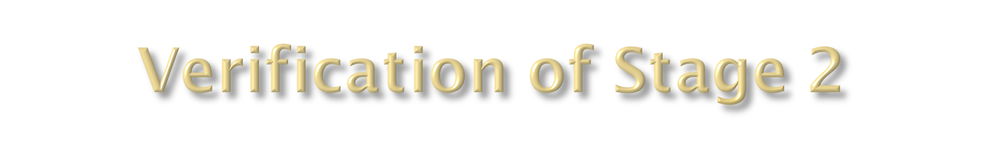
The initial cost to get from router 0 to router 2 should be 3.
After the update, the cost should be 2.

Slide 9
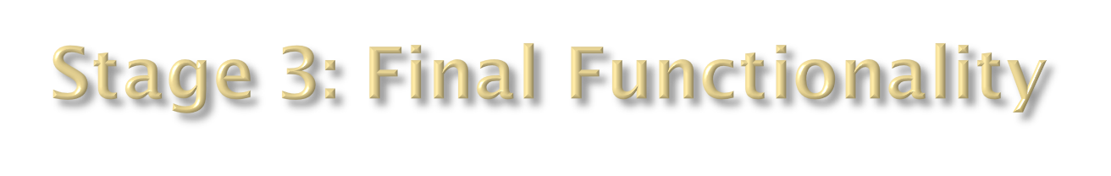
Extend the functionality of stage two to four separate programs, representing routers 0, 1, 2, and 3 on the network diagram and communicating across the network.
Exchange data between routers 0 and 1, as in stage two. But this time, every time a router changes the data in its table, it sends its entire table to all directly connected routers, which also do the same.
Display the initial data table and the new tale after each change for router 0.
Find a way to terminate the program when complete.

Slide 10

Listings of code for Router 0 and one other router.
Screen shots that prove code compiled and ran correctly without errors
Initial and each changed table for Router 0, as specified. (Should be three of more separate tables depending on update order.)
Proof that router programs were on at least two different hosts (four preferred) and passed across a network.

Slide 11
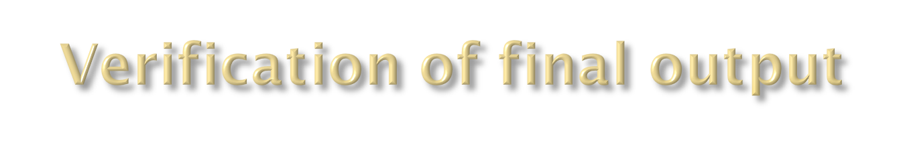
If your programs are working correctly, router 0 will have an initial cost of 7 to get to router 3.
After the first complete set of updates, that cost should be 5.
After the second set of updates, the cost should be 4.

