Slide 1
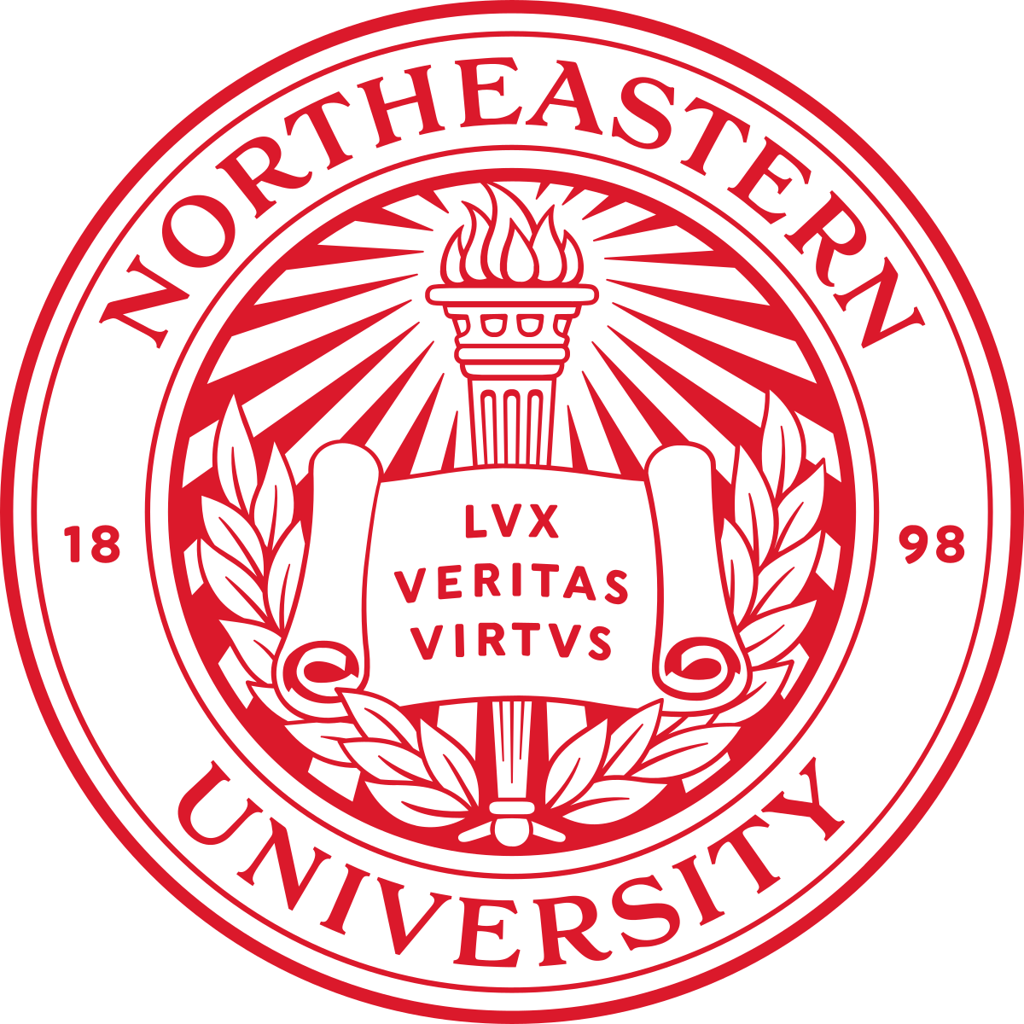
GROUP 5 Project: Alzheimer's Classification and Brain Tumor Relationship Analysis using Annotated MRI Datasets
March 29th, 2024
ALY6980: CAPSTONE
INSTRUCTOR: PROF. HEMA SESHADRI

Slide 2
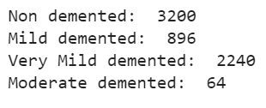
Overview
The data is collected from various sources, including websites, hospitals, and public repositories.
The dataset consists of total of 6400 preprocessed MRI (Magnetic Resonance Imaging) images.
There are four classes of images in the dataset:

Slide 3
Objective & Goals
Develop a machine learning model that can accurately classify Alzheimer's disease using defined MRI datasets.
Determine the significance of the relationship between the presence of brain tumors and Alzheimer's disease.
Develop an effective framework or architecture for Alzheimer's disease classification based on the insights gained from analyzing defined MRI datasets.
Make significant improvements to the understanding and diagnosis of Alzheimer's disease by utilizing new machine-learning techniques and analysis.

Slide 4
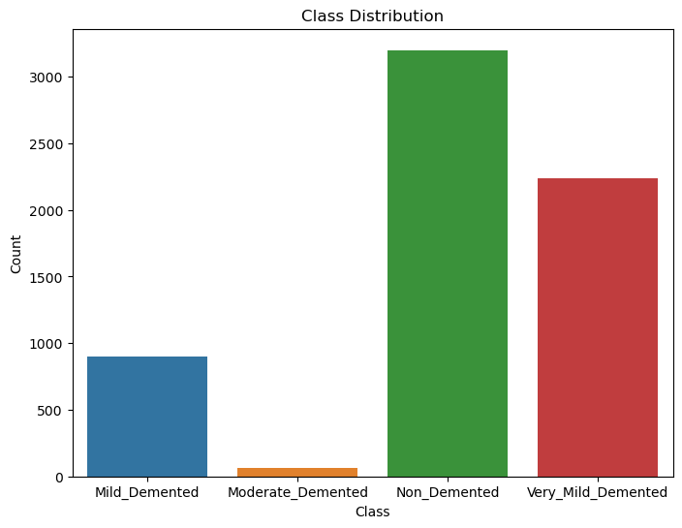
Initial EDAs: Bar Plot: Class Distribution
This visualization helps us understand the balance or imbalance of data across different categories, which is crucial for tasks such as classification, ensuring that the machine learning model receives sufficient training data for each class.

Slide 5
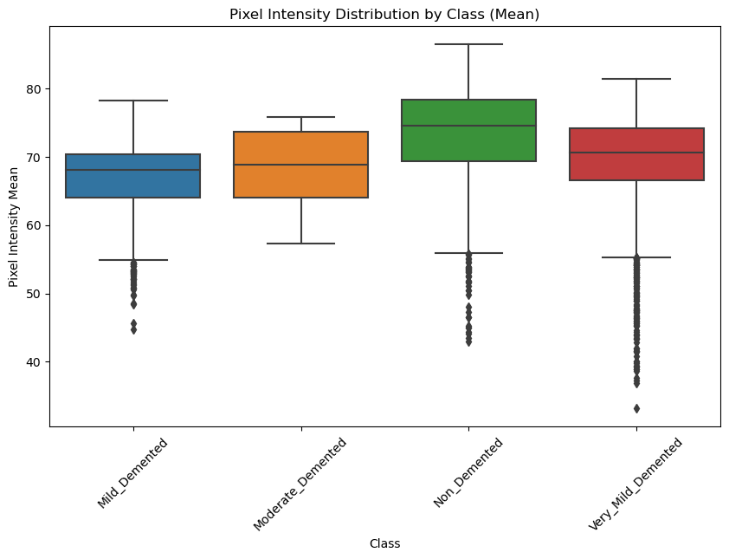
Pixel Intensity Distribution by Class (Mean)
Each box plot gives information about the central tendency and variability of pixel intensities within each class, allowing for a comparative analysis of how the pixel intensity distributions differ between categories.

Slide 6
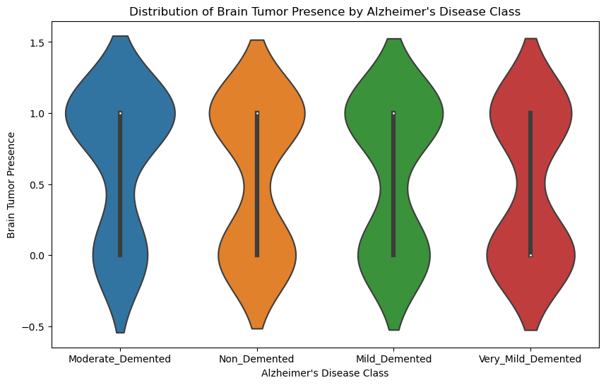
Distribution of Brain Tumor Presence by Alzheimer's Disease Class
Each violin plot depicts the presence of brain tumors within each Alzheimer's Disease class. The width of the plot for a given y-value indicates the density of data points at that level. Thicker portions indicate greater data density, while thinner regions suggest lower density.

Slide 7
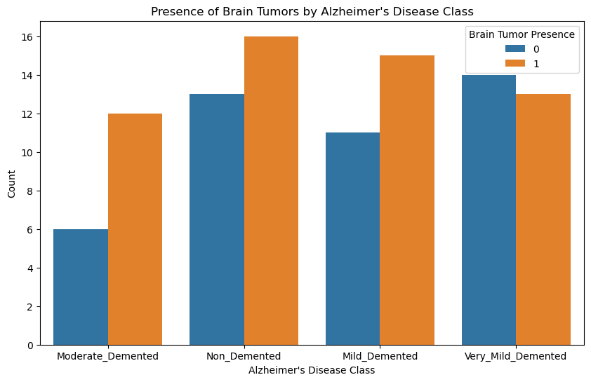
Presence of Brain Tumors by Alzheimer's Disease Class
Brain tumor presence is a binary variable (0 or 1) indicating the presence (1) or absence (0) of a brain tumor.

Slide 8
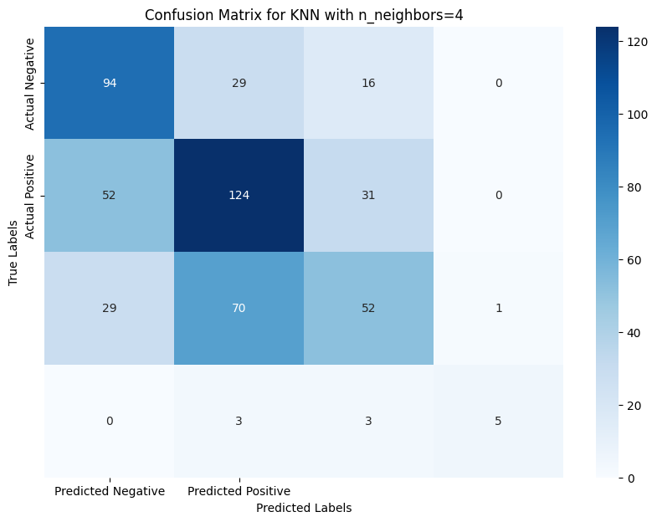
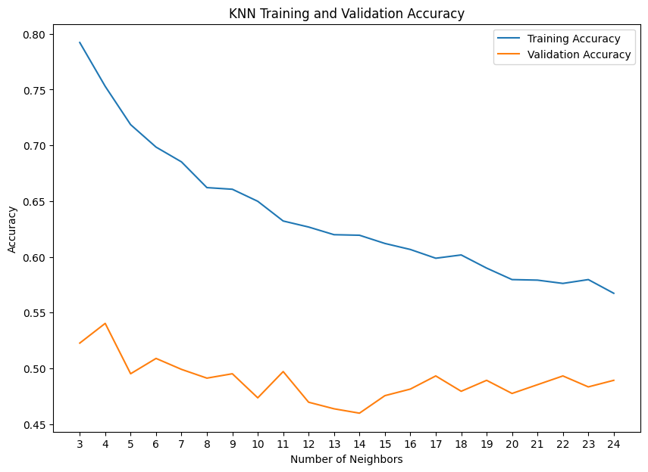
KNN Model
Explored n_neighbors range: 3 to 24.
Calculated accuracy, precision, recall, and F1 score for each KNN configuration.
Best performance achieved with n_neighbors=4.
Highest accuracy recorded at 0.54 on the testing set
The KNN model with n_neighbors=4 shows the strongest predictive ability for the second class, with 124 correct classifications.
From the confusion matrix, there is evidence of misclassification between classes, especially between the first and third classes, we will look into it further in the future optimization of the model.

Slide 9
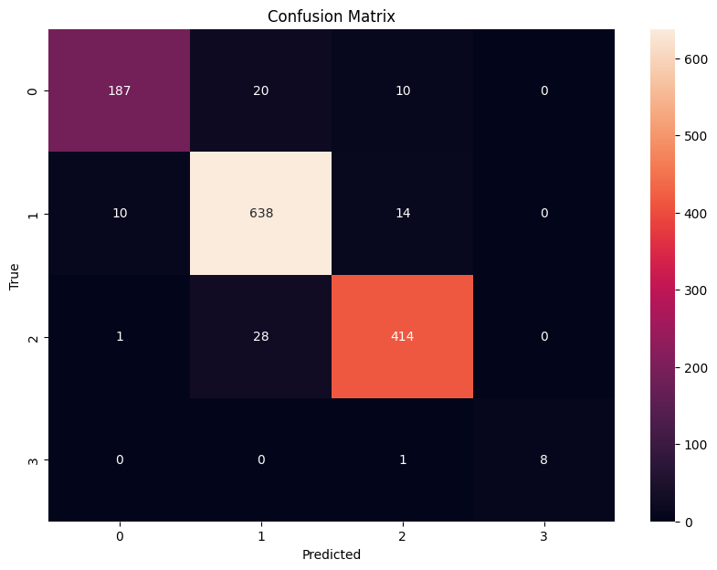
Hyper-tuned KNN
Feature Scaling: Applied StandardScaler to normalize the dataset, ensuring equal contribution of each feature.
Dimensionality Reduction: Used PCA to retain 95% of data variance, simplifying the model without significant information loss.
Initial Grid Search: Conducted hyperparameter tuning for n_neighbors (3-24), identifying the best performance at 3 neighbors with 93.84% accuracy.
Extended Grid Search: Expanded tuning to include n_neighbors, weights, algorithm, and p, finding the optimal combination (n_neighbors: 4, weights: 'distance', algorithm: 'auto', p: 2) with 91.68% accuracy.
Randomized Search: Implemented RandomizedSearchCV with 100 iterations, confirming the optimal parameters and achieving 91.68% accuracy, demonstrating efficiency in finding the best parameters with fewer computations.
Bayesian Optimization (Hyperopt): Applied Hyperopt for parameter tuning, achieving the same optimal parameters and accuracy as the extended Grid Search and Randomized Search.
Genetic Algorithm: Utilized a genetic algorithm for hyperparameter exploration, achieving the optimal configuration that matches previous methods, with a 91.68% accuracy.

Slide 10
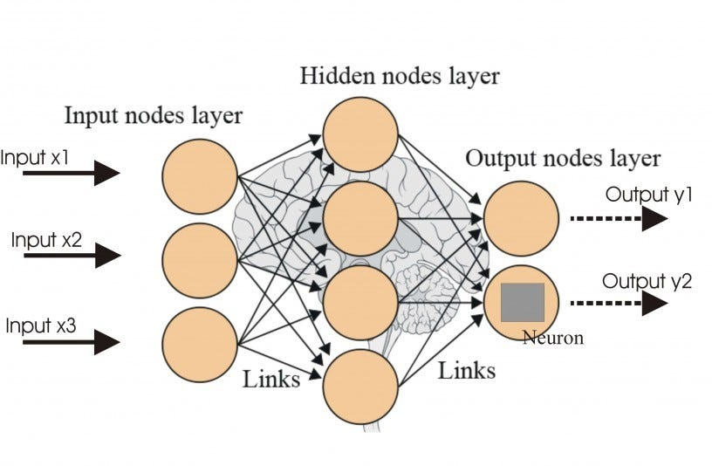
ANN Model
KEY STRENGTHS:
LEARNS COMPLEX PATTERNS FROM LARGE DATASETS.
ADAPTS WELL TO INTRICATE TASKS LIKE MEDICAL IMAGE ANALYSIS.
ADAPTABILITY AND LEARNING:
ANN'S LAYERED STRUCTURE ALLOWS IT TO AUTOMATICALLY EXTRACT RELEVANT FEATURES.
WELL-SUITED FOR TASKS LIKE ALZHEIMER'S CLASSIFICATION AND BRAIN TUMOR ANALYSIS DUE TO ITS CAPACITY TO HANDLE INTRICATE PATTERNS IN MEDICAL IMAGES.
FEATURE EXTRACTION AND PATTERN RECOGNITION:
ANN EXCELS IN EXTRACTING INTRICATE FEATURES FROM MRI DATA, SURPASSING TRADITIONAL METHODS.
ADAPTABILITY AND GENERALIZATION:
ANN SHOWCASES ADAPTABILITY TO DIVERSE DATASETS, ENSURING ROBUSTNESS IN HANDLING VARIATIONS IN MRI DATA.

Slide 11
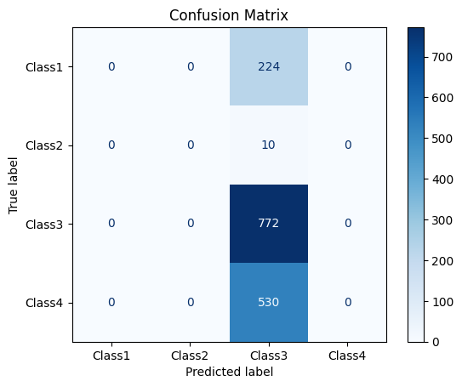
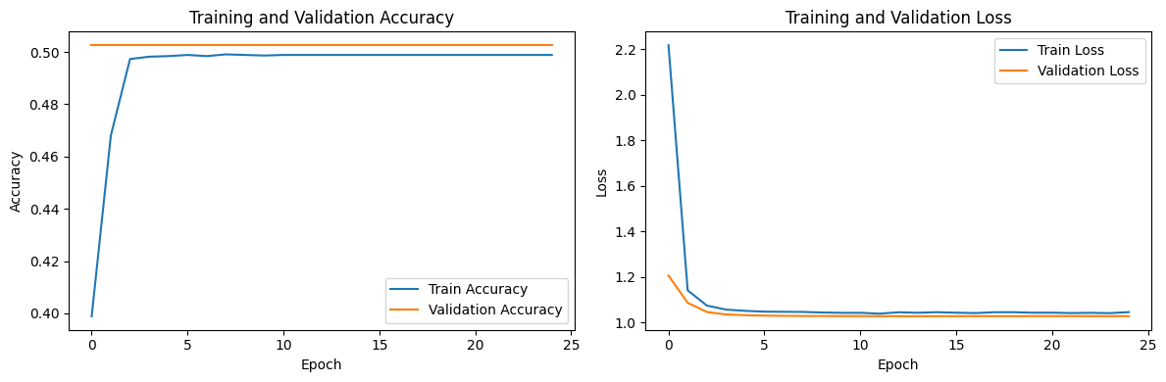
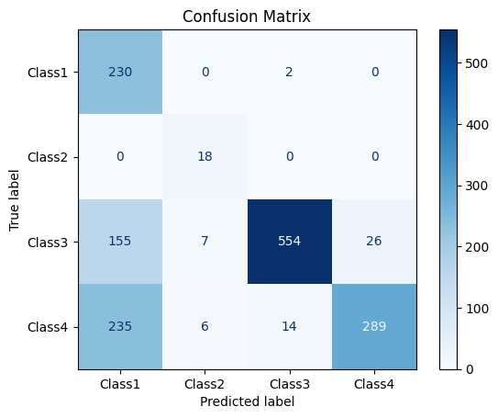
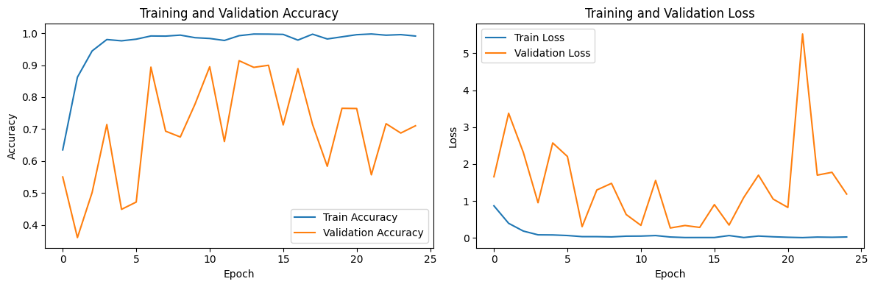
Result on running the model
Overfitting observed

Slide 12
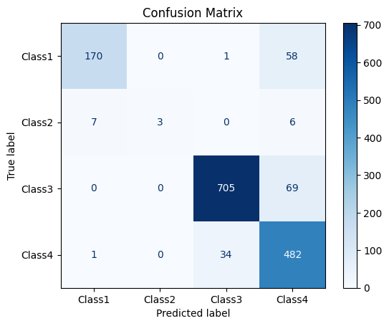
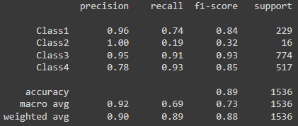
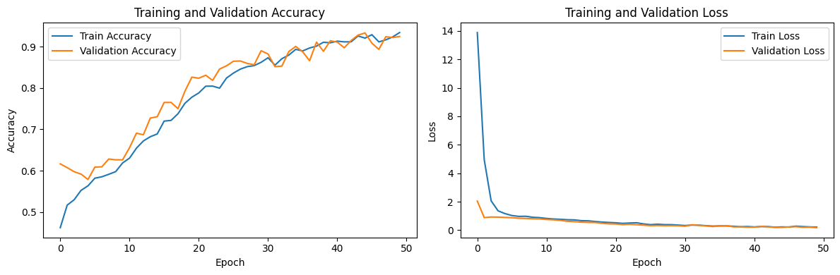
Hyper – tuned ANN

Slide 13
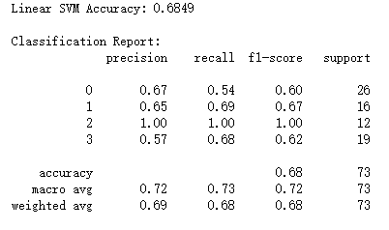
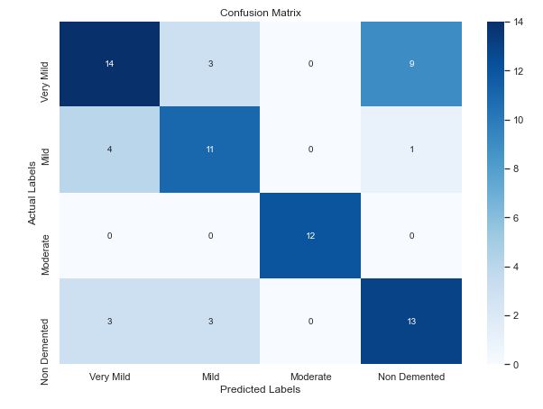
SVM Model
The model achieved an accuracy of approximately 63% originally, now it is 68 %.
The macro average treats all classes as equally important, resulting in a balanced average of the precision and recall across all classes, which is around 0.72 and 0.73 respectively.
There are noticeable confusions between Very Mild (Class 0) and Non Demented (Class 3), as indicated by the off-diagonal elements in the confusion matrix

Slide 14
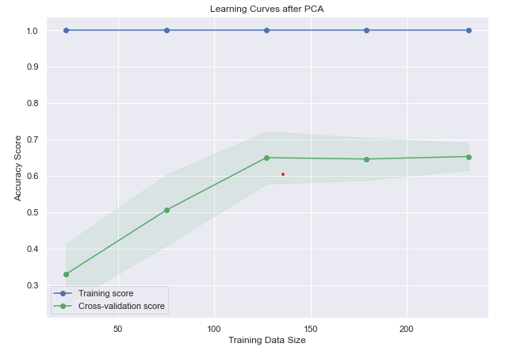
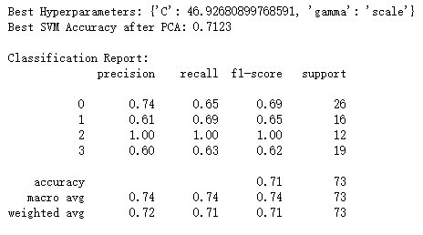
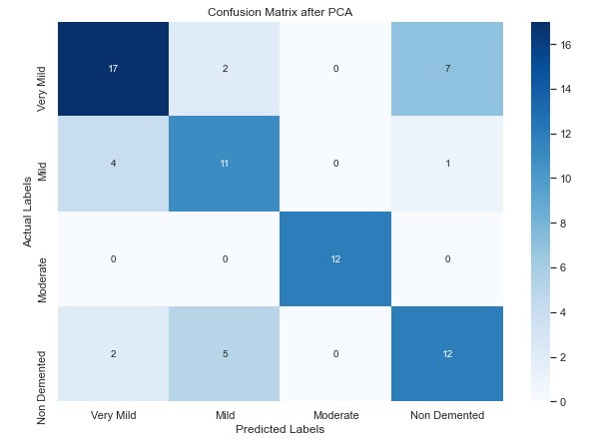
Hyper-tuned SVM
The hypertuned model has an accuracy of 71%, which is an improvement over the original SVM model's accuracy of 63%
The perfect classification for Class 2 (Moderate Demented) remains consistent, indicating that the features for this class are distinctive and well-learned by the model.
The confusion matrix shows fewer misclassifications between Class 0 (Very Mild) and Class 3 (Non Demented), suggesting an improvement in the model's ability to distinguish between these classes.
The learning curves post-PCA demonstrate a close gap between training and cross-validation scores, indicating good generalization of the hypertuned model.

Slide 15
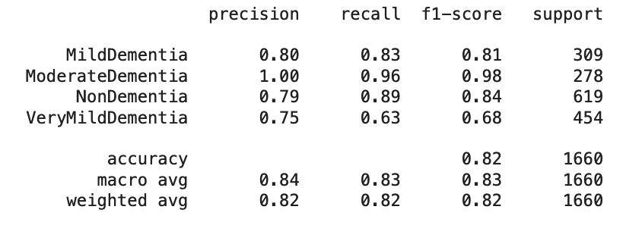
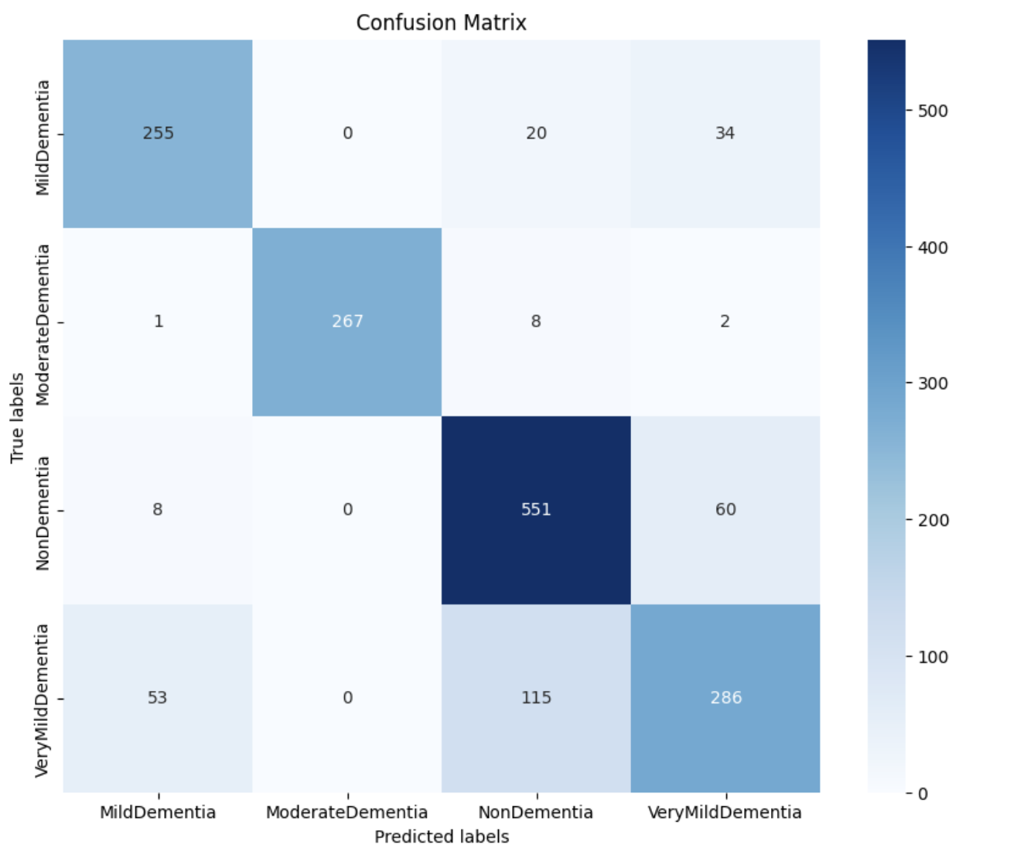
CNN Model
The model achieved an accuracy of approximately 94% auc or 82% accuracy.
The macro average treats all classes as equally important, resulting in a balanced average of the precision and recall across all classes, which is around 0.83 and 0.83 respectively.
From the confusion matrix the model is performing decently on the validation data. The AUC is a metric to be considered as the classes are imbalanced. The AUC indicates how well our model is able to distinguish between different classes, which in our case it is doing really well.

Slide 16
Hyper-tuned Analytical Techniques
Applied Principal Component Analysis (PCA) for feature reduction to handle high-dimensional MRI data effectively.
Importance of PCA in Our Model:
Dimensionality Reduction: Transforms high-dimensional data into a lower-dimensional form.
Efficiency: Reduces training time by limiting the number of input features without significant loss of information.
Performance: Improves model accuracy by eliminating noise and redundancy in the data.
Utilized Support Vector Machine (SVM) with hyperparameter tuning via Grid and Randomized Search to improve classification accuracy.
Confusion Matrix analysis revealed the model's strength in identifying Moderate Demented cases and its initial challenge in distinguishing Very Mild from Non-Demented cases.
Tasks for improvements on next week:
Incorporate Additional Features: Integrate texture-based features from MRI images, like gray-level co-occurrence matrix (GLCM) parameters, to capture more detailed patterns related to Alzheimer's. Strengthen the model's predictive power, specifically in differentiating stages of Alzheimer's and identifying correlations with brain tumors.
Model Tuning: Experiment with custom SVM kernels that may capture the complex patterns in MRI data more effectively than standard kernels.

Slide 17
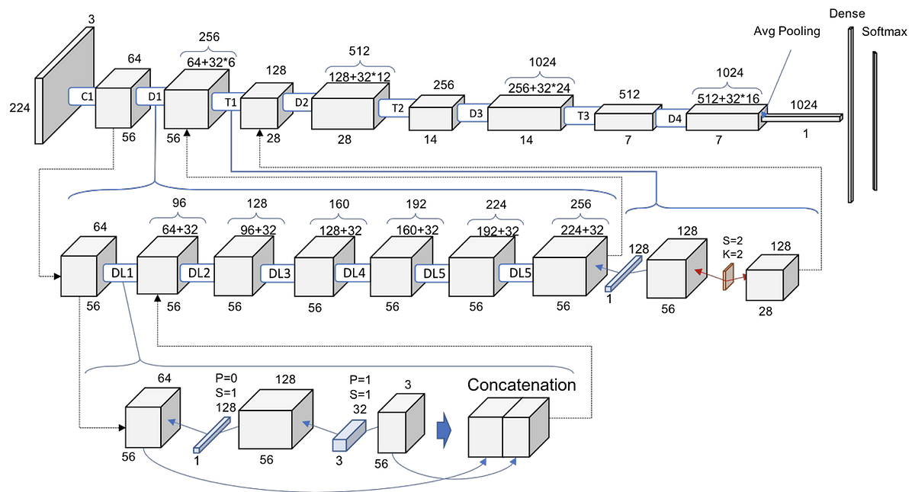
DenseNEt model
Dense Net Model
Feature Extraction and Pattern Recognition:
DenseNet excels in feature extraction from MRI data, surpassing traditional methods.
Non-Linearity and Complexity:
DenseNet effectively models and captures non-linear complexities within medical imaging data.
Adaptability and Generalization:
DenseNet demonstrates adaptability to diverse datasets, ensuring robustness in handling variations in MRI data.
Training on Annotated MRI Datasets:
Annotated MRI datasets are vital for training DenseNet models.

Slide 18
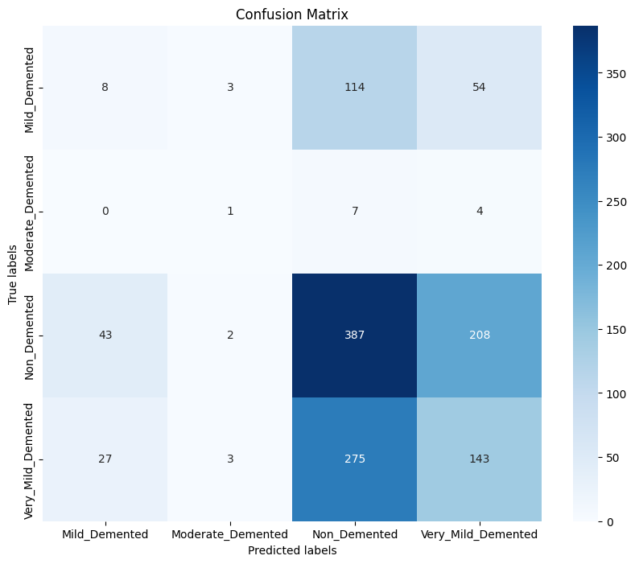
Confusion Matrix on running code

Slide 19
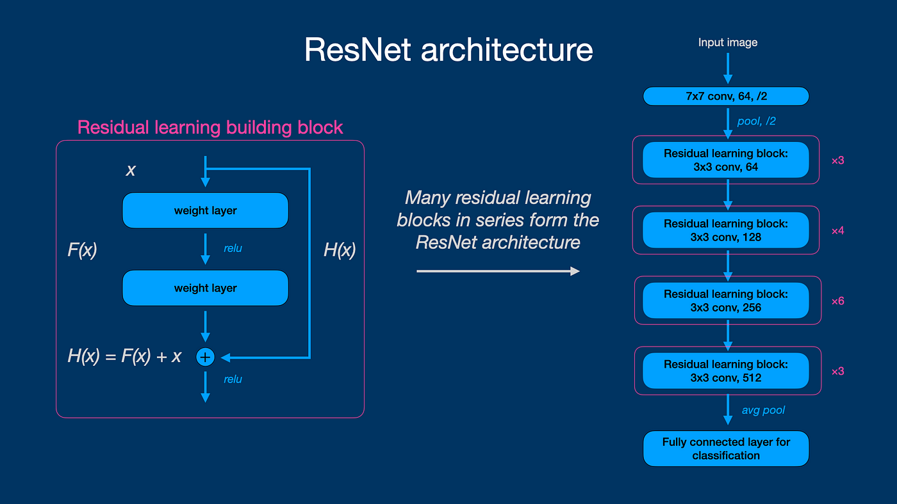
Resnet Model
ResNet Model
ResNet excels in feature extraction from MRI data, outperforming traditional methods.
ResNet effectively models and captures non-linear complexities within medical imaging data.
ResNet demonstrates adaptability to diverse datasets, ensuring robustness in handling variations in MRI data.
Case studies highlight ResNet's significant success in medical imaging tasks.
Using keras-tuner we are working to hypertune this model.

Slide 20
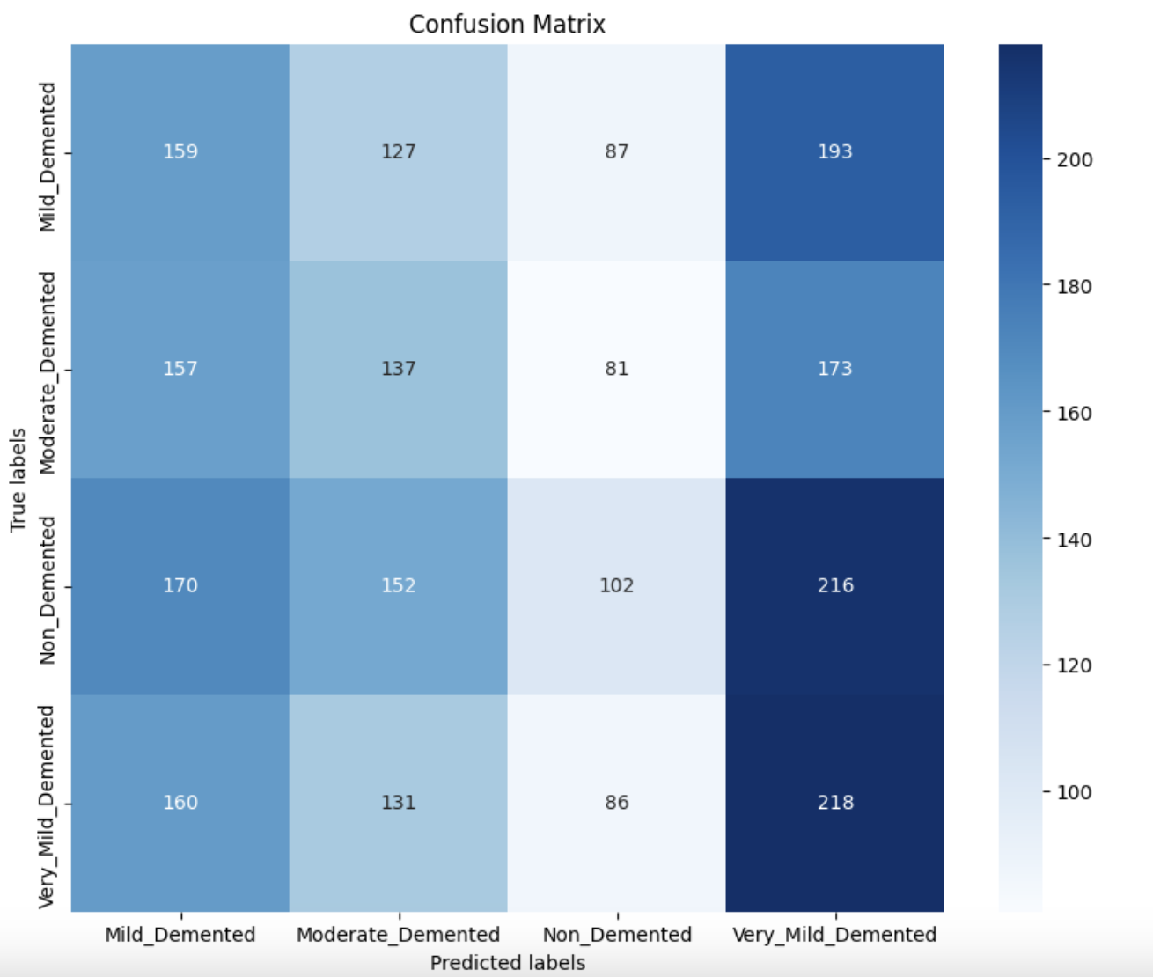
Result on running the model

Slide 21
Comparing models
Algorithms | Accuracy
CNN | 91%
ANN | 71%
KNN | 92%
SVM | 72%
Resnet | 77%
Densenet | 50%
After evaluating the models for accuracy and considering their respective running times, we have chosen the CNN model due to its efficient performance.

Slide 22
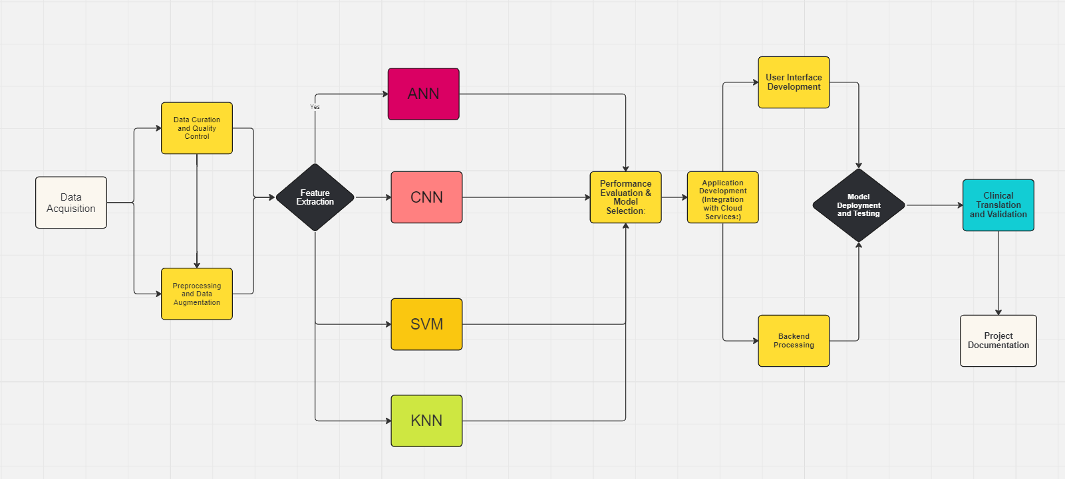
Project Architecture

Slide 23
Findings of the model
From the confusion matrix we can see that the Resnet model is decently predicting the classes, but sometimes it wrongly predicts other class. For eg. It does well on mild demented class, but it also misclassifies a lot of mild demented to be very mild demented.
Next steps will be to fine tune the model by experimenting with various layers and parameters and improve the accuracy of the model.

Slide 24
Power BI (Data Overview and Demographic Analysis)
Data Load and Cleaning:
We start by importing the MIRIAD dataset into Power BI using the "Get Data" option.
Together, we review and clean the data, addressing any missing or inconsistent values.
Demographic Analysis:
Collaboratively, we explore demographic data, creating visuals like bar charts to compare age, gender, and baseline MMSE scores for Alzheimer's and control groups.
Utilize scatter plots or box plots to examine the relationship between age and baseline MMSE scores.
Temporal and Scanning Timepoints Analysis:
Visualize changes in MMSE scores over time using line charts.
Analyze the distribution of scanning time points and completed scans at each interval.
Key Findings:
Summarize initial insights into demographic differences and temporal patterns.
Identify any notable trends or variations in the dataset.

Slide 25
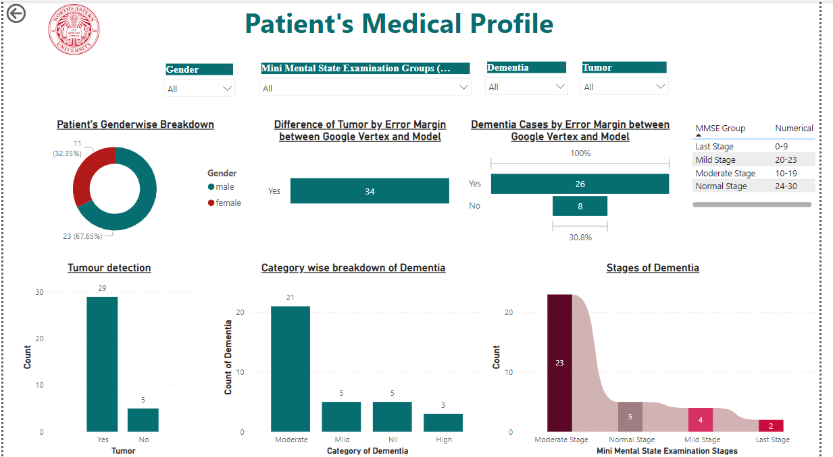
Dashboard
Created an interactive dashboard which shows us patient's medical profile based on MRI and Dementia levels and is in sync with the report.

Slide 26
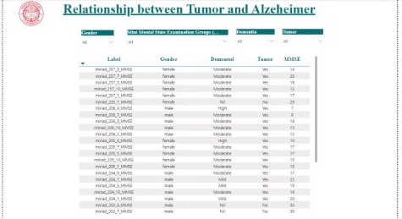
Dashboard (Cont)
Report

Slide 27
Advanced Analysis and Recommendations
Advanced Analytics (Optional):
As a group decision, explore more advanced analyses like regression or clustering to identify patterns within the data.
Reproducibility and MRI Scanner Analysis:
Investigate the reproducibility of back-to-back scans at different intervals.
Examine the impact of the MRI scanner on the data, identifying variations or trends.
Dashboard Creation:
Collaboratively organize visuals into a dashboard for a cohesive presentation.
Enhance interactivity with slicers, filters, or drill-through options.
Publish and Share:
Once satisfied with our analysis, publish the report to the Power BI service.
Share the report with stakeholders for collaborative exploration and decision-making.
Next Steps and Iteration:
Discuss potential next steps based on findings.
Emphasize the iterative nature of data exploration and analysis.
The comprehensive exploration of the MIRIAD dataset using Power BI empowers our research team with valuable insights into the demographics, temporal patterns, and technical aspects of the acquired MRI scans. This methodical analysis not only enhances our understanding of the baseline characteristics of Alzheimer's patients and the control group but also provides a nuanced view of cognitive changes over time.

Slide 28
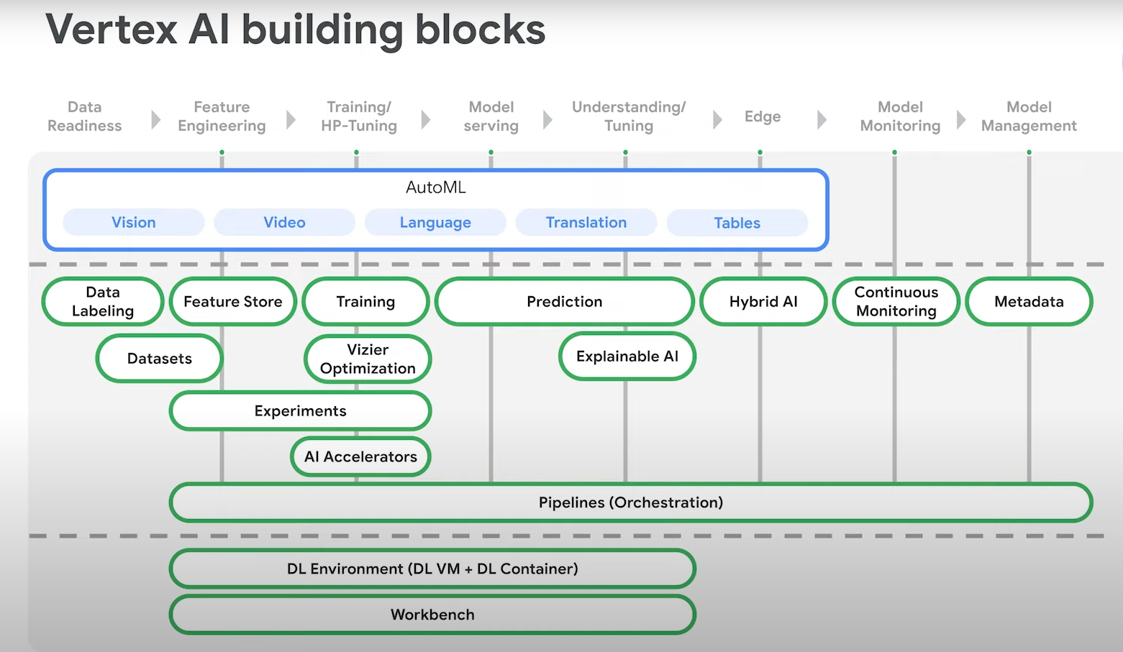
Google Vertex

Slide 29
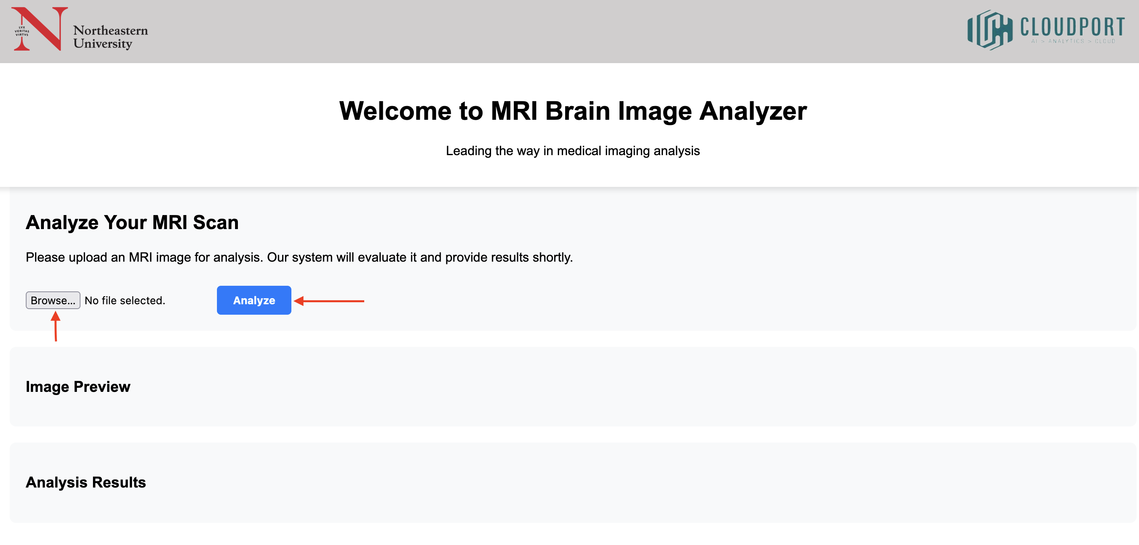
Flask Website
Click on Browse to upload an MRI Image and click on Analyze to run the prediction

Slide 30
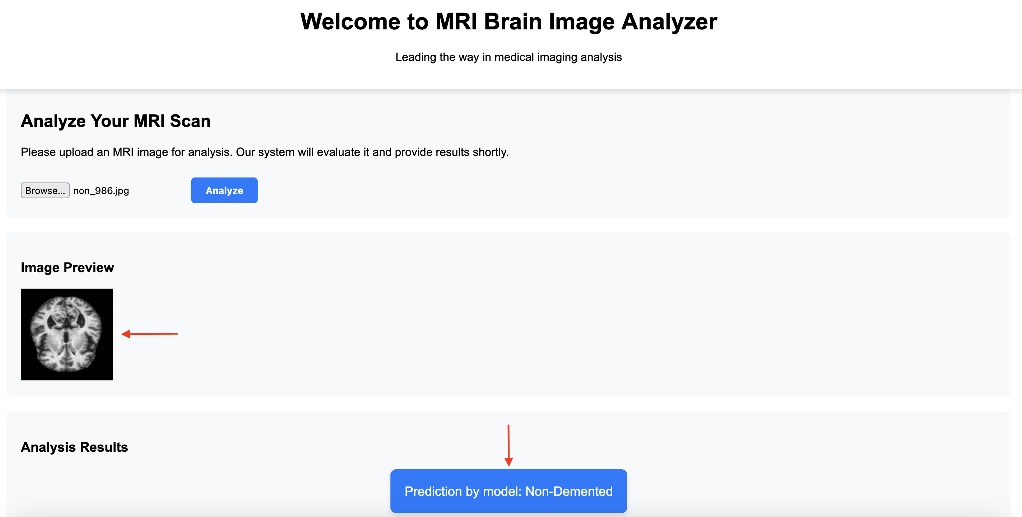
Flask Website
Once uploaded an Image preview is Shown and the prediction by the model is presented as shown in the above snapshot

Slide 31
Project Code Modularization & Data Integration Process
Objective:
Enhance code base manageability and scalability.
Streamline data processing and integration workflows.
Approach:
Modularization:
Break down code into smaller, reusable modules.
Each module serves as a specific function or task.
Facilitates easier maintenance and updates.
Refactor:
Restructure existing code for improved readability and efficiency.
Extract repeated code into functions or modules.
Optimize algorithms and improve code organization.
Rebase:
Integrate changes from feature branches into the main development branch.
Ensure smooth integration and resolve conflicts effectively.
Standardization:
Establish consistent coding conventions and practices.
Maintain uniformity in code formatting, naming conventions, and documentation.
Ensure consistency in data formats, processing workflows, and integration methods.
Benefits:
Improved code clarity, maintainability, and scalability.
Streamlined data processing pipelines and integration workflows.
Reduced errors and enhanced collaboration among team members.

Slide 32
Link to the Colab Notebook Code
https://colab.research.google.com/drive/1GNngMRKx9qZA7nker-6tWQXXeM846Y_e?usp=sharing

Slide 33
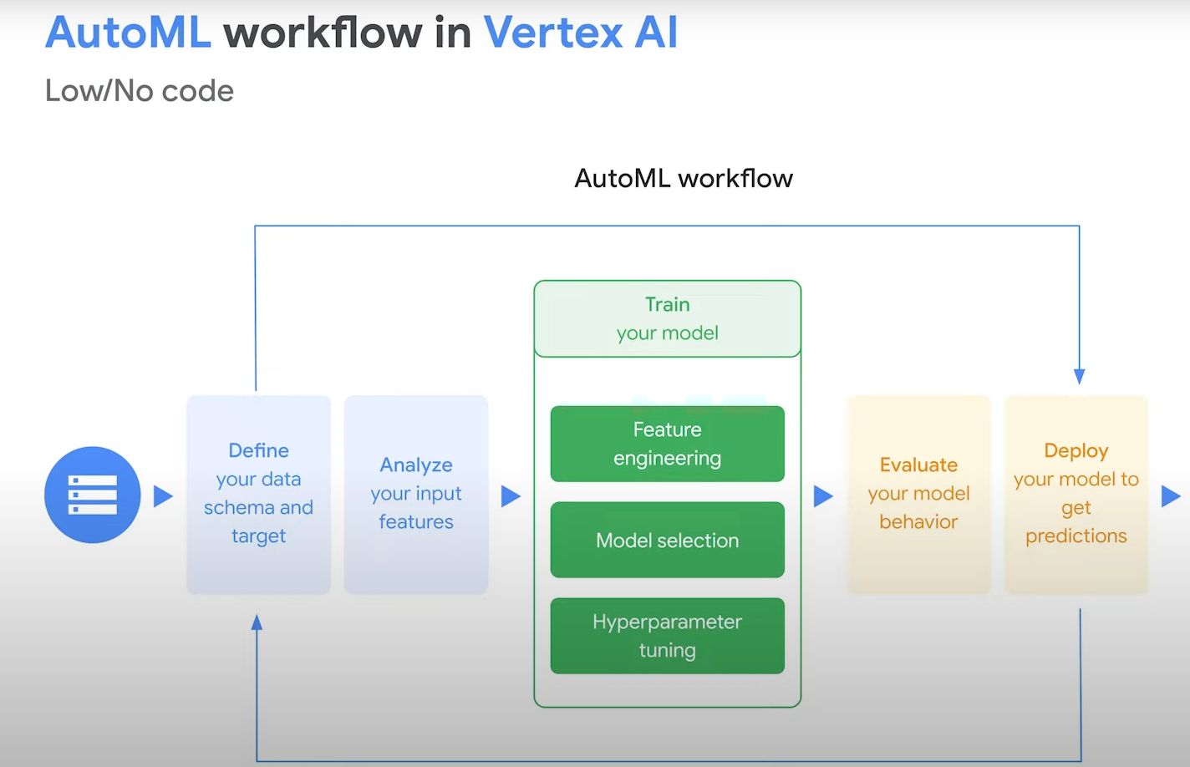
Vertex AI

Slide 34
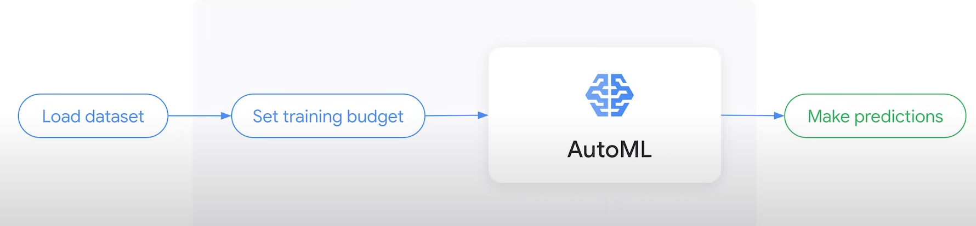
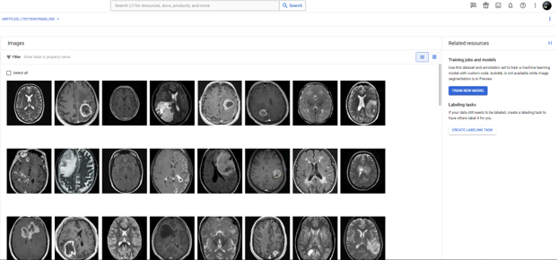
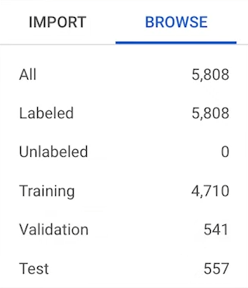

Slide 35
Planned Process for the models Deployment
Conduct thorough documentation of the entire model deployment process, including steps for hyperparameter tuning, model training, and deployment on GCP.
Ensure clear communication and coordination with the Sponsor to adhere to their instructions and requirements for deploying the models on GCP.
Organize the model code into easily manageable files and prepare them for deployment on GCP, following best practices for file structure and version control.
Utilize Flask to create virtual servers on GCP for hosting the deployed models, ensuring scalability and reliability.
Collaborate with teammates responsible for creating the HTML website with a user-friendly GUI for uploading MRI images and displaying prediction results.

Slide 36
Planned Process for the models Deployment (contd...)
Implement a dropdown menu feature on the website to enable users to select the desired model for running predictions on uploaded images, enhancing flexibility and usability.
Conduct rigorous testing of the deployed models and the website interface to identify and resolve any potential issues or bugs.
Prioritize security measures such as access control and data encryption to safeguard sensitive information and ensure compliance with privacy regulations.
Implement monitoring and logging mechanisms to track the performance and usage of the deployed models, facilitating ongoing optimization and troubleshooting efforts.
Provide comprehensive training and support documentation for end-users to effectively utilize the deployed system and troubleshoot common issues.

Slide 37
Project Outline
Our Model is based on ML algorithm of CNN to classify the Alzheimers and Brain Tumor clases based on MRI scan to detect the level of degenerated braincells
We used this technique to classify the level of brain cells and classify them for Alzheimers and Brain Tumor clases based on MRI scan
We will deliver it to Sheldon Lawrence as a POC on behalf of Cloudport Digital Inc.

Slide 38
Research Paper Outline
Developing a research paper detailing pretrained model for image classification
Training the model on Secondary dataset to test it out on real life MRI images.
Further fine tuning model based on feedback loop to improve overall model efficiency by benchmarking it against Google Vertex output for improvement
Developing a dashboard in Looker for highlight the business KPI's for Cloudport Digital Inc.

Slide 39
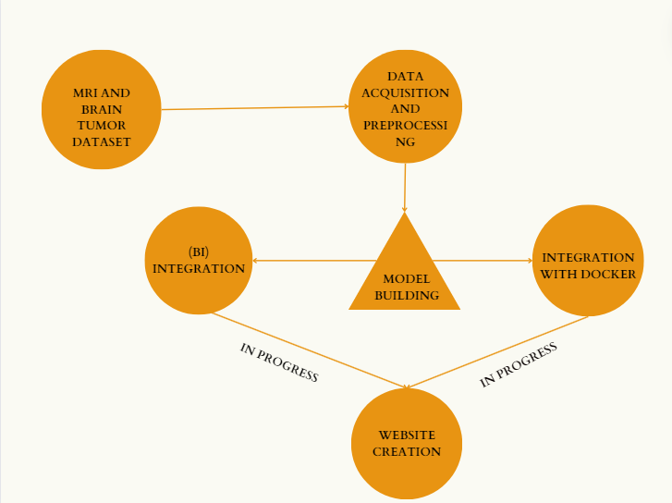
Project flow:
Colab file: https://colab.research.google.com/drive/1GNngMRKx9qZA7nker6tWQXXeM846Y_e?usp=sharing
Project timeline:
Project Timeline_Capstone_Group5.xlsx (sharepoint.com)

Slide 40
Future Recommendations:
1. Model Enhancement:
Continuously improve model accuracy.
Explore advanced ML algorithms.
Incorporate diverse datasets.
2. Collaborative Research:
Partner with medical research institutions.
Gain insights into biological mechanisms.
Inform model development and interpretation.
3. Longitudinal Studies:
Conduct studies to track changes over time.
Understand the progression of brain tumors and Alzheimer's.

Slide 41
References:
Book by Prof. Hema Seshadri: Analytics for Business Success: A Guide to Analytics Fitness
Rrohan.Arrora. (2019, Nov 11). ResNets, DenseNets & UNets. Retrieved from https://medium.com/swlh/resnets-densenets-unets-6bbdbcfdf010
Yehoshua, Dr. R. (2023,May 5). K-Nearest Neighbors (KNN): A Comprehensive Guide. Retrieved from https://medium.com/ai-made-simple/k-nearest-neighbors-knn-a-comprehensive-guide-7add717806ad
Chakraborty, K. (2019,Jun 28). A Complete Guide To Support Vector Machines(SVMs). Retrieved from https://medium.com/@kushaldps1996/a-complete-guide-to-support-vector-machines-svms-501e71aec19e

Slide 42
THANK YOU!

