Slide 1

Department of Computer Science & Engineering
National Institute of Technology Patna
Course Recommender System
Supervised By: Presented By:
Anil Kumar Dudyala Saurabh Kumar(1407014)
(Assistant Professor ) Prem Kumar(1407026)
CSE Department Brajesh Kumar(1407031)
Dileep Bhagat(1407034)

Slide 2
OUTLINE
MOTIVATION
RECOMMENDER SYSTEM
PROBLEM DEFINITION
PROPOSED MODEL
CONCEPTS INVOLVED
IMPLEMENTATION
OUTPUT SCREENS
REFERENCES

Slide 3
MOTIVATION
Problems arise during elective course selection:
Huge number of available courses.
Lack of awareness about the elective courses.
Taking decision become more confusing when different seniors/colleagues suggest different courses.
So, generally students select wrong courses.

Slide 4
RECOMMENDER SYSTEM
Recommender Systems are subclass of information filtering
systems.
These systems predict the rating or preference that user would
give to an item.
Systems recommending item (e.g. books, movies, web-pages,
newsgroups messages etc.) are examples of these systems.
Many websites uses recommender systems like- Amazon,
YouTube, Quora, StackOverflow etc.

Slide 5
RECOMMENDER SYSTEM(cont.)
What is Course Recommender System?
Recommends students to select relevant courses.
Uses advanced data analysis technique to predict courses.
Predicts a list of top recommendations for a particular student.
There are two basic approaches for recommending:
1. Collaborative Filtering
2. Content-based

Slide 6
PROBLEM DEFINITION
“ Build a student course recommender system which help
students to choose elective courses based on past history
of students and measure the performance of predicted result
with actual result.”

Slide 7
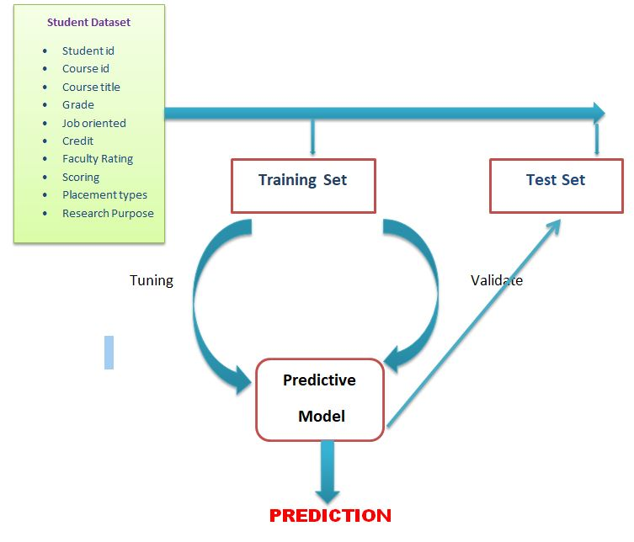
PROPOSED MODEL

Slide 8
CONCEPT INVOLVED
We use collaborative filtering nearest neighbour approach.
Collaborative filtering algorithm considers “user behaviour” for
recommending items.
It exploit behaviour of other users and items in terms of
judgment data(i.e. ratings) which can be explicitly or implicitly
obtained.
There are two types of collaborative filtering:
1. User-Based Collaborative Filtering
2. Item-Based Collaborative Filtering

Slide 9

CONCEPT INVOLVED(cont.)
User-Based Collaborative Filtering
Similarity between the test user and train user is calculated using the
Pearson correlation coefficient. Let the set of items rated by both users
u and v be denoted by I, then similarity coefficient between them is:

Slide 10
CONCEPT INVOLVED(cont.)
User-Based Collaborative Filtering(cont.)
Based upon the value of Pearson's coefficient k-users are selected
whose Pearson’s coefficient value are high.
At last, the predicted ratings of the new user will be mean of the
ratings given by top-k users.

Slide 11
CONCEPT INVOLVED(cont.)
PYTHON-CGI PROGRAMMING
The Common Gateway Interface, or CGI, is set of standards that define how information is exchanged between the web server and the a custom script.
What is CGI?
The Common Gateway Interface, or CGI, is a standard for external
gateway programs to interface with information servers such as HTTP.
The current version is CGI/1.1 and CGI/1.2 is under progress.

Slide 12
CONCEPT INVOLVED(cont.)
PYTHON-CGI PROGRAMMING(cont.)
Web Server Support and Configuration:-
All the CGI programs to be executed by the HTTP server are kept in a
pre-configured directory.
This directory is known as CGI directory and by convention it is named
as /var/www/cgi-bin.
By convention, CGI files have extension as .cgi, but we can keep our
files with python extension .py as well.

Slide 13
CONCEPT INVOLVED(cont.)
PYTHON-CGI PROGRAMMING(cont.)
By default, Linux server is configured to run only the scripts in the
cgi-bin directory in /var/www.
But we can specify any other directory to run out .py files by writing
below code in httpd.conf file like-
<Directory "/var/www/html/cgi-enabled/index.py">
AllowOverride None
Options ExecCGI
Order allow,deny
Allow from all
</Directory>
<Directory "/var/www/html/cgi-enabled/index.py">
Options All
</Directory>

Slide 14
IMPLEMENTATION
We have two data sets. First data set contains previous history of users
on various feature vectors
Feature vectors of 1st data set are-
[Faculty_rating,Job_oriented,Grade,Scoring,Placement_types,
Research_purpose]
Second data set contains the elective courses taken by the old students
On the basis of 2nd data set we recommend elective courses for new
students

Slide 15
IMPLEMENTATION(cont.)
PROCEDURE:-
First of all, we find the correlation value on each features vectors
present in 1st data set
Then we take the mean of correlation values on features vectors and
sort the data frame according to that (in decreasing order)
We take top-3 student_id whose correlation values are higher
Then we extract data from 2nd data set and recommend the elective
courses taken by those students that correlation values are higher

Slide 16
IMPLEMENTATION(cont.)
PROCEDURE:-
We use Apache2 Web Server to provide web support to python
programme present in CGI directory.
We put python programme in /var/www/html/cgi-enabled/ directory
The homepage of Apache2 server which is /var/www/html/
index.html is linked to CGI directory
When the user click ‘login’ in homepage of Apache2 , it will redirect to
backend python programme ,execute the programme and show
the output.

Slide 17
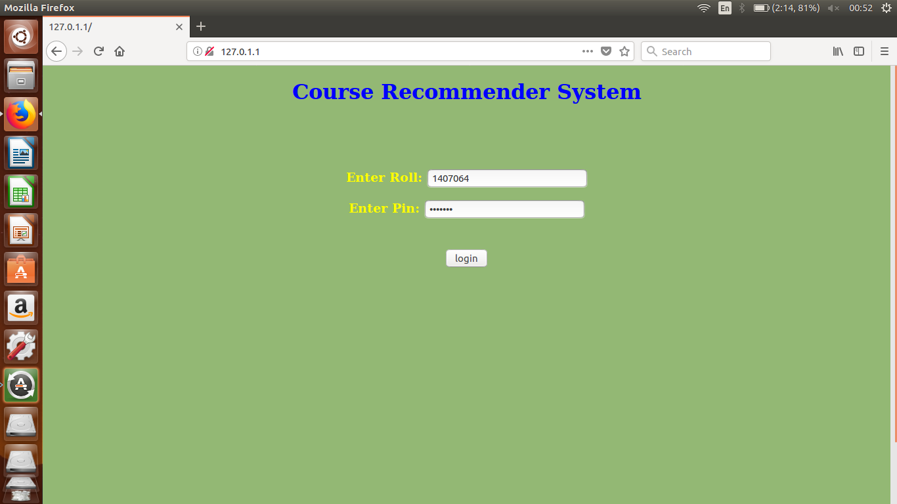
OUTPUT SCREENS

Slide 18
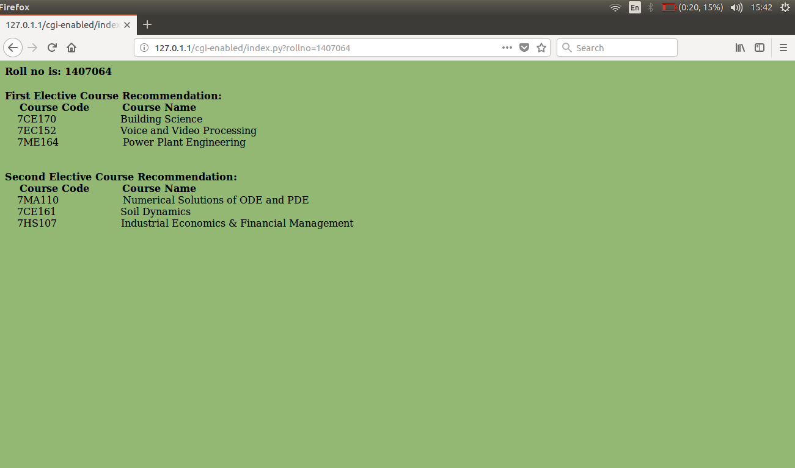
OUTPUT SCREENS(cont.)

Slide 19
FUTURE WORK
Data sets to be extend to predict elective courses for students of any
college
Adding the functionality to predict exact grade in any subject of a
particular student
Using recommender system approaches to predict performance in a
particular student
To provide valuable advice to students during career guidelines
advice

Slide 20
REFERENCES
[1] Linden, G., Smith, B., York, J.: Amazon.com Recommendations: Item-to-Item Collaborative Filtering. In:
IEEE Internet Computing, Volume 7, Issue 1, pp.76-80
[2] Breese, J., Heckerman, D. Kadie, C: Empirical Analysis of predictive Algorithms for collaborative filtering
[3] Ekdahl M, Lindstrom S, Svensson C: A student course recommender. Master of Science Programme
Thesis, Lulea University of Technology
[4] Sandvig J, Burke R : AACORN: A CBR Recommender for Academic Advising. Technical Report TR05-
015, Depaul University, Chicago, USA
[5] Farzan R, Brusilovsky P: Social Navigation support in a Course Recommendation System.
[6] Bendakir N and Aimeur E: Using Association Rules for Course Recommendation
[7] Shivam Bansal ,Understanding Basics of Recommender Systems with case study, Analytics Vidhya.
[8] Shuvayan Das, Beginners Guide to learn about collaborative filtering based Recommender System,
Analytics Vidhya
[9] Jose Portilla: Python for Data Science and Machine Learning Boot camp, Department of Mechanical
Engineering, Santa Clara University

