Slide 1

Zero Effort Spring: An intro to Spring Boot

Slide 2
Agenda
Goal: Introduce developers to Spring Boot, an opinionated way to rapidly build production grade Spring applications quickly and with minimal fuss.
Introduction to Spring Boot
Where it fits in the Spring eco system
Goals, high level features, etc.
Demo: Quick Start
Behind the scenes
More demos, more Boot
End bits (links and such)
ToDo: Adding new features to Boot

Slide 3
Spring vs JEE … ready … FIGHT!
NOT going there! :-)

Slide 4

Spring 4.0 Highlights
Java/EE
Java 8
JSR-310 Date/Time API
JSR-236 Concurrency Utils
JSR-356 WebSocket
Servlet 3.1
Bean Validation 1.1
JPA 2.1
JTA 1.2
JMS 2.0
Spring iO
(Large feature set, and getting larger)

Slide 5



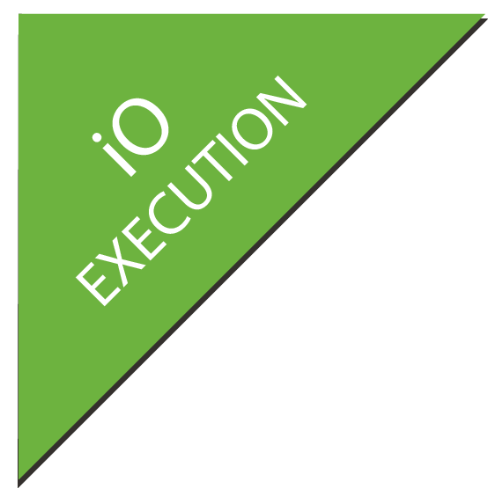















Big Spring Diagram with Boot
XD
BOOT
GRAILS
Stream, Taps, Jobs
Bootable, Minimal, Ops-Ready
Full-stack, Web
INTEGRATION
BATCH
BIG DATA
WEB
Channels, Adapters, Filters, Transformers
Jobs, Steps, Readers, Writers
Ingestion, Export, Orchestration, Hadoop
Controllers, REST, WebSocket
DATA
RELATIONAL
NON-RELATIONAL
CORE
FRAMEWORK
SECURITY
GROOVY
REACTOR

Slide 6
Spring Boot
Intro

Slide 7
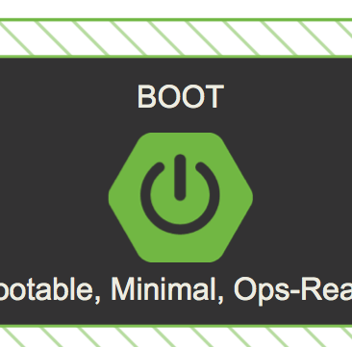
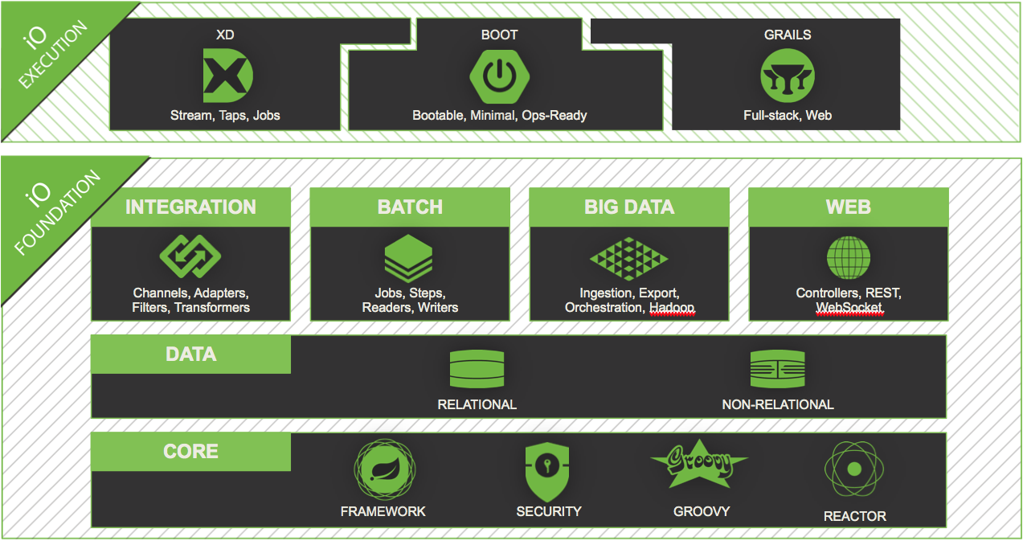
Introduction to Spring Boot
A tool for getting started very quickly with Spring applications
Focuses attention at a single point
Control a large collection of spring-* projects
Common non-functional requirements for “real world” applications
Exposes a lot of useful features by default
Gets out of the way quickly when you need it to
v0.5.0.Mx

Slide 8
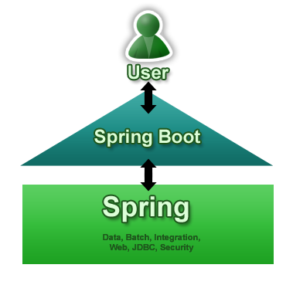
Goals
Provide a radically faster and widely accessible getting started experience
Be opinionated out of the box, but get out of the way quickly as requirements start to diverge from the defaults
Provide a range of non-functional features that are common to large classes of projects (e.g. embedded servers, security, metrics, health checks, externalized configuration)
Absolutely no code generation and no requirement for XML configuration
V0.5.0M4
(Question: What about Roo?)

Slide 9
Getting Started REALLY Quickly
@Controller
class ThisWillActuallyRun
{
@RequestMapping("/")
@ResponseBody
String home() { return "Hello World!" }
}

Slide 10
Demo
Quick Start

Slide 11
What Just Happened?
SpringApplication: convenient way to write a main() method that loads a Spring context
@EnableAutoConfiguration: optional annotation that adds stuff to your context, including...
EmbeddedServletContainerFactory: added to your context if a server is available on the classpath
CommandLineRunner: a hook to run application-specific code after the context is created
JarLauncher was added to the JAR file
It’s beginning to look a lot like Java …

Slide 12
Demo
Doing it in Java

Slide 13
Spring Boot Modules
Spring Boot - main library supporting the other parts of Spring Boot
Spring Boot Autoconfigure - single @EnableAutoConfiguration annotation creates a whole Spring context
Spring Boot Starters - a set of convenient dependency descriptors that you can include in your application.
Spring Boot CLI - compiles and runs Groovy source as a Spring application
Spring Boot Actuator - common non-functional features that make an app instantly deployable and supportable in production
Spring Boot Tools - for building and executing self-contained JAR and WAR archives
Spring Boot Samples - a wide range of sample apps

Slide 14


Spring Boot Modules
CLI
Starters
Autoconfigure
Boot
Actuator
Tools
Samples

Slide 15
Binding to Command Line Arguments
SpringApplication binds its own bean properties to command line arguments, and then adds them to the Spring Environment, e.g.
$ java -jar target/*.jar --server.port=9000
Externalize Config
Just put application.properties in your classpath, e.g.
application.properties
server.port: 9000
Use YAML (if you must)
Just put application.yml in your classpath
Both properties and YAML add entries with period-separated paths to the Spring Environment.

Slide 16
Demo
Change the app behavior by changing parameters

Slide 17
Currently Available Auto-configured Behavior
Embedded servlet container (Tomcat or Jetty) DataSource and JdbcTemplate JPA Spring Data JPA (scan for repositories) Thymeleaf
Batch processing Reactor for events and async processing Actuator features (Security, Audit, Metrics, Trace)

Slide 18
The Actuator
Adds common non-functional features to your application and exposes MVC endpoints to interact with them.
Security Secure endpoints: /metrics, /health, /trace, /dump,
/shutdown, /beans Audit /info
If embedded in a web app or web service can use the same port or a different one (and a different network interface).

Slide 19
Other
Security
Use Actuator
Can also use Spring Security
Logging
Spring Boot provides default configuration files for 3 common logging frameworks: logback, log4j and java.util.logging
Starters (and Samples) use logback External configuration and classpath influence runtime behaviour LoggingApplicationContextInitializer sets it all up

Slide 20
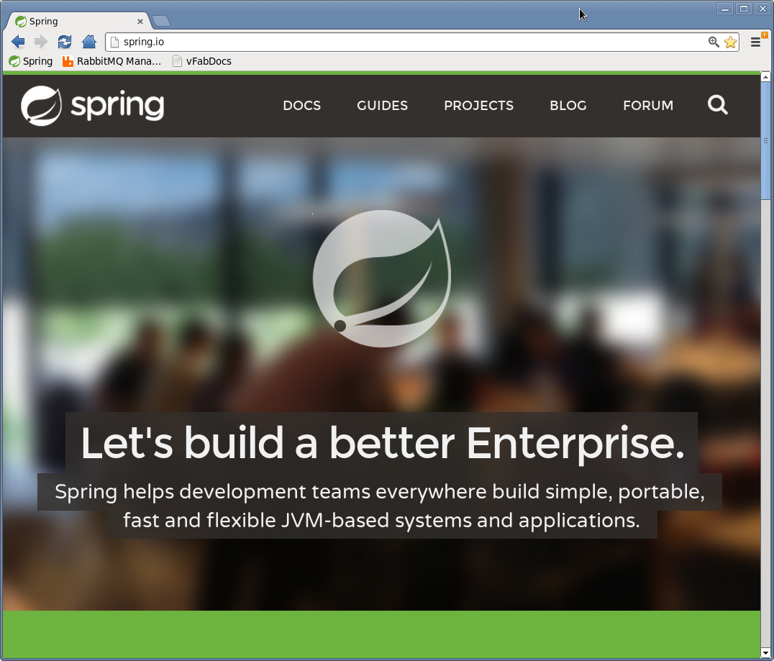
Does Anybody Use This For Real?
We do
Spring Boot app
Thymeleaf UI
Hosted on Cloud Foundry

Slide 21
Links
Spring
https://projects.spring.io/spring-boot
https://github.com/spring-projects/spring-boot (on Github)
http://spring.io/blog/2013/09/20/contributing-to-spring-boot-with-a-pull-request
Random Boot Blogs
http://fbflex.wordpress.com/2013/10/01/a-spring-boot-generator-for-yeoman

Slide 22
Agenda #1
Features & Benefits
Core problem with Spring Framework
Solution with Spring Framework
Solution with Spring Boot and diff with Spring Framework
Spring Boot Auto Configuration
Spring Boot Starter
Spring Boot Starter Projects and configuration
Dependency for Spring Boot Starter Web

Slide 23
Learning
Features & Benefits
Spring Boot Auto Configuration
Spring Boot Starter
Spring Boot Starter Projects and configuration
Dependency for Spring Boot Starter Web

Slide 24
Agenda #2
Spring Boot Features
Spring Maven Project
SB Project Wizard
Spring Initializer – web portal
Spring Boot CLI - works with Groovy – not in scope

Slide 25
Learning
Features & Benefits
Setup Spring Maven Project
How to use SB Project Wizard
How to use Spring Initializer

Slide 26
Agenda #3
Spring Boot Features
Spring Boot + Maven Integration
Common Annotations Use
Run Spring Boot app from cmd/bash
mvn spring-boot:run
5. Event listener
6. Spring Boot – How to Change Default Tomcat Server Port
7. Spring Boot – How to Change Default Context Path

Slide 27
Learning
Features & Benefits
Spring Boot + Maven Integration
Common Annotations Uses
Change Default Tomcat Server Port
Change Default Context Path
Run Spring Boot app from cmd/bash
Event listener

Slide 28
Agenda #4
Spring Boot Features
Spring Boot DM
Spring Boot Properties
Spring Boot Starters - web
Spring Boot Actuator

Slide 29
Learning
Features & Benefits
How SB handles Dependencies
Different Properties
Spring Boot available Starters
Spring Boot available Actuator

Slide 30
Agenda #5
Spring Boot Features
Runners
Logging
Exception Handling

Slide 31
Learning
Features & Benefits
Command Line Runners
Logging
Exception Handling

Slide 32
Agenda #7
Spring Boot Features
Eureka server

Slide 33
Learning
Features & Benefits
Eureka server

Slide 34
Agenda #9
Spring Boot Features
Spring Boot – Creating a RESTful Web Service Example
Spring Boot – Common Application Properties (application.properties)
RESTful Web Service with POST Request in JSON Example
Display All Beans Available in ApplicationContext
End to End application
Testing using Postman

Slide 35
Learning
Features & Benefits
Creating a RESTful Web Service Example
Common Application Properties (application.properties)
RESTful Web Service with POST Request in JSON Example
Display All Beans Available in ApplicationContext
End to End application
Testing using Postman

Slide 36
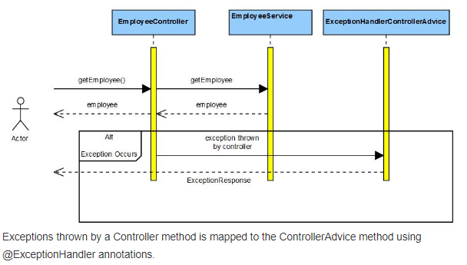
Exception Handling

Slide 37
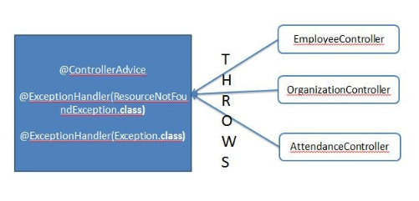
Exception Handling

Slide 38
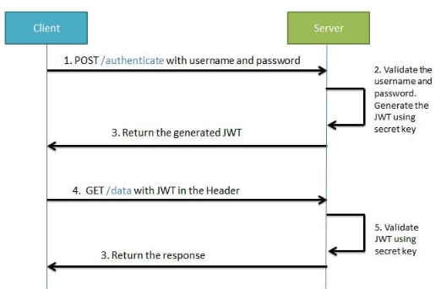
Spring Boot Security- JWT
JWT workflow:-

Slide 39
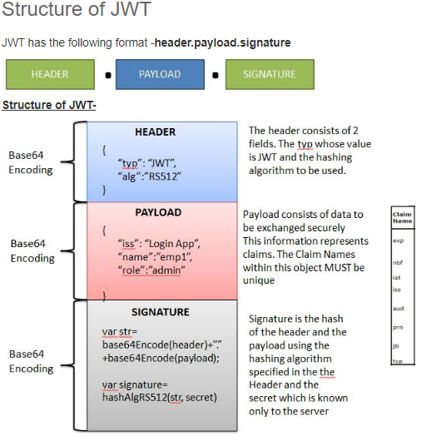
Spring Boot Security- JWT

Slide 40
Spring Boot Security- JWT
Creating a JWT Token - http://jwtbuilder.jamiekurtz.com/
Inspect the contents of the created token –
https://jwt.io/
Bcrypt-Generator.com - Online Bcrypt Hash Generator & Checker –
https://bcrypt-generator.com/

Slide 41
Thanks!

Slide 42
Learn More. Stay Connected.
Download now:
springsource.org/spring-tool-suite-download (eclipse plugin)
springsource.org/download/community (zip)
springsource.org/spring-framework#maven (maven)
Monthly Newsletter: springsource.org/news-events
Twitter: twitter.com/springsource
YouTube: youtube.com/user/SpringSourceDev
RSS Feed: feeds.feedburner.com/springsource/OEVE
LinkedIn: springsource.org/linkedin

