Slide 1
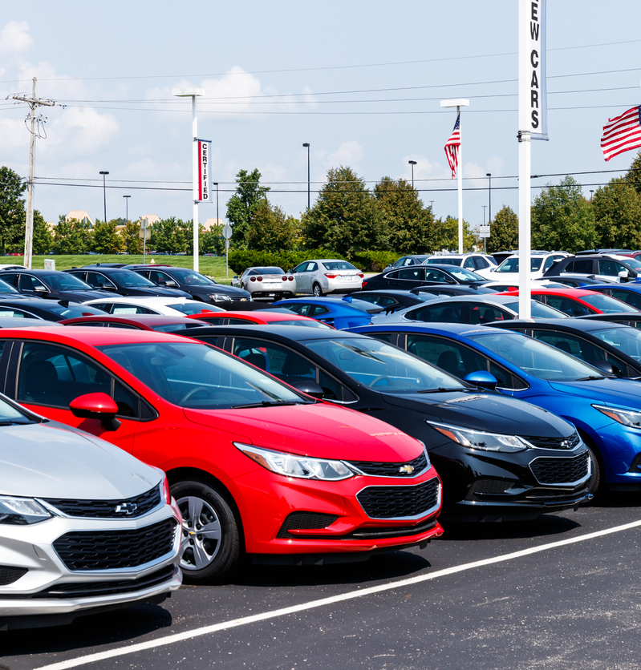

Used Car Sales Information
GROUP NAME – BUTTOWSKI
Team Members- Saurabh Kumar
Lohith Sreekakulam
Mohsin Nazir
Manasa B. M

Slide 2
Table of Content:
1- Analysis of Data
2 – Loading and Querying Data
3 – Flask Application
4 – Deployment for public Access
5 – Data Visualization for Business Requirements

Slide 3

1- Analysis of Data
It Includes:-
Removal of duplicates, Handling missing values (e.g., imputation, removal), Standardize formats (e.g., date formats, string case), Correction of inconsistent data entries.
Processing the data till 3NF Normalization to create an Entity Relationship Model (E-R).
To access unified details from multiple datasets, consolidate the information into a single cohesive dataset or query across disparate sources using appropriate data integration techniques.

Slide 4
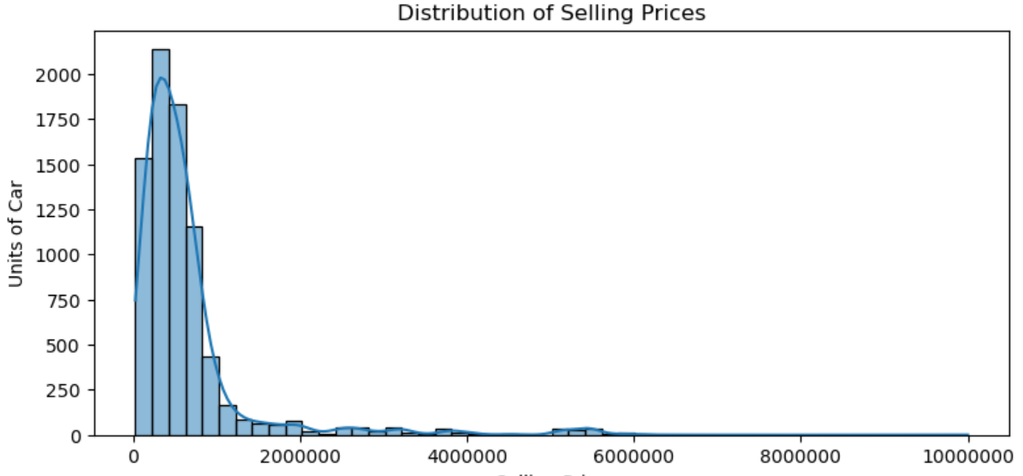
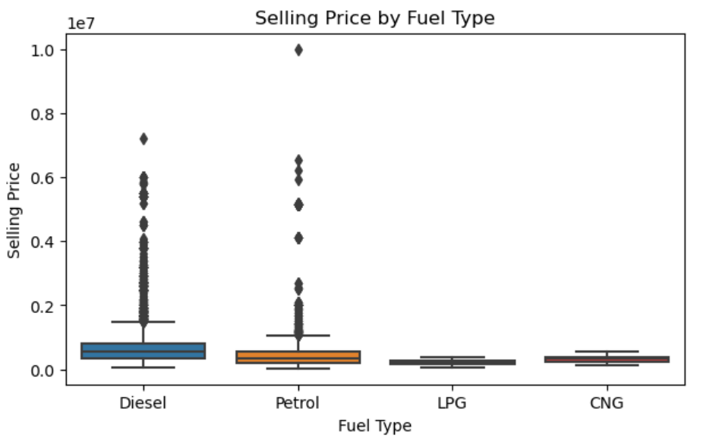

Slide 5
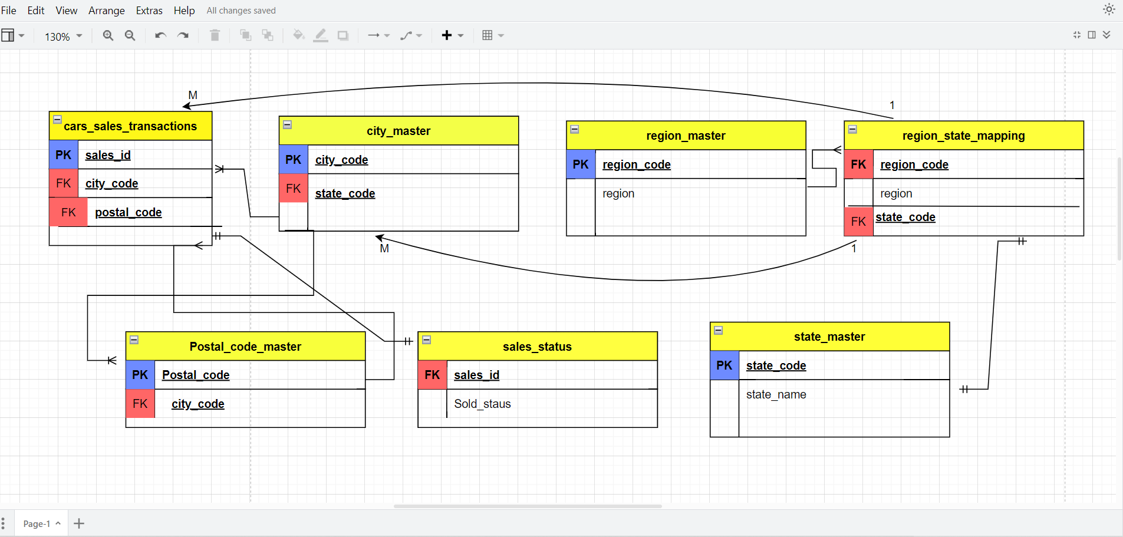
Entity Relation Diagram:-

Slide 6
2- Loading and Querying Data
Loading the data in the database
Querying through SQL to get the general business answers.

Slide 7
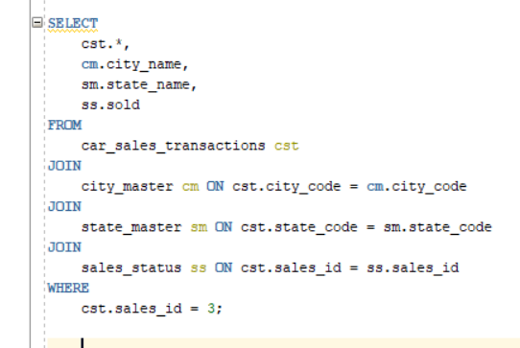
Querying the data
Query
Result

Slide 8

3- Flask Application
Why is it required?
Providing solution for non – technical professional. So that they have an interface to connect with the data and perform necessary task.

Slide 9
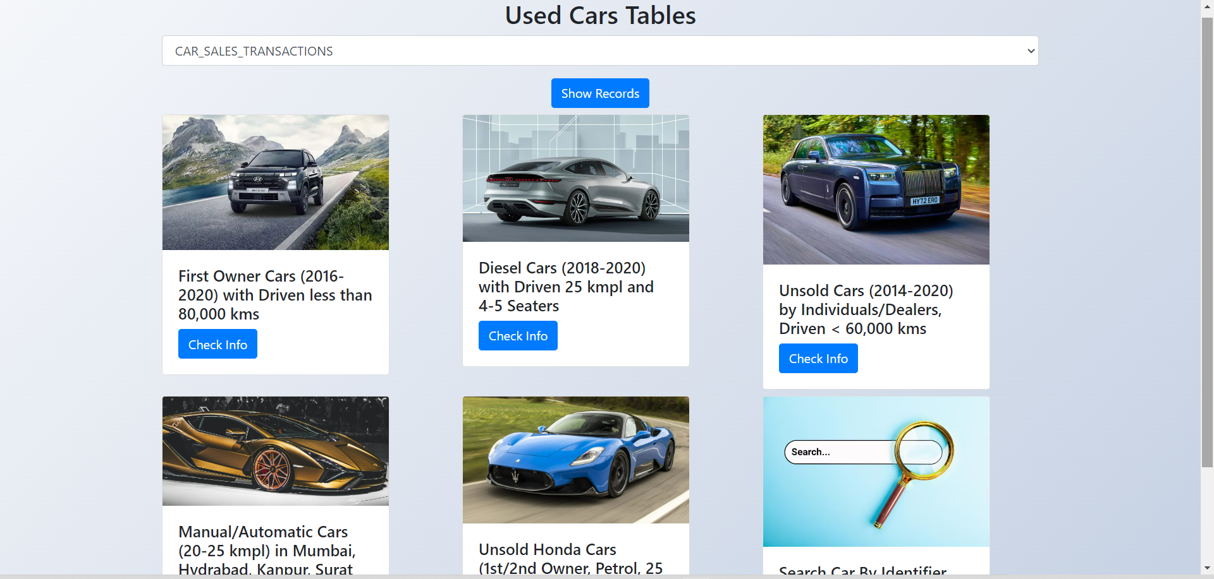
Simple interface to interact

Slide 10
4- Deployment for Public Access
Why deployment needed?
-- It is not limited to access by only one individual and the data should be accessible to many requests at a time.

Slide 11

Steps involved:-
Setting up the IAM Account
Create EC-2 Instance
Uploading Data in S3
Creating the Flask app
Connecting Flask app to S3
Deployment (Public Access)

Slide 12

5- Data Visualization for Business Requirements
Why we need visual statics of data?
-- Data visualization allows us to identify patterns, trends, and outliers, making it easier to gain insights and make informed decisions for business improvement.

Slide 13
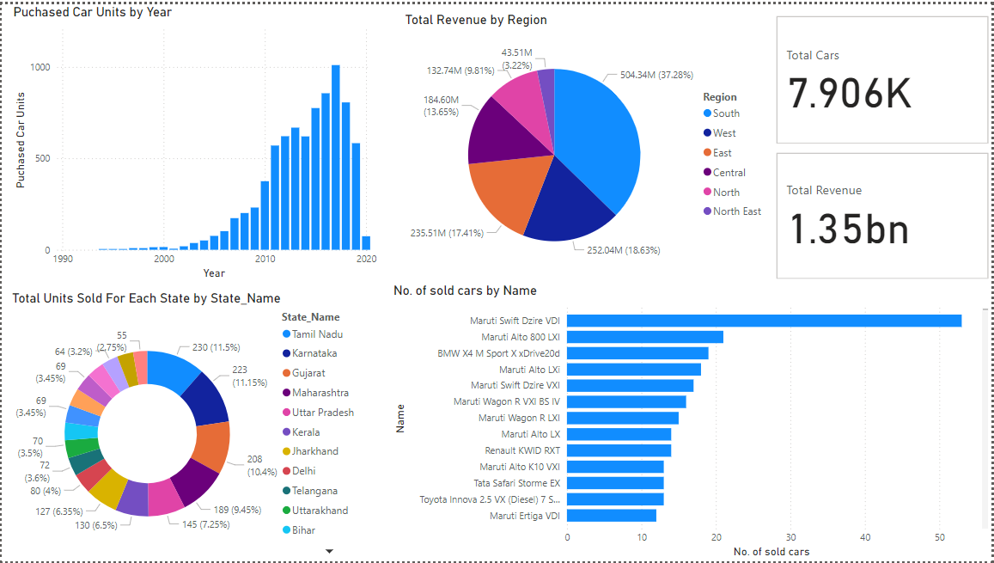
Visual data to get insights of business

Slide 14
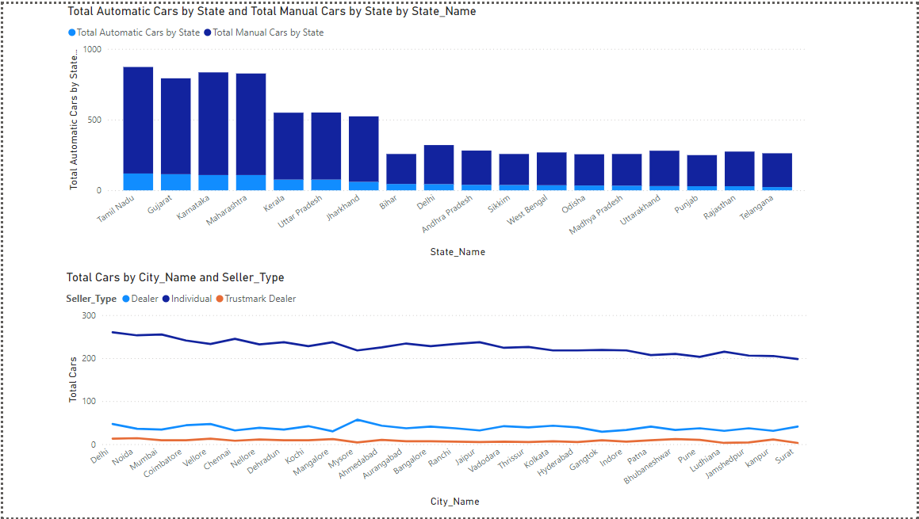

Slide 15
Suggested Business Improvements
Use sales data to target specific demographics with personalized ads.
We can include CNG And EV vehicles to increase the sales.
Take feedback from the customers to identify for what reason specific areas sales is affected.

Slide 16

THANK YOU!!
Car Sales Info

