Slide 1
Data Science visualization

Slide 2
I. What is the purpose of visualization? Ii. Types of visualization iii. Visualization tools
agenda

Slide 3
i. What is the purpose of visualization?
Data science

Slide 4
I. What is the purpose of visualization?
Exploration
Get an idea of what your data looks like
Is it spread out or clustered around a few points?
Observation
Understand relationships in your data
Do certain variables tend to “move” together?
Communication
Show your results to others

Slide 5
Ii. Types of visualization
Data science

Slide 6
Ii. Types of visualization
Bar plots
Histograms
Box plots
Scatter plots
Scatter matrix

Slide 7
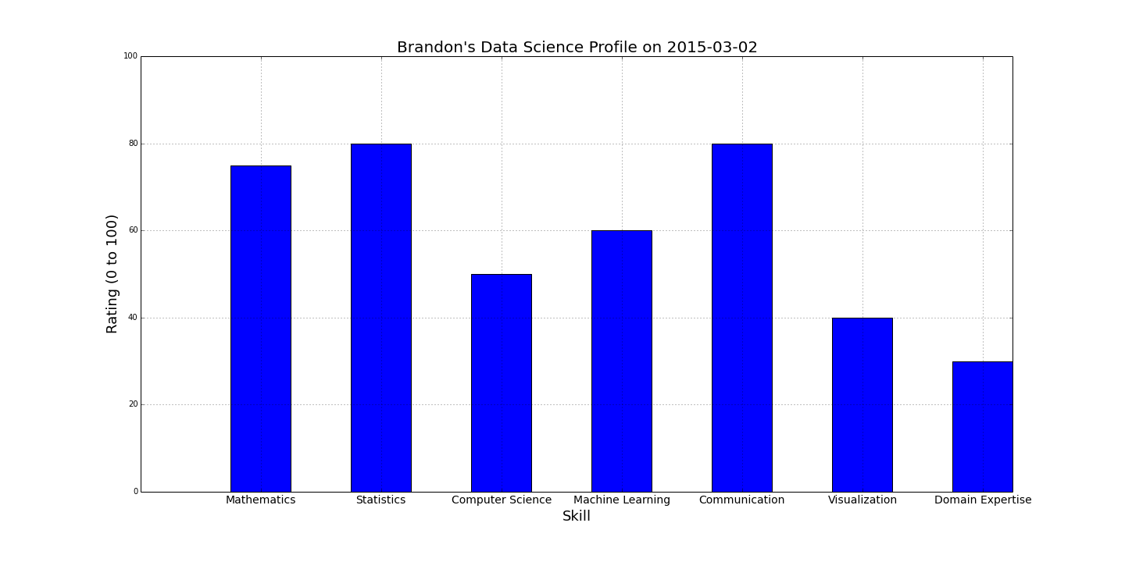
Ii. Types of visualization: Bar plots
Purpose: Show a comparison across different categories or variable values

Slide 8
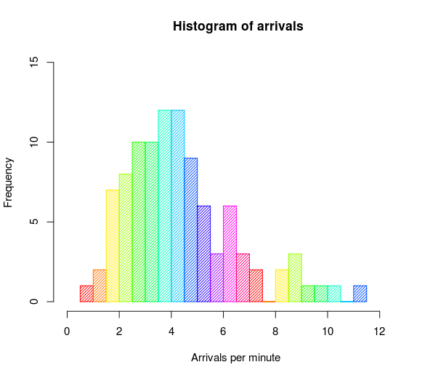
Ii. Types of visualization: Histograms
Purpose: Shows the “distribution” of a numerical variable

Slide 9
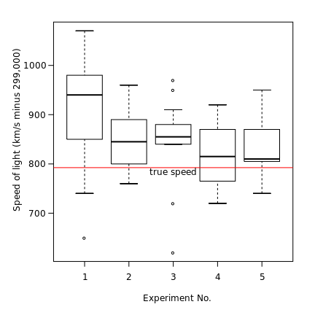
Ii. Types of visualization: Box plots
Purpose: Shows a numerical variable’s quartiles; gives a summary of the variable

Slide 10
Ii. Types of visualization: Scatter plots
Purpose: Shows the “relationship” between two numerical variables; how does one move with the other?

Slide 11
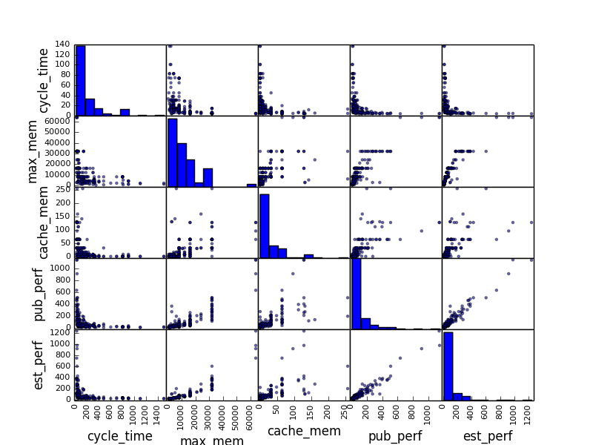
Ii. Types of visualization: Scatter matrix
Purpose: Shows the “relationships” between all numerical variables

Slide 12
iii. Visualization tools
Data science

Slide 13
iii. Visualization tools
Pandas/matplotlib plotting
Seaborn (Python library)
Bokeh (Python library)
GG Plot (ported from R)
Tableau
D3 (JavaScript library)

