Slide 1
Data Science Clustering

Slide 2
I. Unsupervised Learning II. Cluster analysis III. The K-Means Algorithm IV. Choosing K V. Example
agenda

Slide 3
I. Unsupervised Learning
DATA SCIENCE

Slide 4
Supervised Vs. Unsupervised Learning
Supervised learning has clear objectives:
Accurately predict unseen test cases
Understand which features affect the response, and how
You can evaluate how well you are doing!
Unsupervised learning has fuzzy objectives:
Find groups of observations that behave similarly
Find features that behave similarly
It’s difficult to evaluate how well you are doing!

Slide 5
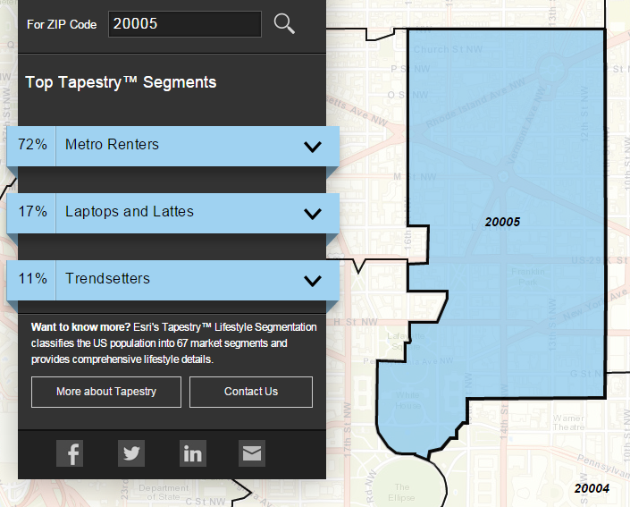
Clustering Example
Classify US residential neighborhoods into 67 unique segments based on demographic and socioeconomic characteristics
Metro Renters:
Young, mobile, educated, or still in school, we live alone or with a roommate in rented apartments or condos in the center of the city. Long hours and hard work don’t deter us; we’re willing to take risks to get to the top of our professions… We buy groceries at Whole Foods and Trader Joe’s and shop for clothes at Banana Republic, Nordstrom, and Gap. We practice yoga, go skiing, and attend Pilates sessions.
Source: http://www.esri.com/landing-pages/tapestry/

Slide 6
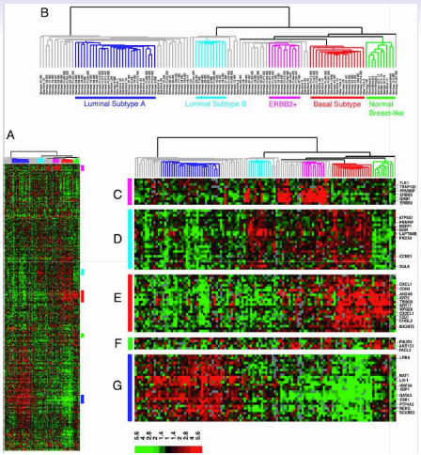
Clustering Example
Classify a tissue sample into one of several cancer classes, based on gene expression data
Each column is a woman with breast cancer (n=88)
Each row is a gene (p=8000)
Color represents level of gene expression
Goal: Locate subcategories of breast cancer showing different gene expressions
Technique: Hierarchical clustering applied to the columns, resulting in six sub-groups of patients
Source: https://class.stanford.edu/c4x/HumanitiesScience/StatLearning/asset/introduction.pdf

Slide 7
II. cluster analysis
DATA SCIENCE

Slide 8
Cluster analysis
Q: What is a cluster?

Slide 9
Cluster analysis
Q: What is a cluster?
A: A group of similar data points.
Notes:
Similar is a loaded word here!

Slide 10
Cluster analysis
Q: What is a cluster?
A: A group of similar data points.
The concept of similarity is central to the definition of a cluster, and therefore to cluster analysis.
Notes:
We will tighten up the concept of similarity when we discuss implementation.

Slide 11
Cluster analysis
Q: What is a cluster?
A: A group of similar data points.
The concept of similarity is central to the definition of a cluster, and therefore to cluster analysis.
In general, greater similarity between points leads to better clustering.

Slide 12
Cluster analysis
Q: What is the purpose of cluster analysis?

Slide 13
Cluster analysis
Q: What is the purpose of cluster analysis?
A: To enhance our understanding of a dataset by dividing the data into groups.

Slide 14
Cluster analysis
Q: What is the purpose of cluster analysis?
A: To enhance our understanding of a dataset by dividing the data into groups.
Clustering provides a layer of abstraction from individual data points.
Notes:
Useful for understanding, inference, platform for further analysis

Slide 15
Cluster analysis
Q: What is the purpose of cluster analysis?
A: To enhance our understanding of a dataset by dividing the data into groups.
Clustering provides a layer of abstraction from individual data points.
The goal is to extract and enhance the natural structure of the data
Notes:
Useful for understanding, inference, platform for further analysis

Slide 16
Cluster analysis
There are many kinds of clustering procedures. For our class, we will be focusing on K-means clustering, which is one of the most popular clustering algorithms.
K-means is an iterative method that partitions a data set into k clusters.
Notes:
Not all clustering algorithms separate the data set into mutually exclusive partitions (e.g., Agglomerative Hierarchical Clustering).

Slide 17
III. K-means clustering
DATA SCIENCE

Slide 18
K-means clustering
Q: How does the algorithm work?

Slide 19
The basic K-means algorithm
1) choose k initial centroids (note that k is an input)
2) for each point:
- find distance to each centroid
- assign point to nearest centroid
3) recalculate centroid positions
4) repeat steps 2-3 until stopping criteria met
Notes:
** write this on the whiteboard **

Slide 20
The basic K-means algorithm
1) choose k initial centroids (note that k is an input)
2) for each point:
- find distance to each centroid
- assign point to nearest centroid
3) recalculate centroid positions
4) repeat steps 2-3 until stopping criteria met
x₁
x₂
Notes:
** write this on the whiteboard **

Slide 21
The basic K-means algorithm
1) choose k initial centroids (note that k is an input)
2) for each point:
- find distance to each centroid
- assign point to nearest centroid
3) recalculate centroid positions
4) repeat steps 2-3 until stopping criteria met
x₁
x₂
Notes:
** write this on the whiteboard **

Slide 22
The basic K-means algorithm
1) choose k initial centroids (note that k is an input)
2) for each point:
- find distance to each centroid
- assign point to nearest centroid
3) recalculate centroid positions
4) repeat steps 2-3 until stopping criteria met
x₁
x₂
Notes:
** write this on the whiteboard **

Slide 23
The basic K-means algorithm
1) choose k initial centroids (note that k is an input)
2) for each point:
- find distance to each centroid
- assign point to nearest centroid
3) recalculate centroid positions
4) repeat steps 2-3 until stopping criteria met
x₁
x₂
Notes:
** write this on the whiteboard **

Slide 24
The basic K-means algorithm
1) choose k initial centroids (note that k is an input)
2) for each point:
- find distance to each centroid
- assign point to nearest centroid
3) recalculate centroid positions
4) repeat steps 2-3 until stopping criteria met
x₁
x₂
Notes:
** write this on the whiteboard **

Slide 25
The basic K-means algorithm
1) choose k initial centroids (note that k is an input)
2) for each point:
- find distance to each centroid
- assign point to nearest centroid
3) recalculate centroid positions
4) repeat steps 2-3 until stopping criteria met
x₁
x₂
Notes:
** write this on the whiteboard **

Slide 26
The basic K-means algorithm
1) choose k initial centroids (note that k is an input)
2) for each point:
- find distance to each centroid
- assign point to nearest centroid
3) recalculate centroid positions
4) repeat steps 2-3 until stopping criteria met
x₁
x₂
Notes:
** write this on the whiteboard **

Slide 27
The basic K-means algorithm
1) choose k initial centroids (note that k is an input)
2) for each point:
- find distance to each centroid
- assign point to nearest centroid
3) recalculate centroid positions
4) repeat steps 2-3 until stopping criteria met
x₁
x₂
Notes:
** write this on the whiteboard **

Slide 28
The basic K-means algorithm
1) choose k initial centroids (note that k is an input)
2) for each point:
- find distance to each centroid
- assign point to nearest centroid
3) recalculate centroid positions
4) repeat steps 2-3 until stopping criteria met
x₁
x₂
Notes:
** write this on the whiteboard **

Slide 29
Step 1 – Choosing initial centroids
Q: How do you choose the initial centroid positions?
Notes:
Note: hierarchical clustering is comp expensive, but does not require initial choice of centroids

Slide 30
Step 1 – Choosing initial centroids
Q: How do you choose the initial centroid positions?
A: There are several options:
Notes:
Note: hierarchical clustering is comp expensive, but does not require initial choice of centroids

Slide 31
Step 1 – Choosing initial centroids
Q: How do you choose the initial centroid positions?
A: There are several options:
- randomly (but may yield divergent behavior)
Notes:
Most general technique, good place to start (div behavior is always possible in a greedy scheme)

Slide 32
Step 1 – Choosing initial centroids
Q: How do you choose the initial centroid positions?
A: There are several options:
- randomly (but may yield divergent behavior)
- perform alternative clustering task, use resulting centroids as
initial k-means centroids
Notes:
Note: hierarchical clustering is comp expensive (in this case, should sample data), but does not require initial choice of centroids

Slide 33
Step 1 – Choosing initial centroids
Q: How do you choose the initial centroid positions?
A: There are several options:
- randomly (but may yield divergent behavior)
- perform alternative clustering task, use resulting centroids as
initial k-means centroids
- start with global centroid, choose point at max distance, repeat (but might select outlier)
Notes:
Dealing with outliers in clustering is another topic (remove, don’t remove, detection)

Slide 34
Step 2 – Assess similarity
Q: How do you determine which centroid a given point is most similar to?

Slide 35
Step 2 – Assess similarity
Q: How do you determine which centroid a given point is most similar to?
The similarity (or distance) criterion is determined by the measure we choose.

Slide 36
Step 2 – Assess similarity
Q: How do you determine which centroid a given point is most similar to?
The similarity (or distance) criterion is determined by the measure we choose.
In the case of k-means clustering, the similarity metric is the Euclidian distance:

Slide 37
Step 2 – Assess similarity
Q: How do you determine which centroid a given point is most similar to?
The similarity (or distance) criterion is determined by the measure we choose.
In the case of k-means clustering, the similarity metric is the Euclidian distance:

Slide 38
Step 3 – Recomputing the Center
Q: How do we recompute the positions of the centers at each iteration of the algorithm?
A: By calculating the centroid (i.e., the geometric center)
Notes:
Results should be pretty consistent for various choices of metric.

Slide 39
Step 4 – convergence
We iterate until some stopping criteria are met; in general, suitable convergence is achieved in a small number of steps.
Notes:
4 or 5 steps is usual

Slide 40
Step 4 – convergence
We iterate until some stopping criteria are met; in general, suitable convergence is achieved in a small number of steps.
Stopping criteria can be based on the centroids (eg, if positions change by no more than ε) or on the points (eg, if no more than x% change clusters between iterations).

Slide 41
IV. Cluster validation
DATA SCIENCE

Slide 42
Cluster validation
In general, k-means will converge to a solution and return a partition of k clusters, even if no natural clusters exist in the data.

Slide 43
Cluster validation
In general, k-means will converge to a solution and return a partition of k clusters, even if no natural clusters exist in the data.
We will look at two validation metrics useful for partitional clustering, cohesion and separation.
Notes:
Note: these are unsupervised validation metrics (don’t depend on external info)
There is a duality between unsup validation metrics & objective funcs

Slide 44

Cluster validation
Cohesion measures clustering effectiveness within a cluster. How close are the points?
The sum of the distances between a point and its centroid
Notes:
Distance between centroids in different clusters

Slide 45

Cluster validation
Cohesion measures clustering effectiveness within a cluster. How close are the points?
The sum of the distances between a point and its centroid
Separation measures clustering effectiveness between clusters. How close are the clusters?
The distance between clusters
Notes:
Distance between centroids in different clusters

Slide 46
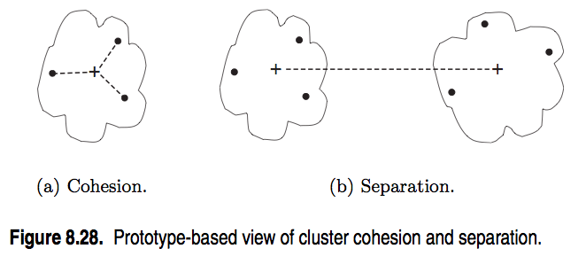
Cluster validation
source: http://www-users.cs.umn.edu/~kumar/dmbook/ch8.pdf
Notes:
In general, want cohesion to be low & separation to be high

Slide 47

Silhouette coefficient
One useful measure than combines the ideas of cohesion and separation is the silhouette coefficient. For point x_{i}, this is given by:
such that:
a_{i} = average in-cluster distance to x_{i} (how far away are other points)
b_{ij} = average between-cluster distance to x_{i} (“ “ “ “ other clusters)
b_{i} = min_{j}(b_{ij}) (minimum other cluster distance)
Notes:
numerator = daylight between clusters
denom = largest length scale

Slide 48
Silhouette coefficient
The silhouette coefficient can take values between -1 and 1.
In general, we want separation to be high and cohesion to be low. This corresponds to a value of SC close to +1.
A negative silhouette coefficient means the cluster radius is larger than the space between clusters, and thus clusters overlap.
Notes:
(in k-means, this is pathological…overlapping clusters means pts are not assigned to nearest centroids!)

Slide 49

Silhouette coefficient
The silhouette coefficient for the cluster C_{i} is given by the average silhouette coefficient across all points in C_{i}:
Notes:
numerator = daylight between clusters
denom = largest length scale

Slide 50

Silhouette coefficient
The silhouette coefficient for the cluster C_{i} is given by the average silhouette coefficient across all points in C_{i}:
The overall silhouette coefficient is given by the average silhouette coefficient across all clusters:
Notes:
numerator = daylight between clusters
denom = largest length scale

Slide 51

Silhouette coefficient
The silhouette coefficient for the cluster C_{i} is given by the average silhouette coefficient across all points in C_{i}:
The overall silhouette coefficient is given by the average silhouette coefficient across all clusters:
NOTE
This gives a summary measure of the overall clustering quality.
Notes:
numerator = daylight between clusters
denom = largest length scale

Slide 52
Cluster validation
One useful application of cluster validation is to determine the best number of clusters for your dataset.

Slide 53
Cluster validation
One useful application of cluster validation is to determine the best number of clusters for your dataset.
Q: How would you do this?

Slide 54
Cluster validation
One useful application of cluster validation is to determine the best number of clusters for your dataset.
Q: How would you do this?
A: By computing the SC for different values of k.

Slide 55
Cluster validation
Ultimately, cluster validation and clustering in general are suggestive techniques that rely on human interpretation to be meaningful.

Slide 56
STRENGTHS AND WEAKNESSES
Strengths:
K-means is a popular algorithm because of its computational efficiency and simple and intuitive nature.

Slide 57
STRENGTHS AND WEAKNESSES
Strengths:
K-means is a popular algorithm because of its computational efficiency and simple and intuitive nature.
Weaknesses:
However, K-means is highly scale dependent, and is not suitable for data with widely varying shapes and densities.

Slide 58
V. Example
DATA SCIENCE

