Slide 1
Data Science Databases and SQL

Slide 2
I. Introduction to Databases II. Star Schemas III. Why do data Scientists need databases? IV. Learning SQL With Code
agenda

Slide 3
I. Introduction to Databases
DATA SCIENCE

Slide 4
Introduction to Databases
What is a database?
An organized collection of data
Organized overall by a schema (like a blueprint of a database)
Organized into tables with different sets of data
If each family is a set of data, a house would be the table, and the neighborhood would be the schema.
Think many Excel sheets/pandas dataframes, but without limitations

Slide 5
Introduction to Databases
WHY USE a database?
You can ask questions of the data
Has a nice, structured language
Produce reproducible code
Access large amounts of data relatively quickly
Reliable and scalable
Many are ACID compliant – ensures your transactions are safely processed or that you’re notified otherwise

Slide 6
Introduction to Databases
Relational VS. NoSQL
Relational
Traditional rows and columns data – like dataframe
Strict structure
Entire column for each feature
NoSQL
No well defined data structure
Works better for unstructured data
Commodity hardware

Slide 7
Introduction to Databases
Relational VS. NoSQL
Today, we’ll be talking about relational databases
Most widely used and most appropriate for many types of data
Popular names
MySQL
Oracle
Postgres
Microsoft SQL Server
SQLite

Slide 8
Introduction to Databases
SQL
Structured Query Language
Used to ask questions of the database
Many different functions for creating, adding, retrieving, transforming, aggregating, and deleting data
Standard language with some differences among “dialects”

Slide 9
Introduction to Databases
Data Types
BOOLEAN/TINY INT– 0/1
INT – any whole number
FLOAT(<n>,<m>) – number with n digits before the decimal and m digits after the decimal
DATETIME, TIMESTAMP, and DATE – various date and time combinations
CHAR(<length>) – text with a fixed length
VARCHAR(<length>) – text with a given maximum length
And many more…

Slide 10
II. Star Schemas
DATA SCIENCE

Slide 11
Star Schemas
The star schema consists of one or more fact tables referencing any number of dimension tables.
A fact table contains “event” data. You can think of this as the type of information that we are really measuring (“measurements, metrics, or facts of a business process”).
A dimension table contains meta data or information that enhances “event” data (“structured labeling information”).
Source: Wikipedia

Slide 12
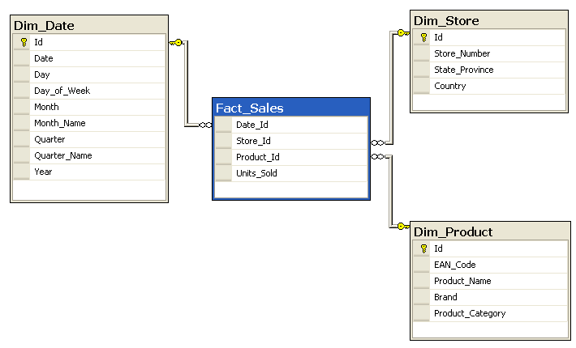
Star Schemas
Source: Wikipedia

Slide 13
Iii. Why do data Scientists need databases?
DATA SCIENCE

Slide 14
Why do data Scientists need databases?
In business, data doesn’t often live in flat files like CSV’s or TXT’s.
Data lives in databases.
You don’t need to know how to build one, just get data out of one.
This opens up the amount of data you can work with.
Looks great on your resume!
This doesn’t change modeling approaches or anything else. It only changes where you get your data from.

Slide 15
IV. Learning SQL With Code
DATA SCIENCE

