Slide 1



#TechInPink2020
#TimeToEndBreastCancer
#ELCHackForPink
#ELCHackathon’20
Team: Infy Ninja
Viral Thakkar
Saurabh K Sinha

Slide 2
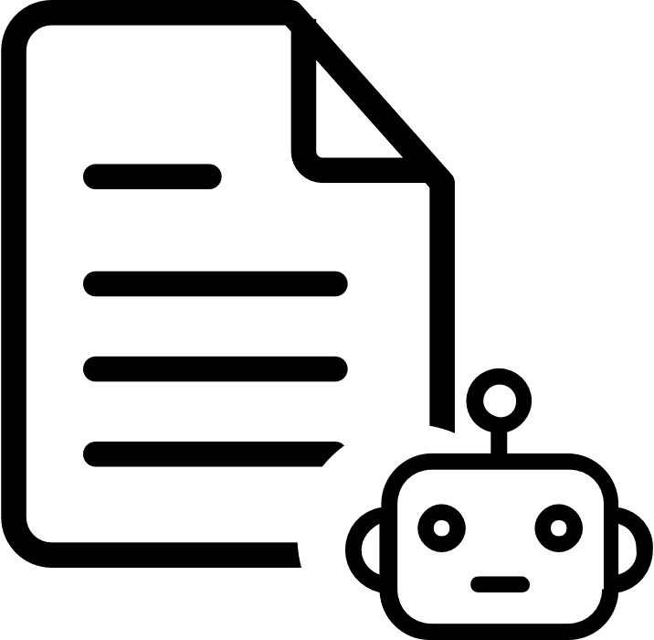

Problem
Breast cancer is the most common cancer in women worldwide.
Every 15 seconds, somewhere in the world, a woman is diagnosed with breast cancer.
Lack of early detection is the main problem. Most cases are diagnosed in late stages.
Every 15 seconds, somewhere in the world, a woman is diagnosed with breast cancer.
Lack of adequate diagnosis and treatment facilities.
The incidence of breast cancer is increasing in the developing world.
Due to increase life expectancy, increase urbanization and adoption of western lifestyles.
Almost 50% of breast cancer cases and 58% of deaths occur in less developed countries.
Over 508,000 women died in 2011 due to breast cancer.
15% of all cancer deaths among women are caused by breast cancer.
WHO
WHO
WHO
Approx. 2.1 Million women are impacted by breast cancer each year globally.
In the year 2018, nearly 2 million new breast cancer cases were diagnosed.
WHO
BCRF
Notes:
Line 1: US Bank | Merck | PWC
Line 2: Travelers | Adtalem | AmEx
Line 3: Digital Twin | NurseBot | Infosys RTW <https://www.youtube.com/watch?v=QWXOnPTkw4s&feature=emb_logo
Line 4: Digital Twin demo | KAO

Slide 3
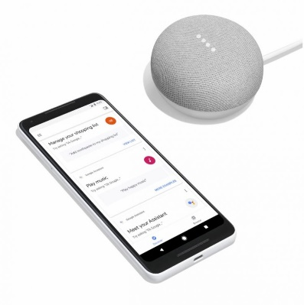






Our Solution
Solution powered through Intelligent AI
Awareness
QnA
Predictions
Connects to nearby Medical Facilities
Gamification Points and Awards
Inclusive Design
Omni-channel
Potential Impact
Technology Stack
Enhanced customer experience
Multi-experience
Reduced Human intervention
Zero Touch User Interface
Reduced Operational Cost
Agent Interfaces
Faster query
resolution
Notes:
Line 1: US Bank | Merck | PWC
Line 2: Travelers | Adtalem | AmEx
Line 3: Digital Twin | NurseBot | Infosys RTW <https://www.youtube.com/watch?v=QWXOnPTkw4s&feature=emb_logo
Line 4: Digital Twin demo | KAO

Slide 4
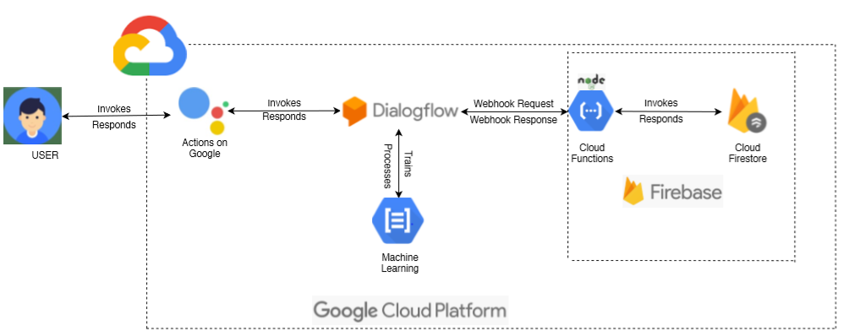
Technology Architecture

Slide 5
Sample Voice Journey
Personalized Welcome Greeting
User: Hey Google, Talk to ELC HackwithPink.
Bot: Welcome Sophia! Hope you are doing well. How can we assist you today?
User: What can I ask?
Bot: You can ask me about your queries regarding Breast Cancer, its symptoms, precautions to be taken, treatments and nearby hospital facilities. I can also help you with personalized predictions if you submit me answers for few questions?
User: ok. Can you help me with the personalized prediction?
Bot: Sure. I will now ask you few questions based on which I will tell you your probability of having this disease. Shall we proceed?
User: Yes
Bot: What is your age?
User: 46
Bot: Do you drink alcohol?
User: Yes.
Bot: Do you have a personal history of breast condition like a breast biopsy that found lobular carcinoma in situ (LCIS) or atypical hyperplasia of the breast,?
About the Bot
Consent Management
Questionnaire to Detect Probability

Slide 6
Sample Voice Journey -Continued
User : No.
Bot: Do you have a personal or family history of breast cancer?
User : No.
Bot: Did you received any radiation treatments to your chest as a child or young adult?
User : No.
Bot: What is your height in centimeters?
User : 172.
Bot: What is your weight in Pounds?
User : 132.
Bot: What was your age when you had your first child?
User: 37.
Bot: What was your age when your period started?
User: 12.
Bot: Thank you Sophia for the information. Based on the present data survey reports, You have 19% chances of having Breast Cancer. Please consult a nearby doctor. Would you like to help you find one?
User : No.
Bot: Ok. Is there anything else I could help you with?
User : No. Goodbye!
Bot : Thank You. Good Day!
Questionnaire to Detect Probability
Graceful Exit
*End of Conversation

Slide 7
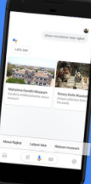
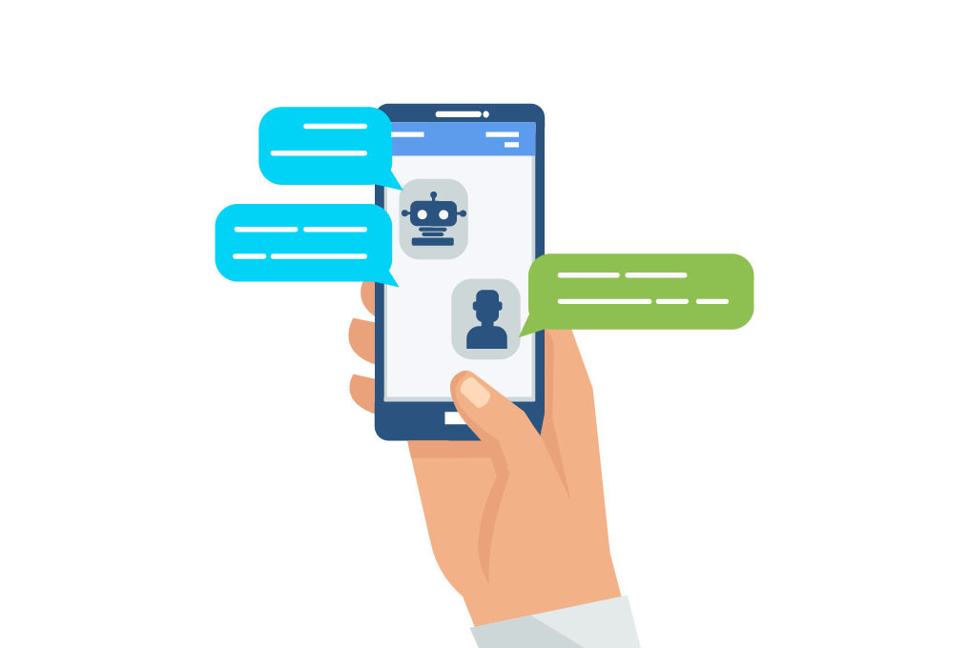





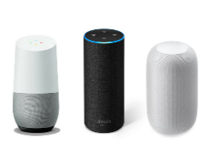

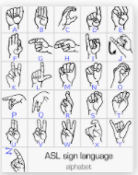
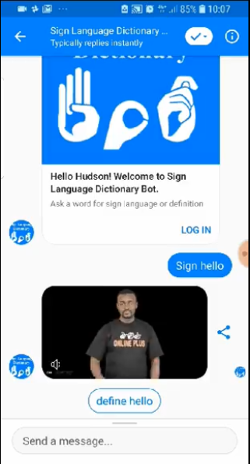
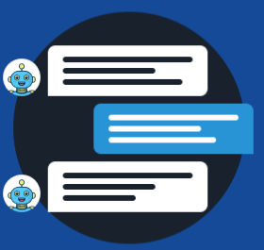



Uniqueness
Find the Nearest
Medical Facility
Access Anytime
Anywhere
Smart Suggestion Chips
Benefits
Available on Chatbot
Get Awareness
Bot based Ads
To connect Hospitals
Powered by Richness
of Data
Available on Voicebot
Personalized Predictions
Conversation Flow based on Users choice
Accessibility through all degrees of Human, even Specially-abled
Smart IVR
User Engagement
through Gamifications
High Reachability
Multi-Language

Slide 8



Logical flow diagram of what we have built..
USER
Hey google, Talk to ELC HackwithPink
Identifies Action / Skill
Analyzes and understands the request.
Action / Skill Invocation
API Gateway and Management
Welcome Sophia! You can ask us about Breast cancer related any queries. Let us know how we can help you?
Can you help check If I have chances?
Match intent from training phrases
{Request}
</>
REST Services
Sure, Let me ask you few questions based on which we will tell you the probability. Shall we proceed?
Text to Speech
{Response}
Can you help me find a doctor near me?
Is there any treatment of breast cancer?
What are the side effects of therapy?
Do you consume Tobacco?
Does Antiperspirants and deodorants
cause Breast cancer?
Is it contagious?
* Interactions mentioned are indicative

Slide 9






Elevate the solution pitch through Next Gen elements
Google Sign In
Fetch First Name, Last Name, Email Address of user post Consent
Usage reporting
Behavior analytics
Sentiment insights
Failure analytics
Language processing reports
Personalization
Multi- channel
NLU Agents
Interface
Analytics
Content Sourcing
Account
Linking
Welcome Greetings
Minimum question asked by bot to detect Probability of Breast Cancer
Integration with multiple systems
Multi mode input-output
Multi mode and multimedia responses
ML based smart actions
Entitlement based intents
Conversational
AI
Voice + Chat
Conversation flow design
Smart UI widgets
Action based processing
Multilingual bots
Humanoid Interfacing
LUIS
Natural language search
FAQ creation

Slide 10

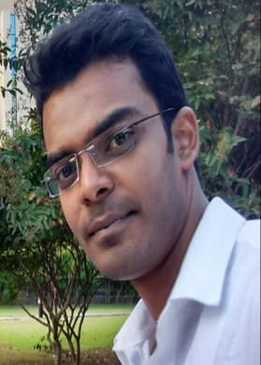
ELC HackForPink
Team ID: 2AEFH5
Team: Infy Ninja
Hackathon is about problem solving in time-boxing method, it is really what it is. And you can’t solve problem unless you have an ability or empathy to perceive all that’s around you. The more you understand and what the problem is through other people’s lens the more you can solve for people in real life.
ELC Hackathons embraces collaboration across borders and cultures to bring about new ideas and innovations. We recognized to act on the urgency of creating awareness through technology for Breast Cancer. Goal is to support the larger society ecosystem with the power of technology to get innovation out in the field.
Viral Thakkar
Saurabh K Sinha

Slide 11
Appendix

Slide 12
Appendix A : Key Technical Terms
Action: An Action is an entry point into an interaction that you build for the Assistant. Users can request your Action by typing or speaking to the Assistant.
Intent: An underlying goal or task the user wants to do; for example, ordering coffee or finding a piece of music. In Actions on Google, this is represented as a unique identifier and the corresponding user utterances that can trigger the intent.
Actions project: A project you create to manage, test, and publish a collection of Actions; Google maintains your Actions project in a cloud backend.
Actions Console: A web-based tool that Google provides to simplify your Actions development; you can create, maintain, test, and publish your Actions using the console.
NLU: Acronym for "Natural Language Understanding". This refers to the capability of software to understand and parse user input. Developers can choose to use Dialogflow or their own NLU solutions when creating Actions.
Dialogflow: Dialogflow is a natural language understanding platform used to design and integrate a conversational user interface into mobile apps, web applications, devices, bots, interactive voice response systems, and so on.
Webhook (fulfillment): Code that responds to an HTTP request in a Watson-specific messaging format; it contains the logic for handling intents and dynamically constructing responses to send to the user.

Slide 13
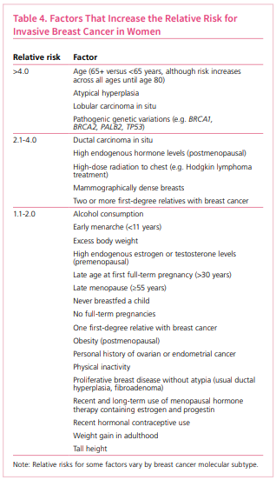
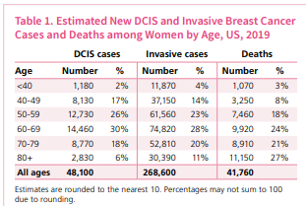
Risk Factors
Reference: https://www.cancer.org/content/dam/cancer-org/research/cancer-facts-and-statistics/breast-cancer-facts-and-figures/breast-cancer-facts-and-figures-2019-2020.pdf

Slide 14
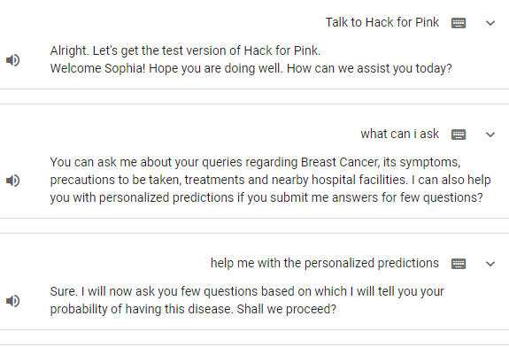
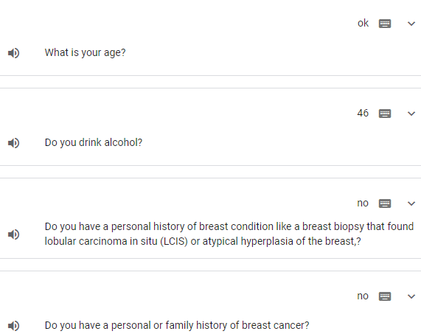
Actions Console Simulator Screenshots

Slide 15
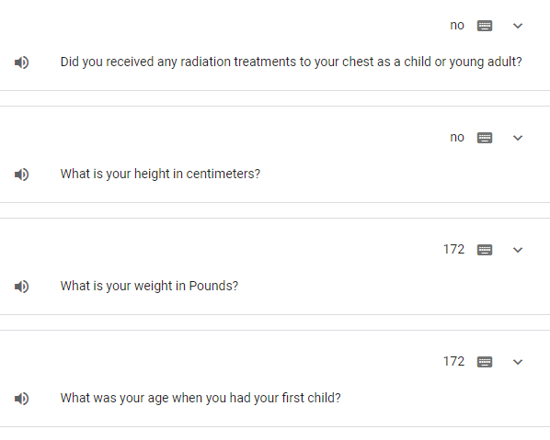
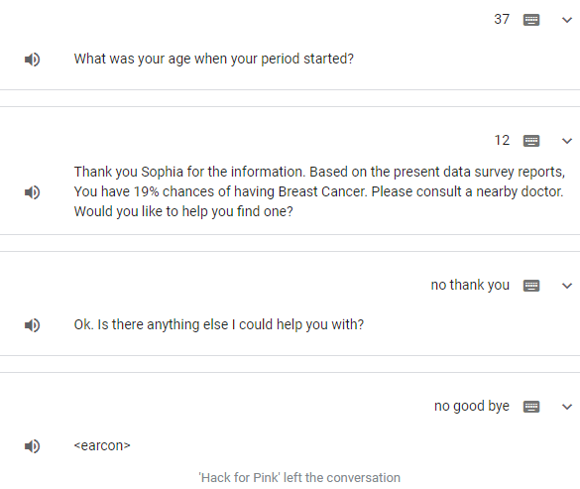
Actions Console Simulator Screenshots --Continued

