Slide 1

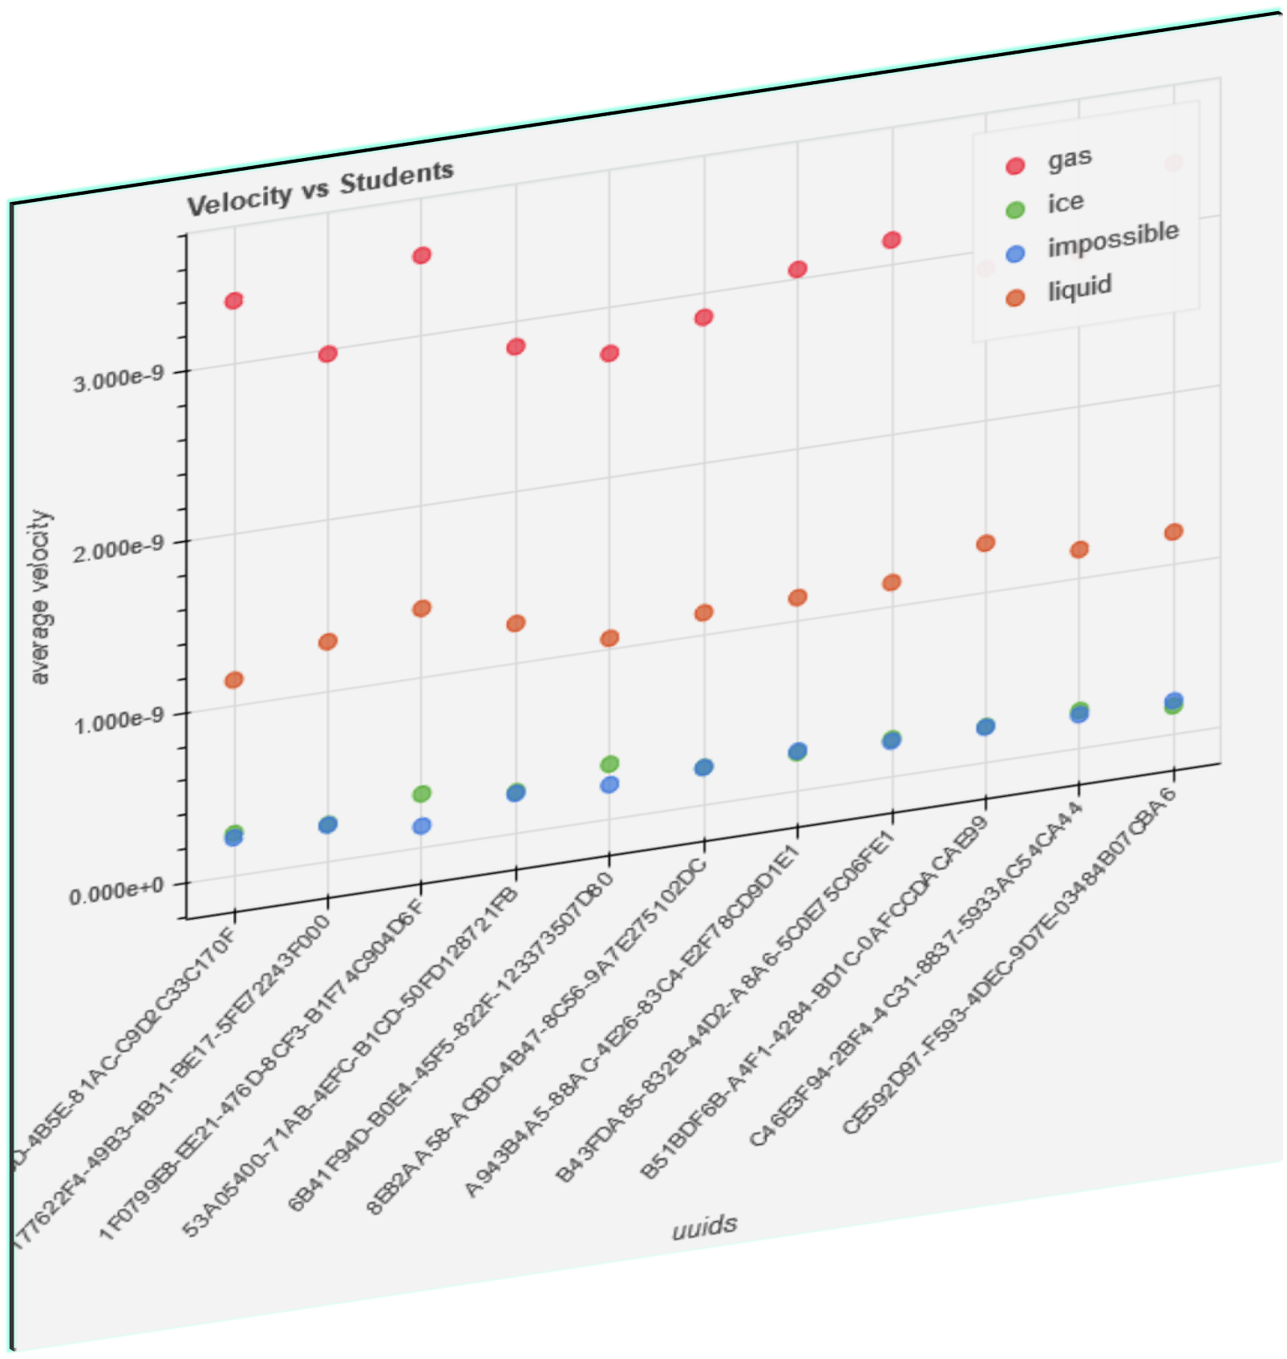
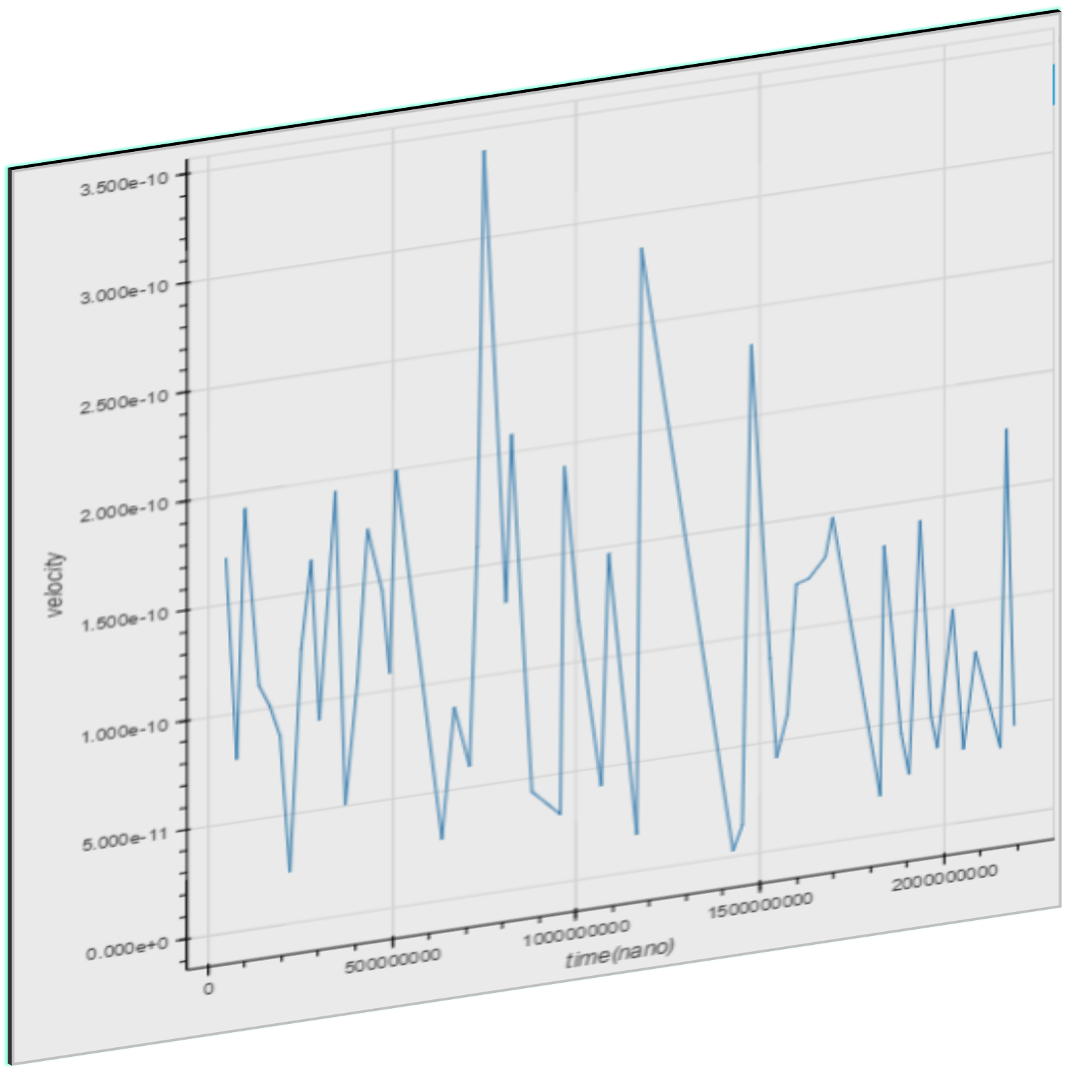
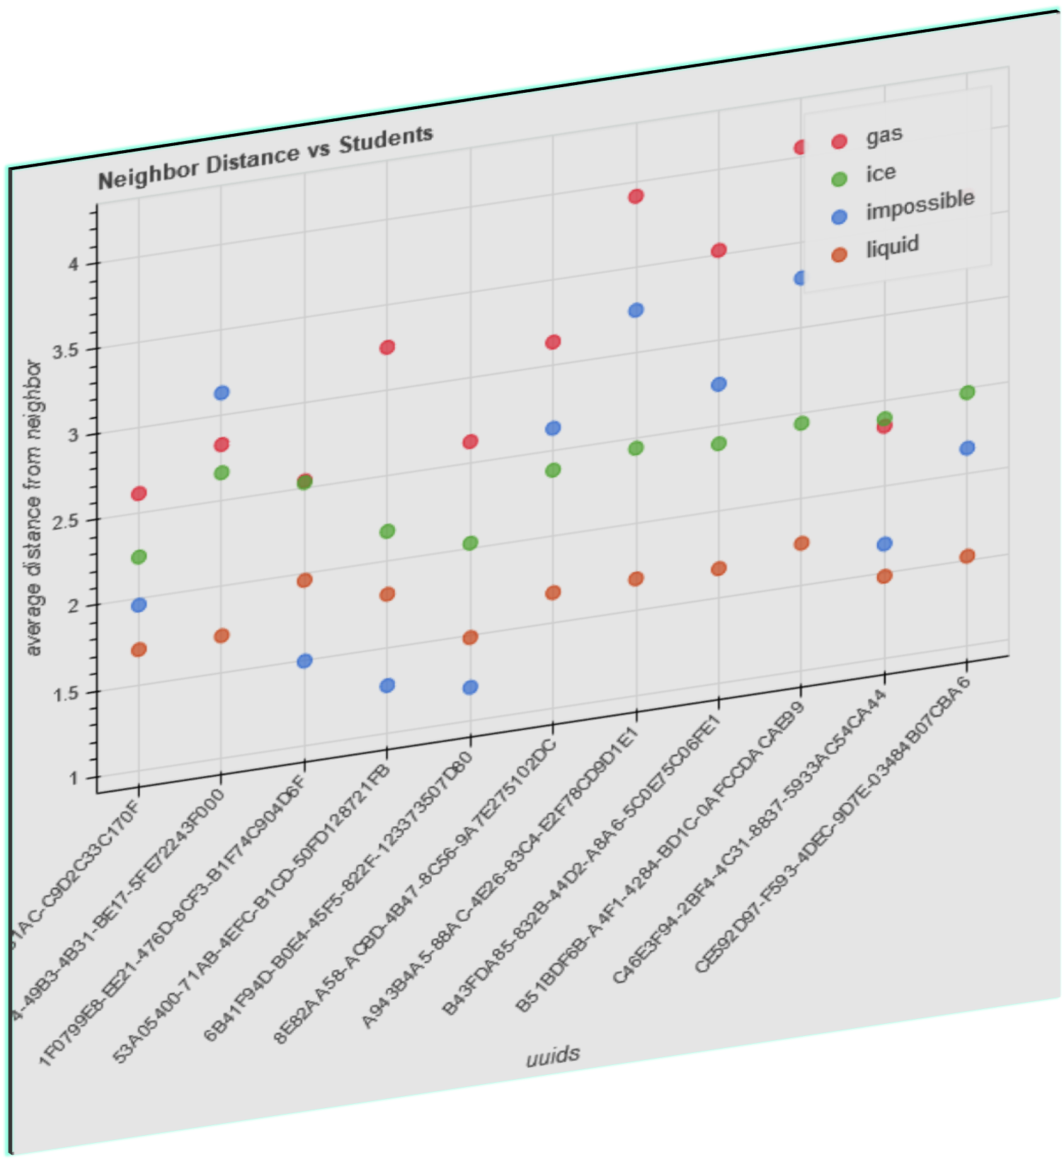
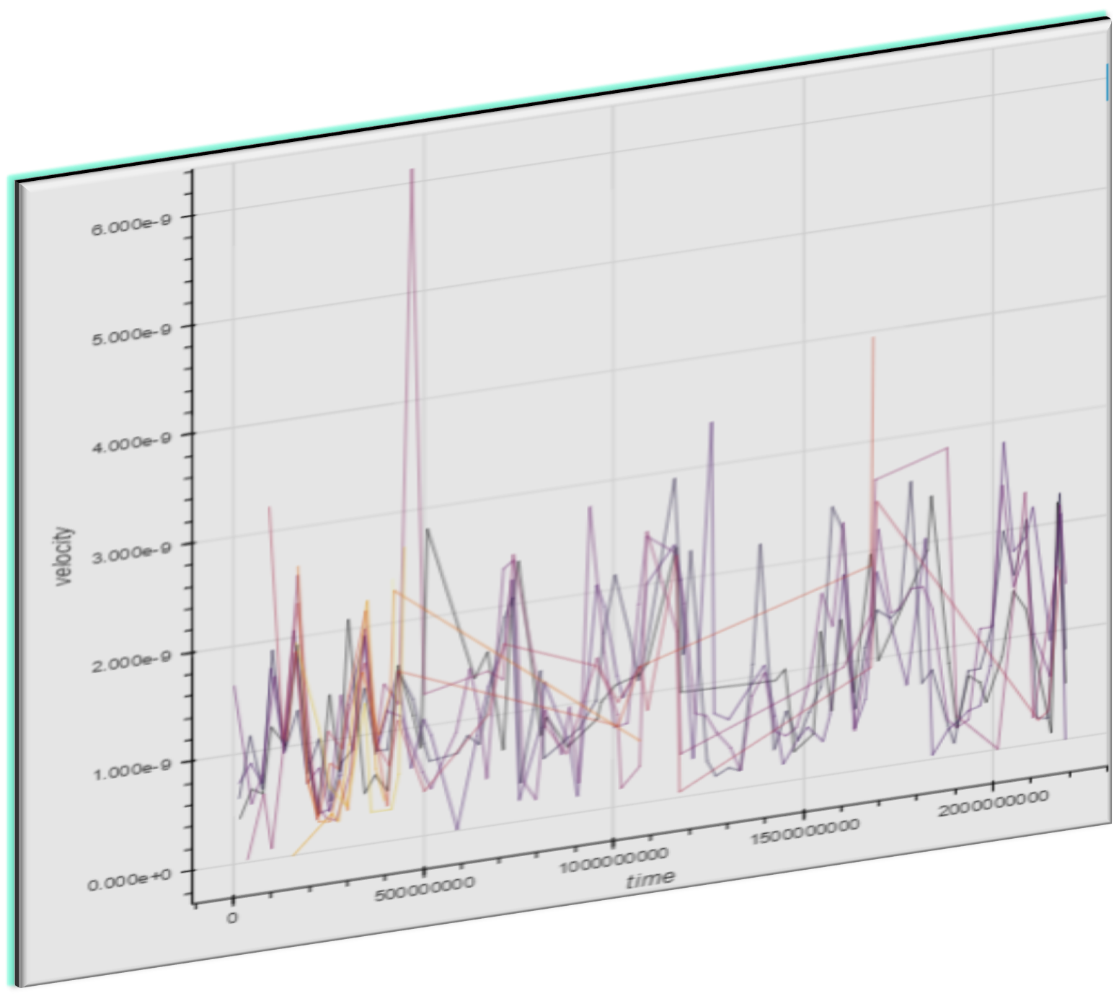
PLAE Project: Motion Captured Children Data for Learning
Saurabh Kumar¹
Abstract
Visualization Pipeline, cont.
Abstract— Augmented reality emerged as a tool by which scientists attempt to develop many techniques to be used by educators. It provides many engaging learning moments and makes learning very attractive. The significance of exploring the application of augmented reality in learning is because research shows that body movements assist students in grasping the material. In this project, we examine how children understand different science notions via some actions which are tracked via the OpenPTrack system. The camera tracks the movement of kids in an open space. These recorded activities were integrated into a computer emulation. The teacher changes the background on a screen at the front of the room to inspire kids to play differently in the space. The goal is to explore how and why augmented reality can generate modern horizons for learning. For this purpose, we are interested in finding patterns of children movements via conducting exploratory visual analysis of the students’ motion data to gain an understanding on how the technology can help kids.
The dataset comprises one day of motion capture activity. Each .rec file corresponds to an distinct phase of matter demonstration by the students of either ice, liquid, or gas.
A python Dataframe was created from the JSON formatted timestamps.
Conclusions
Given the size of the client's dataset, we do not see scaling or complexity as a potential problem.
Analysis should be able to work on a variety of commodity hardware.
During this exploratory phase of the data, we are built tools to simplify the sets of output files and visualize them.
Future work can be utilizing embodied learning in helping students learn more concepts on psychology in a simplified way
Velocity
Visualization were created to analyze the speed of the students recorded
Authors
Background
¹ Graduate Student, Department of Computer Science, Indiana University, Email: cmbays@indiana.edu
² Affiliated Researcher, NC Complex Systems Institute, UNC Charlotte, Email: kdhou@uncc.edu
³ Graduate Student, Department of Computer Science, Indiana University, Email: kumarsau@iu.edu
⁴ Graduate Student, Department of Computer Science, Indiana University, Email: dleybel@umail.iu.edu
⁵ PharmD, PharmacyOne, Email: shaima.qunies@gmail.com
There is a rapidly growing literature on augmented reality, which indicates its effectiveness in learning
The significance of exploring the application of augmented reality in learning is because research shows that body movements assist students in grasping the material
The PLAE Project explores how young students learn about complex science concepts (e.g. states of matter), by engaging in embodied play activities that are tracked using the OpenPTrack system
The PLAE project visualization will need to illustrate relationships between the subjects of motion capture data. Spatial and temporal analysis will be a key component.
Figure 3. Velocity by phase
Distance from neighbor
References
[1] Chao, K.-J., Huang, H.-W., Fang, W.-C. & Chen, N.-S. (2013), ‘Embodied play to learn: Exploring kinect-facilitated memory performance’, British Journal of Educational Technology 44(5), E151–E155.
[2] Tamim, R. M., Bernard, R. M., Borokhovski, E., Abrami, P. C. & Schmid, R. F. (2011), ‘What forty years of research says about the impact of technology on learning a second-order meta-analysis and validation study’, Review of Educational research 81(1), 4–28.
[3] Santos, Marc Ericson C., et al. "Augmented reality learning experiences: Survey of prototype design and evaluation." IEEE Transactions on learning technologies 7.1 (2014): 38-56.
[4] Antonioli, Misty, Corinne Blake, and Kelly Sparks. "Augmented reality applications in education." The Journal of Technology Studies (2014): 96-107.
[5] Abrahamson, Dor, and Robb Lindgren. "Embodiment and embodied design." The Cambridge handbook of the learning sciences 2 (2014): 358-376.
[6] Lindgren, Robb, et al. "Enhancing learning and engagement through embodied interaction within a mixed reality simulation." Computers & Education 95 (2016): 174-187.
Research Question
Figure 1. Velocity of single student over time
Can embodied play activities help students learn scientific concepts like movement of particles in different settings?
Visualization Pipeline
The OpenPTrack system records each event as a JSON formatted timestamp.
A collection of timestamps for a single recording session is saved as a .rec file.
The dataset provided by the client had 274637 JSON formatted timestamps.
18 .rec files were examined for the dataset. There were 24 unique uuids in the dataset. 8 of the unique uuids correspond to type=’Mesh’, subtype=’Marker’, thus identifying a child tracked by the motion capture equipment.
Figure 4. Average distance from nearest neighbor of each student based on phase
Figure 2. Velocity of all students over time

