Slide 1

End-to-End Stock Forecasting System
AI-powered stock prediction platform combining LSTM neural networks, ARIMA time-series analysis, and Ollama integration for intelligent financial insights.

Slide 2




System Architecture
Data Pipeline
Real-time fetching and processing of 5 years of stock data
ML Models
ARIMA and LSTM predictions with dynamic scaling
Streamlit Frontend
Interactive interface with AI chatbot integration

Slide 3

Data Pipeline: Backend ML Workflow
Financial Data Acquisition
Data Preparation
MinMaxScaler normalization at runtime
Yahoo Finance API integration via yfinance
60-day sequence length for LSTM
Dynamic downloads for 30+ Indian MNCs
Automatic missing value handling
5 years historical data per company
No saved scaler files (.pkl)
No static CSV files stored

Slide 4




Dual Model Prediction Engine
ARIMA (5,1,0)
LSTM Neural Network
Time-series forecasting model analyzing Close prices with statistical precision for trend prediction
Pre-trained deep learning model (lstm_stock_model.keras) capturing complex patterns in sequential data
Forecast horizon dynamically calculated: Selected Future Date - Last Available Date
All predictions computed in memory with no intermediate model files saved

Slide 5

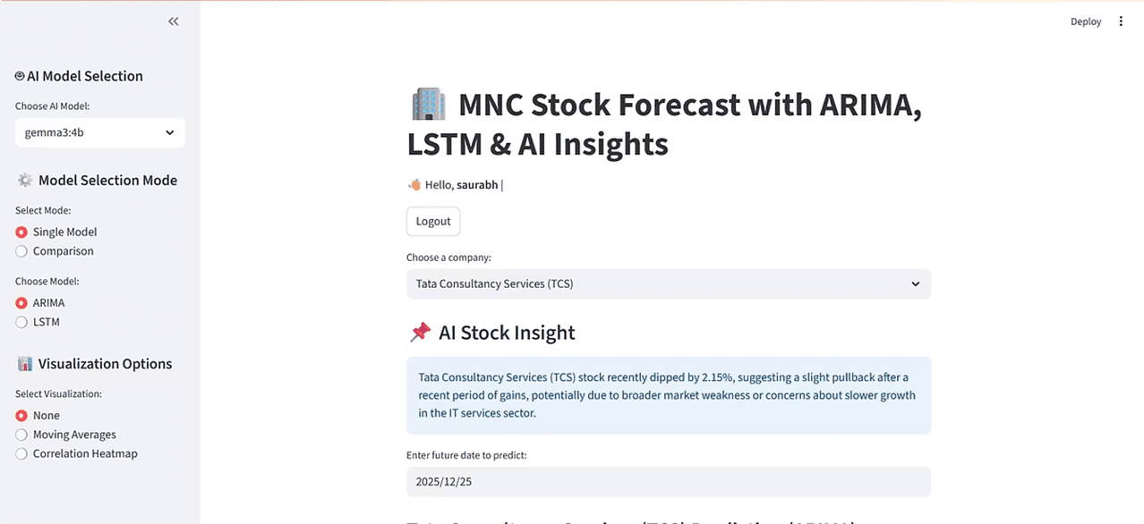
User Journey: Authentication to Insights
1
Login
Secure authentication (saurabh/12345 or admin/admin123)
2
Select Company
Choose from 30+ MNCs like TCS, Infosys, Reliance
3
Choose AI Model
Pick Ollama model: gemma3:4b, mistral, llama2, or None
4
Set Prediction Date
Select future date for forecast horizon

Slide 6

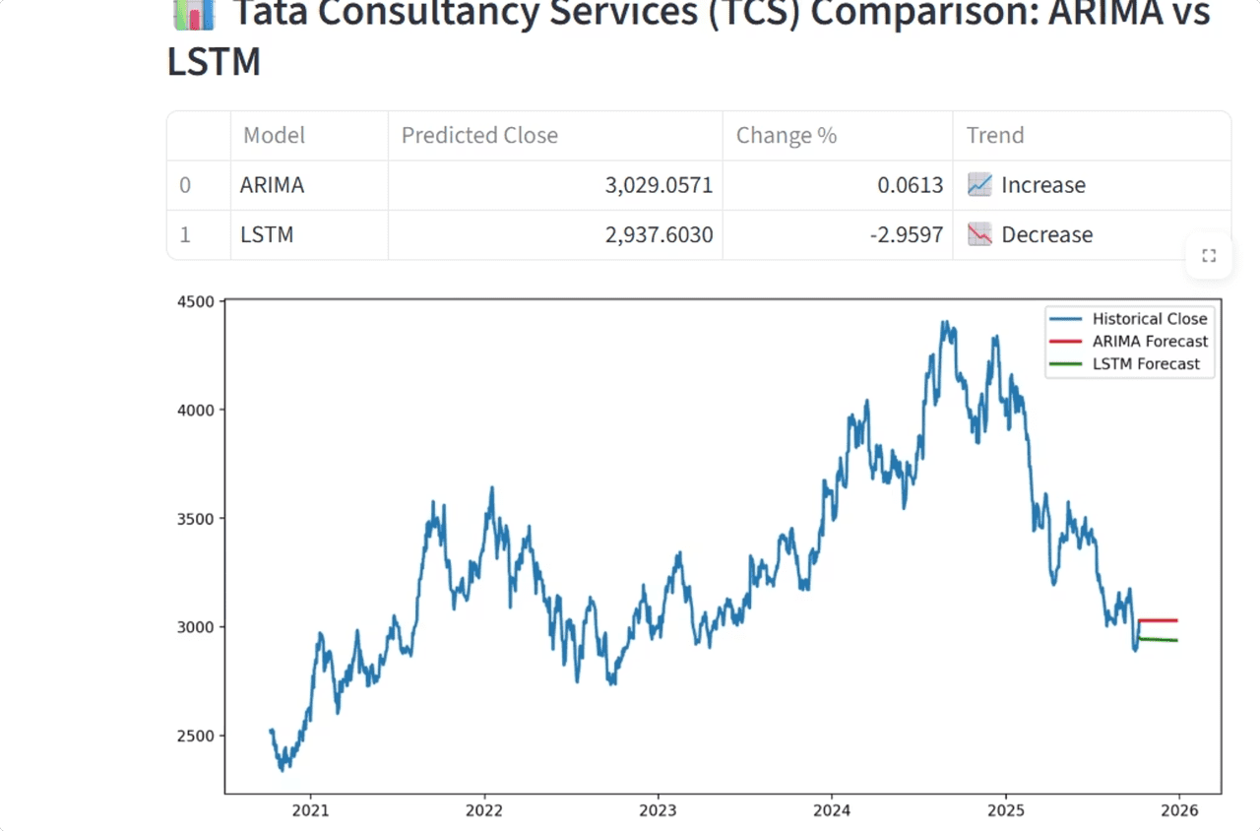


Flexible Prediction Modes
Single Model Mode
Choose ARIMA or LSTM for individual predictions with focused analysis and detailed metrics
Comparison Mode
Run both models simultaneously with side-by-side results, tables, % change, trend direction, and interactive charts

Slide 7



Advanced Visualization Options
Predictions Only
Moving Averages
Correlation Heatmap
Clean forecast display without additional visual elements for focused decision-making
SMA 10 & SMA 50 overlaid with closing prices to identify trends and momentum shifts
Visual matrix showing relationships between Open, High, Low, Close, and Volume metrics

Slide 8
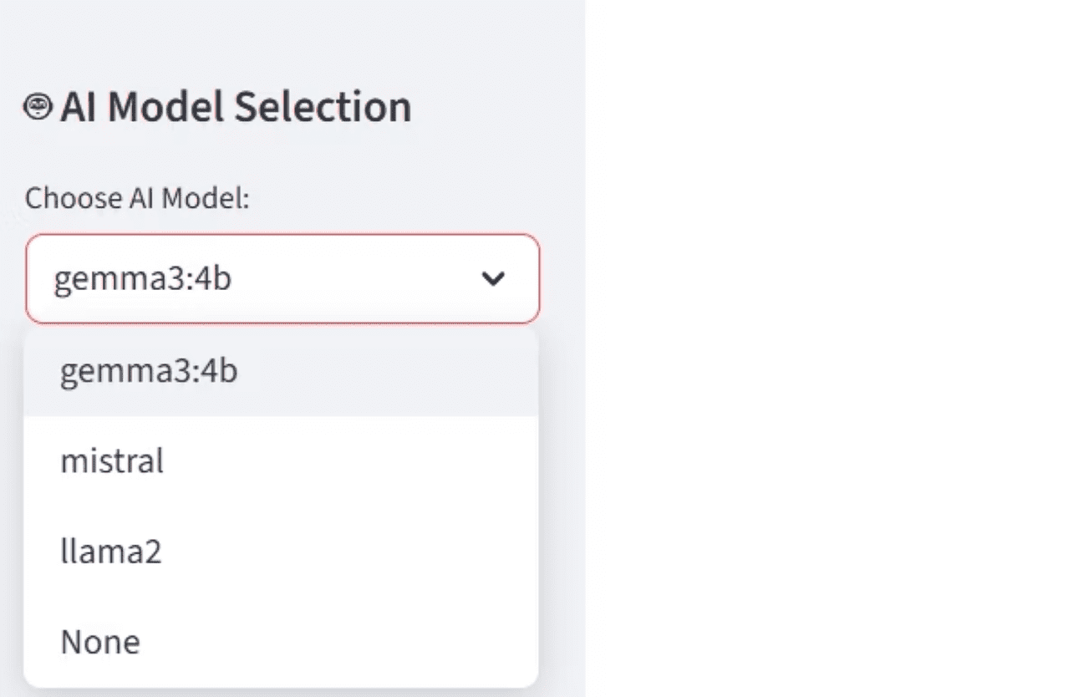
Ollama AI Chatbot Integration
Intelligent Financial Assistant
Interactive chatbot powered by local Ollama API understands company names, dates, and complex queries automatically.
Key Capabilities:
Combines historical prices with ARIMA & LSTM predictions
Generates AI-driven financial insights
Context-aware responses using selected model
Real-time analysis and recommendations

Slide 9

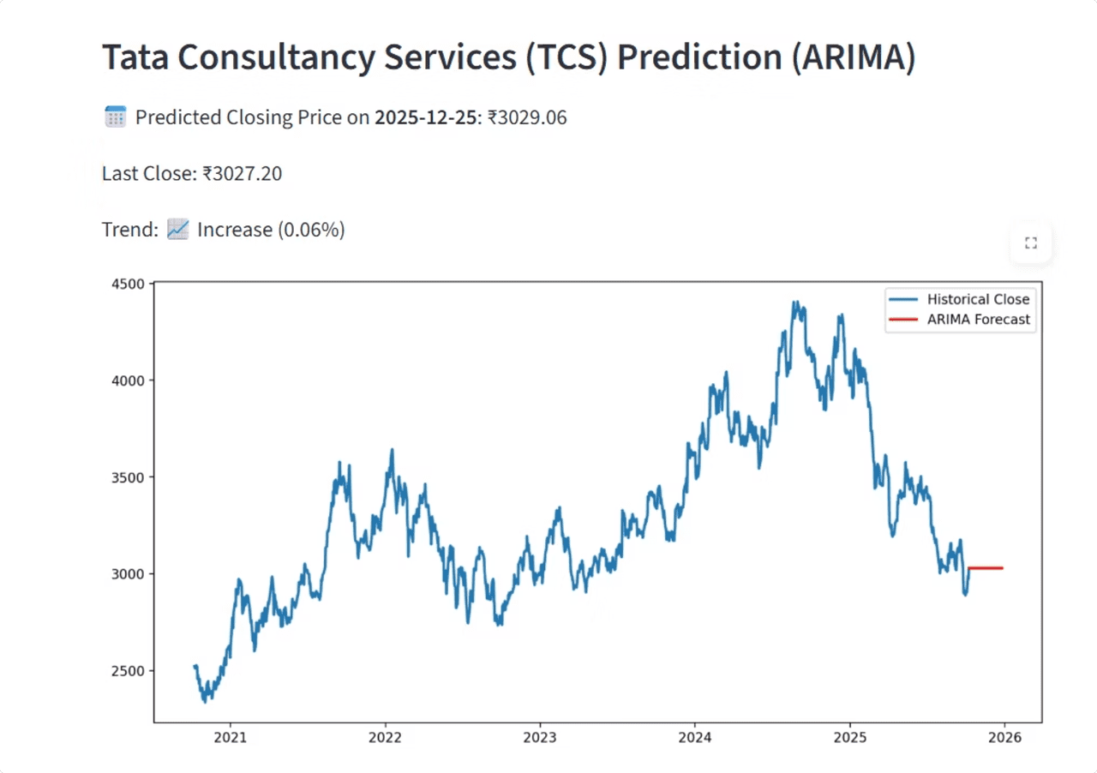

System Outputs & Deliverables
Dynamic Predictions
Interactive Charts
Predicted closing price, trend direction, and percentage change calculated in real-time
Visual comparisons for ARIMA, LSTM, and dual-model analysis modes
AI Insights
Generated financial commentary and chatbot responses for informed decisions
Zero File Storage: All predictions, charts, and tables generated dynamically in Streamlit with no intermediate .csv or .pkl files stored

Slide 10

Technical Requirements
1
Required Files
ollama.py and lstm_stock_model.keras must be present in directory
2
Runtime Processing
All scaling, normalization, and predictions computed in memory without persistent storage
3
API Dependencies
Yahoo Finance API for data, local Ollama API for AI chatbot functionality

Slide 11

Thank You

