Slide 1
Indian Restaurant in Toronto
Data Analysis and Recommendation

Slide 2
Introduction
Review of the Toronto City neighborhood and its adjoining area for opening Indian Restaurant
Feasible location for the new restaurant

Slide 3
Business Problem & Success Criteria
Business Problem
Choice of neighborhood to start Indian Restaurant meeting the below criteria
Low Competition
High demand
Low on crime profile
Success Criteria
Neighborhood which meets the above criteria

Slide 4
Data Description
Dataset 1 : - Toronto City neighborhood and Borough Postal Code
In order to segment the neighborhoods and explore them, we will essentially need a dataset that contains the boroughs and the neighborhoods that exist in each borough as well as the latitude and longitude coordinates of each neighborhood.
This dataset exists for free on the web. Link to the dataset is : https://en.wikipedia.org/wiki/List_of_postal_codes_of_Canada:_M
Dataset 2 : Demographic and population
Demographic and population analysis of the Toronto city in order to find out what is the population structure and where are the South Asian population lives in.
The dataset exists at below location :- https://en.wikipedia.org/wiki/Demographics_of_Toronto http://www12.statcan.ca/census-recensement/2016/dp-pd/hlt-fst/imm/Table.cfm?Lang=E&T=22&Geo=535
Dataset 3 : Toronto City Crime Profile
Analysis of the crime profile of the Toronto City. This can be found at http://data.torontopolice.on.ca/datasets/neighbourhood-crime-rates-boundary-file-/data?orderBy=Neighbourhood
Dataset 4 : Venue Information
Toronto city geographical coordinates data will be utilized as input for the Foursquare API, that will be leveraged to provision venues information for each neighborhood. We will use the Foursquare API to explore neighborhoods in Toronto City.

Slide 5
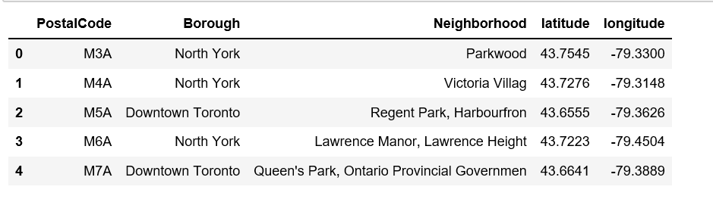
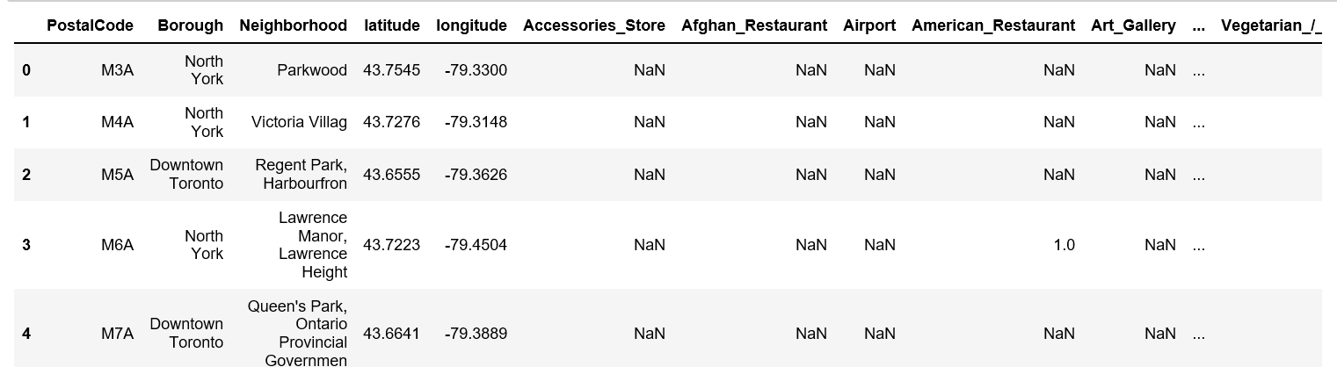
Methodology – Postal Code Toronto City
Get the latitude and longitude of each of the postal code of Toronto City
Get the venues related information by calling Venues explore of the FourSquare which is https://api.foursquare.com/v2/venues/explore

Slide 6
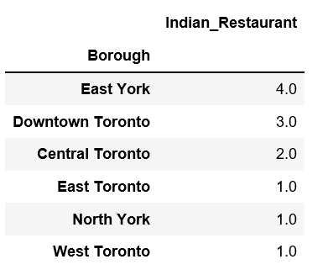
Methodology - Postal Code Toronto City cont..
Get the number of Indian Restaurant in each borough of Toronto City

Slide 7
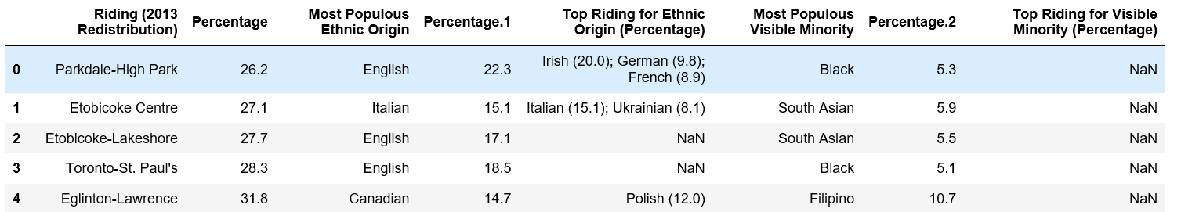
Methodology – Demographic & Population
Analyze the demographic and population of the neighborhood by reading the dataset available on wiki page https://en.wikipedia.org/wiki/Demographics_of_Toronto and Canada Census data for metropolitan city
Get the Visible Minorities as % of Population (2016 Census) & Top Ethnic Origins for each neighborhood and borough

Slide 8
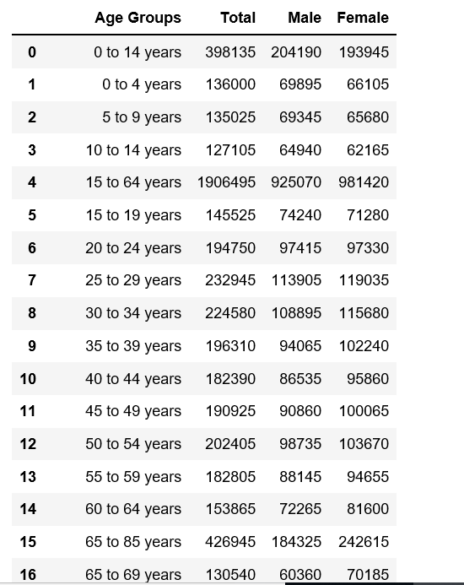
Methodology - Demographic & Population cont…
Get the age group diversification of the Toronto City by the age group

Slide 9
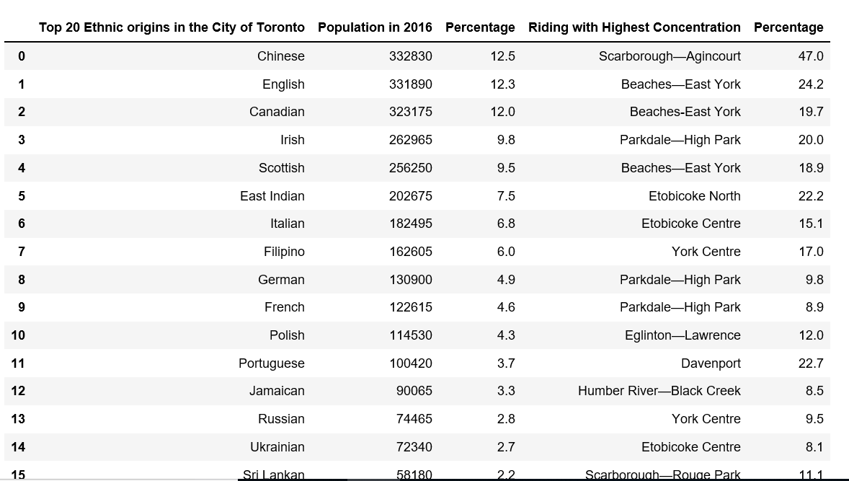
Methodology - Demographic & Population cont…
Get the highest concentration of each ethnic group in Toronto City . This results in establishing that Etobicoke borough has the highest concentration of Indian

Slide 10
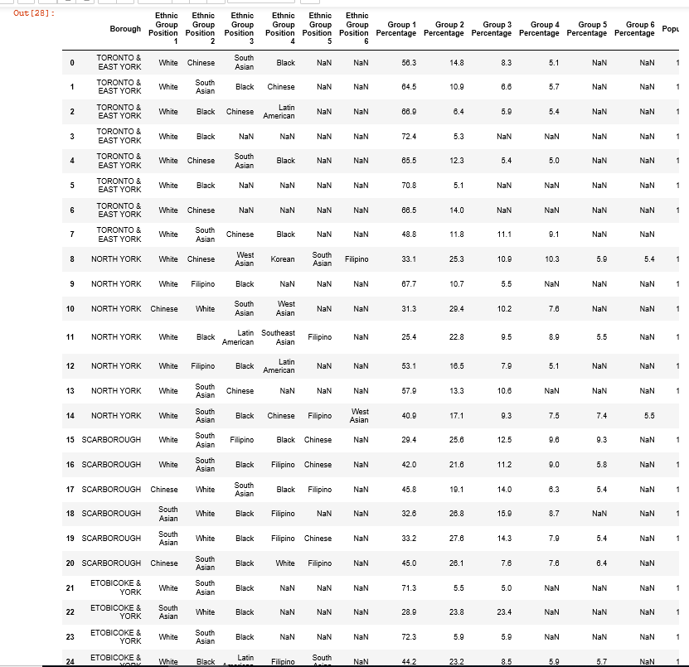
Methodology - Demographic & Population cont…
Assumption it is better and profitable to open Indian Restaurant in the borough where Indian or South Asian population is higher. Percentage of each ethnicity by borough. This results in establishing that “ETOBICOKE” and “SCARBOROUGH” has a sizable population of South Asian in that area. So, it is better to open the Indian Restaurant there.

Slide 11
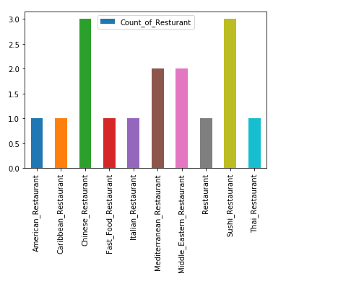
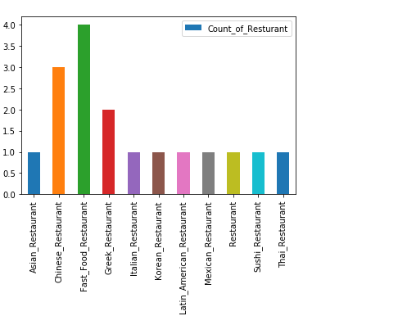
Methodology - Demographic & Population contd.
. Restaurant type in “ETOBICOKE” and “SCARBOROUGH”
ETOBICOKE
SCARBOROUGH

Slide 12

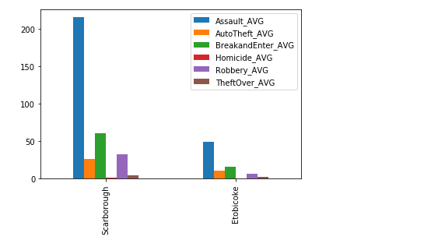
Methodology – Crime Profile Toronto City
Crime profile of the Toronto City to determine in which borough to open Indian Restaurant. Lesser the crime profile of the borough, better is the environment to open the restaurant. Below are the crime profile of the borough “ETOBICOKE” and “SCARBOROUGH”

Slide 13
Result and Discussion
Result :-
The analysis resulted in finding the neighborhood having low competition and less crime to open an Indian Restaurant
Discussion
There will be competition from the Chinese Restaurant as there is presence of them more than other in the Etobicoke area

Slide 14
Conclusion
Various factors need to be studied in order to decide on the Location . Below tables describes the factor that have been considered to reach out to the conclusion.
Recommendation :-
Depending on the south Asian population and crime profile it is better to choose for Borough "Etobicoke" as compared to "Scarborough" to open the Indian Restaurant.
Borough | South Asian Population | Competitor | Crime Rate profile
Scarborough | Position 1 | 0 | High
Etobicoke | Position 2 | 0 | Low

