Slide 1

Machine Learning
Presentation by:
Saurabh Kumar(2017105160)
Sangroshi Jamir(2017105159)

Slide 2
What is machine learning?
1
Machine learning is the scientific study of algorithms and statistical models that computer systems use to perform a specific task without using explicit instructions, relying on patterns and inference instead. It is seen as a subset of artificial intelligence.

Slide 3
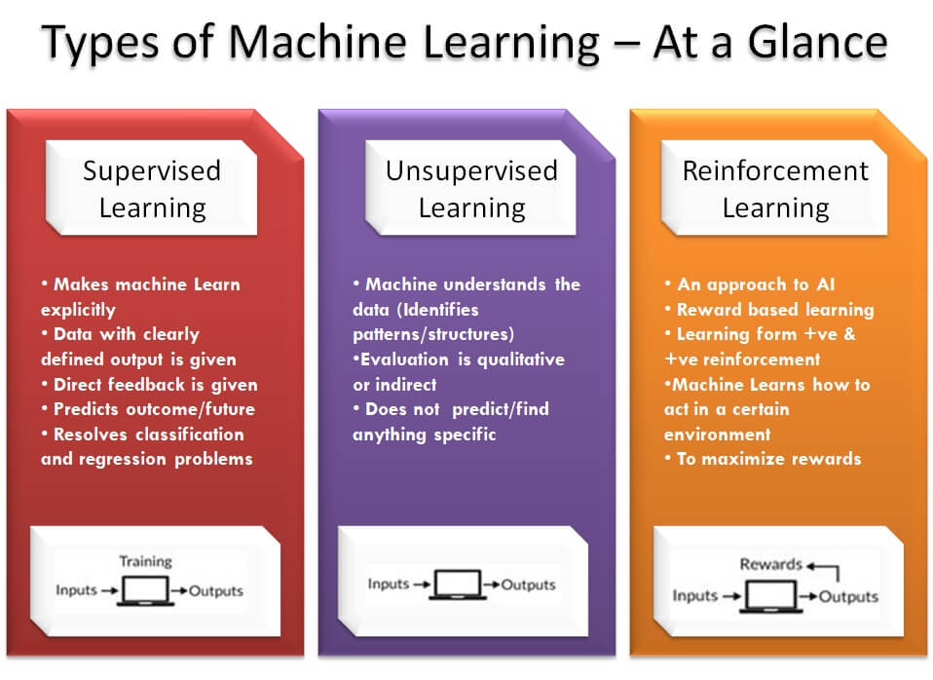
.
2

Slide 4
Support Vector Machine(SVM):
3
“Support Vector Machine” (SVM) is a supervised learning.
Machine learning algorithm which can be used for both classification or regression challenges.
It is mostly used in classification problems.
Support Vector Machine is a frontier which best segregates the two classes (hyper-plane/ line).

Slide 5
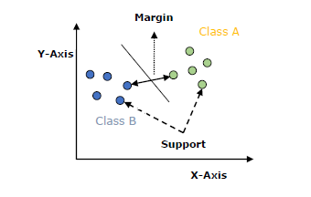
Working of SVM
4
An SVM model is basically a representation of different classes in a hyperplane in multidimensional space. The hyperplane will be generated in an iterative manner by SVM so that the error can be minimized. The goal of SVM is to divide the datasets into classes to find a maximum marginal hyperplane (MMH).

Slide 6
The followings are important concepts in SVM −
5
Support vectors:- Datapoint that are closest to the hyperplane is called support vectors. Separating line will be defined with the help of these data points.
Hyperplane − As we can see in the above diagram, it is a decision plane or space which is divided between a set of objects having different classes.
Margin − It may be defined as the gap between two lines on the closet data points of different classes. It can be calculated as the perpendicular distance from the line to the support vectors. Large margin is considered as a good margin and small margin is considered as a bad margin.

Slide 7
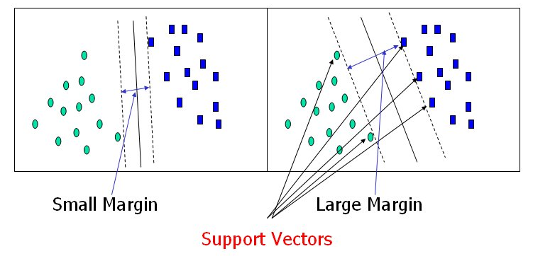
What are Support Vectors?
6
Support vectors are the data points nearest to the hyperplane, the points of a data set that, if removed, would alter the position of the dividing hyperplanes. Because of this, they can be considered the critical elements of a data set, they are what help us build our SVM.

Slide 8
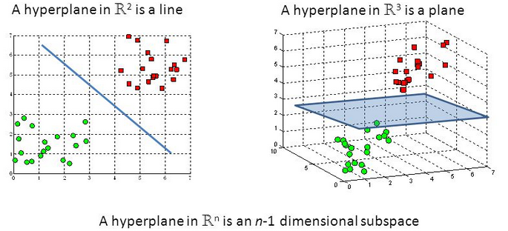
What’s a Hyperplane?
7
Hyperplanes as decision surfacess:
A hyperplanes is a linear decision surface that splits the space into two parts;
It is obvious that a hyperplane is a binary classifier.

Slide 9
.
8
Geometry tells us that a hyperplane is a subspace of one dimension less than its ambient space. For instance, a hyperplane of an n-dimensional space is a flat subset with dimension n − 1. By its nature, it separates the space into two half spaces.

Slide 10
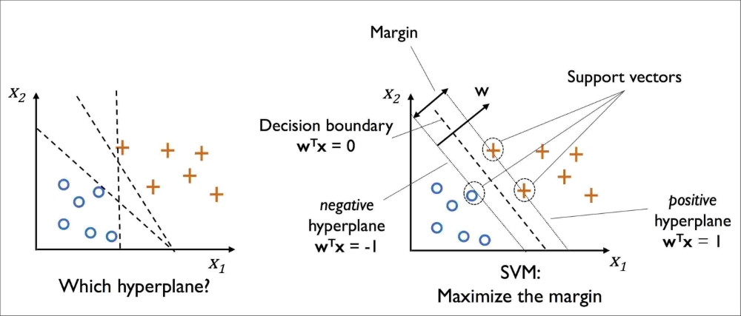
What’s a margin ?
9
A margin is a separation of line to the closest class points. A good margin is one where this separation is larger for both the classes. Images below gives to visual example of good and bad margin. A good margin allows the points to be in their respective classes without crossing to other class.

Slide 11
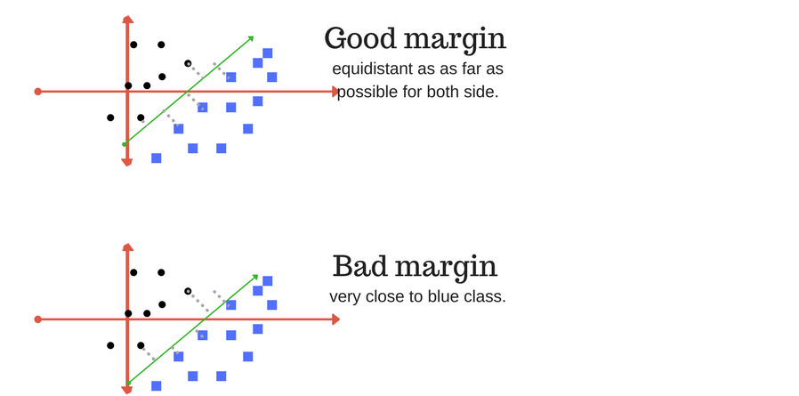
Good and Bad margin:
10

Slide 12
Tuning parameters:
11
A. Kernel
B. Regularization
C. Gamma
Kernel:- The learning of the hyperplane in linear SVM is done by transforming the problem using some linear algebra. This is where the kernel plays role.
For linear kernel the equation for prediction for a new input using the dot product between the input (x) and each support vector (xi) is calculated as follows:
f(x) = B(0) + sum(ai * (x,xi))

Slide 13
B. Regularization:-
12
The Regularization parameter (often termed as C parameter in python’s sklearn library) tells the SVM optimization how much you want to avoid misclassifying each training example.
For large values of C, the optimization will choose a smaller-margin hyperplane if that hyperplane does a better job of getting all the training points classified correctly. Conversely, a very small value of C will cause the optimizer to look for a larger-margin separating hyperplane, even if that hyperplane misclassifies more points.

Slide 14
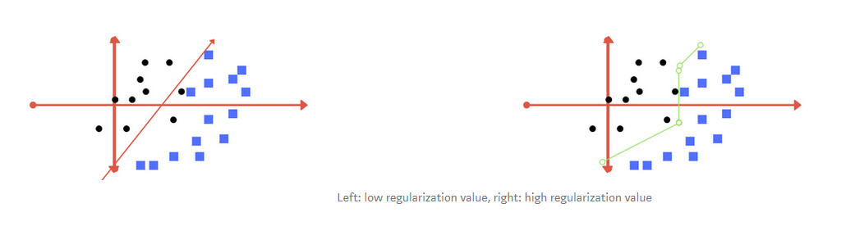
.
13
The images below (same as image 1 and image 2 in section 2) are example of two different regularization parameter. Left one has some misclassification due to lower regularization value. Higher value leads to results like right one.

Slide 15
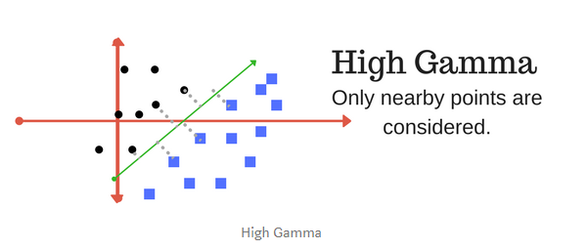
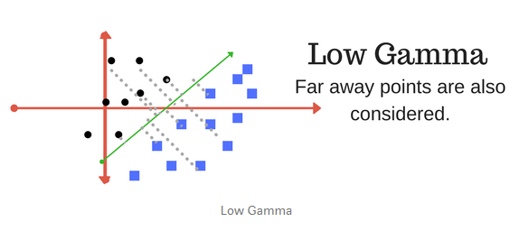
C. Gamma :-
14
The gamma parameter defines how far the influence of a single training example reaches, with low values meaning ‘far’ and high values meaning ‘close’. In other words, with low gamma, points far away from plausible seperation line are considered in calculation for the seperation line. Where as high gamma means the points close to plausible line are considered in calculation.

Slide 16
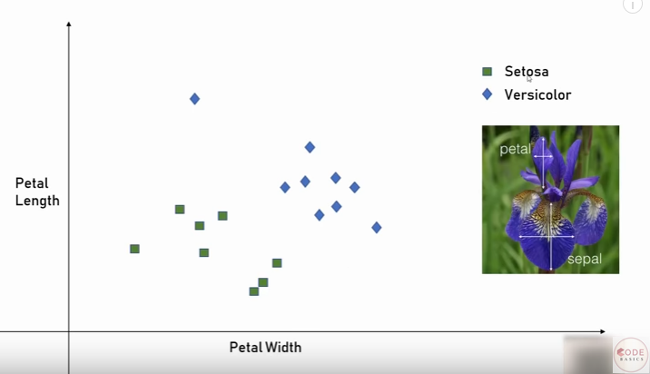
.
15

Slide 17
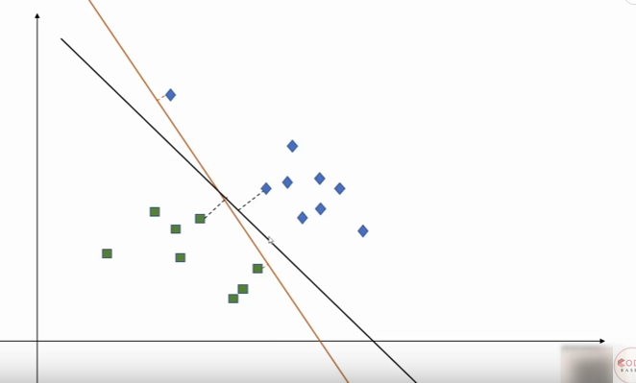
.
16

Slide 18
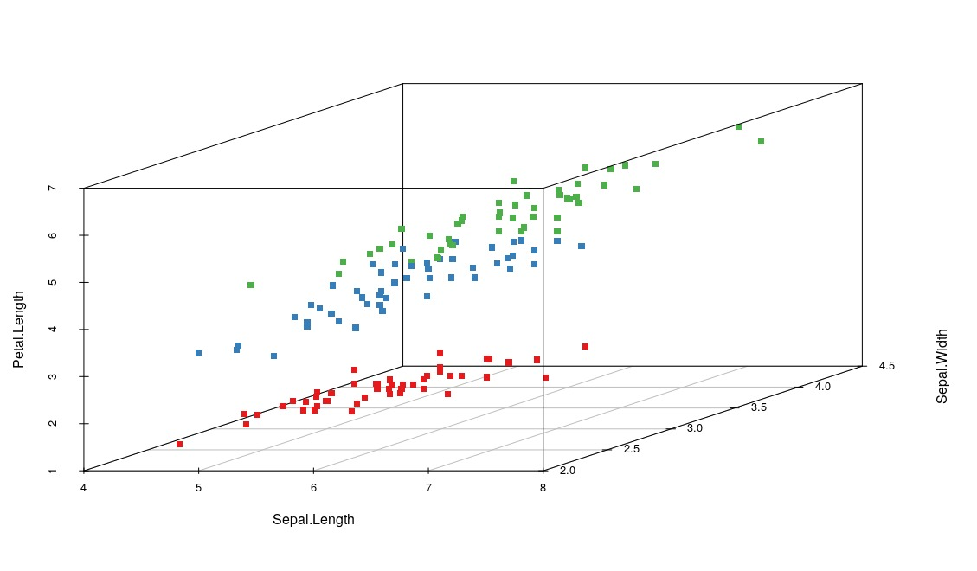
.
17

Slide 19
.
18
SVM(support vertor machine) implementation in python:-
Jupyter notebook

Slide 20
.
19
THANK YOU

