Slide 1
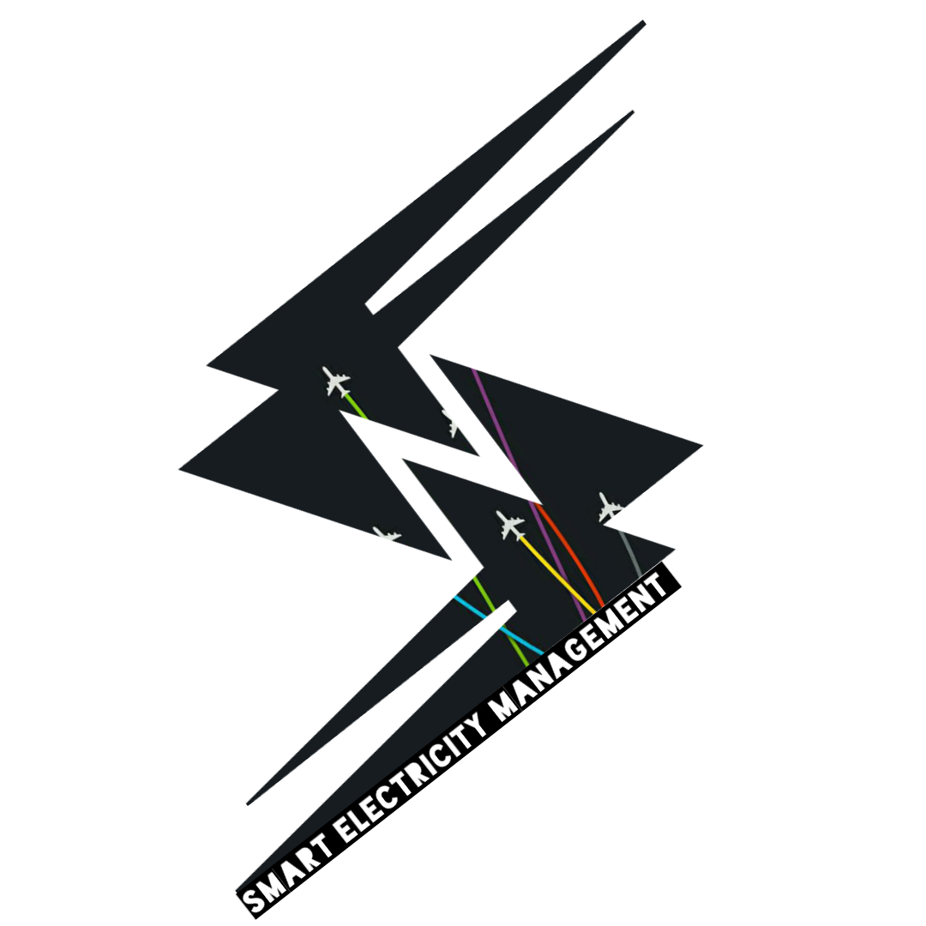
S_E_M
SMART ELECTRICITY MANAGEMENT

Slide 2
s_y_c_s_e
Sr.no. | Name | Roll no. | Mobile no. | Email ID
1) | AKSHAY DANKE | 1504049 | 7768997154 | akshaydanke09@gmail.com
2) | SWAPNIL MANE | 1504035 | 8806071666 | mswapnil108@gmail.com
3) | SAURABH LONDHE | 1504036 | 8888603379 | saurabhlondhe1111@gmail.com
4) | SAURABH PATIL | 1403059 | 9403116966 | sourabh1843@gmail.com
Project Guide
Ms. S.C.Bedage

Slide 3
What is “s_e_m” ??
Smart electricity management over IOT……………….
Go smart Go green……..
Save Electricity and Automize

Slide 4
introduction
As there is automization era evolving very fast then is it possible to save electricity using automization techniques?
Then answer to this question is yes. There are some automization techniques which can be used to save electricity.
We are optimizing human efforts by automizing the electricity management. Using aurdino and GSM module the electricity management would be done. Also many more calibration such as solar panel and MSEB parallel power supply system will be used to save electricity.

Slide 5
objectives
1. To save electricity
2. Automize the building
3. Apply the knowledge of app developing on home automation

Slide 6

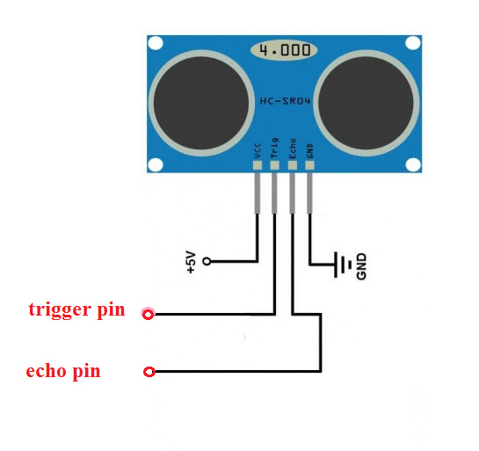

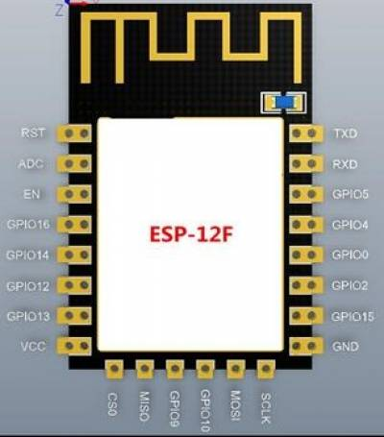
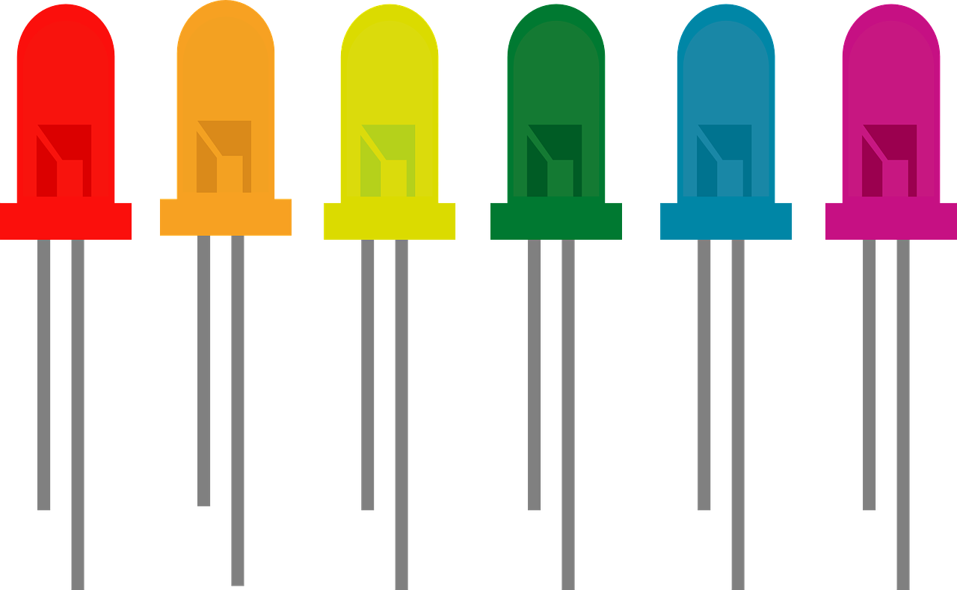
What we did………

Slide 7
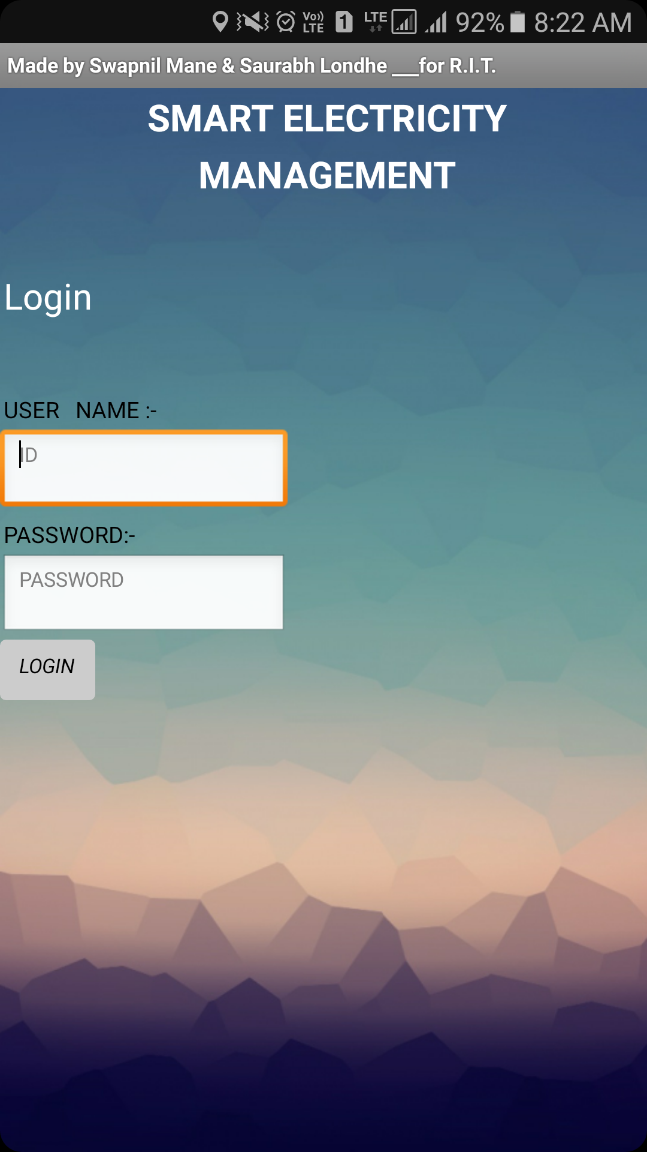
Login page

Slide 8
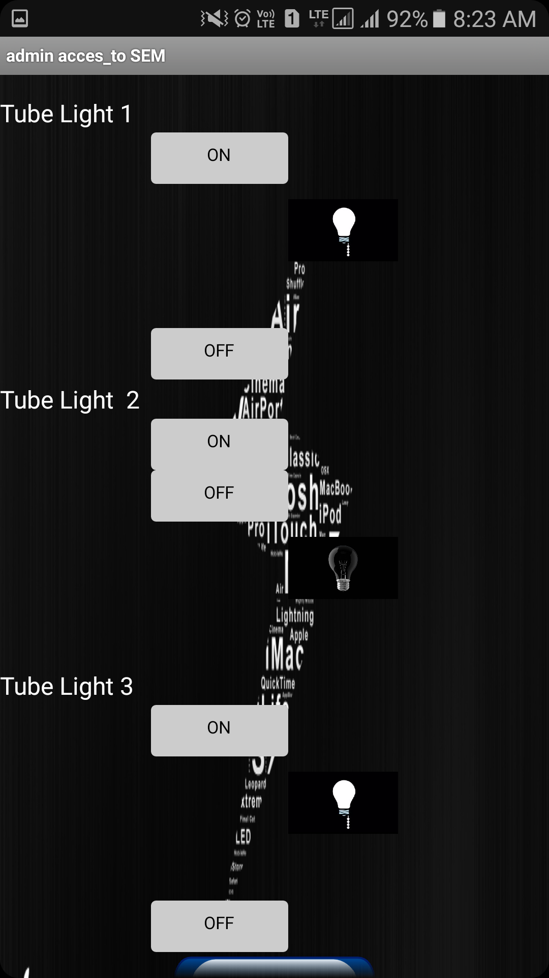
Control page
TUBE LIGHT 1 ON
TUBE LIGHT 2 OFF
TUBE LIGHT 3 ON

Slide 9
ADVANTAGES
1. Energy Savings
2. Convenience
3. Security

Slide 10
DISADVANTAGES
1. Installation
2. Complex Technology
3. System Compatibility
4. Cost

Slide 11
THANK YOU !

