Slide 1
SPAM RATING DETECTOR
SAURABH MEHTA
ARPEET KALE

Slide 2
INDEX
MOTIVATION
PROBLEM DEFINITION
KEY ISSUES
ALTERNATIVE WAYS TO RESOLVE ISSUES
RELATED WORK AND THEIR LIMITATIONS
APPROACH
ARCHITECTURE
EVALUATION
CONCLUSIONS
FUTURE WORK

Slide 3
MOTIVATION
To reduce the false perception about products that can be originated by “spam ratings”.

Slide 4
PROBLEM DEFINITION
The system is oriented to evaluate the accuracy of text­-based product reviews against the ratings provided for the same product. The purpose of this system is to identify “spam ratings” that affect the overall product review score.

Slide 5
KEY ISSUES
Spam ratings constitute misleading information that can jeopardize the perception about a product.
If people rely on ratings without reading the reviews, the presence of spam ratings/reviews would negatively affect the decision making process of consumers when they buy products.
Spam ratings provide inaccurate feedback. As a consequence good products may receive bad scores and vice versa, affecting revenue streams of companies.

Slide 6
ALTERNATIVE WAY TO RESOLVE THIS PROBLEM
A moderator can employed by the online retailer companies to review the ratings and review comments manually before publishing those to the website. This is not feasible, given the massive number of products on the online store.

Slide 7
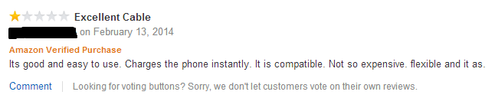
RELATED WORK AND LIMITATIONS
Our assumption is that major companies such as Amazon or Best Buy already have systems to evaluate the accuracy of a text­-based review in relation to the rating provided for a specific product. However, we do not have evidence to support this assumption because after performing experiments on Amazon and BestBuy by posting “spam ratings”, they were published on their websites, as shown in Figures 1 and 2.
Fig 1. Spam rating review on Amazon

Slide 8
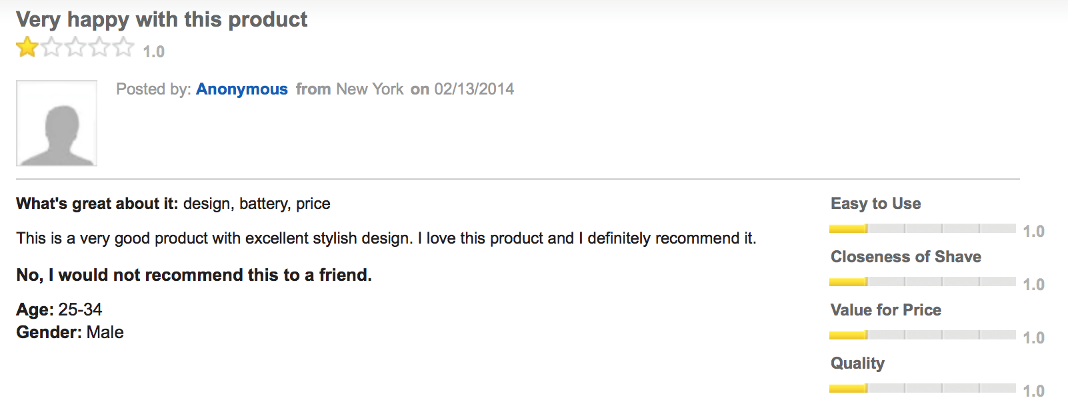
RELATED WORK AND LIMITATIONS
Fig 1. Spam rating review on BestBuy

Slide 9
RELATED WORK AND LIMITATIONS
Researchers Kuldeep Sharma and King-Ip Lin wrote the paper “Review spam detector with rating consistency check”, which studies the problem of spam in product reviews online, and proposes techniques to detect spam reviews (Sharma & Lin, 2013).

Slide 10
APPROACH
Extract data from BestBuy using BBYOPEN API
Preprocessing the data in the format accepted by Mahout
Using NaiveBayes classification algorithm to classify the reviews as “SPAM” and “NOT SPAM”

Slide 11
APPROACH
SKU
CLIENT
SERVER
SKU
PARSER
RESULT
DATA OBTAINED FROM BESTBUY IS PARSED
RESULT
CLASSIFIER

Slide 12
ARCHITECTURE
JAVASCRIPT CLIENT
PHP & JAVA SERVER
MAHOUT
MAP REDUCE
HDFS
(Hadoop Distributed File System)

Slide 13
EVALUATION
NaiveBayes using Mahout on Single-Node Hadoop Cluster
Evaluation of model on 333 Test Instances
Accuracy : 95.7958%
Correctly Classified Instances : 319
Incorrectly Classified Instances : 14

Slide 14
CONCLUSION
The system helps to identify the spam ratings/reviews, which will help to obtain more reliable rating score for products.
The accuracy of NaiveBayes for classifying ratings/reviews increased as the number of instances increased.
Using Mahout on single node Hadoop cluster for classifying the data increased the test performance as compared to implementation using WEKA’s Java libraries for the same dataset.

Slide 15
FUTURE WORK
Using a larger amount of data for classification
Evaluating dataset on other classification algorithms such as Support Vector Machine
Generalising this system for other product categories

