Slide 1
The OSI Model and the TCP/IP Protocol Suite

Slide 2
Objectives
  Understand the 7 layer OSI Model
  Know the purpose and responsibility of each layer of the OSI Model
  Understand the difference between the OSI Model and TCP/IP
  Know the relationship between the OSI layers and TCP/IP layers
  Know the different types of addressing used with TCP/IP
  Know the basic difference between IPv4 and IPv6

Slide 3
The OSI Model
  Open System Interconnection Model
  Dominated before 1990
  The TCP/IP protocol suite became dominant because of the Internet; the OSI model was never fully implemented.
  An open system is a set of protocols that allows any two different systems to communicate regardless of their underlying architecture.
  The OSI model is not a protocol; it is a model for understanding and designing a network architecture that is flexible, robust and interoperable.

Slide 4
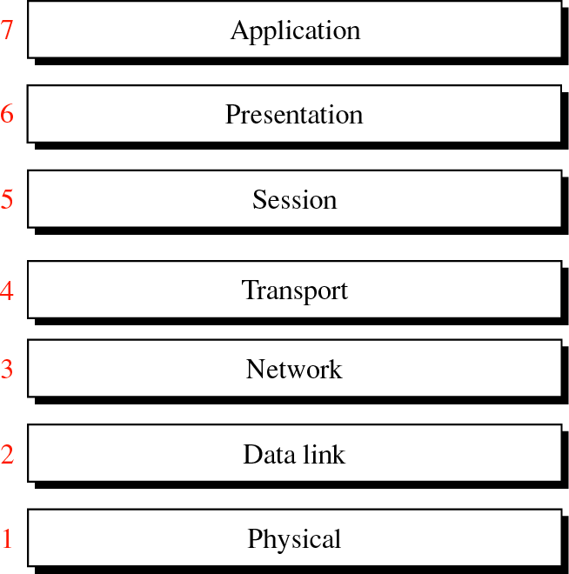
OSI Layers

Slide 5
Layered Architecture
  A message may pass through many intermediate nodes which usually involve only the first three layers of the OSI model.
  The OSI model
    identifies networking functions
    collected into groups that became the layers
  Comprehensive and flexible, allowing complete interoperability between otherwise incompatible systems.
  Agreed series of rules and conventions called protocols.

Slide 6
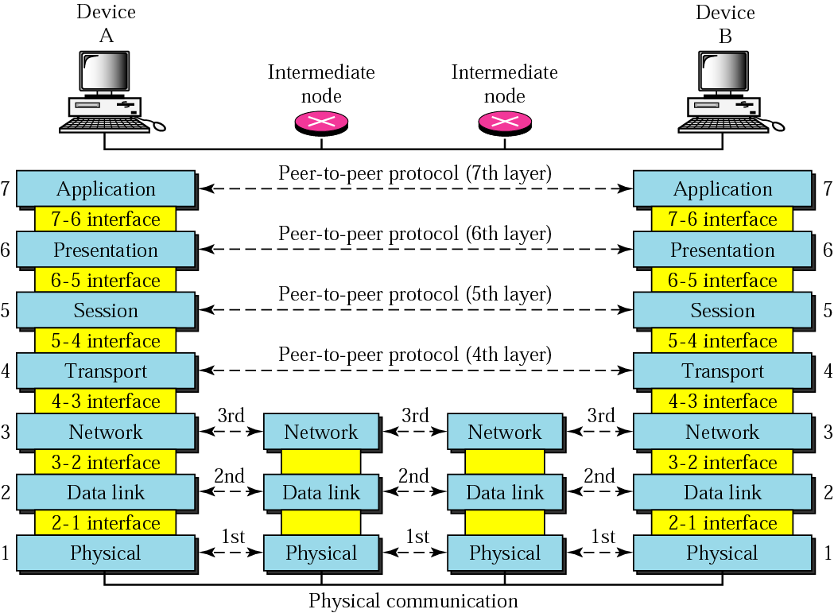
Peer-to-Peer Processes

Slide 7
Interfaces between layers
  Allows the passing of the data and network information down through the layers of the sending device and back up through the layers of the receiving device
  Each interface defines what information and services a layer must provide for the layer above it

Slide 8
Subgroups of Layers
  Network support layers
    1, 2 and 3, physical, data link and network
    Deal with the physical aspects of moving data from one device to another
  User support layers
    5, 6 and 7, session presentation and application
    Allow interoperability among unrelated software systems
  Transport Layer
    4 transport
    Links the two subgroups

Slide 9
Layers in the OSI Model
  Physical
  Data Link
  Network
  Transport
  Session
  Presentation
  Application

Slide 10
Physical
  Physical characteristics of interfaces and media.
  Representation of bits
  Data Rate
  Physical Topology
  Transmission Mode

Slide 11
Data Link
  Framing
  Physical Addressing
  Flow Control
  Error Control
  Access Control

Slide 12
Network
  Source-to-destination delivery of a packet possibly across multiple networks.
  Whereas the Data Link layer oversees the delivery of the packet between two systems on the same network.
  If two systems are connected to the same link, there is usually no need for a network layer. The network layer is designed to accomplish source-to-destination delivery.
  Logical addressing
  Routing
    connecting devices (routers or switches) route or switch the packets to their final destination.

Slide 13
Transport
The transport layer is responsible for the Process-to-process delivery of the entire message
  Network layer => oversees end-to-end delivery of individual packets; no relationship between packets, each one independent.
  Transport layer => whole message arrives intact and in order, error control and flow control.
Service-point addressing (Process/Port addressing)‏
Segmentation and reassembly
Connection, Flow and Error control

Slide 14
Session
Establishes, maintains, and synchronises the interaction between communicating systems
  Dialog control => Full/Half duplex
  Synchronisation => Checkpoints

Slide 15
Presentation
Syntax and Semantics of the information exchange
  Translation => Common format
  Encryption => Another form
  Compression => Less bits

Slide 16
Application
User interface and services
  Network virtual terminal => remote host access
  File transfer, access and management
  Mail services
  Directory services

Slide 17
TCP/IP Protocol Suite
TCP was developed prior to the OSI model, therefore layers do not match exactly with those in the OSI model.
The first four layers correspond to the first four layers of the OSI model.
The three top layers in the OSI model, however, are represented in TCP/IP by a single layer called the application layer.
TCP/IP protocol suite - contains independent protocols that can be mixed and matched.

Slide 18
TCP/IP Protocol Layers
At the transport layer there are two protocols
  Transmission Control Protocol (TCP) and User Datagram Protocol (UDP).
At the network layer
  main protocol Internetworking Protocol (IP)‏
There are some other protocols that support movement in this layer.

Slide 19
The Layers in the TCP/IP Protocol Suite
Application
FTP
HTTP
DNS
NFS
Presentation
…
Session
Transport
TCP
UDP
IP
ICMP
IGMP
Network
ARP
RARP
Data link
Physical

Slide 20
Physical and Data Link Layer
At the physical and data link layers, TCP/IP does not define any specific protocol.
It supports all of the standard and proprietary protocols. Like 802.3, HDLC and Frame Relay.
A network in a TCP/IP internetwork can be a LAN, MAN or WAN.

Slide 21
Network Layer
At the network layer TCP/IP supports the Inter networking Protocol (IP) which in turn contains four supporting protocols:
ARP
RARP
ICMP
IGMP

Slide 22
Internet Protocol (IP)‏
Unreliable and connectionless - Best-effort
No error checking or tracking.
IP transports data in packets called datagrams, each of which is transported separately.
IP does not keep track of routes and has no facility for reordering datagrams once they arrive at their destination.

Slide 23
Address Resolution Protocol (ARP)‏
Associates an Internet (IP) address with the physical address.
Each device on a link is identified by a physical or station address usually imprinted on the network interface card (NIC).
ARP is used to find the physical address of the node when its Internet address is known.

Slide 24
Reverse Address Resolution Protocol (RARP)‏
Allows a host to discover its Internet address when it knows only its physical address.
It is used when a computer is connected to the network for the first time or when a disk less computer is booted.

Slide 25
Internet Control Message Protocol (ICMP)‏
Used by hosts and gateways to send notification of datagram problems back to the sender.
  Like Echo Reply, Destination Unreachable, etc.
Sends query and error reporting messages.

Slide 26
Internet Group Management Protocol (IGMP)‏
Used to facilitate the simultaneous transmission of a message to a group of recipients.

Slide 27
Transport Layer
The transport layer is represented by two transport level protocols: TCP and UDP.
  Where IP is a host-to-host protocol (one physical device to another)‏
  TCP and UDP are process-to-process protocols (one running program to another)

Slide 28
User Datagram Protocol (UDP)‏
Simple
Adds only
  Port address
  Checksum error control
  Length information
Connection Less

Slide 29
Transmission Control Protocol (TCP)‏
Provides full transport layer services
Reliable stream (connection-oriented)‏

Slide 30
Application Layer
Is equivalent to the combined session, presentation and application layers in the OSI model.
Many protocols are defined at this layer.

Slide 31
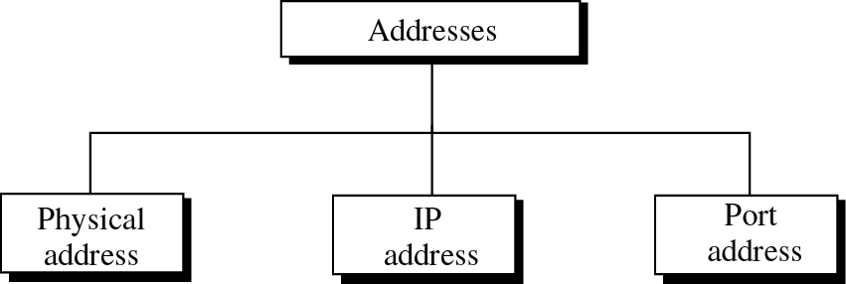
Addressing

Slide 32
Physical Address
The physical address (link address) is the address of a node as defined by its LAN or WAN.
It is included in the frame used by the data link layer. It is the lowest level address.
The size and format of these addresses vary depending on the network.
  48 – bits (6 bytes)‏ (802.3)‏
It is usually imprinted on the network interface card (NIC).

Slide 33
Unicast, Multicast and Broadcast Physical addresses
Physical addresses can be either
  Unicast => one single recipient.
  Multicast => a group of recipients
  Broadcast => received by all systems on the network.
Some networks support all three addresses some do not.

Slide 34
Internet Address
Internet addresses - universal communication independent of underlying physical networks; span multiple networks.
Physical addresses - not adequate in an internetwork where different networks can have different address formats.
Currently a 32-bit address
Uniquely defines a host connected to the Internet. No two hosts on the Internet can have the same IP address.

Slide 35
Port Address
The IP address and the physical address are needed to get a message from source to destination host.
The end objective is for a process to communicate with another process. So the process also needs an address.
The label assigned to a process is called a port address. A port address in TCP/IP is 16 bits long.

Slide 36
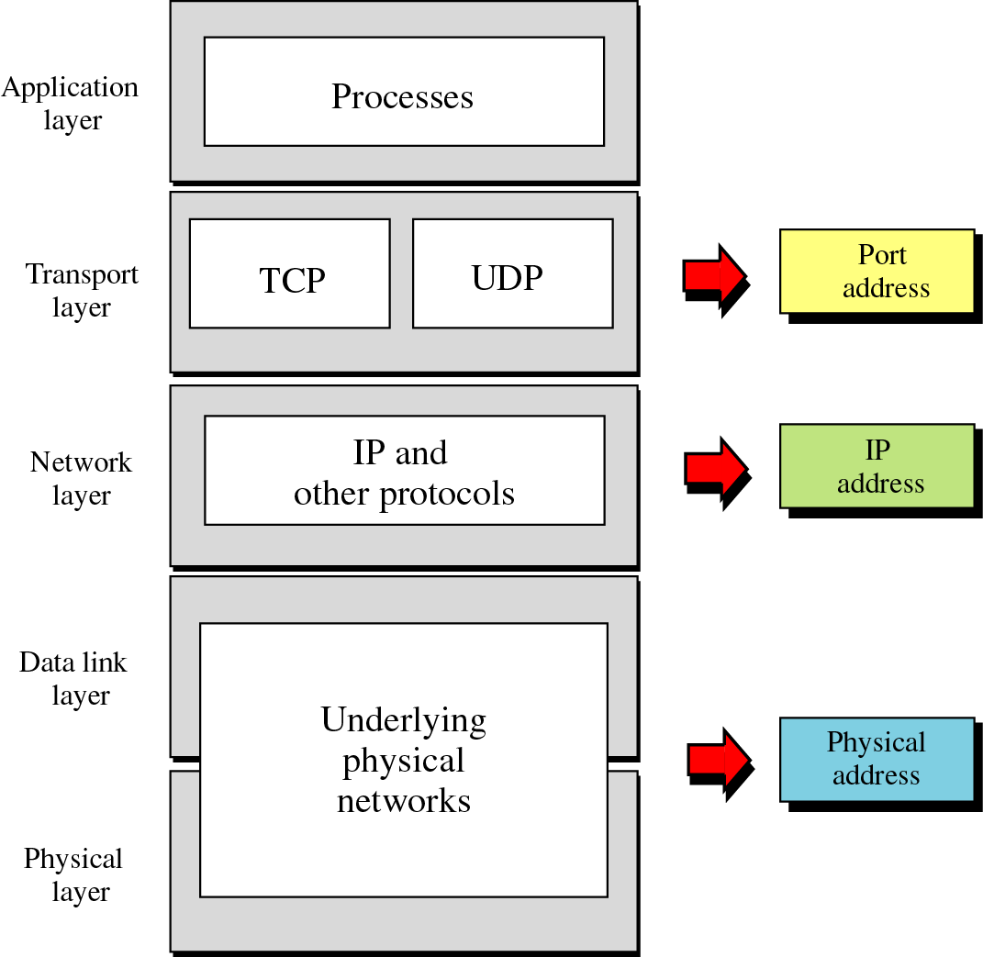
Layer Addresses

Slide 37
TCP/IP Versions
Version 4
  Current version widely used
  Primary problem is that not enough addresses exist to accommodate the rapid growth of the Internet.
Version 5
  Never got past the experimental stage
Version 6
  The new version implemented. 128 bits
In this course we will focus on IPv4.

