Slide 1
Subnetting/Supernetting and Classless Addressing
Training Division

Slide 2
Objectives
Subnetting
Different levels of hierarchy within an IP address
Subnetting a Class A, B or C network.
The process of Masking
To determine a network or subnetwork address from an IP address and a Mask.
Variable-length subnetting.
Supernetting
Classless addressing
Network address in classless addressing.

Slide 3
Subnetting
A network is divided into several smaller subnetworks
Each subnetwork has its own subnetwork address
IP addresses are designed with two levels of hierarchy
  Netid
  Hostid
Sometimes this is not enough

Slide 4
Three levels of Hierarchy
Adding a subnetwork creates an intermediate level of hierarchy
    site
    subnet
    host

Slide 5
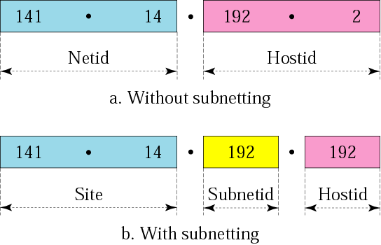
Three levels of Hierarchy

Slide 6
Routing of an IP datagram now requires three steps
Routing of an IP datagram now requires three steps
  delivery to the site
  delivery to the subnetwork
  delivery to the host
similar to a telephone number
  area code (080)‏
  exchange number (4150)‏
  extension number (7114)‏

Slide 7
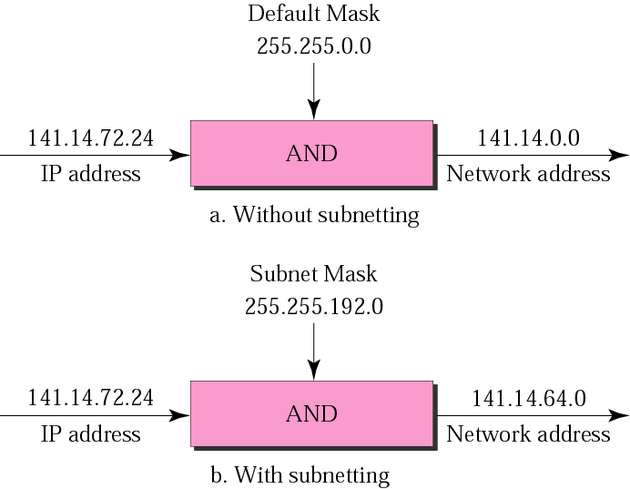
Subnet Mask
When a network is subnetted we must have a subnet Mask

Slide 8
Finding the Subnet Address
Given an IP address, the subnet address can be found by applying the subnet mask to the address
10001000 00101101 00100010 00111000 Address
11111111 11111111 11110000 00000000 SubNet Mask
10001000 00101101 00100000 00000000 SubNetwork Address
(bitwise AND)‏

Slide 9
Number of Subnetworks
found by counting the extra 1s used to make the subnet mask and determining the number of combinations this can represent
if 3 bits are used then 2^3 = 8 subnets can be represented

Slide 10
Number of Addresses per Subnet
found by counting the number of 0s in the subnet mask and determining the number of combinations this can represent
if number of 0s is 13; then there are 2^13 = 8192 possible addresses in each subnet

Slide 11
Special Addresses in Subnetting
two special addresses are added when using subnetting
the first address in each subnet (hostid all 0s) is the subnetwork address
the last address in each subnet (hostid all 1s) is reserved for the limited broadcast inside the subnet

Slide 12
Design Issues
How many subnets depend on
  physical location of site (number of buildings and/or floors)‏
  number of departments
  number of hosts needed in each subnet
  number of subnets must be a power of 2

Slide 13
Designing Subnets
Finding the Subnet Mask
  number of 1s in the default mask
  number of 1s that defines the subnets
  add 1s in 1. and 2.
  Find the number of 0s left (subtract 3. from 32)‏

Slide 14
Variable-Length Subnet Mask
This allows a network to be split into different sized subnets
A router uses two different masks, applied one after the other to determine which subnet the host is on.

Slide 15
Supernetting
Allows several networks to be combined to create a larger range of addresses.
For example this allows an organization to combine several Class C blocks together.

Slide 16
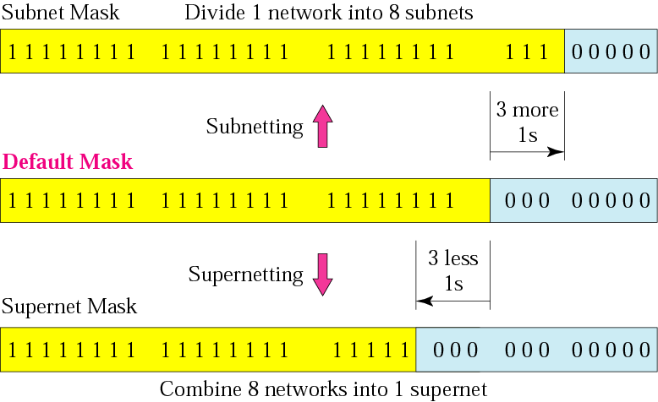
Supernet Mask
The reverse of a subnet mask

Slide 17
Classless Addressing
Allows for variable length address ranges for a more efficient use of available addresses.

Slide 18
Variable-Length Blocks
The idea behind classless addressing is to have variable-length blocks that belong to no class.
Blocks can be very small to very large which allows for different organisational requirements
Number of addresses in a block must be a power of 2
A household may be given a block of 2 addresses, a small business 16 addresses, a large organization 1024 addresses.

Slide 19

Slash Notation
Also known as CIDR (classless interdomain routing) notation
The n defines the number of bits that are the same in every address in the block.
If n is 20 the 20 leftmost bits are identical in each address with 12 bits not the same.
From this; the number of addresses in the block and the last address can be determined.

Slide 20
Finding the Network Address
Classless addressing guarantees that addresses are contiguous so by keeping the first n bits and setting the rest to 0s the network address is easily determined.

Slide 21
Subnetting
The procedure is very simple.
The prefix length (n) increases to define the subnet prefix length.

Slide 22
Supernetting
Not required as a new, larger block can simply be granted.

