Slide 1
ARP & RARP
Training Division

Slide 2
Objectives
Understand and be able to describe how logical addresses and physical addresses are mapped to each other
Understand and be able to describe and give examples of & use of ARP
Understand the advantage that a cache table provides to ARP
Understand and be able to describe and give examples of the use of RARP

Slide 3
Packet Delivery
Delivery of a packet to a host or a router requires two levels of addressing
  Logical => IP Addresses
  Physical => MAC addresses
Mapping of a logical address to its corresponding physical address and vice versa is required

Slide 4
Mapping
Static mapping
  a table stored in each machine on the network that associates a logical address with a physical address
Dynamic mapping
  knowing one of the two (logical or physical) address; uses a protocol to find the other one
  address resolution protocol (ARP)‏
  reverse address resolution protocol (RARP)‏

Slide 5
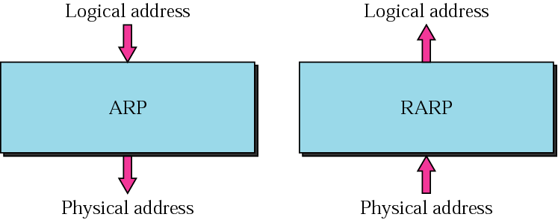
ARP and RARP

Slide 6
ARP
An IP datagram must be encapsulated in a frame to pass through the physical network. This requires the physical address of the receiver.
ARP associates an IP address with its physical address.

Slide 7
Obtaining the Physical Address
When the physical address of another host is required an ARP query packet is sent which includes
  IP address of sender
  IP address of the receiver
The intended recipient recognizes its IP address and send back an ARP response which contains the physical address.

Slide 8
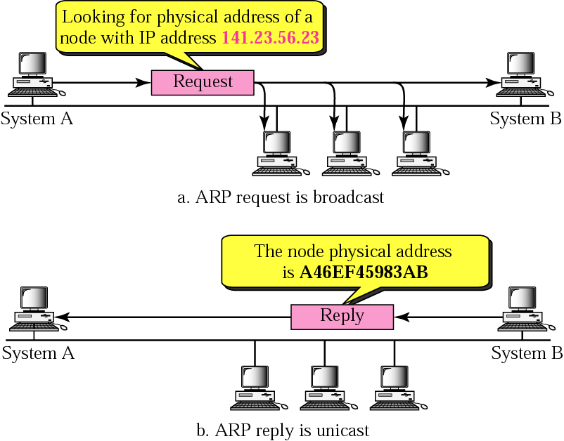
ARP Operation

Slide 9
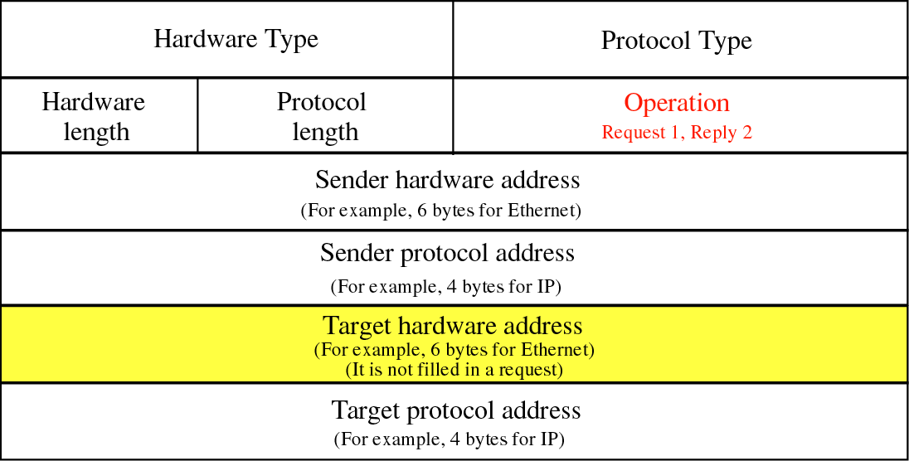
Packet Format

Slide 10
ARP Packet fields
Hardware Type : 16 – bit field defines type of network; Ethernet – 1
Protocol Type : 16 – bit; IPv4 protocol is 0x800
Hardware LEN : 8 – bit; ethernet address – 6 bytes
Protocol LEN : 8 – bit; logical address – 4 bytes
Operation : 16 – bit; ARP req – 1; ARP reply – 2
Sender Hardware Address: Defines the physical address (MAC) of the sender ( source host ), for Ethernet this field is 6 bytes long.
Sender Protocol Address: Defines the Logical Address (IP) of the sender, for IPv4 protocol this field is 4 bytes long.
Target Hardware Address: Defines the Target hardware address, in case of request this value is all 0's.
Target Protocol Address: Defines the logical address of the target, for IPv4 protocol this field is 4 bytes long.

Slide 11
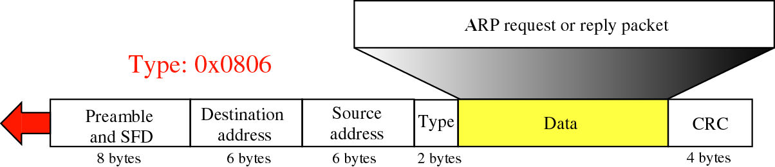
Encapsulation
An ARP packet is encapsulated directly into a data link frame.

Slide 12
ARP functions
Sender knows IP address
IP asks ARP to create an ARP request message
  sender physical address
  sender IP address
  target IP address
  target physical address filled with 0's

Slide 13
ARP functions
Message passed to data link layer; destination address = broadcast address
All hosts receive frame; only target host accepts the packet
Target host replies (unicast) with an ARP reply message containing the physical address
Sender receives reply; it now knows the physical address of the target host
IP datagram's are now unicast to the destination host
ARP request is broadcast; ARP reply is unicast

Slide 14
Four different cases
The sender is a host and wants to send a packet to another host on the same network
The sender is a host and wants to send a packet to another network
The sender is a router that has received a datagram destined for a host on another network
The sender is a router that has received a datagram destined for a host in the same network

Slide 15
Proxy ARP
It is an ARP that acts on behalf of a set of hosts
Router running as proxy ARP receives ARP request looking for the IP address of one of those hosts in the n/w, the router sends an ARP reply announcing its own hardware address
After router receives the actual IP packet, it sends the packet to the appropriate host or router

Slide 16
Cache Table
A sender usually has more than one IP datagram to send to the same destination
It is inefficient to use ARP for each datagram
A cache table is used
  limited size
  mappings retained only for a limited time

Slide 17
RARP
Finds the logical address for a host that only knows its physical address
RARP request packets are broadcast; RARP reply packets are unicast
Used by diskless machines to obtain their IP addresses (Service type 0x8035)‏
RARP request is broadcast; RARP reply is unicast

Slide 18
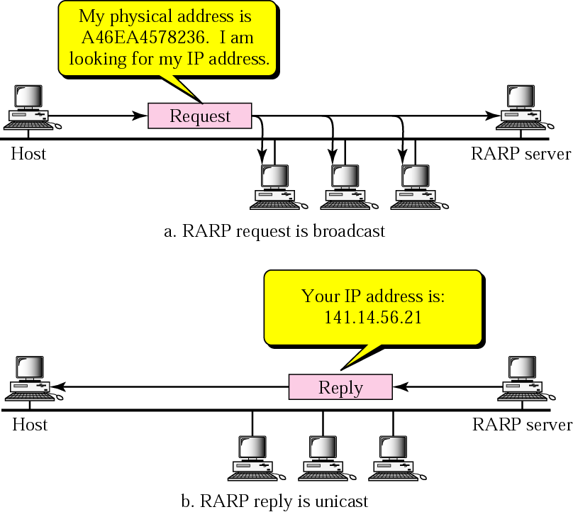
Operation

