Slide 1
Internet Control Message Protocol (ICMP)‏
Training Division

Slide 2
Objectives
Understand why ICMP is required and the benefits it provides
Understand and be able to describe the different ICMP message types
Understand and be able to describe the different error reporting mechanisms and when they are used
Understand and be able to describe the different query reporting mechanisms and when they are used

Slide 3
IP protocol
IP protocol is a best-effort delivery service, however it has two deficiencies
  Lack of error control
  Lack of assistance mechanisms

Slide 4
IP protocol
IP protocol has no error-reporting or error-correction mechanism
  What happens when something goes wrong?
  What happens if a router must discard a datagram because it cannot find a route to the final destination?
  What if the time-to-live field has a zero value?
  What if it has to discard all fragments because not all were received in a predetermined time limit?

Slide 5
IP protocol
IP protocol also lacks a mechanism for host and management queries
ICMP was designed to compensate for these deficiencies
It is a companion to the IP protocol

Slide 6
ICMP Encapsulation
ICMP
message
IP header
IP data
Frame
Header
Frame Data
Trailer

Slide 7
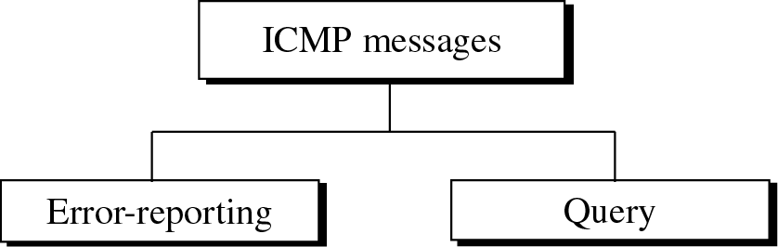
Types of messages

Slide 8
ICMP Error-reporting messages
Category
Type
Message
Error Reporting Messages
3
Destination Unreachable
4
Source Quench
11
Time exceeded
12
Parameter Problem
5
Redirection

Slide 9
ICMP Query messages
Category
Type
Message
Query Messages
8 or 0
Echo request or reply
13 or 14
Timestamp request or reply
17 or 18
Address mask request or reply
10 or 9
Router solicitation or advertisement

Slide 10
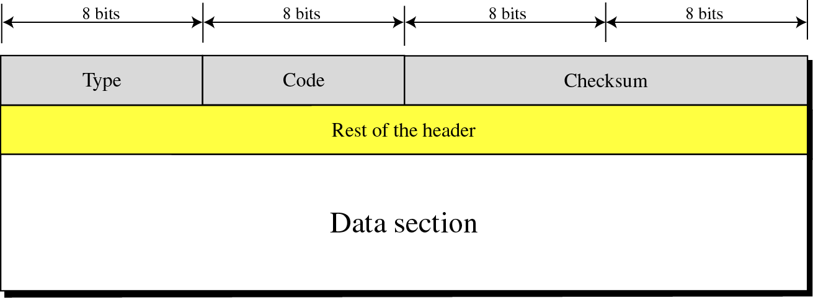
Message Format
Type field specifies the type of error or query message being transmitted.
Code field specifies the reason for the message type.
Data section carries information for finding original packet that had the error

Slide 11
Error Reporting
One of the main responsibilities of ICMP is to report errors
Does not correct errors, Simply reports them
ICMP always reports error messages to the original source

Slide 12
No ICMP error message will be generated
In response to a datagram carrying an ICMP error message.
For a fragmented datagram that is not the first fragment.
For a datagram having a multicast address.
For a datagram having a special address such as 127.0.0.0 or 0.0.0.0

Slide 13
Error Messages
All error messages contain a data section that includes the IP header of the original datagram plus the first 8 bytes of data in that datagram.
This information is required so the source can inform the protocols about the error.

Slide 14
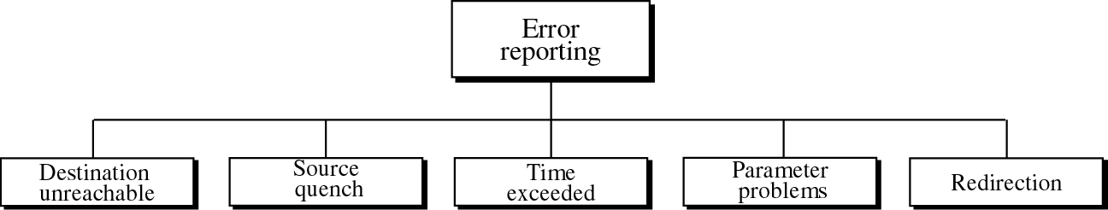
Types of Errors

Slide 15
Destination Unreachable
When a router cannot route a datagram or a host, or cannot deliver a datagram
A router cannot detect all problems that prevent the delivery of a packet

Slide 16
Destination-unreachable format
Type : 3
Code : 0 to 15
Checksum
Unused (All 0s)‏
Part of the received IP datagram including IP header
plus the first 8 bytes of datagram data

Slide 17
Destination-unreachable codes
Code 0 – network is unreachable; possible hardware failure, given by router.
Code 1 – the host is unreachable; possible hardware failure, given by router.
Code 2 – the protocol is unreachable; generated by destination host.
Code 3 – the port is unreachable; generated by destination host.
Code 4 – fragmentation is required, but DF flag set
Code 5 – Source routing cannot be accomplished
Code 6 – the destination network is unknown
Code 7 – the destination host is unknown
Code 8 – the source host is isolated

Slide 18
Destination-unreachable codes
Code 9 – comm. With the destination n/w is administratively prohibited
Code 10 - comm. With the destination host is administratively prohibited
Code 11 – the n/w is unreachable for the specified type of service
Code 12 – the host is unreachable for the specified type of service
Code 13 – the host is unreachable because the admin. has put a filter on it
Code 14 – the host is unreachable because the host precedence is violated
Code 15 – the host is unreachable because its precedence was cut off

Slide 19
Source Quench
IP protocol has no flow control
Routers and hosts have limited size queues (buffers)‏
If datagrams are received faster than they can be processed the queue may overflow
If a router or host discards a datagram due to congestion, it sends a source-quench message to the sender
The source must slow down the sending of datagrams until the congestion is relieved
One source-quench message should be sent for each datagram that is discarded due to congestion

Slide 20
Time Exceeded
whenever a router receives a datagram with a time-to-live value of zero, it discards the datagram and sends a time-exceeded message to the source (code = 0)‏
when the final destination does not receive all of the fragments in a set time, it discards the received fragments and sends a time-exceeded message to the source (code = 1)‏

Slide 21
Parameter Problem
If an ambiguity is found in the header of a datagram the datagram is discarded and a parameter-problem message is sent back to the source
  Code = 0 : there is an error or ambiguity in one of the header fields
  Code = 1 : the required part of an option is missing

Slide 22
Redirection
A host usually starts with a small routing table that is gradually augmented and updated.
One of the tools to accomplish this is the redirection message.
A redirection message is sent from a router to a host on the same local network

Slide 23
Redirection codes
Code 0 – redirection for a n/w specific route
Code 1 – redirection for a host-specific route
Code 2 – redirection for a n/w specific route based on a specified type of service
Code 3 - redirection for a host specific route based on a specified type of service
Type : 5
Code : 0 to 3
Checksum
IP address of the target router
Part of the received IP datagram including IP header plus the first 8 bytes of datagram data

Slide 24
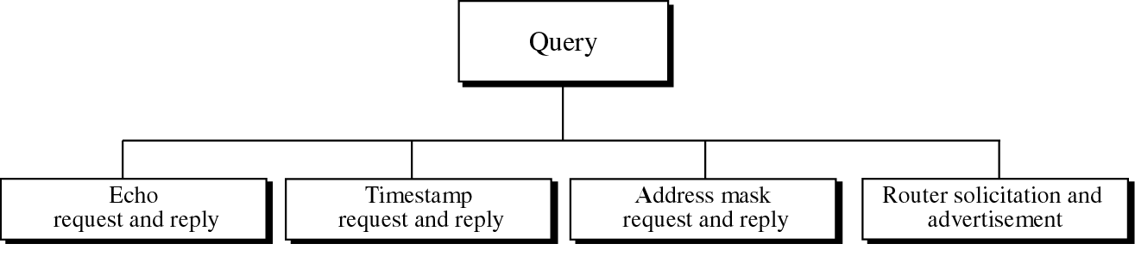
Query
ICMP can also diagnose some network problems

Slide 25
Echo Request and Reply
An echo-request message can be sent by a host or router.
An echo-reply message is sent by the host or router which receives an echo-request message.
Echo-request and echo-reply messages can be used by network managers to check the operation of the IP protocol.
Echo-request and echo-reply messages can test the reachability of a host. This is usually done by invoking the ping command.

Slide 26
Echo Request and Reply format
May be Process ID
8 : echo request
0 : echo reply
Type : 8 or 0
Code : 0
Checksum
Identifier
Sequence number
Optional data
Sent by the request message;
repeated by the reply message

Slide 27
Timestamp Request and Reply
Timestamp-request and timestamp-reply messages can be used to calculate the round-trip time between a source and a destination machine even if their clocks are not synchronised.
Sending time = value of receive timestamp - value of original timestamp
Receiving time = time the packet returned - value of transmit timestamp
Round-trip time = sending time + receiving time
The timestamp-request and timestamp-reply message can be used to synchronise two clocks in two machines if the exact one-way time duration is known.

Slide 28
Address-Mask Request and Reply
Enables a host to request and receive the network or subnetwork mask.
Useful for diskless stations at start-up.

Slide 29
Router Solicitation and Advertisement
Allows for request of routing information and the reply of this information.
Routers can periodically send router-advertisements without being solicited.

Slide 30
Checksum
In ICMP the checksum is calculated over the entire message (header and data).

