Slide 1
Delivery and Routing of IP Packets
Training Division

Slide 2
Objectives
Connection-oriented and connectionless services
Differences between direct and indirect delivery
Methods used in delivery and routing of IP Packets
Describe routing table and routing module are structured and work to route packets
Classless Address routing

Slide 3
Delivery, Forwarding and Routing of IP Packets
Delivery: the way Packets are handled by the underlying network under the control of network layer.
  Connection oriented
  Connection less
Forwarding: the way packet is delivered to the next station or stations.
  Various forwarding methods
Routing: the way the routing tables are created to help forwarding
  Static & Dynamic Routing

Slide 4
Connection-oriented Vs Connectionless Services
Connection-oriented
  network layer first makes a connection with remote site before sending a packet
  packets sent on the same path in sequential order
  decision about route is made only once
Connectionless
  network layer protocol treats each packet independently
  packets sent may not travel the same path
  IP protocol is a connectionless protocol

Slide 5
Direct versus Indirect Delivery
Delivery of a packet to its final destination is accomplished using two different methods of delivery
  Direct delivery
  Indirect delivery

Slide 6
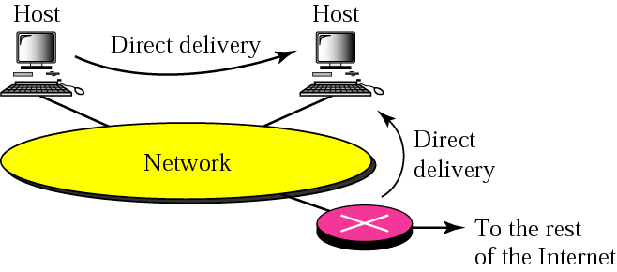
Direct Delivery
Final destination is a host connected to the same physical network as the deliverer
Sender uses the destination IP address to find the destination physical address (ARP)‏

Slide 7
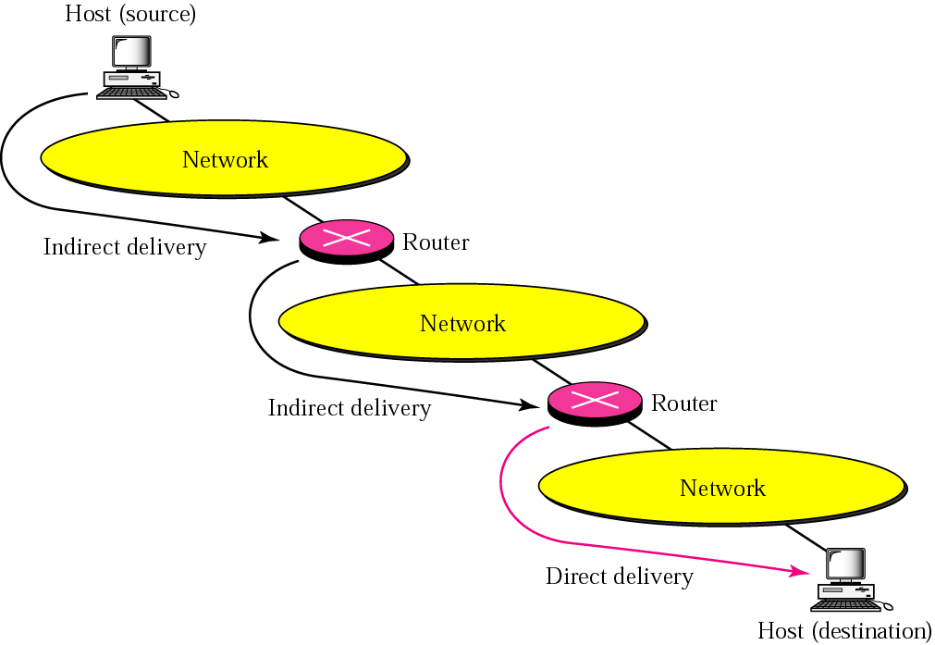
Indirect Delivery
Destination host is not on the same network as the deliverer

Slide 8
Indirect delivery
The packet goes from router to router until it reaches the one connected to the same physical n/w as its final destination
The sender uses the destination IP address and a routing table to find the IP address of the next router to which the packet should be delivered

Slide 9
Forwarding Methods
Forwarding requires a host or router to have a routing table.
This table is looked up to find the route to the final destination.
A single table is no longer a good solution due to the number of entries required (size of the Internet).
Other methods have been developed.

Slide 10
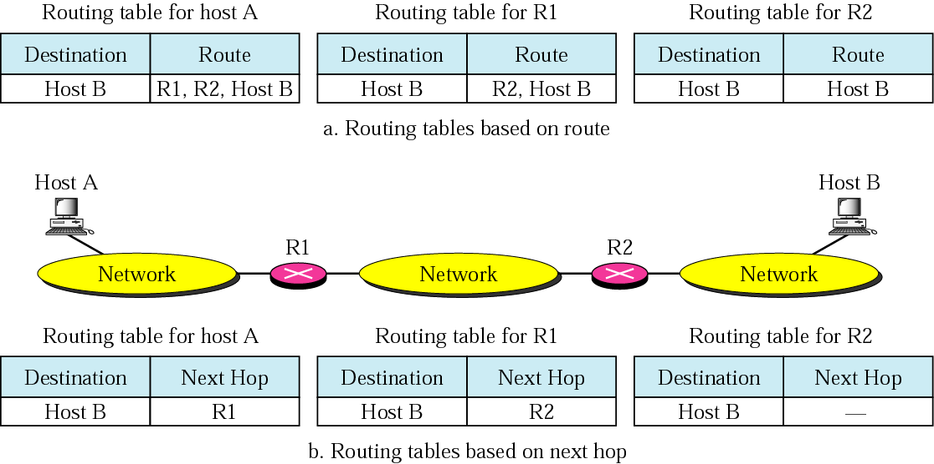
Next-Hop Method
Reduces the size of the routing table by only recording the address of the next hop instead of the complete route.

Slide 11
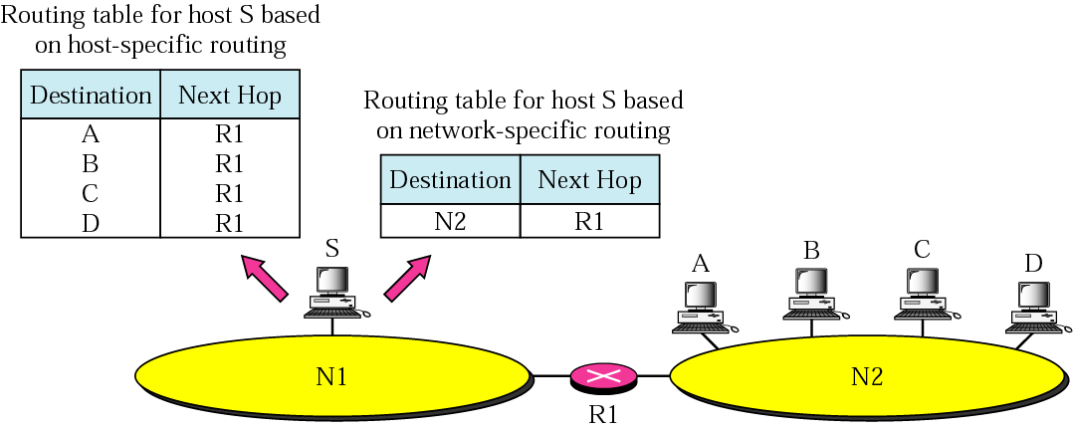
Network-Specific Method
Only one entry to define the address of the network itself
All hosts on a network are treated as one

Slide 12
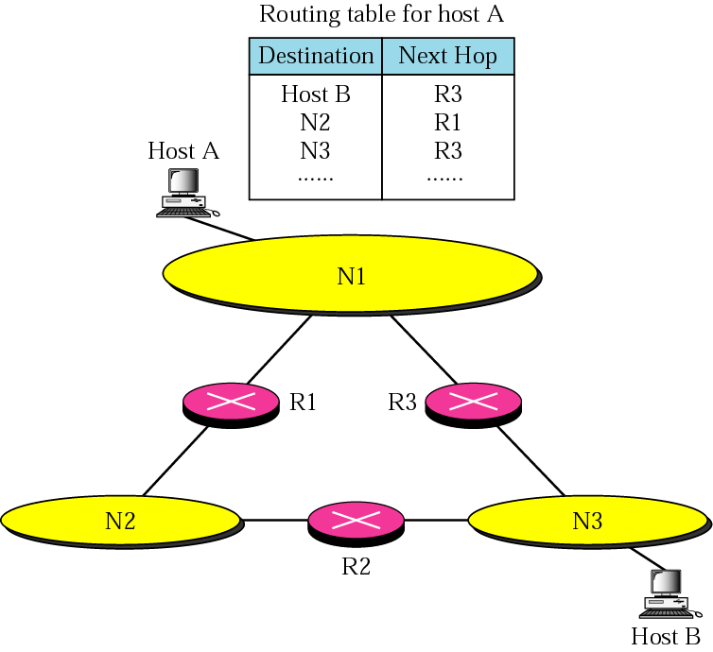
Host-Specific Method
Destination host is given in routing table
Efficiency in size of routing table sacrificed for other advantages
  More control over routing
  Security

Slide 13
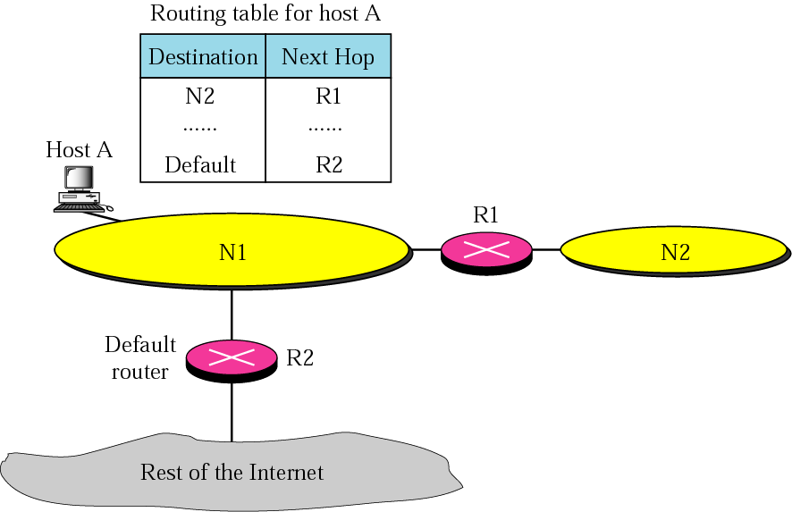
Default Method
One entry called the default sends all non matching packets to a default destination
  Default entry n/w address 0.0.0.0

Slide 14
Static versus Dynamic Routing
Static Routing Table
  contains information entered manually
  does not update automatically when there is a change in the Internet
  used on a small Internet
Dynamic Routing Table
  updated periodically using a dynamic routing protocol
    RIP (Routing Information Protocol)‏
    OSPF (Open Shortest Path First)‏
    BGP (Border Gateway Protocol)‏
  whenever there is a change, the dynamic routing protocol updates all of the tables in the routers

Slide 15
Routing Table and Routing Module
When looking for the route, a router checks the following in order
  direct delivery
  host-specific delivery
  network-specific delivery
  default delivery
Hierarchy is implemented in the routing module

Slide 16
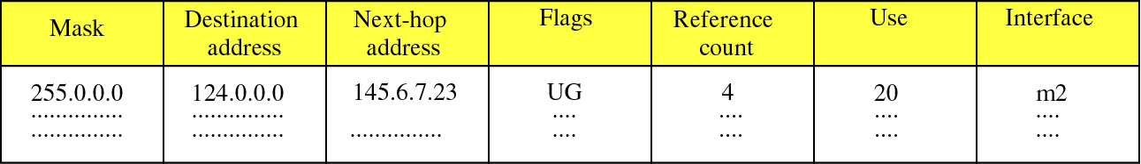
Routing Table
Organised in a hierarchical scheme

Slide 17
Fields in a routing table
Mask
  Defines the mask applied to the destination IP address to find the network or subnetwork address of the destination
Destination Address
  defines either the destination host (host-specific) or the destination network address (network-specific)‏
Next-hop Address
  defines the address of the next-hop router the packet is to be delivered

Slide 18
Fields in a routing table
Flags
  U (Up)‏
    router is up and running
  G (Gateway)‏
    destination is another network
  H (Host-specific)‏
    destination is a host-specific address
  D (added by redirection)‏
    entry added by redirection message from ICMP
  M (Modified by redirection)‏
    entry modified by redirection message from ICMP

Slide 19
Fields in a routing table
Reference count
  Number of users using the route
Use
  number of packets transmitted
Interface
  Name of the interface

Slide 20
Routing Module
goes from entry to entry trying to find a match
first looks for a direct-delivery match, then host-specific delivery match and so on until a match is found

Slide 21
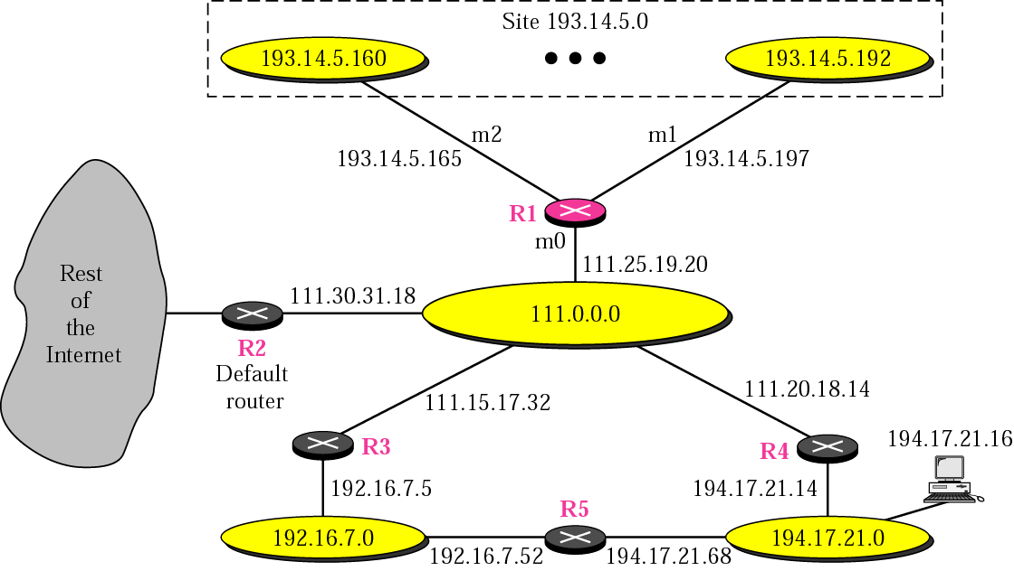
Example

Slide 22
Example Routing table
Mask
Destination
Next Hop
F.
R.C.
U.
I.
255.0.0.0
111.0.0.0
-
U
0
0
m0
255.255.255.224
193.14.5.160
-
U
0
0
m2
255.255.255.224
193.14.5.192
-
U
0
0
m1
…
…
…
…
…
…
…
255.255.255.255
194.17.21.16
111.20.18.14
UGH
0
0
m0
255.255.255.0
192.16.7.0
111.15.17.32
UG
0
0
m0
255.255.255.0
194.17.21.0
111.20.18.14
UG
0
0
m0
0.0.0.0
0.0.0.0
111.30.31.18
UG
0
0
m0

Slide 23
Classless Addressing: CIDR
Requires changes to the routing table organisation and routing algorithms
Hierarchical Routing
  divide the address space into blocks
Routing Table Search Algorithms
  changed to make classless routing more efficient
  no self-contained information in the destination address
  buckets are used with other data structures (tree or binary tree)‏

