Slide 1
User Datagram Protocol (UDP)‏
Training Division

Slide 2
Objectives
Understand and be able to describe the operation and use of UDP.
Understand and be able to describe how Process-to-Process communication is achieved using UDP.
Know and be able to draw and describe each field in a user datagram.
Understand the advantages and disadvantages that UDP has compared to TCP.
Understand and be able to describe the process-to-process communication requirements of UDP.
Be able to provide examples of when to use UDP.

Slide 3
UDP
UDP is a transport layer protocol within the TCP/IP protocol suite.
UDP is simpler than TCP.
UDP lies between the application layer and the IP layer and, like TCP, serves as the intermediary between the application programs and the network operations

Slide 4
Transport layer protocol responsibilities
Creating a process-to-process communication path
Provide control mechanisms at the transport level (very minimal level)‏

Slide 5
Connectionless, Unreliable transport protocol
Only adds process-to-process communications to IP
Performs very limited error checking
Very simple protocol has minimal overhead

Slide 6
Process-to-Process Communication
IP is responsible for host-to-host communication.
Message still needs to be handed to the correct process.
UDP is responsible for delivery of the message to the appropriate process.

Slide 7
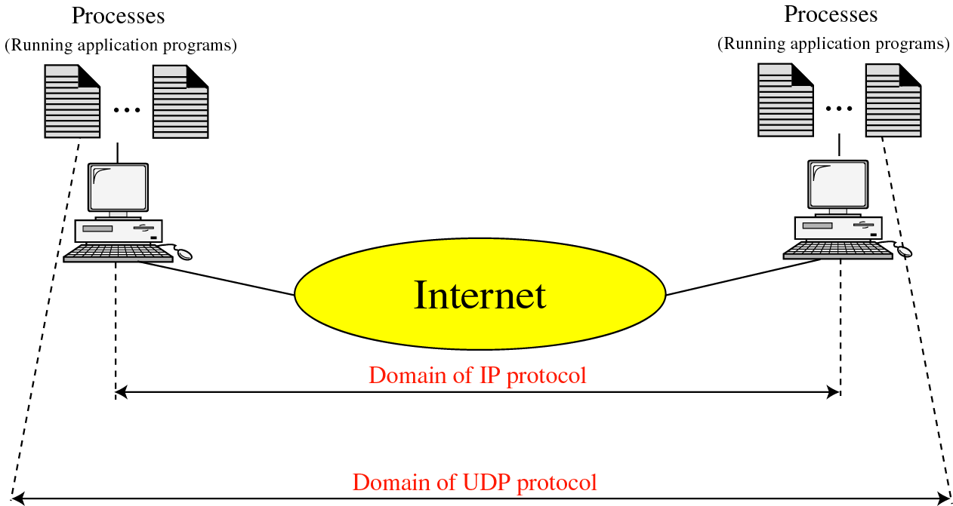
UDP V/S IP

Slide 8
Port Numbers
Local host and remote host are defined by IP addresses
A second identifier called port number is required to identify processes
In TCP/IP port numbers are integers between 0 and 65,535
The server process requires a well-known port number
The client process defines a port number, chosen randomly by UDP, which is known as an ephemeral port number

Slide 9
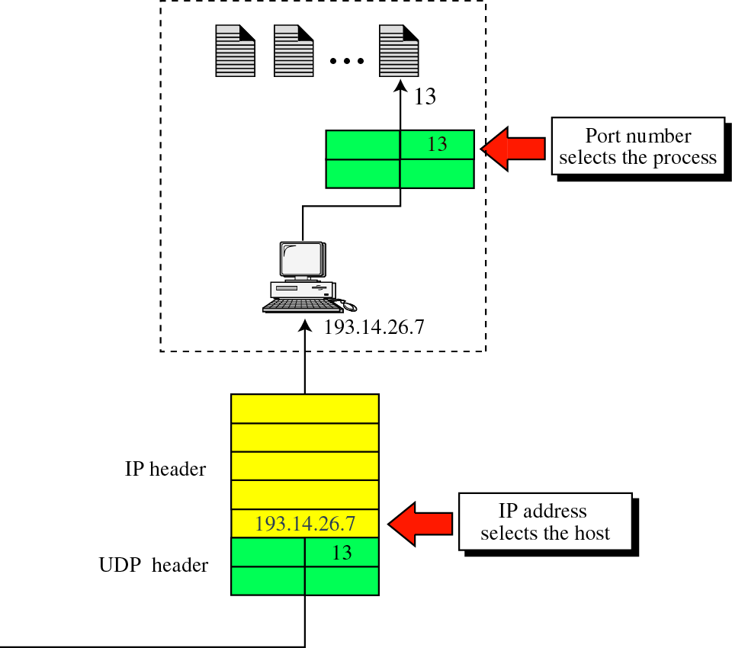
IP addresses versus port numbers

Slide 10
ICANN Ranges
Well-known ports
  Ranging from 0 to 1,023 are assigned and controlled by ICANN.
Registered ports
  Ranging from 1,024 to 49,151 are not assigned or controlled by ICANN. Can only be registered with ICANN to prevent duplication.
Dynamic ports
  Ranging from 49,152 to 65,535 are neither controlled nor registered. Can be used by any process. (known as ephemeral ports)‏

Slide 11
Socket Addresses
The combination of an IP address and a port number is called a socket address
Uniquely defines each client and server process.

Slide 12
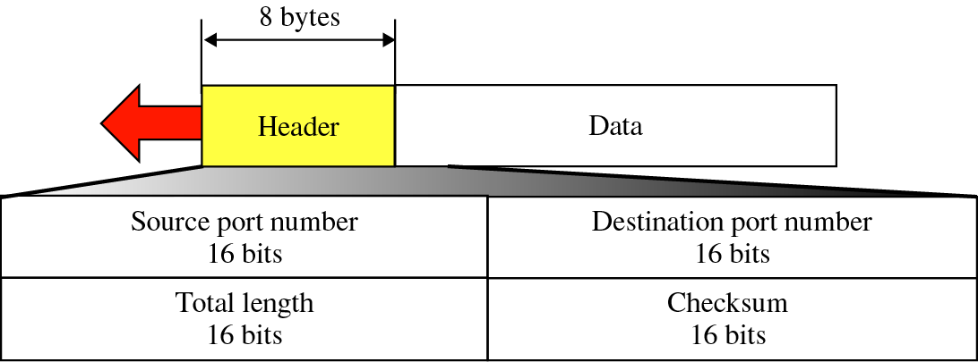
User Datagram Format

Slide 13
Header
Source port number
  16-bits
  range from 0 to 65,535
  port number used by the process running on the source host

Slide 14
Header
Destination port number
  16-bits
  port number used by the process running on the destination host
  in most cases, is a well-known port number

Slide 15
Header
Length
  16-bits
  defines the total length of the user datagram, header plus data
  Note: maximum size of data is 65,507 (65,535 - 20 - 8) bytes (20 bytes for IP header and 8 bytes for UDP header)

Slide 16
Header
Checksum
  used to detect errors over the entire user datagram

Slide 17
Checksum
Includes three sections
  pseudoheader
    part of the header of the IP packet
    ensures that if the IP header is corrupted that the user datagram is not delivered to the wrong host
  UDP header
  Data

Slide 18
UDP Operation
Connectionless Services
Flow and Error Control
Encapsulation and Decapsulation
Queuing
Multiplexing and Demultiplexing

Slide 19
Connectionless Services
Each user datagram sent is an independent datagram
No relationship between different user datagrams
User datagrams not numbered
No connection establishment and no connection termination
Each user datagram can travel on a different path
Only processes sending short messages should use UDP

Slide 20
Flow and Error Control
Very simple, unreliable transport protocol
No flow control
The receiver may overflow with incoming messages
No error control except for the checksum
Sender does not know if a message has been lost or duplicated
An error in the checksum causes the user datagram to be silently discarded

Slide 21
Encapsulation and Decapsulation
To send a message from one process to another, the UDP protocol encapsulates and decapsulates messages

Slide 22
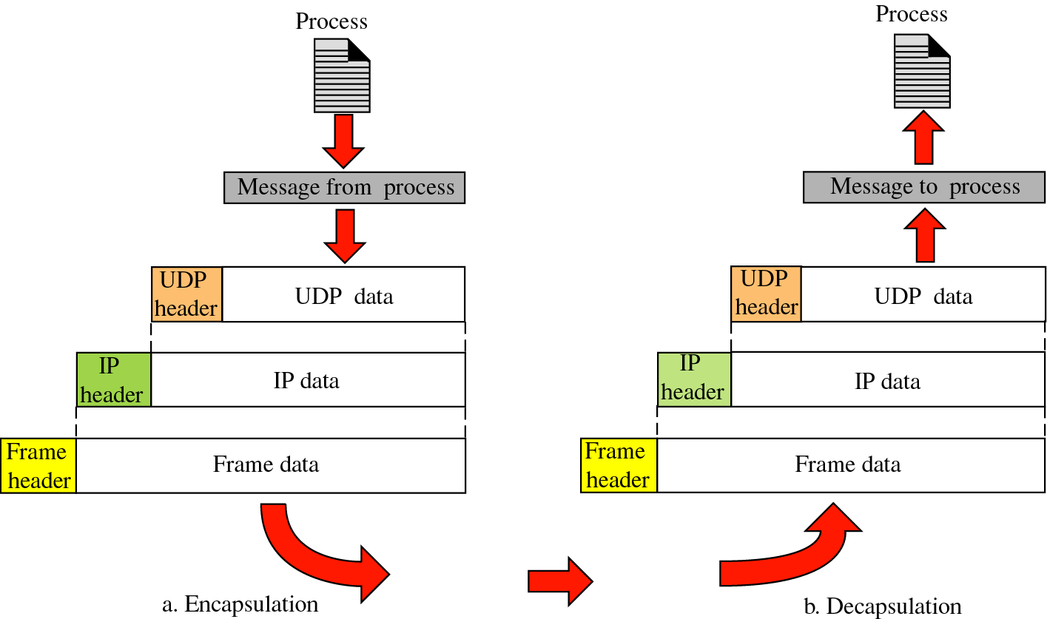
Encapsulation and Decapsulation

Slide 23
Queuing
Each port has an associated incoming queue or incoming and outgoing queue
Outgoing
  UDP removes messages from the queue one by one
  adds the UDP header
  delivers them to IP
Incoming
  UDP checks to see if an incoming queue exists
  if there is, UDP sends the user datagram to the end of the queue
  if there is not, UDP discards the user datagram and asks ICMP to send a port unreachable message

Slide 24
Multiplexing and Demultiplexing
Several processes may want to use the services of UDP
UDP multiplexes and demultiplexes to handle this

Slide 25
Use of UDP
Suitable for processes that require simple request-response communication
Suitable for processes which include internal flow and error-control mechanisms
Suitable for multicast and broadcasting
Used for management processes such as SNMP
Used for some route updating protocols such as RIP

