Slide 1
Transmission Control Protocol (TCP)‏
Training Division

Slide 2
Objectives
The operation and use of TCP.
Process-to-Process communication using TCP.
Various TCP services.
TCP segment numbering, Flow and Error control.
Congestion control used with TCP.
Field in a TCP segment.
Advantages and disadvantages that TCP has compared to UDP.
Connection process used with TCP.

Slide 3
TCP
TCP is a transport layer protocol.
TCP lies between the application layer and the network layer and serves as the intermediary between the application programs and the network operations.

Slide 4
Transport layer responsibilities
Uses port numbers to create process-to-process communications
Uses a sliding window protocol to achieve flow control
Uses acknowledgement packet, time-out, and retransmission to achieve error control
TCP is called a connection-oriented, reliable transport protocol. It adds connection-oriented and reliability features to the services of IP.

Slide 5
Process-to-Process Communication
TCP is responsible for delivery of the message to the appropriate application program.
Port Address
  As with UDP, TCP uses the port number to define programs running on a host.
Socket Addresses
  As with UDP, TCP also needs two identifiers, the IP address and port number, for each end to make a connection.

Slide 6
TCP Services
Stream Delivery Service
Full-Duplex Service
Connection-Oriented Service
Reliable Service

Slide 7
Stream Delivery Service
TCP, unlike UDP, is a stream-oriented protocol.
TCP allows the sending process to deliver data as a stream of bytes.
TCP uses buffers to allow the sending and receiving processes to operate at different speeds.

Slide 8
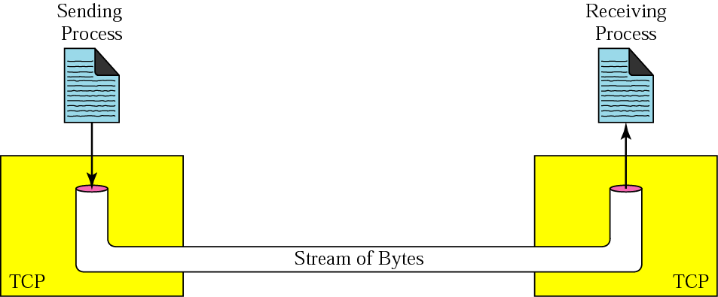
Stream delivery

Slide 9
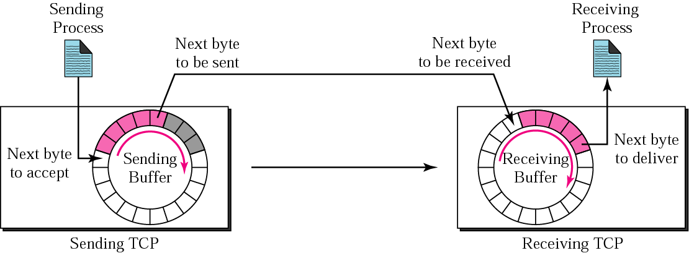
Sending & Receiving Buffer
v

Slide 10
Full-Duplex Service
TCP offers full-duplex service
Data can flow in both directions at the same time

Slide 11
Connection-Oriented Service
When site A wants to send and receive from site B
  A's TCP informs B's TCP and gets approval from B's TCP.
  A's TCP and B's TCP exchange data in both directions.
  After data is sent and buffers are empty, the two TCP's destroy their buffers.
TCP segments can be sent out of order, or lost, or corrupted, and then resent.
Each segment may use a different path.
TCP is responsible for delivering the bytes in order.

Slide 12
Reliable Service
TCP is a reliable transport protocol.
Uses an acknowledgement mechanism to check arrival of data

Slide 13
Numbering Bytes
TCP numbers all data bytes that are transmitted
Sequence Number
  The value of the sequence number field in a segment defines the number of the first data byte contained in that segment.
Acknowledgement Number
  The value of the acknowledgement field in a segment defines the number of the next byte a party expects to receive. The acknowledgement number is cumulative.

Slide 14
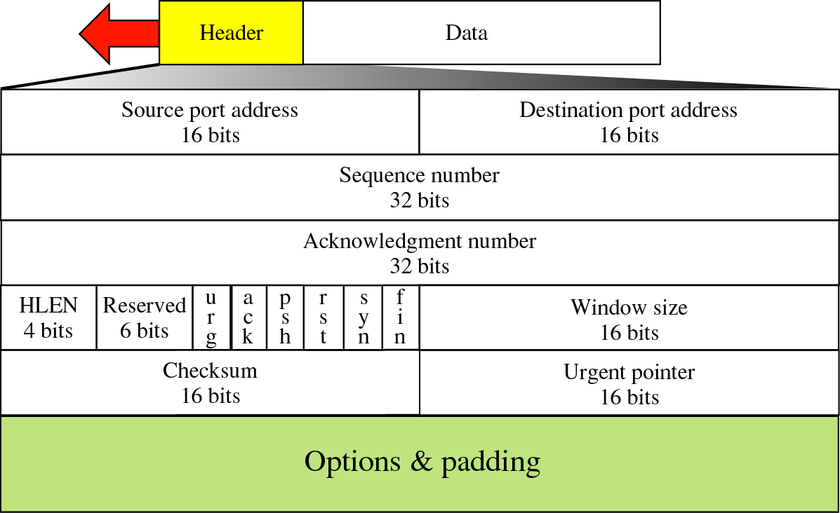
TCP Segment Format

Slide 15
Fields of TCP Segment
Source Port Address: 16 bit, defines the port number of the application program
Destination Port Address: 16 bit, Defines the port number of the application program receiving the segment
Sequence Number: 32 bit, defines the number assigned to the first byte of data contained in this segment.
Acknowledgment Number: 32 bit, defines the byte number that the receiver of the segment is expecting to receive from the other party.

Slide 16
TCP Segment Fields Cont..
Header Length: Indicates the number of 4 – byte words in TCP header. (20 – 60 Bytes)‏
Reserved: 6 bits, For future use
Control: It has six more fields
URG: The value of the urgent pointer field is valid
ACK: The value of the Acknowledgment field is valid
PSH: Push the data
RST: The connection must be Reset
SYN: Synchronize sequence Number
FIN: Terminate the Connection
Window Size: 16 bit, defines the size of the window, normally referred to as the receiving window (rwnd) and is determined by the receiver.

Slide 17
TCP Segment Fields Cont..
Checksum: 16 bit, calculation is done in the same way as for UDP. Unlike UDP inclusion of TCP is mandatory.
Urgent Pointer: 16 bit, valid only if urgent flag is set, used when segment contains urgent data.

Slide 18
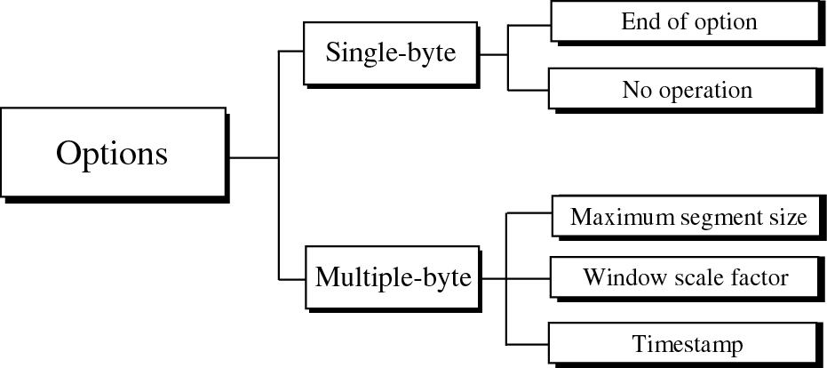
Options

Slide 19
Connection
TCP is a connection-oriented protocol
Establishes a virtual path between source and destination

Slide 20
Connection Establishment
Four actions are required before sending data
  Host A sends a segment to announce its wish for connection and includes its initialisation information
  Host B sends a segment to acknowledge the request of A
  Host B sends a segment that includes initialisation information
  Host A sends a segment to acknowledge the request from B
2nd and 3rd can be combined
called Three-Way Handshaking

Slide 21
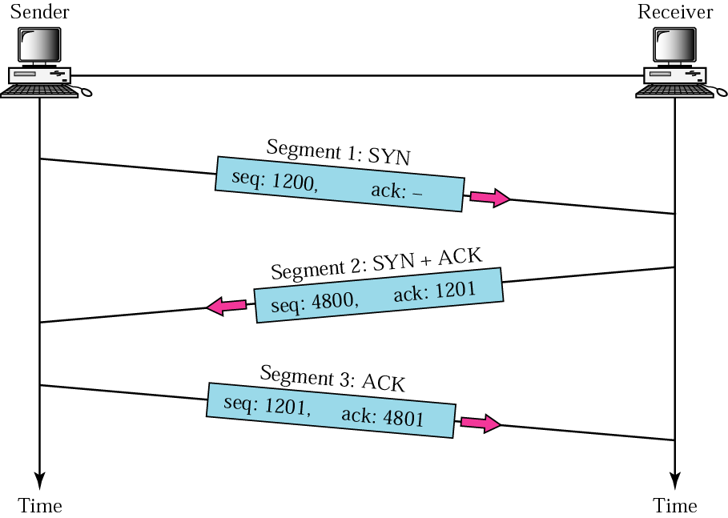
Three-way handshaking

Slide 22
Connection Termination
Either party can close the connection
If connection terminated in one direction, data can continue to be sent in the other direction
Four actions required to close the connection in both directions
  Host A sends a segment announcing connection termination
  Host B sends a segment acknowledging the request from A. After this the connection is closed in one direction.
  When host B has finished sending data, it sends a segment indicating connection closure
  Host A acknowledges the request from B
2nd and 3rd cannot be combined
Called Four-Way Handshaking

Slide 23
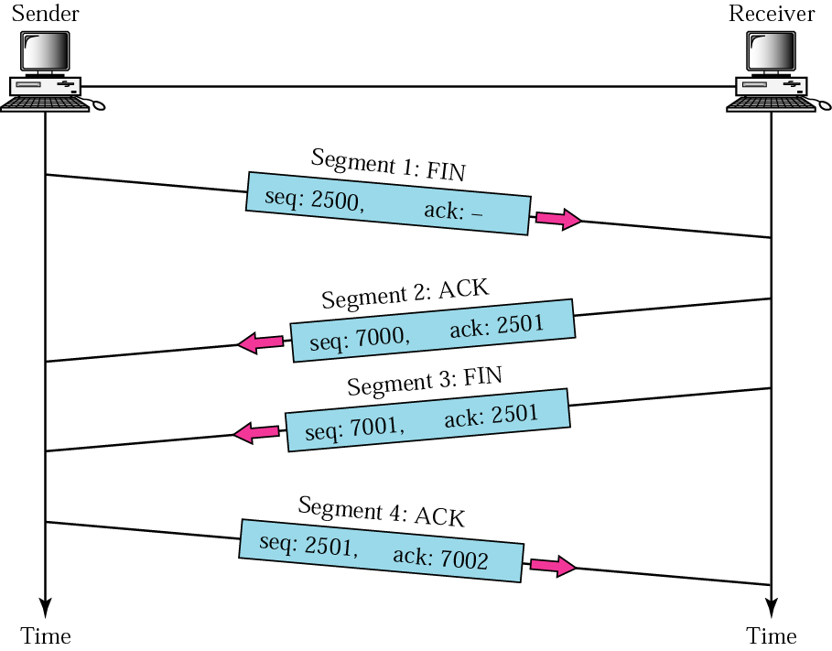
Four-way handshaking

Slide 24
Flow Control
Defines the amount of data a source can send before receiving an acknowledgement from the destination.
TCP uses a window imposed on the buffer of data to limit the amount of data sent before an acknowledgement must be received

Slide 25
Sliding Window Protocol
A sliding window is used to make transmission more efficient as well as to control the flow of data so that the destination does not become overwhelmed with data.

Slide 26
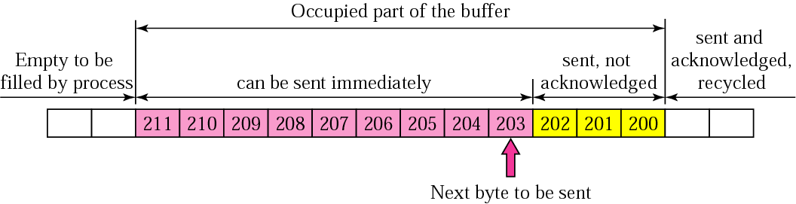
Sender buffer

Slide 27
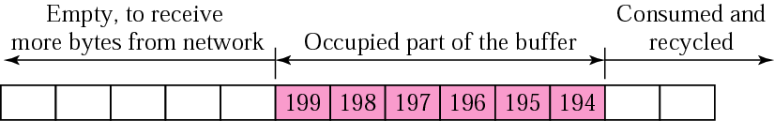
Receiver Buffer

Slide 28
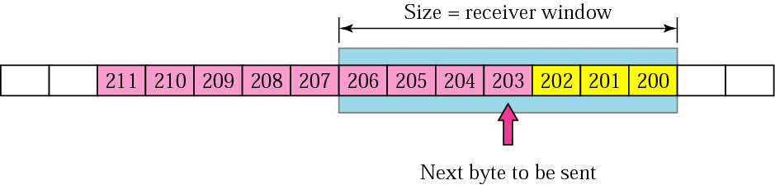
Sender buffer and sender window

Slide 29
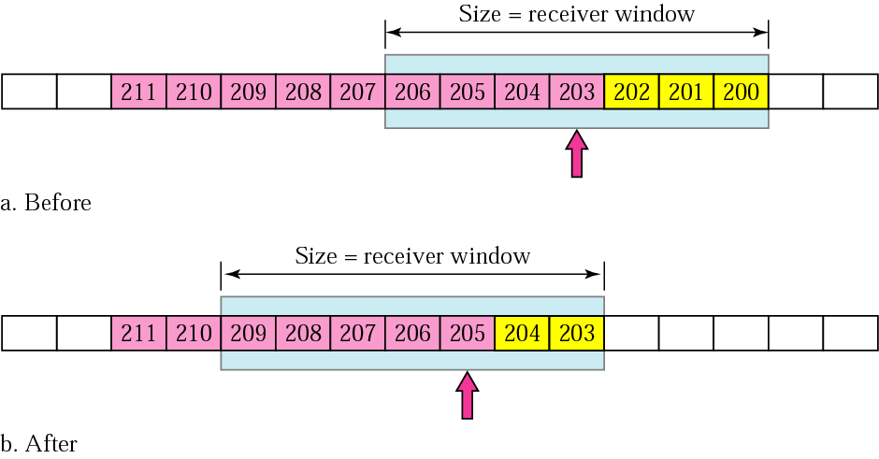
Sliding the sender window
Sent 2 more bytes and acknowledgement is received for last 3bytes sent (expecting byte 203).

Slide 30
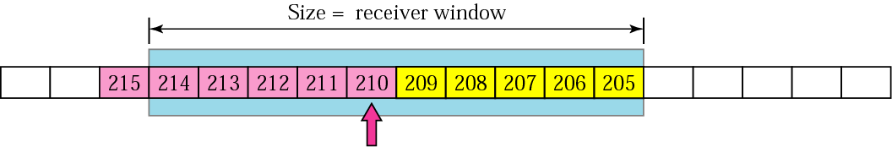
Expanding the sender window
Receiver has acknowledged the receipt of two more bytes (expecting 205), expanding receiver window size to 10.
Meantime sending TCP has sent 5 bytes.

Slide 31
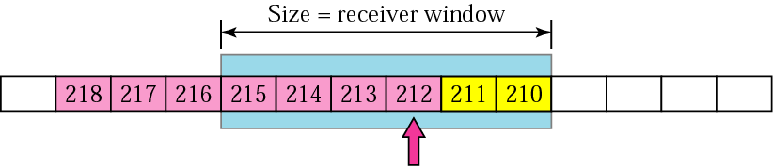
Shrinking the sender window
Receiver has received 5 bytes(205 – 209), but the receiving process has consumed only 1 byte.
The receiver window size reduced to 6 bytes.
Sender has already sent 2 more bytes.

Slide 32
Sliding Windows
Window size determines the number of packets that could be sent un acknowledged
Sender window size is totally controlled by the receiver window value (the number of empty locations in the receiver buffer). However, the actual window size can be smaller if there is congestion in the network.
Some points about TCP's Sliding Windows
  The source does not have to send a full window's worth of data.
  The size of the window can be increased or decreased by the destination.
  The destination can send an acknowledgement at any time.

Slide 33
Silly Window Syndrome
Serious problem caused by sending application generating data slowly or receiving application consuming data slowly, or both
Either situation results in sending data in very small segments, which reduces the efficiency of the operation

Slide 34
Sender solution
Sending TCP is forced to wait as it collects data to send in a larger block
Nagle's Algorithm
  if the application program is faster than the network, the segments are larger
  if the application program is slower than the network, the segments are smaller

Slide 35
Receiver solution
Clark's solution
  Send an acknowledgement as soon as the data arrives, and announce a window size of zero until either there is enough space to accommodate a segment of maximum size or until half of the buffer is empty
Delayed Acknowledgement
  Receiver waits until there is a decent amount of space in its incoming buffer before acknowledging the arrived segments

Slide 36
Error Control
TCP is a reliable transport layer protocol.
TCP delivers the entire stream to the application program on the other end in order, without error, and without any part lost or duplicated.
TCP provides reliability using error control.

Slide 37
Error control includes mechanisms for
Detecting corrupted segments
Detecting lost segments
Detecting out-of-order segments
Detecting duplicated segments
Correcting errors after they are detected

Slide 38
Error Detection
Achieved by using three simple tools
  Checksum
  Acknowledgement
  Time-out

Slide 39
Error Correction
When time-out counter expires, segment is considered to be corrupted or lost, and the segment is retransmitted

Slide 40
TCP Timers
TCP uses the following timers
  Retransmission Timer
    If the timer goes off before the acknowledgement arrives, the segment is retransmitted and the timer is reset
  Persistence Timer
    prevents a deadlock from occurring in the case that an acknowledgement is lost for window size announcement

Slide 41
TCP Timers
Keepalive Timer
  Prevents long idle connections between two TCP's.
  Server waits for response from client
TIME-WAIT Timer
  Used in case of Connection termination, if the last ACK is lost.

Slide 42
Congestion Control
If a router receives packets faster than it can process them, congestion might occur, and some packets could be dropped.
TCP assumes that the cause of a lost segment is due to congestion in the network.
If the cause of the lost segment is congestion, retransmission of the segment not only does not remove the cause, it aggravates it.

Slide 43
Congestion Avoidance
Slow Start and Additive Increase
  Slow Start
    congestion window size initially set to the maximum segment size
    for each segment acknowledge, TCP increases the size of the congestion window by one maximum segment size until it reaches a threshold of half the allowable window size
    Not slow at all - increase is exponential
Additive Increase
    To avoid congestion before it happens, the exponential increase must be slowed.
    After it reaches the threshold, the size is increased one segment for each acknowledgement

Slide 44
Multiplicative Decrease
Congestion window must decrease if congestion occurs.
Congestion detected when a segment is lost (retransmission timer times out).
Upon detection, the threshold is set to half of the last congestion window size, and the congestion window size should start from one again.
Returns to the slow start phase.
Reduces exponentially.

