Slide 1
Socket Interface
Training Division

Slide 2
Contents
Some definitions
Sockets
Byte ordering
Byte manipulation functions
Information about remote host
Socket system calls
Connectionless iterative server
UDP client-server programs
Connection-oriented concurrent server
TCP client-server programs

Slide 3
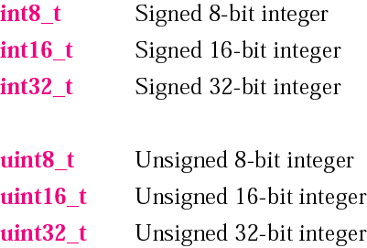
Data types

Slide 4
Client Server Model
Most widely used network applications.
Server : Any process that offers some service over the network.
Client : It sends a request to the server and waits for response.
Servers can be categorized as
Iterative servers
Concurrent servers

Slide 5
Types of servers depending on the service
Depending on whether a server is using TCP or UDP protocol to transmit messages, it can be categorized as connection oriented or connection less.
Connection oriented -> server program should be started first, and sometime later the client must be started which connects to server.
Connection less -> Connection establishment is not required here.

Slide 6
Sockets
Sockets are a protocol independent method of creating a connection between processes.
Sockets can be either connection based or connectionless: Is a connection established before communication or does each packet describe the destination?
Packet based or Streams based: Are there message boundaries or is it one stream?
Reliable or unreliable. Can messages be lost, duplicated,reordered, or corrupted?

Slide 7
Sockets
#include<sys/socket.h>
struct sockaddr {
u_short sa_family; /* addess family*/
char sa_data[14]; /* protocol specific address*/
}

Slide 8
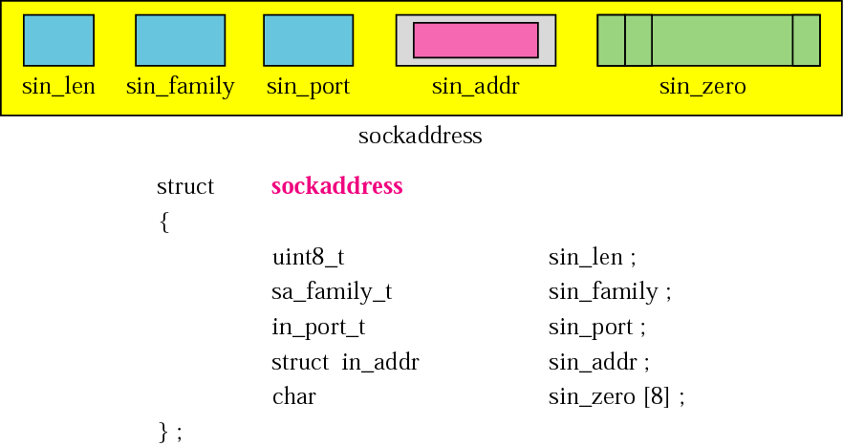
Socket address Structure
<netinet/in.h>
sockaddr_in

Slide 9
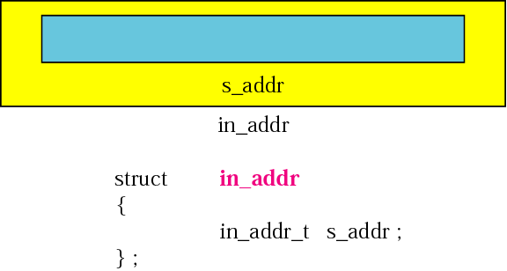
Internet address structure
32 bit netid/hostid network byte ordered. ( u_long)‏

Slide 10
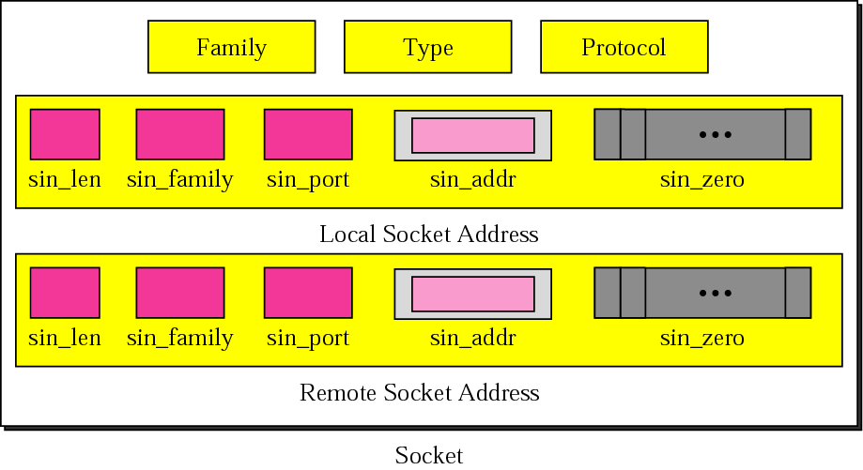
Socket structure

Slide 11
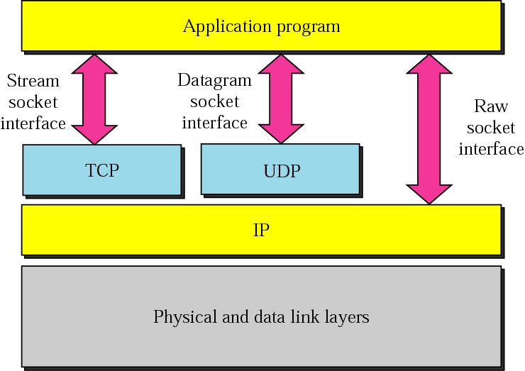
Socket Types

Slide 12
Socket Types
Sockets are typed according to the communication properties visible to the user.
Processes generally communicate b/w sockets of same type
  Stream Socket(SOCK_STREAM)‏
  Datagram Socket(SOCK_DGRAM)‏
  Raw Sockets(SOCK_RAW)‏

Slide 13
Socket Types
Sockets are typed according to the communication properties visible to the user.
Processes generally communicate b/w sockets of same type
  Stream Socket(SOCK_STREAM)‏
  Datagram Socket(SOCK_DGRAM)‏

Slide 14
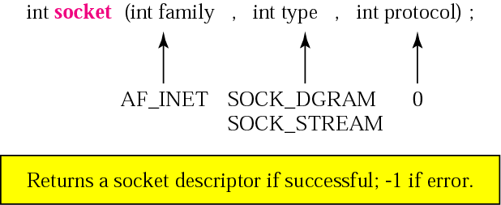
SOCKET SYSTEM CALLS

Slide 15
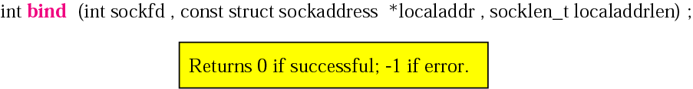
bind ()‏
Sets the value for local socket address
Usually called by client/ server

Slide 16
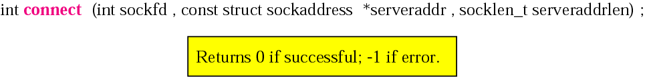
connect()‏
Usually used by the client to establish an active connection
Sets value for remote socket address

Slide 17
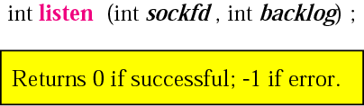
listen()‏
Called by TCP server
Informs the OS that server is ready to accept connection
Backlog is the number of requests that can be queued for this connection

Slide 18
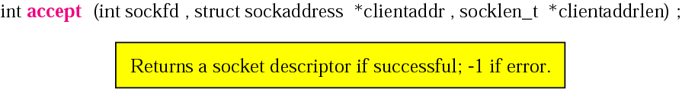
accept()‏
Called by the TCP server to remove the first connection request from the queue
Creates a new socket(child socket) that can be used by the child server to connect to the client (as in case of concurrent servers)‏

Slide 19
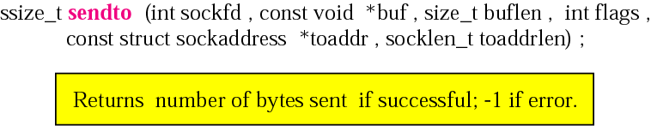
sendto()‏
To send a message to another process using UDP
Flag specifies out-of-band data or lookahead messages

Slide 20
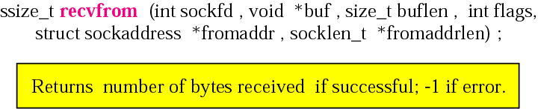
recvfrom()‏
Extracts the next message that arrives at socket

Slide 21
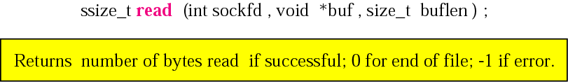
read ()‏
Used by a process to receive data from another process
Assumes that there is already an open connection

Slide 22
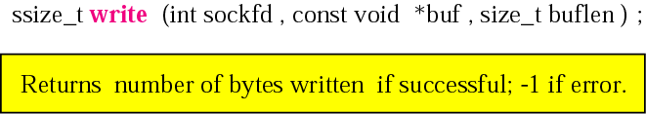
write()‏
Used by a process to send data to another process running on remote machine

Slide 23
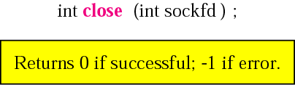
close()‏
To close the connection and terminate the TCP connection
Socket descriptor is no longer valid after calling this function

Slide 24
Socket system calls for connection-oriented protocol
Server
Socket()‏
Connection oriented communication
Bind()‏
Listen()‏
Block until
connection
from client
Client
Socket()‏
Connect()‏
Accept()‏
Data ( request)‏
Write()‏
Read()‏
Process request
Data ( reply)‏
Read()‏
Write()‏

Slide 25
Socket system calls for connectionless protocol
Server
Socket()‏
Connectionless Communication
Bind()‏
Recvfrom()‏
Client
Socket()‏
Block until
Data request
from client
Bind()‏
Data (request)‏
Sendto()‏
Process request
Data (reply)‏
Sendto()‏
Recvfrom()‏

Slide 26

Byte Ordering
The byte order for the TCP/IP
protocol suite is big endian.

Slide 27
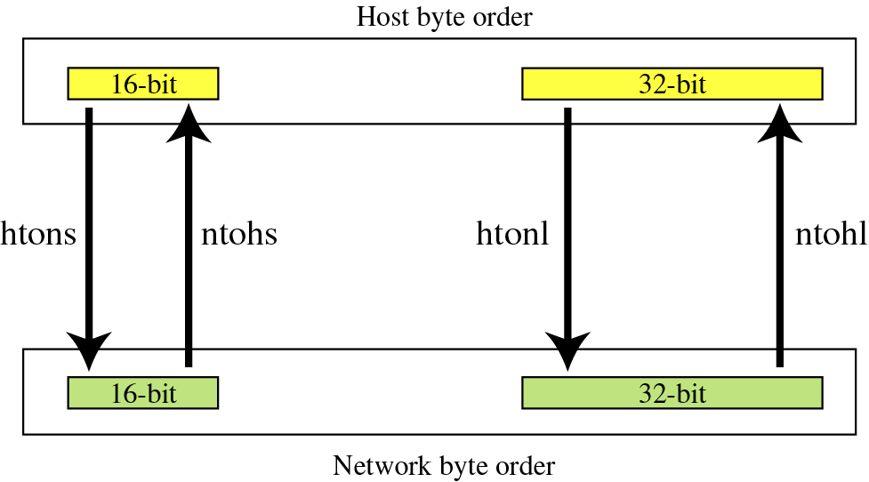
Byte-order transformation

Slide 28
Declaration of byte order transformations
u_long htonl(u_long hostlong);
convert host-to-network, long integer
u_short htons(u_short hostshort);
convert host-to-network, short integer
u_long ntohl(u_long netlong);
convert network to host, long integer
u_short ntohs(u_short netshort);
convert network to host, short integer

Slide 29
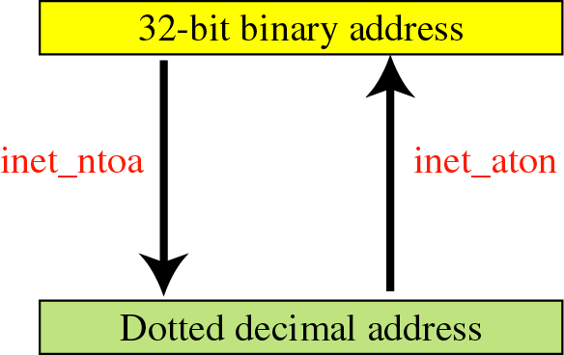
Address transformation

Slide 30

Declarations for address transformation
functions

Slide 31
Information About Remote Host

Slide 32
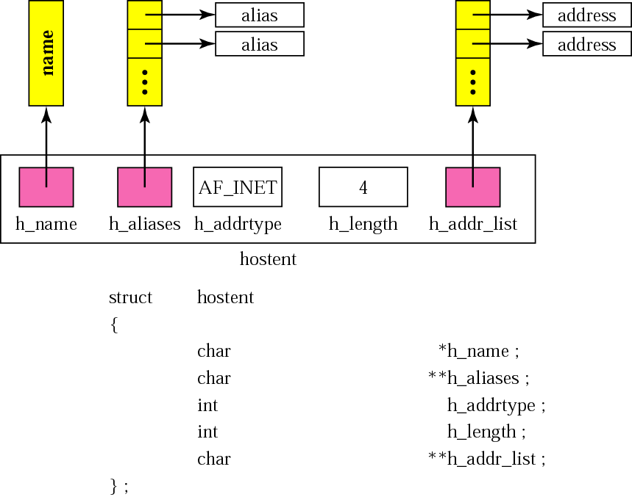
Hostent structure

Slide 33
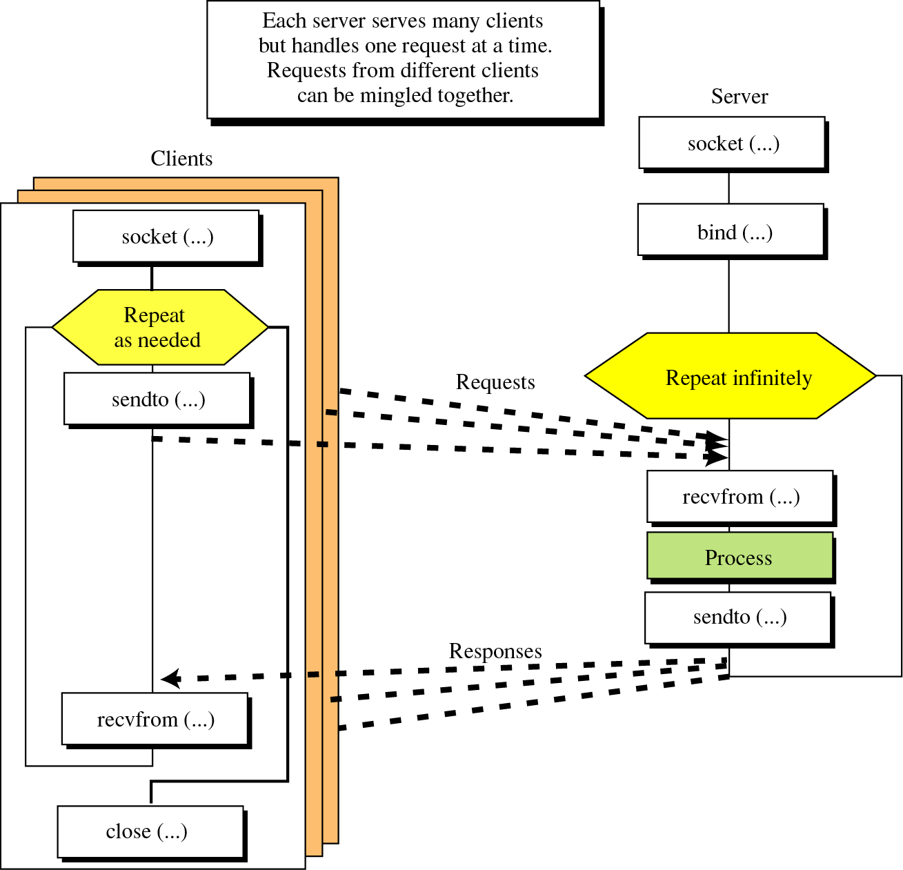
Connectionless Iterative Server
Socket interface for connectionless iterative server

Slide 34
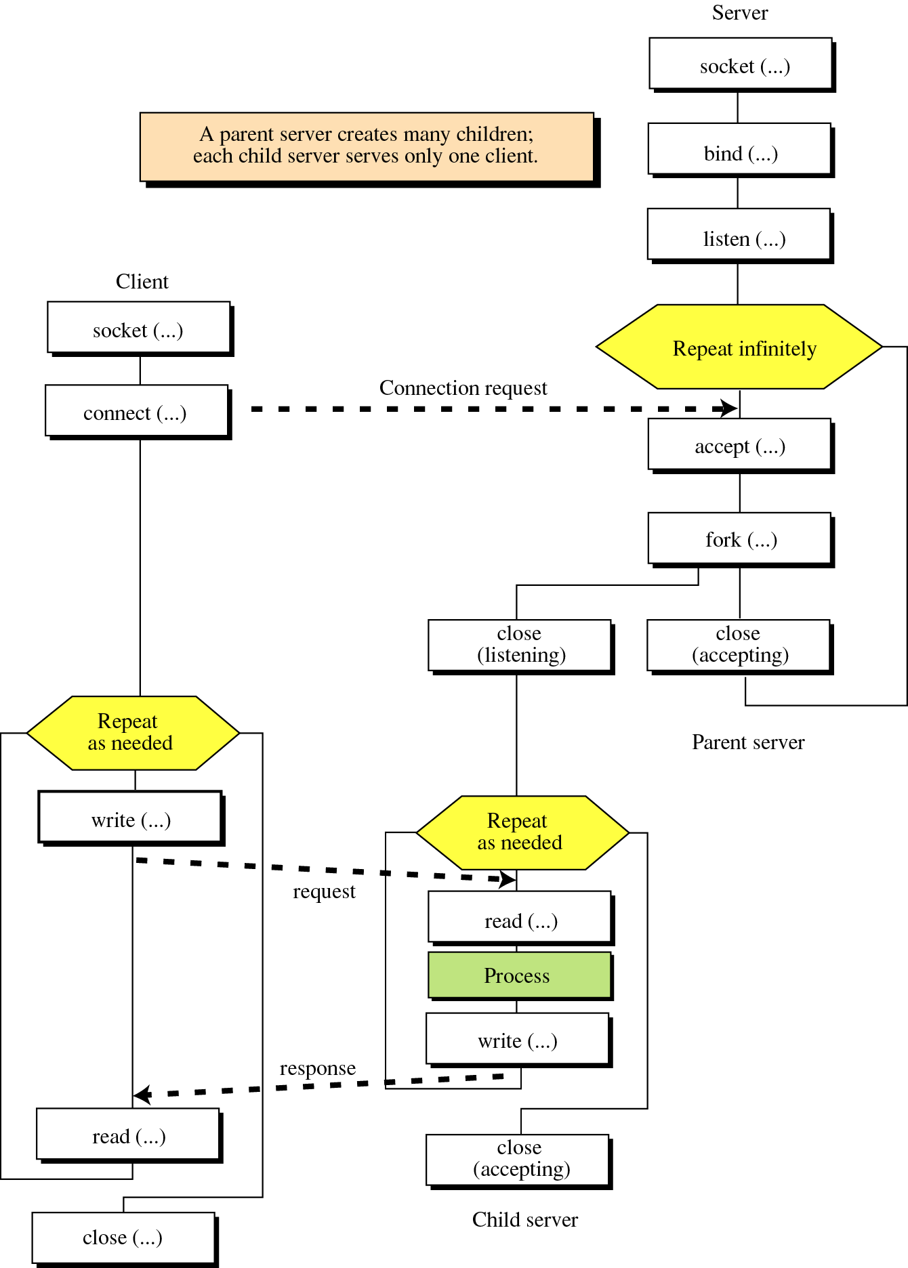
Connection-Oriented Concurrent Server
Socket interface for connection -oriented concurrent server

Slide 35
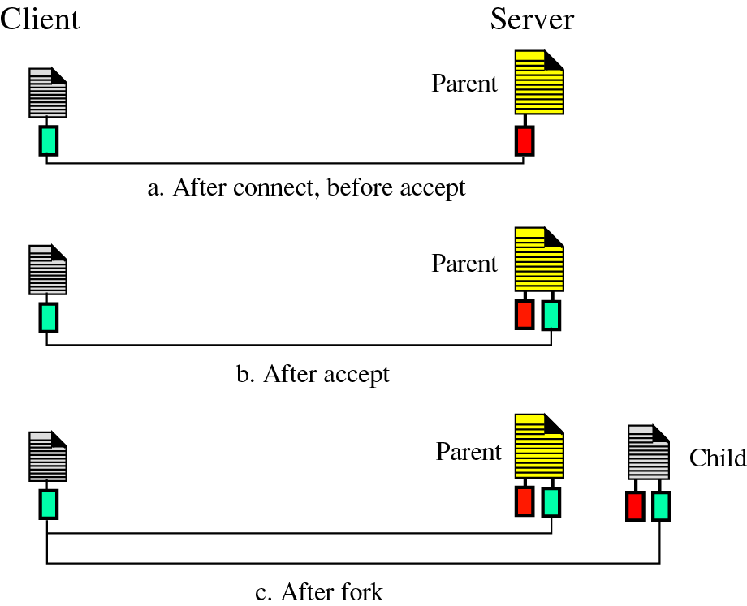
Client and Server

Slide 36
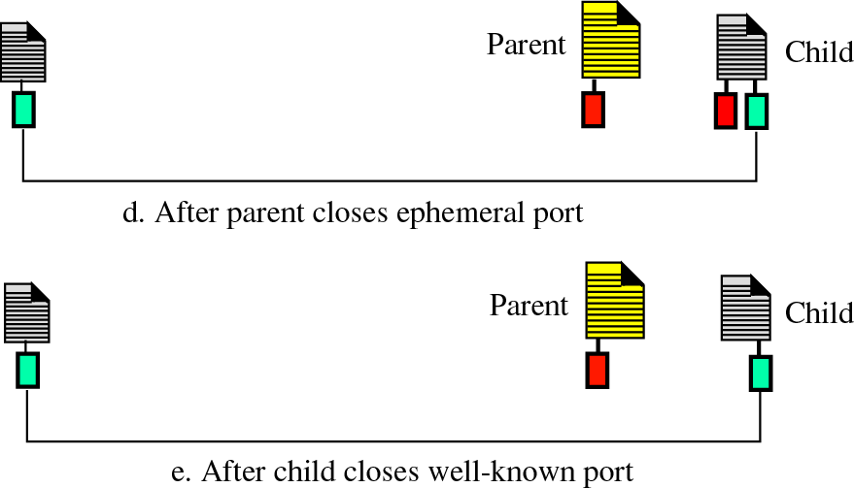
Client and Server (contd)...

Slide 37
UDP Client-Server Program
UDP Server
#define MAXBUF 256
void main(void)‏ {
char buf[MAXBUF];
int passiveSocket;
socklen_t clientAddrLen;
struct sockaddr_in serverAddr;
struct sockaddr_in clientAddr;
passiveSocket= socket(AF_INET,SOCK_DGRAM,0);
memset(&serverAddr, 0, sizeof(serverAddr));
serverAddr.sin_family=AF_INET;
serverAddr.sin_port= htons(a-well-known-port);
serverAddr.sin_addr.s_addr= htonl(INADDR_ANY);
bind(passiveSocket, &serverAddr, sizeof(serverAddr));

Slide 38
UDP Client-Server Program (Cond)...
clientAddrLen=sizeof(serverAddr);
memset(buf,0,MAXBUF);
for(; ;)‏ {
while(recvfrom (passiveSocket, buf, MAXBUF, 0, &clientAddr, &clientAddrLen)>0 )‏ {
PROCESS(..........);
sendto(passiveSocket,buf,MAXBUF,0,&clientAddr,
&clientAddrLen)
memset(buf,0,MAXBUF);
}
}
}

Slide 39
UDP Client
#define MAXBUF 256
void main(void)‏
{
char buf[MAXBUF];
int activeSocket;
socklen_t remoteAddrLen;
struct sockaddress remoteAddr;
struct sockaddress localAddr;
activeSocket= socket(AF_INET,SOCK_DGRAM,0);
memset(&remoteAddr, 0, sizeof(remoteAddr));
remoteAddr.sin_family=AF_INET;
remoteAddr.sin_port= htons(a-well-known-port);
hptr= gethostbyname(“a-domaim-name”);
memcpy((char*)&remoteAddr.sin_addr.s_addr,
hptr->h_addr_list[0],hptr->h_length) ;

Slide 40
UDP Client (Contd)...
memset(buf,0,MAXBUF);
while(gets(buf))‏ {
sendto(activeSocket,buf,sizeof(buf),0,&remoteAddr,
sizeof(remoteAddr);
memset(buf,0,sizeof(buf));
recvfrom(activeSocket,buf,MAXBUF,0,&remoteAddr,
&remoteAddrLen);
printf(“%s\n”,buf);
}
close(activeSocket);
}

Slide 41
TCP Client-Server Programs
TCP Server
#define MAXBUF 256
void main(void) {
char buf[MAXBUF];
int listenSocket;
int acceptSocket;
socklen_t clientAddrLen;
struct sockaddress serverAddr;
struct sockaddress clientAddr;
listenSocket = socket(AF_INET, SOCK_STREAM, 0);
memset(&serverAddr, 0 ,sizeof(serverAddr));
serverAddr.sin_family = AF_INET;
serverAddr.sin_port= htons(a-well-known-port);
serverAddr.sin_addr.s_addr= htonl(INADDR_ANY);
bind(listenSocket, &serverAddr, sizeof(serverAddr));
listen(listenSocket, 1);

Slide 42
TCP Server (Contd)...
clientAddrLen= sizeof(clientAddr);
for(; ;)‏ {
acceptSocket= accept(listenSocket , &clientAddr,
&clientAddrLen );
pid = fork();
if (pid > 0 ) { /* parent */
close(acceptSocket );
continue;
}
else { /* child */
close(listenSocket);
memset(buf , 0 , MAXBUF);
while(read(acceptSocket, buf ,MAXBUF) > 0)‏{
PROCESS(...........);
memset(buf, 0 , MAXBUF);
write(acceptSocket, buf, MAXBUF);

Slide 43
TCP Server (Contd)...
memset(buf, 0 , MAXBUF);
} /* while*/
close(acceptSocket);
} /* else */
} /* for */
}

Slide 44
TCP Client
#define MAXBUF 256
void main(void) {
char buf[MAXBUF];
int activeSocket;
struct sockaddress remoteAddr;
struct sockaddress localAddr;
struct hostent *hptr;
activeSocket = socket(AF_INET, SOCK_STREAM, 0);
memset(&remoteAddr, 0 ,sizeof(remoteAddr));
remoteAddr.sin_family = AF_INET;
remoteAddr.sin_port= htons(a-well-known-port);
hptr= gethostbyname(“a-domaim-name”);
memcpy((char*)&remoteAddr.sin_addr.s_addr,
hptr->h_addr_list[0], hptr->h_length) ;
connect(activeSocket, remoteAddr, sizeof(struct sockaddress))‏
memset(buf,0,MAXBUF);

Slide 45
TCP Client (Contd)...
while(gets(buf))‏ {
write(activeSocket, buf, MAXBUF);
memset(buf, 0, MAXBUF);
read(activeSocket, buf, MAXBUF);
printf(“%s\n”,buf);
memset(buf,0,MAXBUF);
}
close(activeSocket );
}

Slide 46
Thank You

