Slide 1
C Language
Training Division
Notes:
Last class we discussed about introduction to C programming, today lets start with C fundamentals.

Slide 2
Contents
Identifier
Keywords
Constants
Basic Data Types
Variables
The Four C Scopes
Type Qualifiers
Storage Class Specifiers
Operators
Notes:
This sections gives brief introduction about
Identifier Names
Keywords
Constants
Basic Data Types
Variables
The Four C Scopes
Type Qualifiers
Storage Class Specifiers
Operators

Slide 3
Identifier
In c language, the names of variables, functions, labels, and various other user-defined items are called identifiers
The length of these identifiers can vary from one to several characters.
The first character must be a letter or an underscore, and subsequent characters must be either letter, digits, or underscore.
Notes:
Identifiers is the fancy term used to mean ‘name’.
"Identifiers" or "symbols" are the names you supply for variables, types, functions, objects and labels in your program.
Identifier names must differ in spelling and case from any keywords.
The length of the identifiers in standard C is 31. If more than 31 are used, all characters beyond the 31st may be ignored by any given compiler.
The rules for the construction of identifiers are simple:
you may use the 52 upper and lower case alphabetic characters,
the 10 digits and finally the underscore ‘_’, which is considered to be an alphabetic character for this purpose.
The only restriction is the usual one; identifiers must start with an alphabetic character.

Slide 4
Identifier
External identifiers: It is involved in external link process. These include function names and global variable names that are shared b/w source files.
Internal identifiers: These identifies are not used in a external link process.
Example for valid identifier: count, t123, a_b
Example for invalid identifier: 1count, hi!23, a..b
Notes:
A name also has a scope, which is the region of the program in which it is known, and a
linkage, which determines whether the same name in another scope refers to the same object or function.
C defines two kind of identifiers:
External and Internal
An external identifier will be involved in a external link process.
These identifiers, called external names – includes function names and global variable names.
That are shared b/w source files.
If the Identifiers are not used in external link process, called Internal Identifiers.
Ex: it includes a local variables.
Some examples for valid and invalid identifiers
Valid – count, t123, a_b
Invalid – 1count, hi!23, a…b

Slide 5
Key Words
The following identifiers are reserved for the use as keywords, and may not be used otherwise:
auto double int struct
break else long switch
case enum register typedef
char extern return union
const float short unsigned
continue for signed void
default goto sizeof volatile
do if static while
Notes:
Some of the identifiers are reserved for the use as keywords and they have pre-defined meaning in compiler.
The keywords, combined with the formal C syntax, form the C programming Language.
C89 standards supports 32 Keywords. They are

Slide 6
Constants
Objects whose value do not change and belong to the lexical class of identifiers
  Integer-constant
  Character-constant
  Floating-constant
  Enumeration constant
Notes:
Constants refers to fixed value that the program may not alter.
Constant can be of any of the basic data types.
Constants are also called as literals.
There are several kinds of constants.
integer-constant
character-constant
floating-constant
enumeration-constnat
Lets see examples for each type of constants
interger constant
An integer constant consisting of a sequence of digits
if it begins with 0 (digit zero)then it is octal, otherwise its decimal.
Integer constants are specified as numbers, without fractional component.
Ex: 006, 100
Also the hexadecimal digits like A to F with the values 10 to 15
character constant
Is a sequence of one or more characters enclosed in single quotes.
Ex: ‘A’ , ‘x’
C defines both multi-byte characters and wide characters.
Multi-byte and wide characters are used primarily to represent languages that have large character set.
Ex: ‘ab’ or ‘xy’
To specify the wide character constant precede the character with L.
Floating constants
It consists of an integer part, a decimal part, a fractional part, an e or E, an optionally signed integer exponent and suffix like f, F, l or L.
Ex: 11.123
Enumeration constants
Identifiers declared as enumerators are constants of type int.
We will discuss more about enum, when we discuss about structures and union sessions.

Slide 7
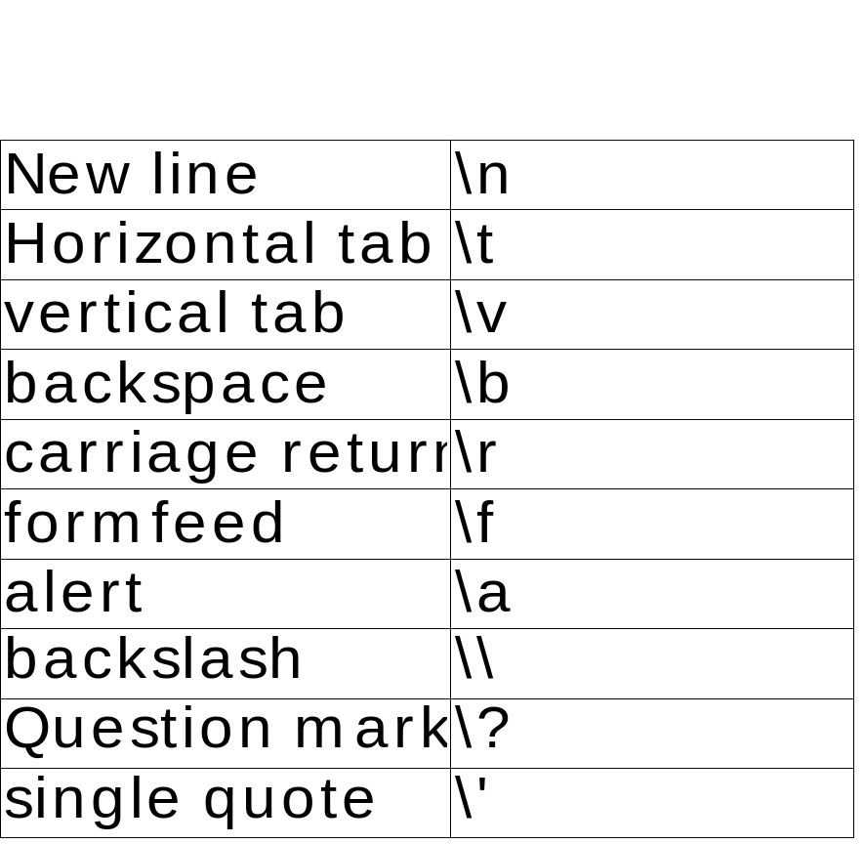
Escape Sequence
These are also called as backslash character constants.
Notes:
Character constant do not contain the ‘ (single quote) character or Newline.
In order to represent them, and certain other characters, the following escape sequences may be used.

Slide 8
What is Data?
Data is a collection of information, such as values or measurements.
It can be numbers, words, measurements, observations or even just descriptions of things.
Notes:
Before going to discuss about data type, we will discuss what is data ?
Data is collection of information, such as values or measurements.
Data can be numbers, words, measurements, observations or even just descriptions of things.
Data can be broadly classified into qualitative and quantitative.
Qualitative is descriptive information ex: “It was a great fun”
Quantitative is numerical information ex: numbers

Slide 9
Data type in C
Data type defines the type of a data which specifies what type of operation can be done.
Data type attaches with variable to determine the number of bytes to be allocate to variable and valid operations which can be performed on that variable.
C supports various data types such as character, integer and floating-point types.
Notes:
The data type in C defines for an variable what type it is and with respect to memory allocation.
The definition of a variable will assign storage for the variable and define the type of data that will be held in the location.
In the C programming language, data types refers to an extensive system for declaring variables of different types.
The language itself provides basic arithmetic types and syntax to build array and compound types.

Slide 10
Basic Data types
Basic data types in C:
  char : a single byte, capable of holding one character in the local character set
  int : an integer, typically reflecting the natural size of integers on the host machine
  float : single-precision floating point
  double : double-precision floating point
  void : explicitly declares a function as returning no value or creates a generic pointers
Notes:
Char, int, float, double, void
Char - is a smallest data type and is a short form for “character”.
It occupies 1 byte (8 bits) of memory. Some standard bit patterns are used like ASCII – American Standard Code for Information Interchange.
Ex: char a=’Z’;
Int – is a short name for integer. This represents some finite subset of the mathematical integers.
Integral data types may be of different sizes. The size of the grouping varies but computer hardware nearly always provides a way to represent a processor register or memory address as an integer.
If the runtime environment uses X bit then the length of integer will be X bit.
A system having X bit means the CPU register length is X bit.
Most computers use 32 bits wide data buses, so integer size is 4 bytes.
Ex: int a=200;
Float – is a short name for floating point. It stores real numbers, but it is only one machine word in size.
Therefore it is used when less precision, so its used to represent the single precision floating number.
i.e this gives 6 significant decimal digits precision.
Ex: float f=20.222;
Double – The double and float are very similar.
The float allows us to store single-precision real numbers,
while double type allows us to store double-precision real numbers.
i.e it gives 10 significant decimal digits precision.
Its size is typically two machine words.
Ex: double d=20.222222;
Void – Its considered a data type for organizational purpose, but it is basically a keyword to use as a placeholder where you would put a data type, to represent “no data”.
It explicitly declares a function as returning no value or creates a generic pointers.
But, you cannot declare variables like this
void bad_variable;
Hence, you can declare a routine which does not return a value as
Void MyRoutine( );

Slide 11
Type specifiers
Modifying the basic types: A Type specifier or modifier alters the meaning of the base type to more precisely fit a specific need.
The int base type can be modified by signed , unsigned, short and long
The char base type can be modified by signed and unsigned.
The double base type can be modified by long.
Notes:
We have so far learned about the fundamental data types, Now let us understand the need for data type modifiers and the way it can be used.
A type modifier alter the meaning of the base type more precisely fit a specific need.
There are 4 types of modifiers, they are
signed
Unsigned
Short
Long
Lets take an example
Char c;
The above declaration tells that character c holds a single character.
But even ‘c’ can hold integer value range from -128 to 127.
That’s because all variables by default signed, so we can modify character ‘c’ so that it can hold 0-255. For this we will use unsigned char.
Signed
Signed means that the data type is capable of storing negative values. By default all data types are declared as signed.
Unsigned
To modify a data types behavior so that it can only store positive values, we require to use the type unsigned.
Long
Many times in our programs we would want to store values beyond the storage capacity of the basic data types. In such cases we use the data type modifier long.
Short
If long data type modifier doubles the size, short on the other hand reduces the size of the data type to half.
The int base type can be modified by signed, unsigned, short and long.
The char type can be modified by unsigned and signed.
You may also apply long to double.

Slide 12
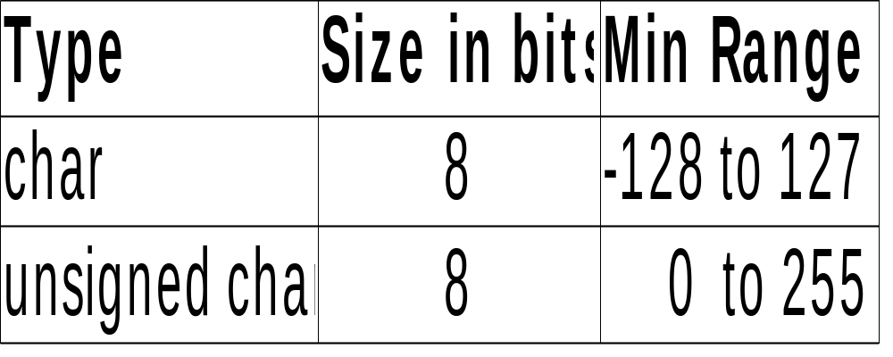
Basic Data Types
Modifying the basic types: char data type
Notes:
Modifying the basic Char data type.
Signed char – 8 bits – Range -128 to 127
Unsigned char – 8 bits – Range 0 to 255

Slide 13
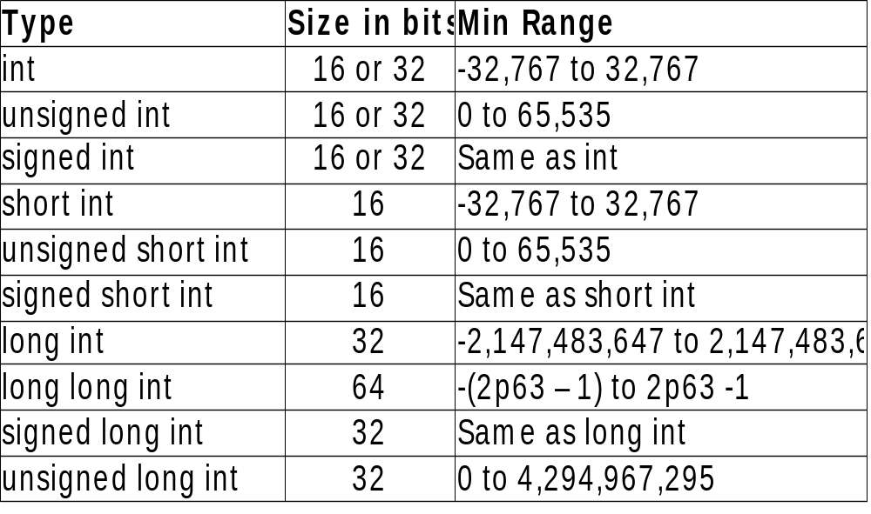
Basic Data Types
Modifying the basic types: int data type
Notes:
Modifying the basic int data type.

Slide 14
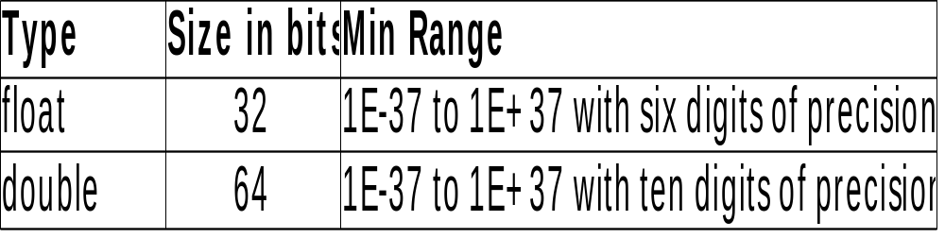
Basic Data Types
Modifying the basic types: float and double
Notes:
Modifying the basic float and double data type.
Long double – 80 bits – ten digits precision.

Slide 15
Variables
A variable is a named location in memory that is used to hold a value that can be modified by the program.
General form of a declaration is: type variable_list;
Example:
int a,b,c;
char ch;
double balance, amount;
Notes:
It is a data name which is used to store data and may change during program execution.
All variables must be declared before they can be used.
Ex: int a,b,c;
char ch;
double balance, amount;

Slide 16
Where Variables Are Declared
Variables can declared in three places:
Local variables
Formal variables
Global variables
Notes:
Now we will discuss where a variable can be declared in our program.
Variables can be declared in three places:
inside a function
in the definition of function parameters
Outside of all the function
These positions correspond to local variables, formal parameters, and global variables, respectively.

Slide 17
Variables
Local variables: These are also called as automatic variables. It is used by statements that are inside the block in which the variables are declared.
int x;
int fun ( int y )
{
int z;
}
A variable is created upon entry into its block and destroyed upon exit.
Local variables are not known outside their own code blocks.
Notes:
A variable which is declared inside function or block are called as local or private variables.
Each local variable in a function comes into existence only when the function is called, and disappears when the function is exited.
That is why such variables are usually known as automatic variables.
Lets take an example to understand the variables.
int x;
int fun ( int y )
{
int z;
}
Here the variable z is local to the function fun.

Slide 18
Variables
Formal Variables: They behave like any other local variables inside the function. Their declaration occurs after the function name and inside the parenthesis.
Global variables: These are known through out the program execution.
These are created by declaring them outside of any function.
Any expression can access them regardless of what block of code that expression is in
Notes:
Formal Variables - If a function takes arguments, it must declare variables that will accept the values of the arguments.
These variables are called the formal parameters of the function.
In our previous example, we have taken y as formal parameter to the function fun.
They behave like any other local variables inside the function.
Global Variables – The variables which are declared outside of any function is called Global Variables.
They are known through out the program execution.
Lets refer our previous example, where x is declared as global variable.
By default all global variables will be initialized to Zero. Any expression can access them regardless of what block of code that belongs.

Slide 19
The Four C Scopes
C defines four scopes that determine the visibility of an identifier
  File Scope
  Block Scope
  Function prototype Scope
  Function Scope
Notes:
In the earlier discussion the terms local and global are used to describe in a general way the difference between identifiers.
Standard C defines four scopes that determine the visibility of an identifier.
They are
File scope
Block scope
Function Prototype scope
Function scope

Slide 20
The Four C Scopes
File Scope: Starts at the beginning of the file and ends with the end of the file. Variables that have file scope are global.
Block Scope: Begins with the opening { of a block and ends with its associated closing }. Variables with block scope are local to their block.
Function prototype scope: Identifiers declared in a function prototype; visible within the prototype and in function.
Functions Scope: Begins with the opening { of a function and ends with its closing }.
Notes:
Lets understand one by one
1. File scope – Starts at the beginning of file & ends with end of file.
It refers only those identifier that are declared out side the functions i.e global variables
2. Block scope - Begins with the opening { of a block and ends with its associated closing }.
Variables with block scope are local to their block.
3. Function prototype scope - Identifiers declared in a function prototype; visible within the prototype.
4. Function Scope - Begins with the opening { of a function and ends with its closing }.

Slide 21
Example – C Scope
/* File Name: add.c */
int Global_Variable; File Scope
Int add ( int a, int b) Function Prototype Scope
Int main ( )
{
int local_1, local_2; Function Scope
printf( “%d”, add ( local_1, local_2));
{
int p, q; Block Scope
}
return 0;
}
int add ( int x, int y )
{
return (x+y);
}
Notes:
Lets consider an example to demonstrate C scopes.
We have a file name called add.c
In the file we have declared the global variable called Global_Variable which has File scope.
We have also declared function prototype for add function. i.e having variable a and b are Function prototype scope.
Inside the main function, we have declared two local variables i.e local_1 & local_2 are having function scope.
Also in main, we have a block, which contains p and q variables, having block scope.

Slide 22
Type Qualifier
C defines type qualifiers that control how variables may be accessed or modified.
Type Qualifiers precede the type names that they qualify.
Two types
  const type qualifier
  volatile type qualifier
Notes:
Type Qualifiers
We have seen that a variable is characterized by its type. In addition to that, we will see two more properties – constancy and volatility.
C defines type qualifiers that control how variables may be accessed or modified.
C89 defines two qualifiers : const and volatile.

Slide 23
Type Qualifier
Variables of type const can't be changed by your program.
Variables of const type are placed into read-only memory.
Ex: const int a = 10;
Volatile tells the compiler that a variable's value may be changed in ways not explicitly specifier by the program.
Notes:
Const - Declaring an object const announces that its value will not be changed during the program execution.
The compiler is free to place variables of this type into read-only memory.
Ex: const int a=10;
It increases the opportunity for optimization.
Volatile – Variable value may be changed in ways not explicitly specified by the program.
The purpose of the volatile is to force an implementation to suppress optimization.
For example, for a machine with memory-mapped input/output, a pointer to a device register might be declared as a pointer to volatile,
Because in order to prevent the compiler from removing apparently redundant references through the pointer.

Slide 24
Storage Class
The storage class determines the lifetime of the storage associated with the objects.
There are two storage classes:
  Automatic
  Static
Notes:
The storage class determines the lifetime of the storage associated with the objects.
A name object also has a scope, which is the region of the program in which it is known.
There are two storage classes:
Automatic and Static
Automatic objects are local to a block and are discarded on exit from the block.
Static objects may be local to a block or external to all blocks, but in either case retain their values across exit from and reentry to functions and blocks.
The objects declared outside all blocks, at the same level as function definitions, are always static.
Static can be made local to a particular translation unit and this gives internal linkage.
By omitting static we can make them global to entire program and this gives external linkage.
Although those things, Lets understand in a simpler manner, what storage classes determine:
Whether
The object has internal, external, or no linkage
The object is to be stored in memory or in a register, if available
The object receives the default initial value of 0 or an indeterminate default initial value
The object can be referenced throughout a program or only within the function, block, or source file where the variable is defined
The storage duration for the object is maintained throughout program run time or only during the execution of the block where the object is defined

Slide 25
Storage class specifiers
The Specifiers tell the compiler how to store the subsequent variable.
Four storage class specifier
  auto
  register
  static
  extern
  The general form
  storage_specifier type var_name;
Notes:
For a variable, its default storage duration, scope, and linkage depend on where it is declared: whether inside or outside a block statement or the body of a function.
auto – The auto storage class is the default storage class for variables declared inside a block i.e, local variables.
Objects with the auto storage class specifier have automatic storage duration.
Each time a block is entered, storage for auto objects defined in that block is made available.
When the block is exited, the objects are no longer available for use.

Slide 26
Storage Class Specifier
Ex: for auto
{
int count ;
auto int date ;
}
Ex: for register
{
register int count ;
register float f;
}
Notes:
For ex:
{
int count;
auto int date;
}
Here we define two variables with the same storage class.
Auto can only be used within functions, i.e local variables.
register – A register declaration is equivalent to an auto declaration, but hints that the declared objects will be accessed frequently.
Only a few objects are actually placed into registers, and only certain types are eligible; the restrictions are implementation-dependent.
However, if an object is declared register, the unary & operator may not be applied to it, explicitly or implicitly.
The storage location for register variable will be in CPU registers.
If enough registers are not available, it will be considered as auto.
Ex:
{
register int counter;
register float f;
}

Slide 27
Storage Class Specifier
Ex: for local static
int fun ( )
{
static int s;
return ++s;
}
int main ( )
{
printf(“%d\n”, fun( ));
printf(“%d\n”, fun( ));
reutn 0;
}
Notes:
static – static storage class can be used only if we want the value of a variable to persist between different function calls.
There are two types of static variables as:
Local Static Variable
Global Static Variable
The storage location for static will be in data segment.
For Local static
Lets see an example
We have defined a local static variable “s” inside the function fun.
In the main function, we are calling the fun function twice.
First time it will print 1.
Then second time it will print 2.
So here the value of the variable persists between different function call.

Slide 28
Storage Class Specifier
Ex: for global static
static int s;
int fun ( ) int run ( )
{ {
return ++s; return ++s;
} }
int main ( )
{
printf(“%d\n”, fun());
printf((“%d\n”, run());
return 0;
}
Notes:
We have defined two functions called fun and run, also a global static variable “s”.
In both the function we are incrementing “s” value.
In main we are calling both the functions.
It will print 1 and 2.
So here also the value of the variable persists.

Slide 29
Storage Class Specifier
Ex: for extern within a file
extern int s;
int main ( )
{
s=s+1;
printf(“%d\n”, s);
return 0;
}
int s;
Notes:
extern - A declaration with extern, used inside a function, specifies that the storage for the declared objects is defined elsewhere;
If we use the extern keyword to identifiers, it refers to an external linkage.
The variables of this class can be referred to as ‘global or external variables’.
They are declared outside the functions and can be invoked at anywhere in a program.
Ex: for extern within a file
We have a declared a variable s, as extern. Means, its definition will be somewhere else.
In the main we are using directly s and incrementing the value of s.
Outside the main we have defined the variable s.

Slide 30
Storage Class Specifier
Ex: for extern with two file
File Name – main.c File Name add.c
int s; extern int s;
void add(); void add( )
int main ( ) {
{ s=s+1;
printf(“%d\n”, s); }
add();
printf(“%d\n”, s);
return 0;
}
Notes:
Ex: for extern with two files
We have two files here, one is main.c and other is add.c
In main.c, we have defined a global variable s and declared a function called add.
Inside a main function we are calling add function.
In other file add.c we have defined add function and declared variable s as extern.
So that we can use the variable s which was defined in main.c file.
We need to compile both the file together to resolved the external linkage.
The output is 0 and 1.

Slide 31
Typedef
typedef specifier is called storage class specifier only for syntactic convenience.
We can define new data type by using the keyword typedef
typedef actually will not create a new data rather define new name for existing type.
The general form of the typedef statement is
  typedef type new_name
typedef float balance;
balance over_due;
Notes:
The typedef specifier does not reserve storage and is called a storage class specifier only for syntactic convenience.
It helps us to create a new data type names.
We are not actually creating a new data type, but rather defining the new name for existing type.
This process can help make machine-dependent programs more portable.
If you define your own type name for each machine- dependent data type used by your program,
then only the typedef statements have to be changed when compiling for a new environment.
typedef also can help in self-documenting the code by allowing descriptive names for the standard data types.
For ex:
typedef float balance;
balance over_due;
Now over_due will be float variable.

Slide 32
Typedef
typedef struct linked_list
{
int data;
struct linked_list *next;
} *NODE;
struct linked_list *first, *last;
Instead we can write
NODE first, last;
Notes:
Lets take another complex example
For Ex: struct linked_list *NODE;
Every time when we want to create an object to linked_list structure we need to write the complete declaration as shown in slide.
Instead we can make use of typedef while declaring.

Slide 33
Storage Class Specifier
Storage Class | Storage Location | Intial Value | Life | Scope
auto | Stack | Garbage Value | Control remains in a block whrer it is defined | Local to the block in which variable is declared
register | CPU register /stack | Garbage Value | Local to the block in which variable is declared | Local to the block
static | Data segment | zero and cab be initilize once only | depends on function calls and the whole program | Local or Global
extern | Data segment | - | Until the program ends | Global to the program

Slide 34
Operators
Assignment Operator
Multiple Assignments
Compound Assignments
Arithmetic Operators
Increment and Decrement Operators
Relational and Logical Operators
Bitwise operators
The ? : Operator
The & and * pointer operators
Sizeof operator
Comma Operator
Dot(.) and Arrow(->) operator
Notes:
C is very rich in built-in operators.
There are four main classes of operators: arithmetic, relational , logical, and bitwise.
In addition to that we have other category of operators as shown in slide.
Lets discuss one by one.

Slide 35
Assignment operator
General form variable_name=expression
The target, or left part, of the assignment must be an object, such as a variable, that can receive a value
A modifiable lvalue means “variable”
The term rvalue refers to expressions on the right side of an assignment.
Notes:
First Lets discuss Assignment Operator.
You can use the assignment operator within any valid expression. The general form of the assignment operator is
variable_name = expression;
An lvalue is an expression referring to an object.
If that object can occur on the left side of an assignment statement, its called “modifiable lvalue”.
This will be normally called as variable.
The term rvalue refers to expressions on right side of an assignment.
It simply means the value of expression.

Slide 36
Operators
Multiple Assignments x=y=z=0
Compound assignments x=x+10 can be written as x+=10
Arithmetic Operators:
+ (addition), - (subtraction), * (multiplication),
% (modules), / (division).
Notes:
Multiple Assignments
You can assign many variables the same value by using multiple assignments in a single statement.
For example, Instead of x =0; y =0; z = 0; this we can use x = y = z = 0;
Compound Assignments
There is a variation on the assignment statement, called compound assignment, that simplifies the coding of a certain type of assignment operations.
For example,
x = x+10;
can be written as
x += 10;
The operator += tells the compiler to assign to x, the value of x plus 10.
Compound assignment operators exist for all the binary operators (those that require two operands).
In general, statements like
var = var operator expression
can be rewritten as
var operator = expression
Arithmetic Operator
The binary arithmetic operators are
+ (addition), - (subtraction), * (multiplication), / (division), % (modulus)
The binary + and - operators have the same precedence, which is lower than the precedence of *, / and %,
which is in turn lower than unary + and -. Arithmetic operators associate left to right.
More on associativity we will explain at the end of this session.

Slide 37
Operators
Increment and Decrement Operators:
x = x + 1 can be written as ++x or x++
x = x - 1 can be written as --x or x--
Preincrement and predecrement operator
x = 10;
y=++x; /* y is 11, x is 11 */
z= - -x; /* z is 9, x is 9 */
Postincrement and postdecrement operator
x=10; y=x++; /* y is 10, x is 11 */
z=x- -; /* z is 10, x is 9 */
Notes:
C includes two useful operators that simplify two common operations.
These are the increment and decrement operators, ++ and – –.
The operator ++ adds 1 to its operand, and – –subtracts 1.
Both increment and decrement operators may be either prefix or postfix.
Lets consider prefix operator first.
Initially the value of x = 10
Then we apply Pre-increment i.e
y = ++ x ; then value of y will be 11 and x will also be 11.
If we apply Pre-Decrement i.e
y = - - x; then value of y will be 9 and x will also be 9.
Now we will move on to postfix operator
Initially the value of x = 10
Then we apply Post-increment i.e
y = x ++ ; then value of y will be 10 and x will also be 11.
If we apply Post-Decrement i.e
y = x- -; then value of y will be 10 and x will also be 9.

Slide 38
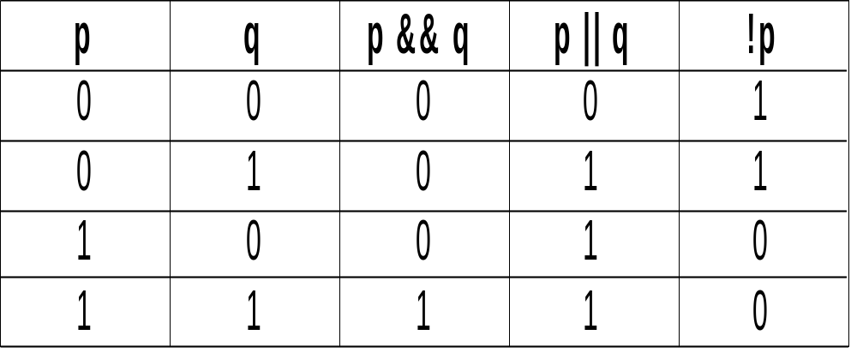
Operators
Logical Operators:
Example : a && b, a | | b,
!( a < b ) && c
Notes:
The logical operator ! is unary, and the logical operator && and | | are binary.
All of these operators, when applied to expressions, yields either the integer value 0 or the integer value 1.
Logical operators are lower in precedence than the arithmetic operators.
Lets look at the truth table for logical operators.
Here using 1’s and 0’s.
Example : a && b, a | | b, !( a < b ) && c

Slide 39
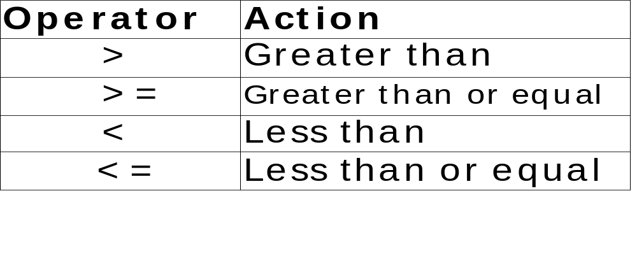
Operators
Relational Operator:
Ex: a < b, a >= b, a != b
Equality Operator
  == and !=
  Ex: c == ‘A’ , k != -2
Notes:
Relational Operator
The relation operators are all binary.
They each take two expressions as operands and yields either the integer value 0 or integer value 1.
Some example are
a < b, a >= b, a != b
Equality Operator
The equality operators = = and != are binary operators acting on expressions.
They yield either the integer value 0 or the integer value 1.
Some examples are
C = = ‘A’
K != -2

Slide 40
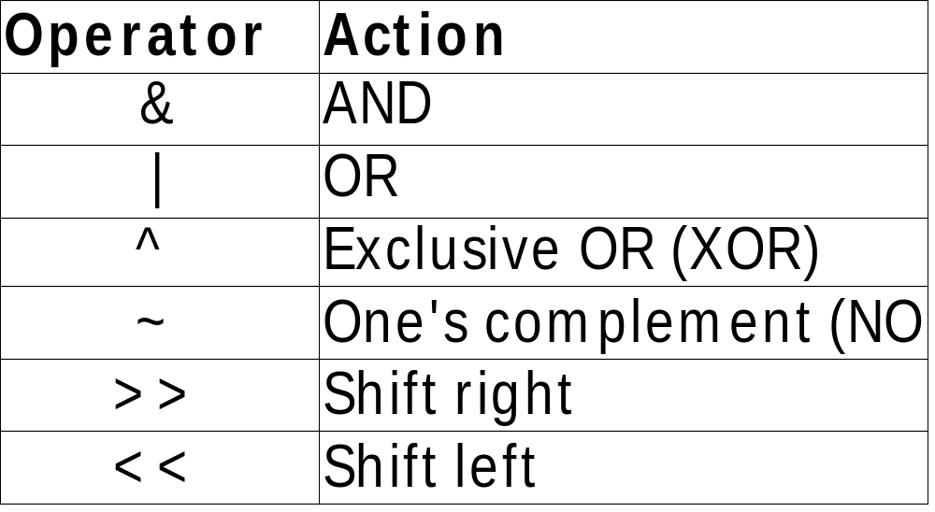
Operators
Bitwise Operator:
Notes:
The bitwise operators act on integral expressions represented as strings of binary digits.
C provides six operators for bit manipulation. These operators only be applied to integral operands i.e char, short, int, and long, whether signed or unsigned.
The operators are
& AND
| OR
^ XOR
~ one’s complement
>> right shift
<< left shift
Bitwise operations most often find in device drivers— such as modem programs, disk file routines, and printer routines— because the bitwise operations can be used to mask off certain bits, such as parity.

Slide 41
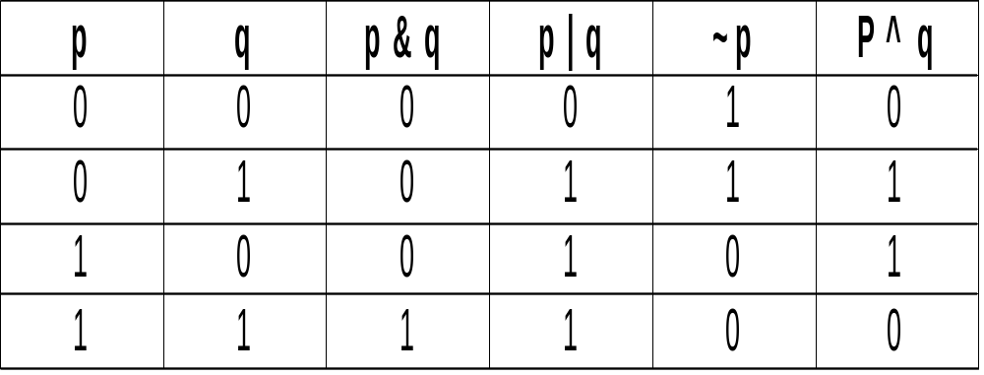
Operator
Bitwise Operator
Notes:
The operator operations are like this
Consider two operands p & q.
The input value for p & q are

Slide 42
Bitwise Operator
To set a bit
num = num | 1 << pos;
To clear bit
num = num & ~( 1 << pos );
To toggle a bit
num = num ^ ( 1 << pos );
Notes:
Let us take an example for bitwise operators
To set a particular bit with given position
First we take integer 1 and left shift to pos number of times.
Then OR with number and finally store the result in number.
To clear a particular bit with given position.
First we take integer 1 and left shift to pos number of times.
Then take one’s complement of that.
Then AND with number and finally store the result in number.
To toggle a particular bit with given position
First we take integer 1 and left shift to pos number of times.
Then XOR with number and finally store the result in number.

Slide 43
Operators
The ? Operator: exp1 ? exp2 : exp3
Where exp1,exp2 and exp3 are expressions.
Ex: x=10
y = x>9 ? 100 : 200
Finally y value will be 100.
Notes:
The ? Operator:
C contains a powerful and convenient operator that replaces certain statements of the if-then-else form.
The ternary operator ? takes the general form
Exp1 ? Exp2: Exp3;
where Exp1, Exp2, and Exp3 are expressions.
Please note the use and placement of the colon properly.
The ? operator works like this:
Exp1 is evaluated first.
If it is true, Exp2 is evaluated and becomes the value of the expression.
If Exp1 is false, Exp3 is evaluated, and its value becomes the value of the expression.
For example, in
x = 10;
y = x>9 ? 100 : 200;
So finally y value will be 100.

Slide 44
Operators
The & and * Operator
  A pointer is the memory address of an object.
& is a unary operator that returns the memory address of its operand.
Ex: m=&count;
* is a unary operator that returns the value of the object located at the address.
Ex: if m contains the memory address of the variable count,
  q = *m;
Notes:
The & and * Pointer Operators
A pointer is the memory address of an object.
A pointer variable is a variable that is specifically declared to hold a pointer to an object of its specified type.
Pointers are one of C's most powerful features, and they are used for a wide variety of purposes.
The first pointer operator is &,
a unary operator that returns the memory address of its operand.
(Remember, a unary operator requires only one operand.)
For example,
m = &count;
The second pointer operator is *, which is the complement of &.
The * is a unary operator that returns the value of the object located at the address that follows it.
For example, if m contains the memory address of the variable count,
q = *m;
More about these operators will be discussed in pointers session.

Slide 45
Operators
The Compile time operator: sizeof()‏
It returns the length (unsigned int), in bytes, of the variable or parenthesized type specifier that it precedes
Ex: double f;
printf("%d ", sizeof f);
printf(''%d", sizeof(int));
Notes:
The Compile-Time Operator sizeof
sizeof is a unary compile-time operator,
that returns the length in bytes, of the variable or parenthesized type specifier that it precedes.
For example, assuming that integers are 4 bytes and doubles are 8 bytes, this fragment will display 8 and 4.
double f;
printf("%d ", sizeof f);
printf(''%d", sizeof(int));
Remember, to compute the size of a type, you must enclose the type name in parentheses.
This is not necessary for variable names, although there is no harm done if you do so.
sizeof primarily helps to generate portable code that depends upon the size of the built-in data types.

Slide 46
Operators
The Comma operator ,
The left side of the comma operator is always evaluated as void and right side becomes the value of the total comma-separated expression.
Ex: x=(y=3, y+1);
Notes:
The Comma Operator
The comma operator strings together several expressions.
The left side of the comma operator is always evaluated as void.
This means that the expression on the right side becomes the value of the total comma-separated expression.
For example,
x = (y=3, y+1);
First assigns 3 to variable y and then assigns x the value 4.
The parentheses are necessary because the comma operator has a lower precedence than the assignment operator.
Essentially, the comma causes a sequence of operations.
When you use it on the right side of an assignment statement, the value assigned is the value of the last expression of the comma-separated list.
The comma operator has somewhat the same meaning as the word "and" in English, as used in the phrase "do this and this and this."

Slide 47
Operators
The Dot(.) and Arrow (->) operators
It access individual elements of structure and unions.
The dot operator is used when working with a structure or union directly.
The arrow operator is used with a pointer to a structure or union.
Notes:
The Dot (.) and Arrow (–> Operators )
In C, the . (dot) and the –>(arrow) operators access individual elements of structures and unions.
Structures and unions are compound data types that may be referenced under a single name.
The dot operator is used when working with a structure or union directly.
The arrow operator is used with a pointer to a structure or union.
More about operators will be discussed during structure and union session.

Slide 48
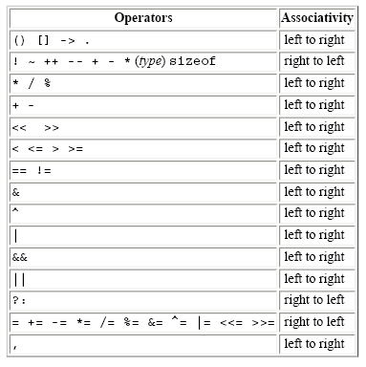
Precedence & Associativity
Notes:
This table summarizes the rules for precedence and associativity of all operators.
Operators on the same line have the same precedence.
Rows are in order of decreasing precedence,
For ex: *, /, and % all have the same precedence, which is higher than that of binary + and -.

Slide 49
Summary
Identifier - Internal & External
32 Keywords
Different types of constant
Basic Data types
How to declare variable
Four C scopes
Type qualifier – const & volatile
Storage class specifier
Operators
Notes:
Finally we reached end of the session.
Lets summarize what all we discussed.
First we understood what is identifier and its type.
Then 32 keywords and different types constants like integer constant, character constant etc..
We understood different data types and how to declare a variables using that.
Four C scopes i.e File scope, Block scope, Function prototype scope and function scope.
Type qualifier – const and volatile
Storage class specifier – auto, register, static, extern and typedef
Finally we understood Different types of operators and its usage.

Slide 50
.
Thank You

