Slide 1
C Language
Training Division
Notes:
Good Day…
Today we will discuss on Basic Introduction to C Program

Slide 2
Contents
History of C Language
Features of C Language
Character Set
Compiler and Interpreter
Compilation steps
GESL, Training Dept
Notes:
This section gives brief introduction about
At the end of the session you will come to know about history, features of C language, character set and how compilation is done.

Slide 3
History of C Language
C was invented and first implemented by Dennis Ritchie on a PDP-11 that used the UNIX OS.
C is the result of older development language called BCPL.
BCPL was developed by Martin Richards.
BCPL has influenced a language called 'B', which was invented by Ken Thompson.
'B' led to the development of C in the 1973s.
GESL, Training Dept
Notes:
First Lets discuss history of C language.
In 1965, Bell Laboratories joined an effort with General Electrical Company to develop a new operating system called Multics.
The main objectives of the system were to provide simultaneous computer access to a large community of users.
In 1969 this research group decided that, to develop MULTICS would take a lot longer time than expected, so Bell Laboratories pulled out of the joint development venture.
At the same time, Ken Thomson who was working with this team, developed a language Called B.
Language B was based upon Martin Richards, BCPL ( Basic Combined Programming Language).
However, B suffered several limitations: it was type less and only, supported a single machine word data type.
Because of B’s limitation, Ritchie went on to develop C in 1973.

Slide 4
History
BCPL
B
New B
Early C
Language
UNIX (Written in
PDP-7 Assembly)‏
UNIX (Written In
PDP-11 Assembly)‏
UNIX in C
Operating System
PDP - 7
PDP - 11
PDP – 11/45
Hardware
GESL, Training Dept
Notes:
This gives you pictorial representation of C Language History.
Languages from BCPL -> B -> New B -> Early C
On the similar Line we can view the Operating system and Hardware which was supporting this.

Slide 5
Features of C
Middle Level language
Portability
Structured programming language
Modularity
Documentability
Data structures
GESL, Training Dept
Notes:
Middle Level Language
Because it combines the best elements of high-level languages with the control and flexibility of assembly language.
C allows the manipulation of bits, bytes, and address – the basic elements with which the computer functions.
Example for High Level Language – PASCAL, COBOL
Low Level – Assembler.
Portability
C Code is also very portable. Means that it is easy to adapt software written for one type of computer or operating system to another type.
Structured Programming
The distinguished feature of structured language is compartmentalization of Code and Data.
That means,
We can achieve compartmentalization, by using subroutines that employ local variables.
By using local variables, you can write subroutines so that the events that occurs within them cause no side effects in other parts of the program.
This capability makes it very easy for your C programs to share sections of code.
Modularity
In C functions are the building blocks in which all program activity occurs. They allow you to define and code individually the separate tasks in the program.
Being able to create stand-alone functions is extremely important in larger projects, where one programmer’s code must not accidentally affect another’s.
Documentation
Documentation in the code can be extremely useful in enhancing the understandability of programs.
It consists of comment inserted in the code at various points.
Ex: prologue at the start of the file, comments for the global and static variable being defined.
In C we can use multi-line commenting style like /* ……*/
Or
Single line commenting //
Data Structures
C supports many data structures like Arrays, Stacks, Queues & Lists etc…

Slide 6
Why C...?
Why C in Embedded Programming...?
GESL, Training Dept
Notes:
Till now we understood features of c Language.
Now we will see why C in Embedded Programming.
There are many reasons for C in Embedded programming, some are
1) Direct access to low level hardware APIs
2) We can find a C compiler for the vast variety of devices
3) The hardware API/drivers will likely be written in C.

Slide 7
Character Set
Standard specifies that the character set must have
  English alphabet in both upper and lower case
  The digits 0 through 9
  The white space character – newline, space, tab, vertical tab, and form feed character.
  The special character
! “ # % , ( ) * + ` - . / :
; < > = ? [ ] \ ^ _ { } | ~
GESL, Training Dept
Notes:
Basic character set contains
- Totally 52 alphabetic char - Upper and lower case characters
- 10 decimal digits ( 0- 9)
- White space character – newline, tab, Blank space, form feed, carriage return
- Special character

Slide 8
Comments
A comment begins with the occurrence of the two chars /* and ends with the first subsequent occurrence of the two chars */
Comments are treated as white space
A comment can also begin with the chars // and extends upto the next line break
Ex: char str[ ]=”array/*of chars*/”;
An alternative to comments is
#if 0
#endif
GESL, Training Dept
Notes:
While discussing C features, one of feature we discussed was Documentation.
C89 standard defines only one style of comments, which begins with the character pair /* and ends with */.
There must be no space between the asterisk and the slash.
The compiler ignores any text between the beginning and ending comment symbols.
Comments are treated as white space.
Comments may be placed anywhere in the program, as long as they do not appear in the middle of a keyword or identifier.
Swi/*this will not work */tch ( )
{ … }
One more important point is,
Multi-line comment should not be nested.
i.e one comment may not contain another comment.
C99 standard supports two types of comments. The first is multi-line comment, second is the single-line comment.
Single-line comments begin with // and end at the end of line.
Single-line comments are especially useful when short description or line-by-line description are needed.
An alternative to comment is
Through conditional compilation like,
#if 0
#endif
More about this we will discuss, when we discuss about conditional compilation.

Slide 9
Comments
//#define one (2*5)‏
#define one /* one: xyz
*/ (2*5)‏
//comments
/* comments */
int main(/* comment */)‏
{
char string[] = "arrays/*comments*/abc"; /* comments not removed */
printf("/* hello world */ //abcd //efg \n"); /* comments not removed */
c = one;
return 0;
}
GESL, Training Dept
Notes:
Consider the example
In the first line we have a put a single line comment
In second line, b/w #define we have placed the comment “one: xyz”
Next, In the main function, while receiving arguments we can place a comment.
In array initialization, in b/w string constant, if we place a comment, this comment will not be removed.
Same as with the printf case.

Slide 10
Compilers & Interpreters
A compiler reads the entire program and converts it into object code. Object code is also referred as binary code or machine code.
An Interpreter reads the source of your program one line at a time, performing the specific instructions contained in that line.
GESL, Training Dept
Notes:
It is important to understand that a computer language defines the nature of a program and not the way that the program will be executed.
There are two general methods by which a program can be executed.
Can be compiled
Can be interpreted
Lets taken an analogy,
If a politician travelled to other state and wants to delivery a speech/discussion. But he don’t know the native language. So he gets a translator or interpreter, who will translate or interpret sentence by sentence to audience.
In the similar line, the politician gets a speech notes from secretary and he will analyze it and delivery how the audience wants to listen.
Like secretary would’ve written a comments, the politician will not deliver all those things, he will deliver only the meaningful content to audience.
In Programming also, programmers would’ve written comments, but the compiler will analyze it and gives the machine code what target can understand.
A Compiler reads the entire program and converts it into object code, which is a translation of the programs source code into a form that the computer can execute directly.
It is also referred as binary code or machine code. Once the program is compiled, a line of source code is no longer meaningful in the execution of your program.
An interpreter reads the source code of your program one line at a time, performing the specific instruction contained in that line.
In language such as Java, a program’s source code is first converted into an intermediate form that is then interpreted.
C was designed to be compiled, where as Java was designed to be interpreted.

Slide 11
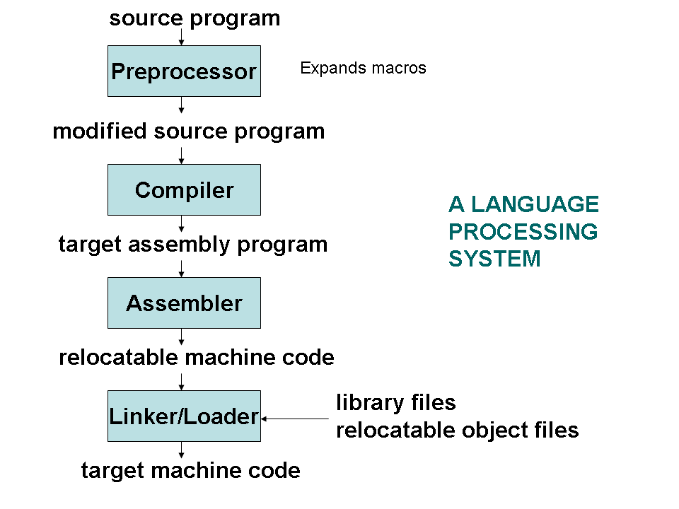
Compilation Process
GESL, Training Dept
Notes:
Now we will understand steps in compilation process
there are majorly four steps
Pre-processor
Compiler
Assembler
Linker and Loader
As shown in the figure.

Slide 12
Preprocessor
  Preprocessor performs the following operations
    Macro substitution
    Inclusion of Header files
    Comments Removal
    Conditional compilation
GESL, Training Dept
Notes:
Preprocessor
Lets understand the functionality of each steps in detail.
Lines beginning with #, communicate with the preprocessor.
A preprocessor performs the following operations
Macro substitution
Inclusion of header files
Comment Removal
Condition Compilation

Slide 13
Compiler
A compiler is a program takes a program written in a source language and translates it into an equivalent program in a target language.
source program COMPILER target program
( Normally a program written in
a high-level programming language)‏
( Normally the equivalent program in
machine code – relocatable object file)‏
GESL, Training Dept
Notes:
Compilation is a process of translating source into object code or machine understandable form.
As shown in the figure, Source program as input to the compiler, will provide the machine code as a output, which will be understandable by target.

Slide 14
Phases of Compiler
There are two major phases in compiler: Analysis and Synthesis
In analysis phase we have 3 sublevels
  Lexical Analyzer
  Syntax Analyzer
  Semantic Analyzer
In synthesis phase we have 3 sublevels
  Intermediate Code Generation
  Code Optimization
  Code Generation
GESL, Training Dept
Notes:
There are two major phases in compiler
Analysis Phase
Synthesis Phase
In analysis phase we have three sub levels lexical analyzer, syntax analyzer and semantic analyzer.
In synthesis phase we have intermediate code generation, code optimization and code generation.

Slide 15
Phases of Compiler
Analysis
Synthesis
Source Code
Lexical Analyzer
Intermediate Code
Syntax Analyzer
Optimized Code
Semantic Analyzer
Code generator
Target code
GESL, Training Dept
Notes:
Steps are shown in the figure.

Slide 16
Lexical Analyzer
Lexical Analyzer reads the source program character by character and returns the tokens of the source program.
A token describes a pattern of characters having same meaning in the source program. (such as identifiers, operators, keywords, numbers and so on)‏
Puts information about identifiers into the symbol table.
Regular expressions are used to describe tokens (lexical constructs).
GESL, Training Dept
Notes:
Now we will discuss each phase in detail – Lexical Analyzer
In this stage combines each character in the source file to form a TOKEN.
A Token is some collection of ASCII characters from the input stream that are meaningful to the compiler when taken as a group.
There are six classes of tokens
Keywords
Identifiers
Constants
String literals
Separators
Operators
The compiler uses a symbol table to keep track of the locations of variables in memory.
Lexical analyzer puts information about identifiers into the symbol table.

Slide 17
Lexical Analyzer
Ex: newval = oldval + 12
=> tokens: newval , oldval = assignment operator
+ addition operator
12 constant number
GESL, Training Dept
Notes:
Lets look at the example.
The expression newval = oldval + 12

Slide 18
Syntax Analyzer
A Syntax Analyzer creates the syntactic structure (generally a parse tree) of the given program.
A syntax analyzer is also called as a parser.
A parse tree describes a syntactic structure.
Grammar check
GESL, Training Dept
Notes:
This unit checks for the syntax in the code.
The syntax analyzer is also called parser.
A parser organizes the tokens returned from the token recognizer in such a way that the compiler can conveniently generate code parse tree.
This phase basically does grammer check.

Slide 19
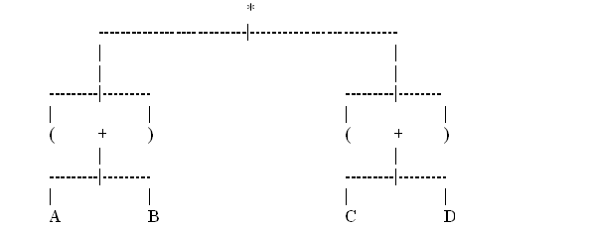
Parse Tree
A simplified parse tree for (A+B)*(C+D)
GESL, Training Dept
Notes:
Lets look the example of parse tree
(A+B)*(C+D)
In the root it will be operators and leaf node will be operands.

Slide 20
Semantic Analyzer
Semantic analysis is the phase in which the compiler adds semantic information to the parse tree and builds the symbol table.
This phase performs semantic checks such as type checking (checking for type error) or rejecting incorrect programs or issuing warnings.
GESL, Training Dept
Notes:
This unit checks for the meaning in the statements.
It adds semantic information to the parse tree and builds symbol table.
This phase checks the sematic, such as type checking, then rejectign programs or issue warnings.

Slide 21
Semantic Analyzer
Ex: newval := oldval + 12
The type of the identifier newval must match with type of the expression (oldval+12)‏
2) 12 = newval + oldval
GESL, Training Dept
Notes:
In first example, we check the type of the identifier newval must match with type of the expression (oldval+12)
In second example, adding newval and oldval and try to assign the result in to constant, which is not possible.

Slide 22
Intermediate Code Generation
A compiler may produce an explicit intermediate codes representing the source program.
These intermediate codes are generally machine (architecture independent). But the level of intermediate codes is close to the level of machine codes.
Ex:
newval := oldval * fact + 1
id1 := id2 * id3 + 1
MULT id2,id3,temp1 Intermediate Codes (Quadruples)‏
ADD temp1,#1,temp2
MOV temp2, id1
GESL, Training Dept
Notes:
Intermediate code generator will generate a code which is in the form of generic assembly language like instructions.
These intermediate codes are generally machine independent.
But the level of intermediate codes is close to the level of machine codes.
For example:
newval := oldval * fact + 1
id1 := id2 * id3 + 1
MULT id2, id3, temp1
(Quadruples)
ADD temp1, #1, temp2
MOV temp2, id1

Slide 23
Code Optimizer (for Intermediate Code Generator)‏
The code optimizer optimizes the code produced by the intermediate code generator in the terms of time and space.
Ex:
MULT id2,id3,temp1
ADD temp1,#1,id1
GESL, Training Dept
Notes:
Intermediate code generation process introduces many inefficiencies like extra copies of variables or using variables instead of constants or repeated evaluation of expressions etc.
Code optimization removes such inefficiencies and improves code.
Improvement may be time, space or power consumptions.
Many optimization techniques are there to improve the efficiency,
Such as loop-unrolling, in-line functions and eliminating the some programmer-defined variables,
but currently we will not get into details of optimization techniquies

Slide 24
Code Generator
Produces the target language in a specific architecture.
The target program is normally is a relocatable object file containing the machine codes.
Ex: ( assume that we have an architecture with instructions whose at least one of its operands is a machine register)‏
MOVE id2,R1
MULT id3,R1
ADD #1,R1
MOVE R1,id1
GESL, Training Dept
Notes:
The final stage of the compiler is the generation of the target code, consisting normally assembly or relocatable machine code if assembler is combined with code generator.
Example: Assume that we have an architecture with instructions whose at least one its operand is a machine register.

Slide 25
Assembler
Some compiler will produce assembly code
Code is given for the assembler for further processing to produce direct relocatable object code
Relocatable code contains the opcode and operands for processing in the form of binary or machine code
GESL, Training Dept
Notes:
Some compiler will produce assembly code and assembly code given for the assembler for futher processing to produce direct relocatable object code.
The relocatable object code contains the opcode and operands for processing in the form of binary or machine code .

Slide 26
Compilation Process
Linking
    The assembler output is given to linker.
    Linking object codes, linking with libraries
Loading
    Loading executable code into main memory
GESL, Training Dept
Notes:
In the compilation process, last step is
Linking:
Process of combining multiple code modules into a runnable program.
Ex: using standard library code ( printf, malloc, etc…) in your program.
Loader:
Process of getting an executable running on the machine.

Slide 27
Summary
History of C language
Features of C language
Compilation Steps
    Pre-processing
    Compiler
    Assembler
    Linker/Loader
GESL, Training Dept
Notes:
Finally we reached end of the session. Lets summarize what all we understood.
First we got to know History of C Language
Then Understood Features of C Language
Finally we got clarity on How compilation is done with detailed explanation of each step.

Slide 28
Thank you

