Slide 1
Input/Output Statements
Global Edge, Training Division

Slide 2
Contents
Basic I/O Functions
Char I/O
Buffered I/O
Formatted I/O

Slide 3
Standard C Library
I/O commands are not included as part of the C language
Instead they are part of the standard C Library.
    A collection of functions and macros that must be implemented by any ANSI standard implementation.
    Implementation depends on processor, operating system, etc., but interface is standard.
Since they are not part of the language, compiler must be told about function interfaces.
Standard Header files are provided, which contain declarations of functions, variables, etc...

Slide 4
I/O Functions
The Standard I/O functions are declared in <stdio.h> header file.
    putchar – writes a char to stdout
    getchar – reads char from stdin
    printf – prints a formatted string
    scanf – reads formatted string

Slide 5
Character I/O
All character based I/O in C is performed on text streams.
A Stream is sequence of ASCII characters.
Characters are processed in the order in which they were added to the stream.
Ex: Standard input stream - stdin
char c='h';
putchar(c);
putchar('h');
putchar(104);

Slide 6
Character I/O
int getchar(void);
int putchar( int );

Slide 7
Buffered I/O
In many systems, characters are buffered in memory during an I/O operation.
Input stream - Characters are added to the buffer only when new line occurs.
Output stream – Characters are not flushed to the output device until the new line character is added.
gets – reads a line from stdin in to the buffer pointed by S, until by new line or EOF, which replaces '\0'

Slide 8
Formatted I/O
printf and scanf allows conversion between ASCII representations and internal data types.
Format string contains text to be read/written, and formatting characters that describe how data is to be read/written.
%d – signed decimal integer
%f – floating-point number
%x – unsigned hexadecimal number
%c – ASCII character
%s – ASCII string

Slide 9
Formatted I/O
int printf(char *format, arg1,arg2, ... );
printf writes the output to stdout with all formatting characters replaced by the ASCII representation of the corresponding data argument.

Slide 10
Formatted I/O
int scanf(char *format, ...);
  Reads characters from the stdin, interprets them according to the specification in format.
  scanf stops when it exhaust its format string, or when some input fails to match the control specification.
  It returns as its value the number of successfully matched and assigned input items.

Slide 11
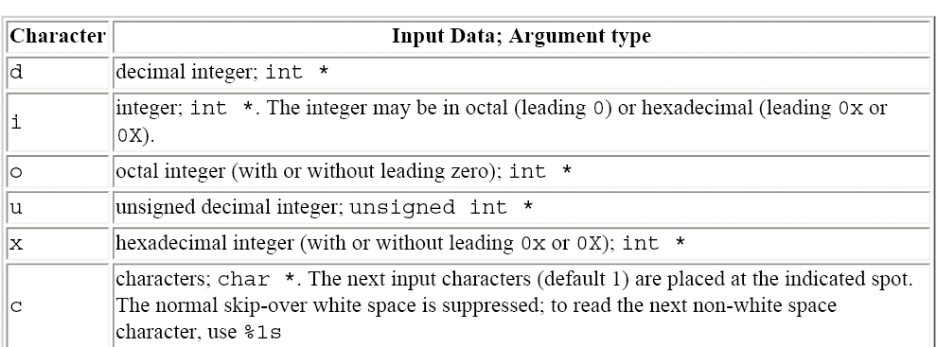
Formatted I/O

Slide 12
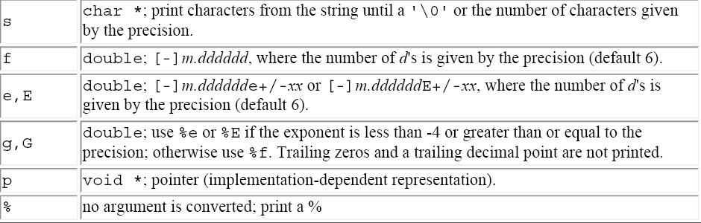
Formatted String

Slide 13
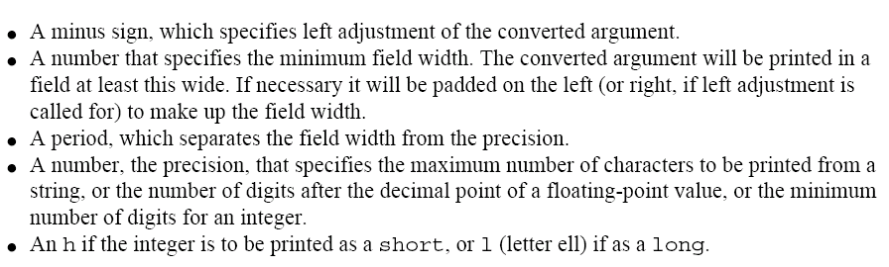
Formatted String
Between the % and the conversion character there may be, in order:

Slide 14
Variable-length argument list
int printf(char *format, ...);
Where the declaration ... means that the number and types of these arguments vary. The ... can appear only at the end of an argument list.
The standard header <stdarg.h> contains a set of macro definitions that define how to proceed.
va_list - declare a variable that will refer to each argument in turn(argument pointer)‏
va_start – initializes 'ap' to point to the first unnamed argument.
var_arg – returns one argument and steps ap to the next.
va_end – does necessary clean-up, must be called before program returns;

Slide 15
Thank You

