Slide 1
Threaded Binary Trees

Slide 2
Threaded Binary Tree
Too many null pointers in current
representation of binary trees
n: number of nodes
number of non-null links: n-1
total links: 2n
null links: 2n-(n-1)=n+1
Replace these null pointers with some useful “threads”.

Slide 3
Threaded Binary Tree
root
inorder traversal:
H, D, I, B, E, A, F, C, G
A
B
C
D
E
F
G
H
I

Slide 4
Threaded Binary Tree
root
A
B
C
D
E
F
G
H
I
inorder traversal:
H, D, I, B, E, A, F, C, G

Slide 5
Data Structures for TBT
    left_thread left_child data right_child right_thread
TRUE
●
●
FALSE
TRUE: thread
FALSE: child
typedef struct threaded_tree {
char left_thread :1;
char right_thread:1;
char data;
threaded_tree *left_child;
threaded_tree *right_child;
}

Slide 6
Memory Representation of a TBT
root
--
f
f
f
A
f
f
B
f
f
C
f
f
D
f
t
E
t
t
F
t
t
G
t
t
H
t
t
I
t

Slide 7
Next Node in Threaded BT
thread_pointer insucc(thread_pointer *tree)‏
{
temp = tree->right_child;
if (!tree->right_thread)‏
while (!temp->left_thread)
temp = temp->left_child;
return temp;
}

Slide 8
Inorder Traversal of TBT
void tinorder(threaded_pointer tree)‏
{
/* traverse the threaded binary tree inorder */
threaded_pointer temp = tree;
for (;;) {
temp = insucc(temp);
if (temp==tree) break;
printf(“%d”, temp->data);
}
}

Slide 9
Inserting Nodes into TBT
Insert newnode as the right child of node parent
  change parent->right_thread to FALSE
  set child->left_thread and child->right_thread to TRUE
  set child->left_child to point to parent
  set child->right_child to parent->right_child
  change parent->right_child to point to child

Slide 10
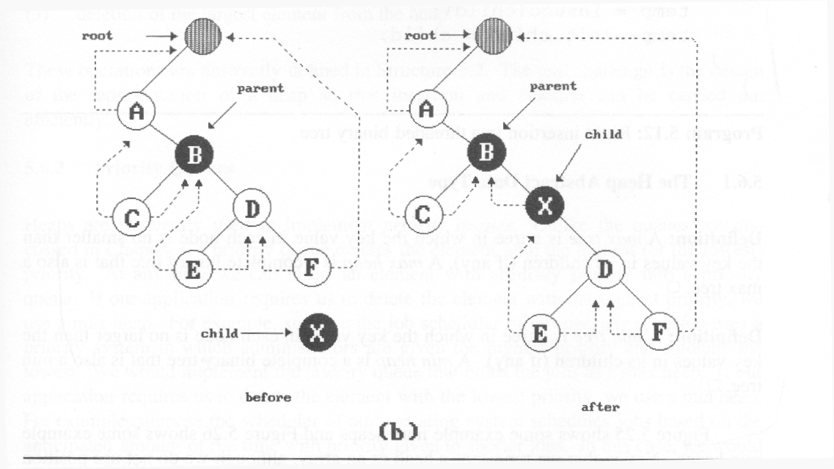
Insertion of child as a R child of parent in a TBT

Slide 11
Examples
Insert a node D as a right child of B.
root
root
A
A
B
parent
B
parent
child
child
C
D
C
D

Slide 12
Threaded Trees
Binary trees have a lot of wasted space: the leaf nodes each have 2 null pointers
We can use these pointers to help us in inorder traversals
We have the pointers reference the next node in an inorder traversal; called threads
We need to know if a pointer is an actual link or a thread, so we keep a boolean for each pointer

Slide 13
Threaded Tree Code
Example code:
struct Node {
Node left, right;
boolean leftThread, rightThread;
}

Slide 14
Threaded Tree Example
6
3
8
1
5
7
11
9
13

Slide 15
Threaded Tree Traversal
We start at the leftmost node in the tree, print it, and follow its right thread
If we follow a thread to the right, we output the node and continue to its right
If we follow a link to the right, we go to the leftmost node, print it, and continue

Slide 16
Threaded Tree Traversal
6
Output
1
3
8
1
5
7
11
9
13
Start at leftmost node, print it

Slide 17
Threaded Tree Traversal
Output
1
3
6
3
8
1
5
7
11
9
13
Follow thread to right, print node

Slide 18
Threaded Tree Traversal
Output
1
3
5
6
3
8
1
5
7
11
9
13
Follow link to right, go to leftmost node and print

Slide 19
Threaded Tree Traversal
Output
1
3
5
6
6
3
8
1
5
7
11
9
13
Follow thread to right, print node

Slide 20
Threaded Tree Traversal
Output
1
3
5
6
7
6
3
8
1
5
7
11
9
13
Follow link to right, go to leftmost node and print

Slide 21
Threaded Tree Traversal
Output
1
3
5
6
7
8
6
3
8
1
5
7
11
9
13
Follow thread to right, print node

Slide 22
Threaded Tree Traversal
Output
1
3
5
6
7
8
9
6
3
8
1
5
7
11
9
13
Follow link to right, go to leftmost node and print

Slide 23
Threaded Tree Traversal
Output
1
3
5
6
7
8
9
11
Output
1
3
5
6
7
8
9
11
6
3
8
1
5
7
11
9
13
Follow thread to right, print node
Follow thread to right, print node

Slide 24
Threaded Tree Traversal
Output
1
3
5
6
7
8
9
11
13
6
3
8
1
5
7
11
9
13
Follow link to right, go to leftmost node and print

Slide 25
TBT Traversal Code
void inOrder(Node n)
{
Node cur = leftmost(n); while (cur != null) {
print(cur);
if (cur.rightThread) {
cur = cur.right;
} else {
cur=leftmost(cur.right);
}
}
}
Node leftMost(Node n)
{
Node ans = n;
if (ans == null) {
return null;
}
while (ans.left != null) {
ans = ans.left;
}
return ans;
}

Slide 26
Threaded Tree Modification
We’re still wasting pointers, since half of our leafs’ pointers are still null
We can add threads to the previous node in an inorder traversal as well, which we can use to traverse the tree backwards or even to do postorder traversals

Slide 27
Threaded Tree Modification
6
3
8
1
5
7
11
9
13

Slide 28
Thank You

