Slide 1
Heap Trees

Slide 2
Contents
  Introduction Heap Tree
  Operations on Heap Tree
  Applications of Heap Tree

Slide 3
2 Rules
Almost Complete Tree
Maintain Heap property

Slide 4

Introduction
  Rule 1: A heap is almost complete binary tree with the following properties:
    Every leaf-node has a height h or h-1.
    Every leaf-node of height h appears to the left of every leaf-node of height h-1

Slide 5
Introduction
Rule 2: Heap Property
  The key value of each node is greater / less than or equal to the key value in each of its descendants.

Slide 6
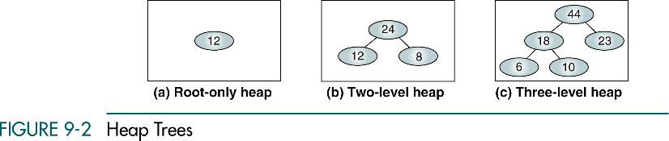
Introduction

Slide 7
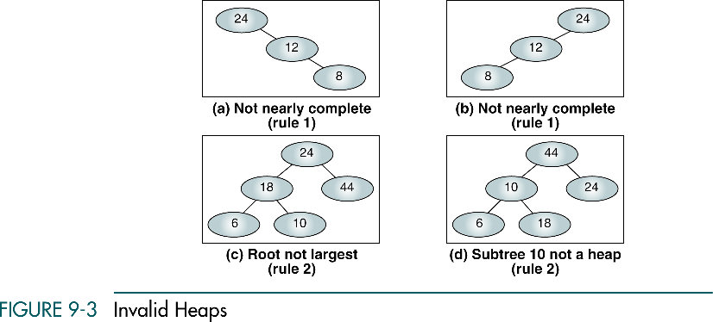
Introduction

Slide 8
Heap tree operations
Heaps are usually implemented in an array structure. Following are the heap tree operations .
Create a heap
Insert a Node into a Heap
Sort the elements of heap
Delete a Node from a Heap

Slide 9
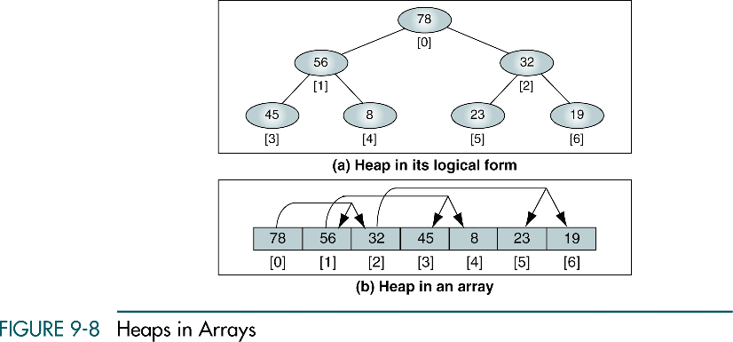
Array Representation
The location of parent node for a child node at position i is ( i – 1 ) / 2

Slide 10
Create a Heap
Here we compare the ith ( Start i = 1 ) node with its father node at location ( (i – 1) / 2 ).
If the father node is lesser than child, shift father node down the tree, proceed until the node i is placed in proper position.

Slide 11
Create a Heap
creatheap(x,n)
{
for(i = 1;i < n; i++){
elt = x[i];
s = i;
f = (s – 1)/2;
while (s > 0 && x[f] < elt) { // shift down
x[s] = x[f];
s = f;
f= (s – 1) / 2 ;
}
x[s] = elt;
}
}

Slide 12
Heaps
Min Heap
Max Heap

Slide 13
Insert into Heap
Insertion into heap is same as creating a heap.
  Place the element at the end of the list.
  Compare it with parent nodes and shifting down correspondingly until right position is found.

Slide 14
Insert into a Heap
insert(x,n,ele){
x[n] = ele ;
for(i = n/2;i >= 1;i--)‏
createheap(x,i);
}
}

Slide 15
Create a Heap
25 57 48 37 12 92 86 33
Max Heap
root
25

Slide 16
Create a Heap
25 57 48 37 12 92 86 33
25
57

Slide 17
Create a Heap
25 57 48 37 12 92 86 33
Up heap
57
25

Slide 18
Create a Heap
25 57 48 37 12 92 86 33
57
25
48

Slide 19
Create a Heap
25 57 48 37 12 92 86 33
57
25
48
37

Slide 20
Create a Heap
25 57 48 37 12 92 86 33
57
Up heap
37
48
25

Slide 21
Create a Heap
25 57 48 37 12 92 86 33
57
37
48
25
12

Slide 22
Create a Heap
25 57 48 37 12 92 86 33
57
37
48
25
12
92

Slide 23
Create a Heap
25 57 48 37 12 92 86 33
57
37
92
Up heap
25
12
48

Slide 24
Create a Heap
25 57 48 37 12 92 86 33
57
37
92
25
12
48

Slide 25
Create a Heap
25 57 48 37 12 92 86 33
92
Up Heap
37
57
25
12
48

Slide 26
Create a Heap
25 57 48 37 12 92 86 33
92
37
57
25
12
48
86

Slide 27
Create a Heap
25 57 48 37 12 92 86 33
92
37
86
Up Heap
25
12
48
57

Slide 28
Create a Heap
25 57 48 37 12 92 86 33
92
37
86
25
12
48
57

Slide 29
Create a Heap
25 57 48 37 12 92 86 33
92
37
86
25
12
48
57
33

Slide 30
Create a Heap
25 57 48 37 12 92 86 33
92
37
86
Up Heap
33
12
48
57
25

Slide 31
Create a Heap
25 57 48 37 12 92 86 33
92
37
86
33
12
48
57
25

Slide 32
Create a Heap - Array
25 57 48 37 12 92 86 33
25
57
48
37
12
92
86
33

Slide 33
Create a Heap
25 57 48 37 12 92 86 33
Shift down
57
25
48
37
12
92
86
33

Slide 34
Create a Heap
57
No shift
25
48
37
12
92
86
33

Slide 35
Create a Heap
57
25
48
37
12
92
86
33

Slide 36
Create a Heap
Shift Down
57
37
48
25
12
92
86
33

Slide 37
Create a Heap
No Shift
57
37
48
25
12
92
86
33

Slide 38
Create a Heap
57
37
No Shift
48
25
12
92
86
33

Slide 39
Create a Heap
57
37
48
25
12
92
86
33

Slide 40
Create a Heap
57
Shift down
37
92
25
12
48
86
33

Slide 41
Create a Heap
57
37
92
25
12
48
86
33

Slide 42
Create a Heap
92
Shift down
37
57
25
12
48
86
33

Slide 43
Create a Heap
92
37
57
25
12
48
86
33

Slide 44
Create a Heap
92
37
86
Shift Down
25
12
48
57
33

Slide 45
Create a Heap
92
No shift
37
86
25
12
48
57
33

Slide 46
Create a Heap
92
37
86
25
12
48
57
33

Slide 47
Create a Heap
92
Shift down
37
86
33
12
48
57
25

Slide 48
Create a Heap
92
No shift
37
86
33
12
48
57
25

Slide 49
Heap Sort ( Delete Root )‏
Repeat following until the array elements are sorted.
Swap the Maximum element ( root ) with the nth element.
Repeat the following steps until the swapped element is placed in its proper position
find the largest son
if the father is less than largest son
shift the father node down
else
position is found place it there

Slide 50
Heap Sort ( Delete Root )‏
heapsort(x,n){
for( i = n-1 ;i > 1; i-- ){
temp = x[i];
x[i] = x[0];
x[0] = temp;
f=0;
s = largeson(0,i-1);
While ( s > = 0 && temp < x[s] )‏
x[f]=x[s];
f = s;
s = largeson ( f, i-1);
}
x[f]=temp;
}
}

Slide 51
Heap Sort ( Delete Root )‏
largeson(f,m) {
s = 2*f+1;
if( s+1 <= m && x[s] < x[s+1]
s = s + 1;
if( s > m )‏
return (-1 );
else
return ( s );
}

Slide 52
Heap Sort - Deletion
92
Delete root
Swap 92 and 25
37
86
33
12
48
57
25
Right Most element from last level

Slide 53
Heap Sort
f
25
Shift down
s
37
86
Swap with Highest child
33
32
48
57
92

Slide 54
Heap Sort
f
86
Shift down
s
37
25
33
32
48
57
92

Slide 55
Heap Sort
86
37
57
33
32
48
25

Slide 56
Heap Sort
86
Delete root
Swap 86 and 25
37
57
33
32
48
25
Right Most element from last level

Slide 57
Heap Sort
f
25
s
Swap with Highest Child
37
57
33
32
48
86

Slide 58
Heap Sort
f
57
s
37
25
33
32
48
86

Slide 59
Heap Sort
57
37
48
33
32
25

Slide 60
Heap Sort
57
37
48
33
32
25
Cont ...

Slide 61
Applications
Some of the applications of heap tree are
Priority Queue
Sorting algorithm

Slide 62
Thank You

