Slide 1
Software Design
Author Name

Slide 2
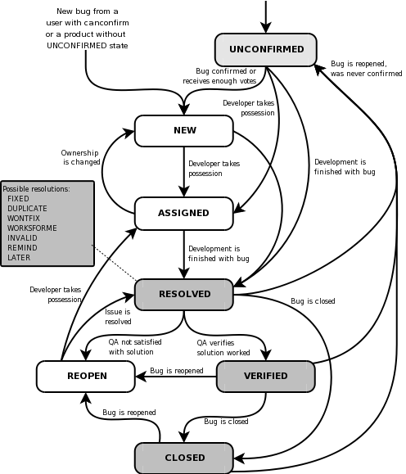
Bug life cycle

Slide 3
Conti...
1) A tester finds a bug and reports it to Test Lead.
2) The Test lead verifies if the bug is valid or not.
3) The bug is verified and reported to development team with status as ‘New’.
4) The development leader and team verify if it is a valid bug. The bug is valid and the development leader assigns a developer to it marking the status as ‘Assigned’.
5) The developer solves the problem and marks the bug as ‘Fixed’ and passes it back to the Development leader.
6) The development leader changes the status of the bug to ‘Pending Retest’ and passes on to the testing team for retest.
7) The test leader changes the status of the bug to ‘Retest’ and passes it to a tester for retest.
8) The tester retests the bug and the same problem persists, so the tester after confirmation from test leader reopens the bug and marks it with ‘Reopen’ status. And the bug is passed back to the development team for fixing.

Slide 4
Conti..
1) A tester finds a bug and reports it to Test Lead.
2) The Test lead verifies if the bug is valid or not.
3) The bug is verified and reported to development team with status as ‘New’.
4) The developer tries to verify if the bug is valid but fails in replicate the same scenario as was at the time of testing, but fails in that and asks for help from testing team.
5) The tester also fails to re-generate the scenario in which the bug was found. And developer rejects the bug marking it ‘Rejected’

Slide 5
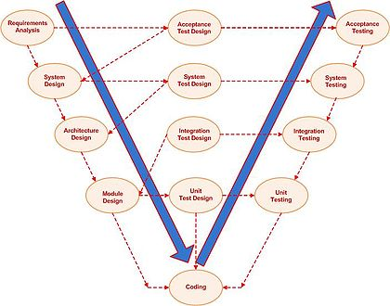
Vmodel

Slide 6
Various stages of V model
1) Requirement Analysis
This document is required by the business analysts to convey the function of the system to the users
2)System Design
Diagrams and data dictionary is also produced here.
3)Architecture Design
Software design should realize the modules and the functionality of the modules which have to be incorporated
4)Module Design
In the module design, the architectural design is again broken up into sub units so that they can be studied and explained separately.

Slide 7
Validation Phase in V Model
Unit Testing
Integration Testing or Interface Testing
System Testing
Acceptance Testing
Release Testing

Slide 8
Thank You

