Slide 1
Project Scheduling and Tracking

Slide 2
Why Are Projects Late?
Unrealistic deadline established by someone outside the software development group
Changing customer requirements that are not reflected in schedule changes
An honest underestimate of the amount of effort and/or the number of resources that will be required to do the job
Predictable and/or unpredictable risks that were not considered when the project began

Slide 3
Why Are Projects Late?
Technical difficulties that could not have been foreseen in advance
Human difficulties that could not have been foreseen in advance
Miscommunication among project staff that results in delays
A failure by project management to recognize that the project is falling behind schedule and a lack of action to correct the problem

Slide 4
Scheduling Principles
Compartmentalization -- define distinct tasks
Interdependency -- indicate task interrelationships
Time allocation -- assign work units
Effort validation -- be sure resources are available
Defined responsibilities – assign people
Defined outcomes -- each task must have an output
Defined milestones -- review for quality

Slide 5
Scheduling Principles:Compartmentalization
Partition or decompose work into a number of manageable activities and tasks
Decompose both product and process

Slide 6
Scheduling Principles:Interdependency
Determine interdependencies between the compartmentalized activities and tasks
Identify required sequencing
Identify possible parallel (independent) activities

Slide 7
Scheduling Principles:Time Allocation
Each task must be allocated some number of work units
Identify start date and completion date that take account of interdependencies and assignment of people to the tasks

Slide 8
Scheduling Principles:Effort Validation
Track how much actual personnel effort is being used by a particular task
Validate effort estimates

Slide 9
Scheduling Principles: Defined Responsibilities
Each task that is scheduled should be assigned to a specific team member
“Tasks assigned to more than one person are assigned to no one”

Slide 10
Scheduling Principles:Defined Outcomes
Each task must have a defined output
The output is normally a work product or part of a work product (a deliverable)‏

Slide 11
Scheduling Principles:Defined Milestones
Each task or group of tasks should be associated with a project milestone
The milestone is complete when all (the only or every one) of the work products have been reviewed and approved

Slide 12
People and Effort: Not Linear
Work completed does not scale linearly with the number of people involved
The critical component is the additional amount of interpersonal communication required as the number of team members increases
Consider the case where one person can write 5000 LOC/year and where each line of communication reduces the developer productivity by 250 LOC/year

Slide 13
People and Effort: Example
For two developers, there is one communication path; net productivity is then 2 x 5000 LOC - 250 LOC = 9750 LOC
For three developers, there are now three communication paths; net productivity is now 3 x 000 LOC - (3 x 250 LOC) = 14250 LOC
For four developers, there are now six communication paths; net productivity is now 4 x 5000 LOC - (6 x 250 LOC) = 18500 LOC

Slide 14
People and Effort :Result
The nonlinear relationship illustrated can be approximated by an empirical formula
L = lines of code produced
P = productivity factor (range 2000 to 28000)
E = development effort in person-months
B = skills factor (range 0.16 to 0.39, depending on the size of the software to be produced)
t = project duration in months
L = P x (E/B)^{1/3} t^{4/3} or E/B = L³/(P³t⁴)

Slide 15
Effort Allocation
“front end” activities
  customer communication
  analysis
  design
  review and modification
construction activities
  coding or code generation
testing and installation
  unit, integration
  white-box, black box
  regression
40-50%
15-20%
30-40%

Slide 16
Effort allocation
This is a guideline only
2% or 3% may be project planning
10 to 25% requirements analysis
20 to 25% software design

Slide 17
Defining the Task Set
A task set is a collection of software engineering work tasks, milestones, and deliverables, appropriate for a particular project
Task sets are designed to accommodate
  different types of projects and
  different degrees of rigor

Slide 18
Type of Project
Concept Development projects -- explore some new business concept or the application of some new technology
New Application Development projects -- undertaken as a consequence of a specific customer request
Application Enhancement projects -- occur when existing software undergoes major modifications to function, performance, or interfaces that are observable by the end user

Slide 19
Type of Project
Application Maintenance projects -- correct, adapt, or extend existing software in ways that may not be immediately obvious to the end user
Re-engineering projects -- undertaken with the intent of rebuilding an existing system in whole or in part

Slide 20
Degree of Rigor
Casual -- all process framework activities are applied, but only a minimum task set is required. Umbrella tasks are minimized and documentation requirements are reduced.
Structured -- Framework activities and related tasks appropriate to the project type will be applied and umbrella activities necessary to ensure high quality will be applied. Quality assurance, documentation, and measurement tasks are streamlined.

Slide 21
Adaptation Criteria
Adaptation criteria can be used to determine the degree of rigor for a project
size of the project
number of potential users
mission criticality
application longevity
stability of requirements
ease of customer-developer communication
maturity of applicable technology
performance constraints
embedded/non-embedded characteristics
project staffing
Re engineering factors

Slide 22
Computing the Task Set Selector
Review each of the adaptation criteria and assign an appropriate grade (range 1 to 5)
See Table 7.1 for weighting factors and entry point multipliers
Multiply grade x weight x entry point multiplier
Compute average product
This is the TSS where
TSS < 1.2 for casual rigor
1.0 < TSS < 3.0 for structured rigor
TSS > 2.4 for strict rigor

Slide 23
Selecting Software Engineering Tasks
Concept development projects require the following tasks:
  Concept scoping
  Preliminary concept planning
  Technology risk assessment
  Proof of concept
  Concept implementation
  Customer reaction to concept
Tasks are iterative in nature

Slide 24
Concept Development
I
.
2
P
r
e
l
i
I
m
i
n
a
r
y
c
o
n
c
e
p
t
p
l
a
n
n
i
n
g
.
3
T
e
c
h
n
o
l
o
g
y
r
i
s
k
a
s
s
e
s
s
m
e
n
t
P
l
a
n
n
i
n
g
P
r
o
j
E
n
g
i
n
e
e
r
i
n
g
/
e
c
t
D
e
f
i
n
i
t
i
o
n
C
o
n
s
t
r
u
c
t
i
o
n
I
.
1
C
o
n
c
e
p
t
s
c
o
p
i
n
g
I
.
4
P
r
o
o
f
o
f
c
o
n
c
e
p
t
C
o
n
c
e
p
t
D
e
v
e
l
o
p
m
e
n
t
N
e
w
A
p
p
l
i
c
a
t
i
o
n
E
A
p
p
l
i
c
a
t
i
o
n
D
e
v
e
l
o
p
m
e
n
t
A
p
p
l
i
c
a
t
i
o
n
n
h
a
n
c
e
m
e
n
t
R
e
e
n
g
i
n
e
e
r
M
a
i
n
t
e
n
a
n
c
e
i
n
g
I
.
6
C
u
s
t
o
m
e
r
r
e
a
c
t
i
o
n
I
.
5
C
o
n
c
e
p
t
i
m
p
l
e
m
e
n
t
a
t
i
o
n
C
u
s
t
o
m
e
r
R
e
l
e
a
s
e
E
v
a
l
u
a
t
i
o
n

Slide 25
Defining a Task Network
Tasks and subtasks have interdependencies based on sequence
The task network is a graphic representation of the task flow for a project
The planner must determine the inter-task dependencies to ensure continuous progress toward completion
Must also determine the critical path, that is, tasks that must be completed on schedule to keep the project as a whole on schedule

Slide 26
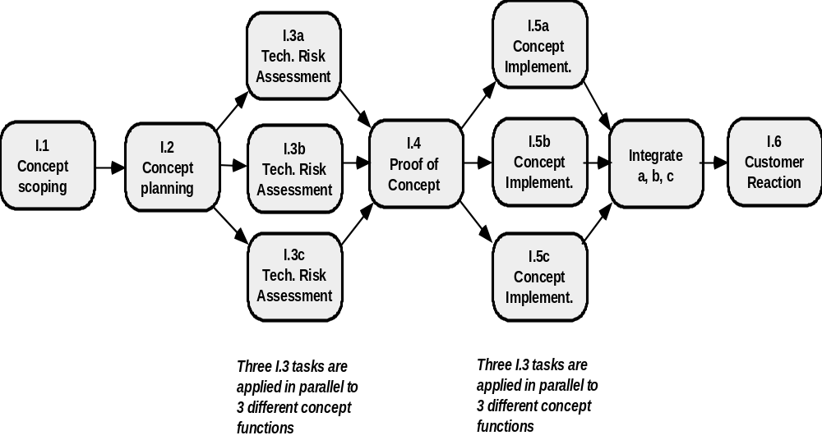
Task Network

Slide 27
Schedulling
Program Evaluation and Review Technique (PERT) and Critical Path Method (CPM) are two project scheduling methods applicable to software development
Both use data developed during project planning activities:
  estimates of effort
  decomposition of product function
  selection of the appropriate process model
  selection of project type and task set

Slide 28
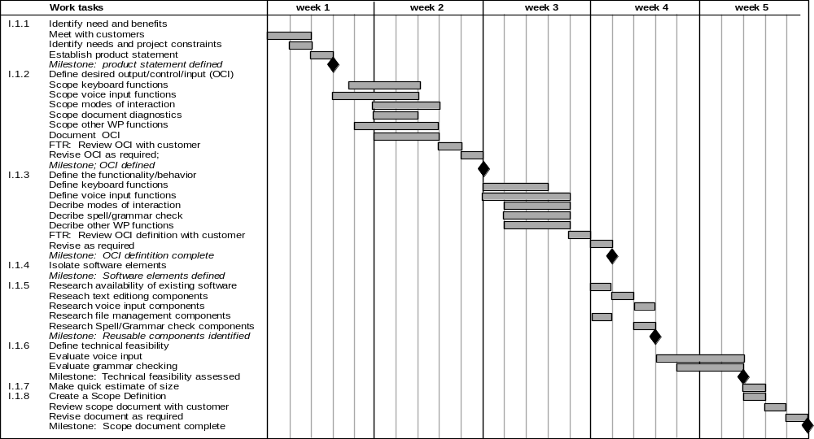
Using Automated Tools to Derive a Timeline Chart

Slide 29
Software Project Plan
The Software Project Plan is the culmination of the planning tasks
It must:
  Communicate scope and resource to software management, technical staff, and the customer
  Define risks and suggest risk management techniques
  Define cost and schedule for management review
  Provide an overall approach to software development for the project staff
  Outline how quality will be ensured and how change will be managed

Slide 30
Software Project Plan Outline
I Introduction
A. Purpose of Plan
B. Project Scope and Objectives
  1. Statement of Scope
  2. Major Functions
  3. Performance Issues
  4. Management and Technical Constraints

Slide 31
Software Project Plan Outline
II. Project Estimates
A. Historical Data Used for Estimates
B. Estimation Techniques
C. Estimates of Effort, Cost, Duration
III. Risk Management Strategy
A. Risk Table
B. Discussion of Risks to be Managed
C. RMMM Plan for Each Risk:
  1. Risk Mitigation
  2. Risk Monitoring
  3. Risk Management (contingency plans)‏

Slide 32
Software Project Plan Outline
IV. Schedule
A. Project Work Breakdown Structure
B. Task Network
C. Time line Chart (Gantt Chart)‏
D. Resource Table
V. Project Resources
A. People
B. Hardware and Software
C. Special Resources

Slide 33
Software Project Plan Outline
VI. Staff Organization
A. Team Structure (if applicable)‏
B. Management Reporting
VII. Tracking and Control Mechanisms
A. Quality Assurance and Control
B. Change Management and Control
VIII. Appendices

Slide 34
Thank You

