Slide 1
Software Quality Assurance

Slide 2
What is software Quality Assurance
An umbrella activity applied throughout the software process
Encompasses:
  a quality management approach
  effective software engineering technology
  formal technical reviews
  a multi-tiered testing strategy
  control of software documentation and changes to it
  a procedure to assure compliance with software development standards
  measurement and reporting mechanisms

Slide 3
What is Quality Management?
General “quality management” objectives:
  Reduce the “variation between samples”, and
  Improve
but how does this apply to software?

Slide 4
What is Quality Assurance?
Quality control: a series of inspections, reviews, tests
Quality assurance: analysis, auditing, and reporting activities
Cost of quality
  appraisal costs
  failure costs
  external failure costs

Slide 5
What is Software Quality
Conformance to explicitly stated functional and
performance requirements, explicitly
documented development standards,
and implicit characteristics that are expected
of all professionally developed software.

Slide 6
What is Software Quality
Software requirements are the foundation from which quality is measured.
Specified standards define a set of development criteria that guide the manner in which software is engineered.
There is a set of implicit requirements that often goes unmentioned; if software conforms to its explicit requirements, but fails to meet implicit requirements, software quality is suspect.

Slide 7
Why SQA Activities Pay Off
cost to find and fix a defect
100
log scale
60.00-100.00
10
10.00
3.00
1.50
1
0.75
1.00
design
unit test
sys test
field
use
reqts
code

Slide 8
What are Reviews
Software reviews are a filter for the software engineering process
Applied at various points during software development
An iterative process

Slide 9
What are Reviews
A meeting conducted by technical people for technical people
A technical assessment of a work product created during the software engineering process
A software quality assurance mechanism
A training ground

Slide 10
What Reviews are Not
A project budget summary
A scheduling assessment
An overall progress report
A mechanism for reprisal or political intrigue

Slide 11
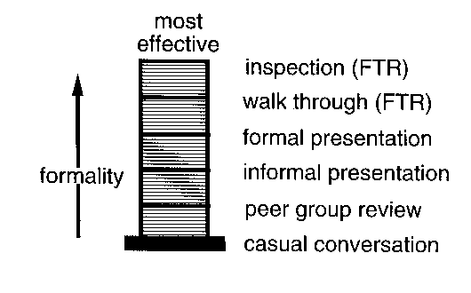
Review Effectiveness

Slide 12
Review Participants
review
leader
standards bearer (SQA)‏
producer
maintenance
oracle
recorder
reviewer
user rep

Slide 13
Review Process
Typically three to five people on the review team
Advance preparation required, but should not take more than 2 hours per person
Duration of meeting should be two hours or less

Slide 14
Review Guidelines
Be prepared -- evaluate product before the review
Review the product, not the producer
Keep your tone mild, ask questions instead of making accusations
Set an agenda and maintain it
Limit debate and rebuttal; record issues for further discussion off-line
Enunciate problem areas, but don’t attempt to solve every problem noted

Slide 15
Review Guidelines
Take written notes; the recorder should collect the critical concerns so that wording and prioritization can be assessed by other reviewers as information is recorded
Limit the number of participants and insist upon advance preparation
Develop a check-list for each type of work product that is likely to be reviewed

Slide 16
Review Guidelines
Allocate resources and time schedule for formal technical reviews
Conduct meaningful training for all reviewers
Review your early reviews--debriefing can be beneficial in uncovering problems with the review process itself
Avoid discussions of style – stick to technical correctness
Schedule reviews as project tasks
Record and report all review results

Slide 17
Reviewers Preparation
Be sure you understand the context
First, skim all product material to understand location and format of the information
Next, read product material and annotate hard copy
Pose your written comments as questions
Avoid issues of style
Inform the review leader if you cannot prepare

Slide 18
Types of Reviews
IPR
WT
IN
RRR
trained leader
agenda established
reviewers prepare in advance
producer presents product
“reader” presents product
recorder takes notes
checklists used to find errors
errors categorized as found
issues list created
team must sign-off on result
IPR—informal peer review WT—Walkthrough
IN—Inspection RRR—round robin review
yes
yes
yes
no
yes
yes
yes
yes
yes
yes
yes
yes
yes
no
no
yes
no
no
yes
maybe
no
maybe
maybe
maybe
no
maybe
no
no
no
no
yes
yes
yes
yes
no
yes
no
no
yes
yes

Slide 19
Metrics Derived from Reviews
Inspection time per page of documentation
Inspection time per KLOC or FP
Inspection effort per KLOC or FP
Errors uncovered per reviewer hour
Errors uncovered per preparation hour
Errors uncovered per SE task (e.g., design)‏
Number of minor errors (e.g., typos)‏
Number of major errors (e.g., nonconformance to requirement)‏
Number of errors found during preparation

Slide 20
Statistical Quality Assurance
Information about software defects is collected and categorized
An attempt is made to trace each defect to its underlying cause
Using the principle that 80% of the defects can be traced to 20% of all possible causes, find the 20%
Once these vital few causes have been identified, move to correct the problems that have caused the defects (root causes)‏

Slide 21
Thank You

