Slide 1
Basics Of Networking

Slide 2
Objectives
Basics of networking
Understand the 7 layer OSI Model
Know the purpose and responsibility of each layer of the OSI Model
Understand the difference between the OSI Model and TCP/IP
Know the relationship between the OSI layers and TCP/IP layers
Know the different types of addressing used with TCP/IP
Know the basic difference between IPv4 and IPv6

Slide 3
Network
-A network can be defined as a group of computers and other devices
connected in some ways so as to be able to exchange data.
-Each of the devices on the network can be thought of as a node; each
node has a unique address.
-Addresses are numeric quantities that are easy for computers to work
with, but not for humans to remember.
Example: 204.160.241.98
-Some networks also provide names that humans can more easily
remember than numbers.
Example: www.javasoft.com, corresponding to the above numeric
address.
…

Slide 4
Data Transmission
-In modern networks, data are transferred using packet switching.
-Messages are broken into units called packets, and sent from one
computer to the other.
-At the destination, data are extracted from one or more packets and
used to reconstruct the original message.
-Each packet has a maximum size, and consists of a header and a data
area.
-The header contains the addresses of the source and destination
computers and sequencing information necessary to reassemble
the message at the destination.
1001….101 00010000111…000000110001100

Slide 5
Types of Network
There are two principle kinds of networks: Wide Area Networks
(WANs) and Local Area Networks (LANs).
WANs
-Cover cities, countries, and continents.
-Based on packet switching technology
-Examples of WAN technology: Asynchronous Transfer Mode (ATM),
LANs
-Cover buildings or a set of closely related buildings.
-Examples of LAN technology: Ethernet, Token Ring, and Fibber
Ethernet LANs: based on a bus topology and broadcast communication
Token ring LANs: based on ring topology

Slide 6
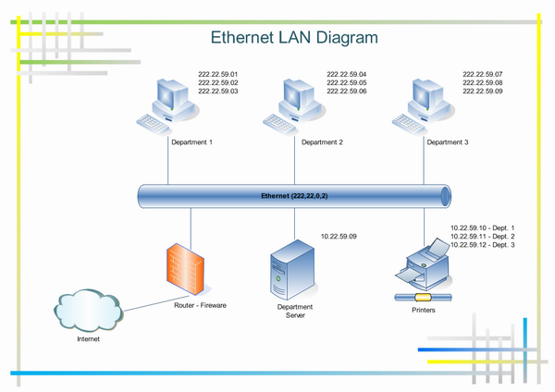

Slide 7
Interconnection
-Networks of low capacity may be connected together via a backbone
network which is a network of high capacity such as a FDDI network, a
WAN network etc.
-LANs and WANs can be interconnected via T1 or T3 digital leased
lines
-According to the protocols involved, networks interconnection is
achieved using one or several of the following devices:
→Bridge: a computer or device that links two similar LANs based on
the same protocol.
→ Router: a communication computer that connects different types of
networks using different protocols.
→ B-router or Bridge/Router: a single device that combines both the
functions of bridge and router.
→ Gateway: a network device that connects two different systems, using
direct and systematic translation between protocols.

Slide 8
Firewall And Proxy Server
A firewall is a system or group of systems that enforces an access control policy between two networks.
A proxy server is a server (a computer system or an application) that acts as an intermediary for requests from clients seeking resources from outside.
Uses
  To keep machines behind it anonymous, mainly for security.
  To apply access policy to network services or content, e.g. to block undesired sites

Slide 9
The OSI Model
  Open System Interconnection Model
  Dominated before 1990
  The TCP/IP protocol suite became dominant because of the Internet; the OSI model was never fully implemented.
  An open system is a set of protocols that allows any two different systems to communicate regardless of their underlying architecture.
  The OSI model is not a protocol; it is a model for understanding and designing a network architecture that is flexible, robust and interoperable.

Slide 10
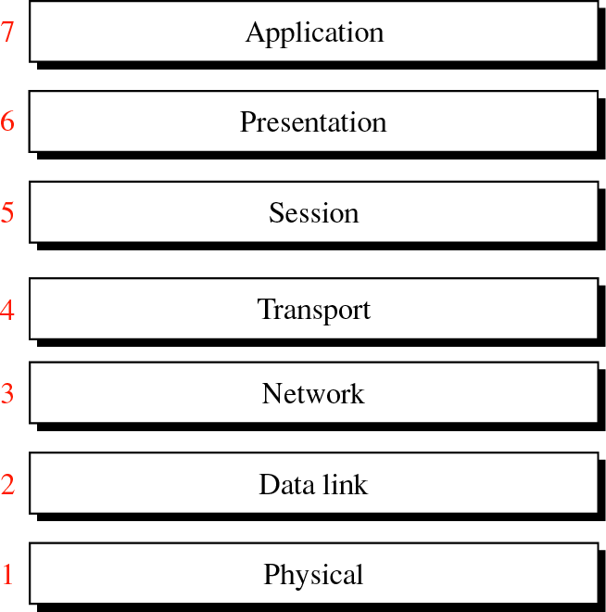
OSI Layers

Slide 11
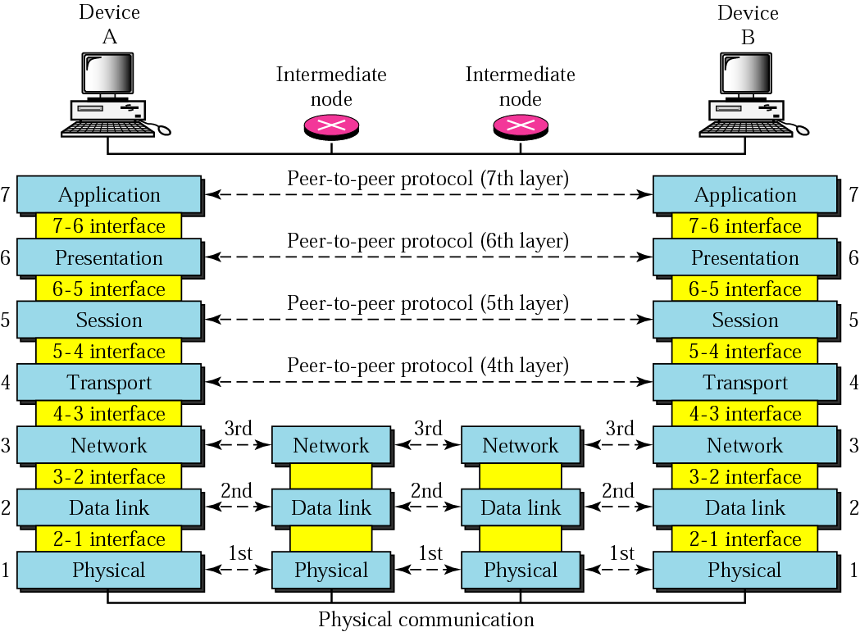
Peer-to-Peer Processes

Slide 12
Interfaces between layers
  Allows the passing of the data and network information down through the layers of the sending device and back up through the layers of the receiving device
  Each interface defines what information and services a layer must provide for the layer above it

Slide 13
Subgroups of Layers
  Network support layers
    1, 2 and 3, physical, data link and network
    Deal with the physical aspects of moving data from one device to another
  User support layers
    5, 6 and 7, session presentation and application
    Allow interoperability among unrelated software systems
  Transport Layer
    4 transport
    Links the two subgroups

Slide 14
Layers in the OSI Model
  Physical
  Data Link
  Network
  Transport
  Session
  Presentation
  Application

Slide 15
Physical
  Physical characteristics of interfaces and media.
  Representation of bits
  Data Rate
  Physical Topology
  Transmission Mode

Slide 16
Data Link
  Framing
  Physical Addressing
  Error Control

Slide 17
Network
  Source-to-destination delivery of a packet possibly across multiple networks.
  Whereas the Data Link layer oversees the delivery of the packet between two systems on the same network.
  If two systems are connected to the same link, there is usually no need for a network layer. The network layer is designed to accomplish source-to-destination delivery.
  Logical addressing
  Routing
    connecting devices (routers or switches) route or switch the packets to their final destination.

Slide 18
Transport
The transport layer is responsible for the Process-to-process delivery of the entire message
  Network layer => oversees end-to-end delivery of individual packets; no relationship between packets, each one independent.
  Transport layer => whole message arrives intact and in order, error control and flow control.
Service-point addressing (Process/Port addressing)‏
Segmentation and reassembly
Connection, Flow and Error control

Slide 19
Session
Establishes, maintains, and synchronises the interaction between communicating systems
  Dialog control => Full/Half duplex
  Synchronisation => Checkpoints

Slide 20
Presentation
Syntax and Semantics of the information exchange
  Translation => Common format
  Encryption => Another form
  Compression => Less bits

Slide 21
Application
User interface and services
  Network virtual terminal => remote host access
  File transfer, access and management
  Mail services
  Directory services

Slide 22
TCP/IP Protocol Suite
TCP was developed prior to the OSI model, therefore layers do not match exactly with those in the OSI model.
The first four layers correspond to the first four layers of the OSI model.
The three top layers in the OSI model, however, are represented in TCP/IP by a single layer called the application layer.
TCP/IP protocol suite - contains independent protocols that can be mixed and matched.

Slide 23
TCP/IP Protocol Layers
At the transport layer there are two protocols
  Transmission Control Protocol (TCP) and User Datagram Protocol (UDP).
At the network layer
  main protocol Internetworking Protocol (IP)‏
There are some other protocols that support movement in this layer.

Slide 24
The Layers in the TCP/IP Protocol Suite
Application
FTP
HTTP
DNS
NFS
Presentation
…
Session
Transport
TCP
UDP
IP
ICMP
IGMP
Network
ARP
RARP
Data link
Physical

Slide 25
Physical and Data Link Layer
At the physical and data link layers, TCP/IP does not define any specific protocol.
It supports all of the standard and proprietary protocols. Like 802.3, HDLC and Frame Relay.
A network in a TCP/IP internetwork can be a LAN, MAN or WAN.

Slide 26
Network Layer
At the network layer TCP/IP supports the Inter networking Protocol (IP) which in turn contains four supporting protocols:
ARP
RARP
ICMP
IGMP

Slide 27
Internet Protocol (IP)‏
Unreliable and connectionless - Best-effort
No error checking or tracking.
IP transports data in packets called datagrams, each of which is transported separately.
IP does not keep track of routes and has no facility for reordering datagrams once they arrive at their destination.

Slide 28
Address Resolution Protocol (ARP)‏
Associates an Internet (IP) address with the physical address.
Each device on a link is identified by a physical or station address usually imprinted on the network interface card (NIC).
ARP is used to find the physical address of the node when its Internet address is known.

Slide 29
Reverse Address Resolution Protocol (RARP)‏
Allows a host to discover its Internet address when it knows only its physical address.
It is used when a computer is connected to the network for the first time or when a disk less computer is booted.

Slide 30
Internet Control Message Protocol (ICMP)‏
Used by hosts and gateways to send notification of datagram problems back to the sender.
  Like Echo Reply, Destination Unreachable, etc.
Sends query and error reporting messages.

Slide 31
Internet Group Management Protocol (IGMP)‏
Used to facilitate the simultaneous transmission of a message to a group of recipients.

Slide 32
Transport Layer
The transport layer is represented by two transport level protocols: TCP and UDP.
  Where IP is a host-to-host protocol (one physical device to another)‏
  TCP and UDP are process-to-process protocols (one running program to another)

Slide 33
User Datagram Protocol (UDP)‏
Simple
Adds only
  Port address
  Checksum error control
  Length information
Connection Less

Slide 34
Transmission Control Protocol (TCP)‏
Provides full transport layer services
Reliable stream (connection-oriented)‏

Slide 35
Application Layer
Is equivalent to the combined session, presentation and application layers in the OSI model.
Many protocols are defined at this layer.

Slide 36
TCP/IP Versions
Version 4
  Current version widely used
  Primary problem is that not enough addresses exist to accommodate the rapid growth of the Internet.
Version 5
  Never got past the experimental stage
Version 6
  The new version implemented. 128 bits
In this course we will focus on IPv4.

