Slide 1

Unix Internals
UNIX is simple and coherent, but it takes a genius to understand and appreciate its simplicity – D Ritchie, 1987

Slide 2
Contents
Introduction
Brief history of Unix
Reasons for popularity of Unix
Unix System Architecture
User's Perspective
- File Subsystem
- Process Subsystem
Unix Kernel Architecture

Slide 3
Brief History of Unix
1965 - Massachusetts Institute of Technology, AT&T Bell Labs, and General Electric worked on experimenting operarting system called Multics
UNIX: 1969 Thompson & Ritchie AT&T Bell Labs
1973 – The operating system was rewritten in C
BSD: 1978 Berkeley Software Distribution
Commercial Vendors: Sun, HP, IBM, SGI, DEC
GNU: 1984 Richard Stallman, FSF
POSIX: 1986 IEEE Portable Operating System unIX
Minix: 1987 Andrew Tanenbaum
SVR4: 1989 AT&T and Sun
Linux: 1991 Linus Torvalds Intel 386 (i386)‏

Slide 4
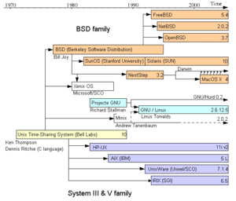
Filiation of Unix and Unix-like systems

Slide 5
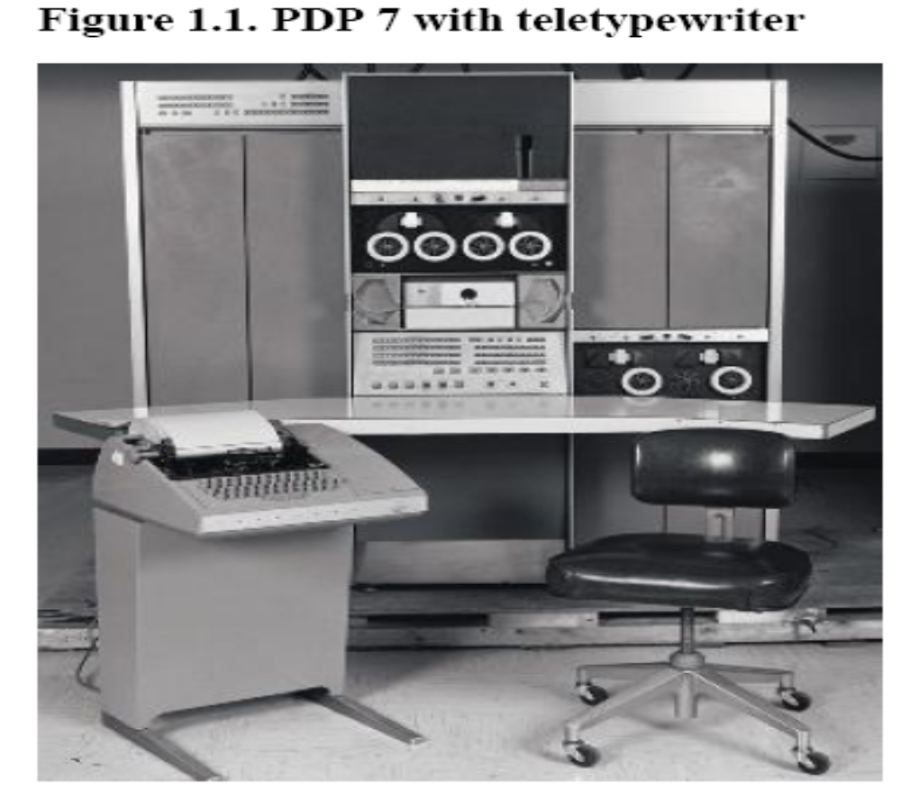

Slide 6
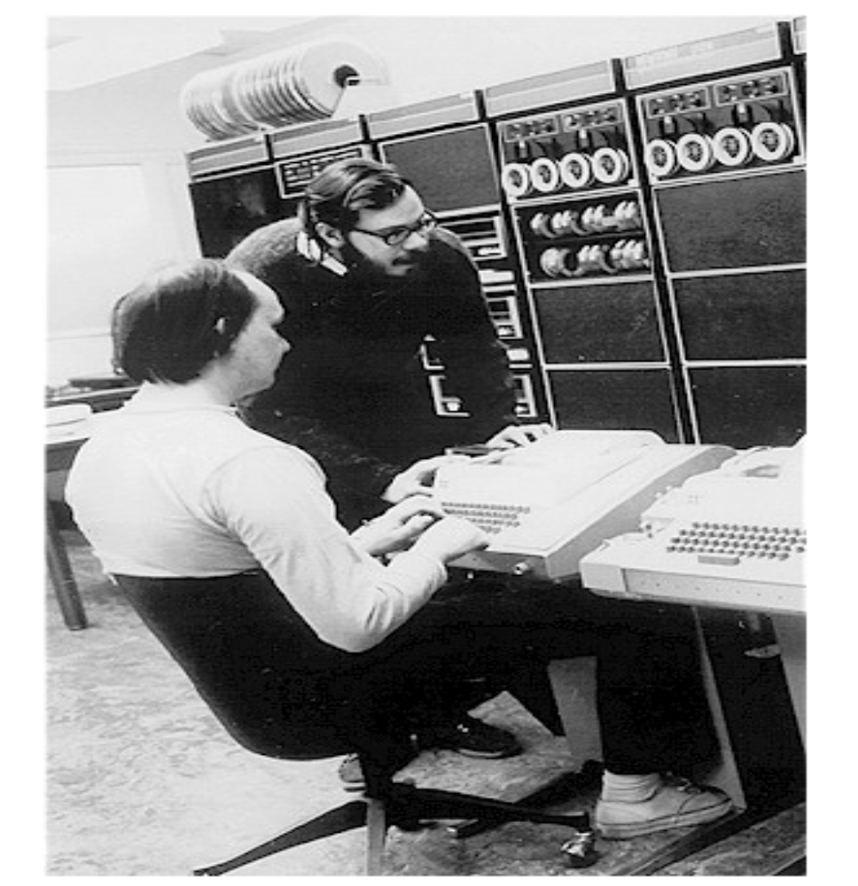

Slide 7
Popularity of Unix
Written in a high-level language – easy to read, understand,change and move.
Simple powerful user interface.

Slide 8
Popularity of Unix
Written in a high-level language – easy to read, understand,change and move.
Simple powerful user interface.
Many useful primitives – permit complex programs to be built from simpler programs.
Hierarchical file system – allows easy maintenance and efficient implementation.

Slide 9
Popularity of Unix
Written in a high-level language – easy to read, understand,change and move.
Simple powerful user interface.
Many useful primitives - permit complex programs to be built from simpler programs
Hierarchical file system – allows easy maintenance and efficient implementation.
Consistent format for files (byte stream) – making programs easier to write.
Device access consistent

Slide 10
Popularity of Unix
Written in a high-level language – easy to read, understand,change and move.
Simple powerful user interface.
Many useful primitives - permit complex programs to be built from simpler programs
Hierarchical file system – allows easy maintenance and efficient implementation.
Consistent file format (byte stream) – making programs easier to write.
Device access consistent
Multi-user, multiprocess system.
Hides machine architecture from user, making easier to write a programs.

Slide 11
Architecture of Unix System
Other Application Programs
sh
who
cpp
a.out
open()
close()
comp
read()
wc
hardware
cc
as
lseek()
kernel
write()
ld
Stat()
date
vi
grep
Other Application Programs

Slide 12

User Perspective
File Subsystem
Process Subsystem
Building Block Primitives

Slide 13
File System characteristics
Hierarchical structure – as a tree with a root.
Consistent treatment of file data – unformatted stream of bytes.

Slide 14
File System characteristics
Hierarchical structure – as a tree with a root.
Consistent treatment of file data – unformatted stream of bytes.
Ability to create and delete files.
Dynamic growth of files.

Slide 15
File System characteristics
Hierarchical structure – as a tree with a root.
Consistent treatment of file data – unformatted stream of bytes.
Ability to create and delete files.
Dynamic growth of files.
Protection of file data – access permissions for three classes of users.
Treatment of peripheral devices as files.

Slide 16
Processing Environment
Program – executable file.
Process – program in execution.
Multiprogramming / Multitasking.
System calls for controlling processes.
Shell – command interpreter program.

Slide 17
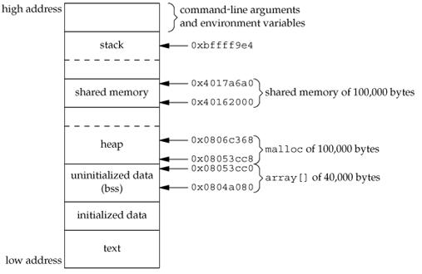
Unix Process

Slide 18
Processing Environment
Process control : fork, exec, wait, exit
Shell allows three types of commands -
  - Internal command
  - External command
  - Script files (executable)‏

Slide 19
Processing Environment
Shell executes a command
  - synchronously (foreground)‏
  - asynchronously (background)‏
  Can run different types of shells
    sh, ksh, csh, bash

Slide 20
Building Block Primitives
To provide operating system primitives that enable users to write small, modular programs that can be used as building blocks to build more complex programs.

Slide 21
Building Block Primitives
To provide operating system primitives that enable users to write small, modular programs that can be used as building blocks to build more complex programs.
I/O redirection – redirects standard input, output, error to a file.

Slide 22
Building Block Primitives
To provide operating system primitives that enable users to write small, modular programs that can be used as building blocks to build more complex programs.
I/O redirection – redirects standard input, output, error to a file.
Pipe – allows stream of data to be passed between reader and writer processes.
    Eg :- cat list | sort | wc -l

Slide 23
Operating System Services
Controlling Processes
  : creation, termination, suspension, communication
Scheduling of Processes
  : time sharing in preemptive round robin fashion
Main memory management
  : virtual memory, swapping, paging
Secondary storage management
  : disk space freed/allocated
Device management
  : it recognizes device/regular file, but hides the distinction from user process.

Slide 24
Process Execution modes
Process execution modes : User and Kernel
Some machine instructions are privileged and result in an error when executed in user mode
Kernel mode for accessing privileged instructions
The kernel runs on behalf of a user process
  Kernel is not a separate set of processes that run in parallel to user processes
Processes in user mode can access their own instructions and data but not kernel instructions and data

Slide 25
Interrupts
Interrupt is generated from devices to indicate events
  On receipt of interrupt,
    kernel saves its current context,
    determines the cause of interrupt,
    services the interrupt
    On return from service, restores its interrupted context and proceeds as if nothing happened
  Interrupts have priorities, decided by the hardware (processor)‏

Slide 26
Exceptions
An exception condition refers to unexpected events caused by a process
  Illegal memory
  Executing privileged instruction
  Divide by zero
Exceptions happen “in the middle” of the instruction execution
System will attempt to restart the instruction after handling exception
The UNIX system uses one mechanism to handle interrupts and exception conditions

Slide 27
Processor Execution Levels
Computer have a set of privileged instructions that set the processor execution level in the processor status word.
Setting the processor execution level to certain values masks off interrupts from that level and lower levels, allowing only higher-level interrupts.
Machine Errors
Clock
Disk
Network Devices
Terminals
Software Interrupt

Slide 28
Memory Management
The kernel permanently resides in main memory.
Kernel allocates space in main memory for a process, but the virtual address generated by the compiler need not be identical to the physical addresses.
Kernel coordinates with the hardware to map virtual to physical addresses.

Slide 29
User program
trap
libraries
User Level
Kernel Level
System call interface
File subsystem
Inter-process
communication
Process
Control
subsystem
Buffer cache
scheduler
character
block
Memory
management
Device drivers
hardware control
Kernel Level
Hardware Level
Hardware
Fig : Unix Kernel Architecture

Slide 30
Thank You

