Slide 1
The Structure of Processes

Slide 2
Contents
Process
Process States and Transitions
Kernel data structures
Layout of System Memory
Context of a Process
System call Interface

Slide 3
Process
A process is an entity that runs a program and provides execution environment.
The process contends for and owns various system resources.
Process has a definite lifetime.

Slide 4
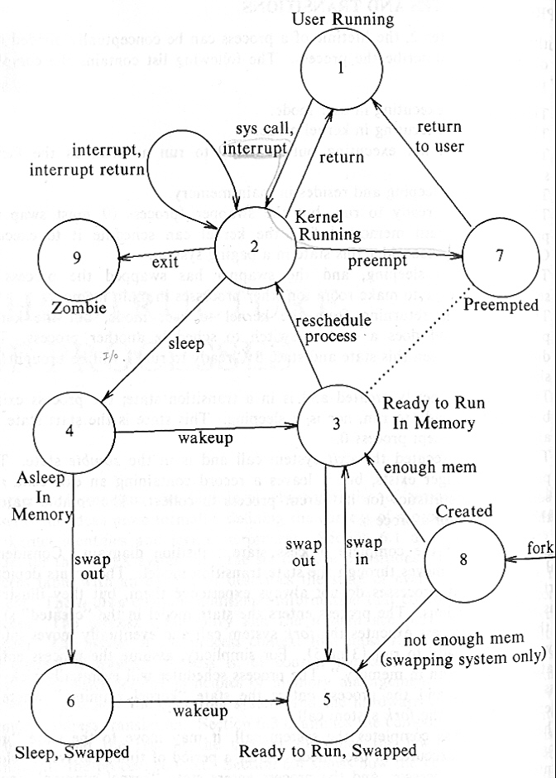
Process States and Transition

Slide 5
Process Table
Process Table Entry & U Area
  Kernel data structures that describe the state of a process
Process Table Entry (always be accessible to kernel)‏
    Process state
    Pointer to u area
    Process size
    User ID
    Process ID
    Event descriptor table
    Scheduling parameters
    Signal field (signals sent to process, but not yet processed)‏
    Timers (process execution time, kernel resource utilization timer, user-set timer etc)‏

Slide 6
U area
Pointer to PTE
Timer : spent in kernel and user mode
Signal Handler array
The control terminal
System call Error
Return value (result of system call)
I/O parameters (amount of data to transfer, address of source, file offsets etc)‏
Current directory and Current root
User File Descriptor table (UFDT)‏
Limit fields restrict the size of process and the size of a file it can write
Permission modes field masks mode setting on the files the process creats.

Slide 7
Layout of System Memory
Problem of Physical Address Space
  A Process on the UNIX system consists of three logical sections : text, data, and stack
  If the machine were to treat the generated addresses as address locations in physical memory, it would be impossible for two processes to execute concurrently if their set of generated addresses overlapped.

Slide 8
Layout of System Memory
Problem of Physical Address Space
  A Process on the UNIX system consists of three logical sections : text, data, and stack
  If the machine were to treat the generated addresses as address locations in physical memory, it would be impossible for two processes to execute concurrently if their set of generated addresses overlapped.
Virtual Address Space
  The machine’s memory management unit translates the virtual addresses generated by the compiler into address locations in physical memory.
  The compiler does not have to know where in memory the kernel later load the program for execution.

Slide 9
Regions
Regions
  A contiguous area of the virtual address space of a process
  It can be treated as a distinct object to be shared/protected.
  Thus text, data, and stack usually form separate regions of a process. – Several processes can share a region.

Slide 10
Regions
Regions
  A contiguous area of the virtual address space of a process
  It can be treated as a distinct object to be shared/protected
  Thus text, data, and stack usually form separate regions of a process – Several processes can share a region
Region Table
  Kernel contains Region Table which has information to determine where its contents are located in physical memory
  Each pregion(Per Process Region Table) entry contains:
    Pointer to a region table entry
    Starting virtual address in the process
    Permission field : read-only, read-write or read-execute
  Several processes can share parts of their address space via a region.

Slide 11
Layout of System Memory
Virtual Address Space
  All execute using the same virtual addresses but reference different physical addresses
Regions of Memory Area
  A region is a contiguous area of the virtual address space of a process can be treated as a distinct object to be shared or protected
  Text, Data, Stack
  Each Process has own region table called pregion
  Pregion entry
    Permission : ro, rw, re

Slide 12
Region
Pregion
Regions
8K
b
text
Process A
data
16K
c
stack
32K
a
4K
e
text
Process B
data
8K
d
stack
32K
Notes:
File table : inode
Pregion : region

Slide 13
Relationship
Per process region table
u area
region table
Process table
Main memory

Slide 14
Layout of the Kernel
Layout of the Kernel
  The code and data for the kernel reside in the system permanently, and all processes share it.
  The kernel page tables are analogous to the page tables associated with a process.
  When executing in kernel mode, the system permits access to kernel addresses, but it prohibits such access when executing in user mode.

Slide 15
Kernel access to U area
Kernel access u area as if there is only one in the system
Kernel changes its virtual address according to the executing process u area
The u area of a process is mapped to a fixed virtual address
A process can access its u area when it executes in kernel mode but not when it executes in user mode

Slide 16
The Context of a Process
The Context of a Process
  It consists of its (user) address space, hardware registers and kernel data structures that relate to the process.
  Formally, the union of its user-level context, register context, and system-level context.

Slide 17
The Context of a Process
The Context of a Process
  It consists of its (user) address space, hardware registers and kernel data structures that relate to the process.
  Formally, the union of its user-level context, register context, and system-level context.
User-level Context
  Process text, data, user stack, and shared memory
  Parts of the virtual address space of a process periodically do not reside in main memory for swapping or paging.

Slide 18
The Context of a Process
The Context of a Process
  It consists of its (user) address space, hardware registers and kernel data structures that relate to the process.
  Formally, the union of its user-level context, register context, and system-level context.
User-level Context
  Process text, data, user stack, and shared memory
  Parts of the virtual address space of a process periodically do not reside in main memory for swapping or paging.
Register Context
  Program counter, process status register, stack pointer, general-purpose registers

Slide 19
The Context of a Process
System-level Context
  Static part : process table entry, u area, region / page tables
  Dynamic part : kernel stack, system-level context layer (including register context)‏
  The kernel pushes a context layer when an interrupt occurs, when a process makes a system call, or when a process does a context switch.

Slide 20
The Context of a Process
System-level Context
  Static part : process table entry, u area, region / page tables
  Dynamic part : kernel stack, system-level context layer (including register context)‏
  The kernel stack contains the stack frames of kernel procedures as a process executes in kernel mode
  Kernel stack for a process may be placed in its u area (implementation specific)‏
  The kernel stack is empty when the process executes in user mode

Slide 21
The Context of a Process
The kernel pushes a context layer when an interrupt occurs, when a process makes a system call, or when a process does a context switch
Process table entry stores the necessary info to recover the current context layer
Kernel always executes in the context of some process
Context Layer
  A process runs within its context or, more precisely, within its current context layer.
  The number of context layers is bounded by the number of interrupt levels the machine supports.
  Ex) 5 for interrupt level + 1 for system call + 1 for user-level => 7 context layers are sufficient to hold all context layers.

Slide 22
Static and Dynamic part
Static portion of context
Dynamic portion of context
User level context
Process Text
Data
Stack
Shared Data
Kernel stack for Layer 3
Saved Register Context
For Layer 2
Layer 3
Logical pointer
To current context layer
Kernel stack for Layer 2
Saved Register Context
For Layer 1
Layer 2
Static part of
System level context
Kernel stack for Layer 1
Saved Register Context
For Layer 0
Process table entry
U Area
Per process Region table
Layer 1
(User level)‏
Kernel context
Layer 0

Slide 23
Handling Interrupt
It Saves current register context of the executing process and creates(pushes) a new context layer.
It determines the “source” or cause of the interrupt, identifying the type of interrupt(such as clock or disk). When the system receives an interrupt, it gets a number from the machine that it uses as an offset into a table, commonly called an interrupt vector.
The kernel invokes the interrupt the interrupt handler.
The interrupt handler completes it work and returns.Restores the register context and Kernel stack of the previous context layer.

Slide 24
System Call Interface
Algorithm syscall
Input : system call number
output : result of system call
{
  Find entry system call table corresponding ro system call number
  Determine number of parameters to system call
  Copy parameters from user address space to u ares
  Save current context for abortive return
  Invoke system call code in kernel
  if(error during execution of system call {
    Set register 0 in user saved register contextto error number
    Turn on carry bit in PS register in user saved register context
  }
  else
    Set register 0, 1 in user saved register context to return values from system call
}
Notes:
U area -> U area 의 커널 스택을 말한다.

Slide 25
Context Switch
Time to Context Switch
  Process puts itself to sleep
  It exits
  It returns from a system call to user mode but is not the most eligible process to run
  It returns to user mode after the kernel completes handling an interrupt but is not the most eligible process to run
Notes:
Eligible 적합한

Slide 26
Context Switch
Context switch steps
  Decide whether to do a context switch, and whether a context switch permissible now
  Save the context of the “old” process
  Find the best process to schedule for execution, using the process scheduling algorithm
  Restore its context
Notes:
Eligible 적합한

Slide 27
Region Table entry
Region table entry
  A pointer to the inode of the file whose contents were originally into the region
  Region type(text,data,stack)‏
  Region size
  Location of the region in physical memory
  Status
    Locked
    in demand
    in the process of being loaded into memory
    Valid, loaded into memory
  Reference counter

Slide 28
Thank you
Global Edge Software Proprietary and Confidential Information
Disclosed Subject to a Nondisclosure Agreement

