Slide 1
Process Control

Slide 2
Contents
Process Creation -fork
Vfork
Copy-on-Write
Process Termination
Awaiting Process Termination
Invocation of programs

Slide 3
Process Creation
Fork
The syntax for the fork system call
  Pid = fork();
    In the parent process, pid is the child process ID
    In the child process, pid is 0
Sequence of operations for fork.
  1. It allocates a slot in the process table for the new process
  2. It assigns a unique ID number to the child process
  3. It makes a logical copy of the context of the parent process.
    Sometimes increment a region reference count
  4. It increments file and inode table counters for files associated with the process
  5. It returns the ID number of the child to the parent process, and a 0 value to the child process.

Slide 4
Process Creation
Algorithm fork
Input : none
Output : to parent process, child PID number
to child process, 0
{
check for available kernel resources;
get free proc table slot, unique PID number;
check that user not running too many processes;
mark child state “being created;”
copy data from parent proc table slot to new child slot;
increment counts on current directory inode and changed root (if applicable)‏
increment open file counts in file table;
make copy of parent context (u area, text, data, stack) in memory;
push dummy system level context layer onto child system level context;
dummy context contains data allowing child process to recognize itself,
and start running from here when scheduled;

Slide 5
Process Creation
if( executing process is parent process )‏
{
change child state to “ready to run;”
return( child ID ); /* from system to user */
}
else
{
initialize u area timing fields;
return( 0 ); /* to user */
}
}

Slide 6
Process Creation
Parent Process
File Table
Per Process
Region Table
U Area
:
Parent
Data
Open Files
Current Directory
Changed Root
:
Parent
User
Stack
:
:
:
Kernel Stack
Shared
Text
Inode Table
Per Process
Region Table
U Area
:
Parent
Data
Open Files
Current Directory
Changed Root
:
:
:
Parent
User
Stack
:
:
Kernel Stack
Child Process

Slide 7
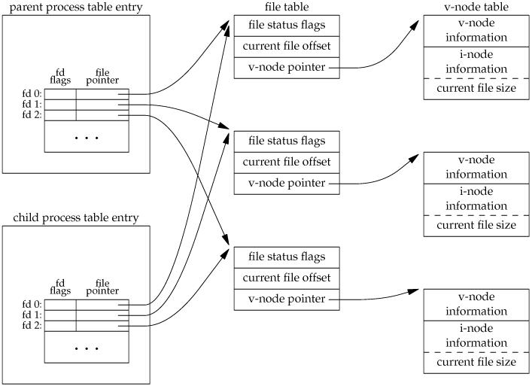
After fork()‏

Slide 8

Inherited by child from parent
Besides the open files, there are numerous other properties of the parent that are inherited by the child:
  Real user ID, real group ID, effective user ID, effective group ID
  Supplementary group IDs
  Process group ID
  Session ID
  Controlling terminal
  The set-user-ID and set-group-ID flags
  Current working directory
  Root directory
  File mode creation mask
  Signal mask
  The close-on-exec flag for any open file descriptors
  Environment
  Attached shared memory segments
  Memory mappings
  Resource limits

Slide 9
Difference bw child & parent
The return value from fork
The process IDs are different
The two processes have different parent process IDs: the parent process ID of the child is the parent; the parent process ID of the parent doesn't change
The child's tms_utime, tms_stime, tms_cutime, and tms_cstime values are set to 0
File locks set by the parent are not inherited by the child
Pending alarms are cleared for the child
The set of pending signals for the child is set to the empty set

Slide 10
vfork
The syntax for the vfork system call
  Pid = vfork();
Parent is suspended until child calls execve or exit.
Child executes using parent's address space.
When child calls exec or exit, kernel returns the address space to the parent and awakens it.
Signal handlers are inherited but not shared.
It is a dangerous call, as it permits one process to use and modify the address space of another process.

Slide 11
Copy-on-Write
  In copy-on-write method, the data and stack pages of the parent are temporarily made read-only and marked as copy-on-write.
  It shares the memory pages with the parent, when either tries to modify a page, a new writeable copy of that page is given.
  Only those pages that are modified are copied, not the entire address space.
  If the child calls exec or exit, the copy-on-write flag is cleared.

Slide 12
Process termination
By executing the exit system call
An exiting process enters the zombie state, relinquishes its resources and dismantles its context except for its slot in the process table
Syntax for the call
  Exit( status );
Child Process

Slide 13
Process termination
Algorithm exit
Input: return code for parent process Output:none
{
ignore all signals;
if( process group leader with associated control terminal )‏
{
  send hangup signal to all members of process group;
  reset process group for all members to 0;
}
close all open files ( internal version of algorithm close );
release current directory ( algorithm iput );
release current ( changed ) root, if exists ( algorithm iput );
free regions, memory associated with process ( algorithm freereg );
write accounting record;
make process state zombie
assign parent process ID of all child processes to be init process (1);

Slide 14
Process termination
if any children were zombie, send death of child signal to init;
send death of child signal to parent process;
context switch;
}

Slide 15
Awaiting process termination
A process can synchronize its execution with the termination of a child process by executing the wait system call
The syntax for the system call
  Pid = wait( stat_addr );
Processes only wake up on receipt of signal
For any signal except “death of child”, the process will react as described above. However, if the signal is “ death of child” the process may respond differently
  In the default case, it will wake up from its sleep in wait, and sleep invokes algorithm issig to check for signals.
  If the process catches “death of child” signals, the kernel arranges to call the user signal-handler routine, as it does for other signals
  If the process ignores “death of child” signals, the kernel restarts the wait loop, free the process table slots of zombie children, and searches for more children.

Slide 16
Awaiting process termination
Algorithm wait
Input: address of variable to store status of exiting process
Output : child ID, child exit code
{
if( waiting process has no child processes )‏
return( error );
for(;;) /* loop until return from inside loop */
{
if( waiting process has zombie child )‏
{
pick arbitrary zombie child;
add child CPU usage to parent;
free child process table entry;
return ( child ID, child exit code );
}

Slide 17
Awaiting process termination
if( process has no children )‏
return error;
sleep at interruptible priority ( event child process exits );
}
}

Slide 18
Invoking other programs
The exec system call invokes another program, overlaying the memory space of a process with a copy of an executable file.
The syntax for the system call
  Execve( filename, argv, envp )‏
Process can access their environment via the global variable environ
The logical format of an executable file
  1. The primary header describes how many sections are in the file, the start address for process execution, and the magic number, which gives the type of the executable file.
  2. Section headers describe each section in the file, giving the section size, the virtual addresses the section should occupy when running in the system, and other information.
  3. The sections contain the “data”, such as text, that are initially loaded in the process address space
  4. Miscellaneous sections may contain symbol tables and other data, useful for debugging.

Slide 19
Invoking other programs
Algorithm exec
Input: (1) file name (2) parameter list (3) environment variables list
Output: none
{
get file inode ( algorithm namei );
verify file executable, user has permission to execute;
copy exec parameters from old address space to system space;
for( every region attached to process )‏
  detach all old regions ( algorithm detach);
for( every region specified in load module )‏
{
  allocate new regions ( algorithm allocreg );
  attach the regions ( algorithm attachreg );
  load region into memory if appropriate ( algorithm loadreg );
}

Slide 20
Invoking other programs
copy exec parameters into new user stack region;
initialize user register save area for return to user mode;
release inode of file ( algorithm iput );
}

Slide 21
The User ID of a process
  Real user ID identifies the user who is responsible for the running process
  The effective use ID is used to assign ownership of newly created files, to check file access permissions, and to check permission to send signals to processes via the kill system call.
  Setuid program is an executable file that has the setuid bit set in its permission mode field – kernel sets the effective user ID fields in the process table and u area to the owner ID of the file.
  The syntax for the setuid system call
    Setuid(uid)‏

Slide 22

The User ID of a process
Executable file produced by compiling the program has owner “XYZ” (user ID 2323), its setuid biit is on. All user have permission to execute it.
User “global” (user ID 8989) and “XYZ” own the files of their respective names, and that both files have read-only permission for their owners.
  When “global” executes the program
  uid 8989 euid 2323
  fdglobal -1 fdXYZ 3
  After setuid(8989): uid 8989 euid 8989
  fdglobal 4 fdXYZ -1
  After setuid(2323): uid 8989 euid 2323

Slide 23
The User ID of a process
When “XYZ” executes
uid 2323 euid 2323
  fdglobal -1 fdXYZ 3
  After setuid(2323): uid 2323 euid 2323
  fdglobal -1 fdXYZ 4
  After setuid(2323): uid 2323 euid 2323
  The process will never open file “global”, but it can open file “XYZ”.
  The effective user ID stored in the u area is the result of the most recent setuid system call.

Slide 24
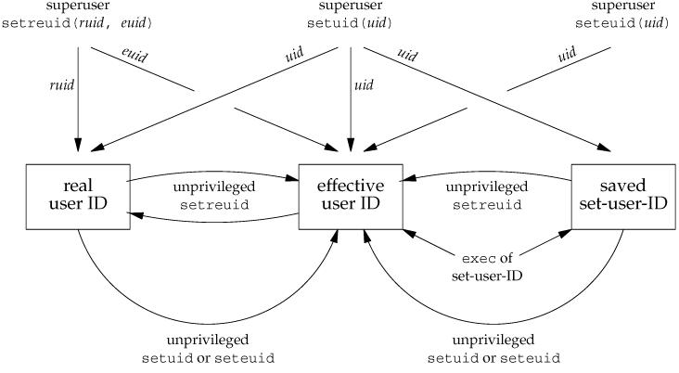
User Ids relationship

Slide 25
The User ID of a process
  If the effective user id of the calling process is super user – kernel resets real and effective user id in the process table and uarea.

Slide 26
The User ID of a process
  If the effective user id of the calling process is super user – kernel resets real and effective user id in the process table and uarea.
  If the effective user id of the calling process is not super user – kernel resets the effective uid in the uarea to uid, if uid has the value of the real user id or if it has the value of the saved user id.

Slide 27
Changing data segment size
  A process may increase or decrease the size of its data region by using the brk system call.
  The syntax for the brk system call
    Brk( endds );
    Where endds becomes the value of the highest virtual address of the data region of the process.
    Oldendds = sbrk( increment );
    Where increment changes the current break value by the specified number of bytes.
    Oldendds is the break value before the call.

Slide 28
Booting of Unix System
  Runs self-test.
  Probes for the boot device.
  Bootstrap procedure reads the boot block of a disk and loads it into memory.
  Boot program reads in the kernel and passes control to it.
  The kernel initialises its internal data structures.

Slide 29
Booting of Unix System
  Mounts root file system.
  Creates Process 0
  - Forks process 1(init)‏
  - Runs as swapper program
  Process 1
  - Creates getty process
  - Adopts orphan processes

Slide 30
Booting of Unix System
  Getty Process
  - Opens terminals.
  - Runs as login program
  User logins

Slide 31
Thank you
Global Edge Software Proprietary and Confidential Information
Disclosed Subject to a Nondisclosure Agreement

