Slide 2
CA 844 – Visual Programming Unit - III
Database connectivity through ADO.NET

Slide 3
Introduction and Evolution of ADO.NET

Slide 4
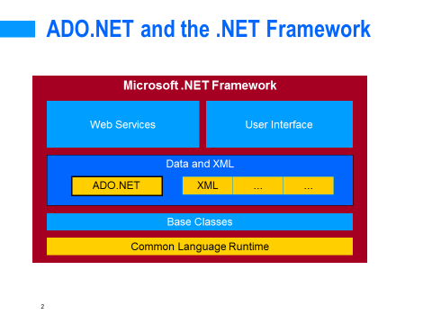
ADO.NET
ADO.NET is an object-oriented set of libraries that allows you to interact with data sources.
Commonly, the data source is a database, but it could also be a text file, an Excel spreadsheet, or an XML file.

Slide 5
ADO .NET is a collection of classes, interfaces, structures, and enumerated types that manage data access from relational data stores within the .NET Framework
These collections are organized into namespaces:
System.Data, System.Data.OleDb, System.Data.SqlClient, etc.
ADO .NET is an evolution from ADO.
Does not share the same object model, but shares many of the same paradigms and functionality!

Slide 6
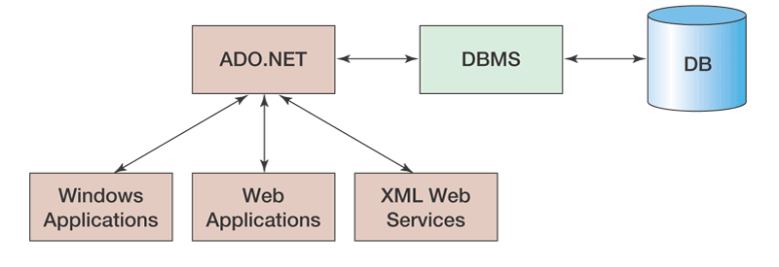
Role of ADO.NET
ADO.NET serves as an intermediary between all types of .NET applications and the DBMS and database

Slide 7
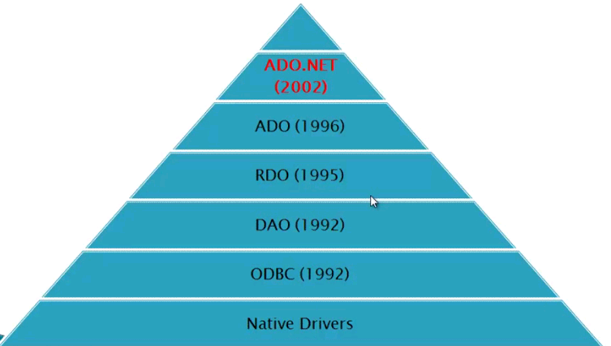
Evolution of ADO.NET

Slide 8
Native Drivers
Specific to a given database
Different API for every new database
Ex. For SQL : SQL API
ODBC Drivers
ODBC Drivers
Available in the form of Win32 Libraries
Database independent API
Same API implemented differently for every database

Slide 9
DAO/RDO
Object based approach for operating with database
DAO – Data Access Objects were used for MS Access
RDO – Remote Data Access Objects were used for remote database like Oracle and SQL server.
Used only for database backends
Cannot be used with Excel, CSV, Email etc. backends

Slide 10
ADO (ActiveX Data Objects)
Common Object Model for all database
Uses Ole-DB provider instead of ODBC
It’s a compact and efficient Object Model
Can be used for all types of backends including databases, excel files, emails etc.

Slide 11
Introduction to ADO.NET
ADO.NET is a bridge between Client Application and data source through which application can communicate to database using data provider.
ADO.net is the data-access technology that enables applications to connect to data stores and manipulate data contained in them in various ways.
ADO.NET is entirely based on XML. ADO.NET provides consistent access to data sources such as Microsoft SQL Server, as well as data sources exposed via OLE DB and XML.
It is based on the .NET framework and it is highly integrated with the rest of the framework class library.
ADO.NET includes .NET data providers for connecting to a database, executing commands, and retrieving results. Those results are either processed directly, or placed in an ADO.NET DataSet object in order to be exposed to the user in an ad-hoc manner, combined with data from multiple sources, or remoted between tiers.

Slide 12
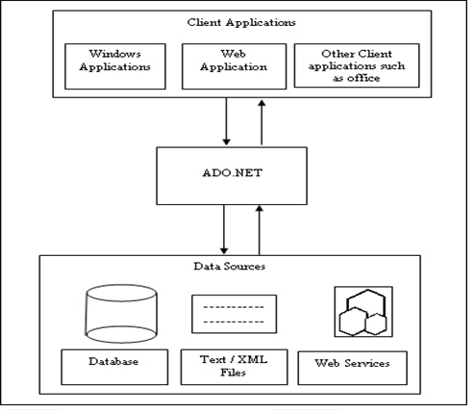

Slide 13
ADO.Net Advantages/Features
ADO.NET is the common name for the classes and interfaces of the namespace System.Data. ADO.NET data components in Visual Studio environment encapsulate data access functionality in various ways that help you to develop applications more easily and with fewer errors.
ADO.Net offers performance advantages by its Disconnected Architecture, it is a remarkably efficient and scalable architecture. The DataSet class in ADO.Net operates in an entirely disconnected nature. This model allows for the DataSet class to be unaware of the origin of its data source, an unlimited number of supported data sources can be plugged into code without any hassle in the future

Slide 14
ADO.NET programs can take advantage of the flexibility and broad acceptance of Extensible Markup Language (XML). XML is the format for transmitting datasets across the network, so any component that can read the XML format can process data. In fact, many of the classes in ADO.NET, like the DataSet, are so intertwined with XML that they simply cannot exist or function without utilizing the technology.
The role of ADO.NET data providers is to permit direct manipulation of data through SQL. ADO.NET includes a SQL Server Data Provider that is highly optimized for interaction with SQL Server. It uses SQL Server's own Tabular Data Stream (TDS) format for exchanging information. This is deftly handled by the ADO.NET Data Provider.
Another advantage of ADO.NET is its rich object model. The entire ADO.NET architecture is built on a hierarchy of class inheritance and interface implementation. Once you trace for things you need within this namespace, you can find that the logical inheritance of features and base class support makes the entire system extremely easy to use.

Slide 15
Architecture of ADO.NET
ADO.NET is conceptually divided into consumers and data providers.
The consumers are the applications that need access to the data
The providers are the software components that implement the interface and there by provide the data to the consumer.
ADO.NET includes .NET Framework data providers for connecting to a database, executing commands, and retrieving results.

Slide 16
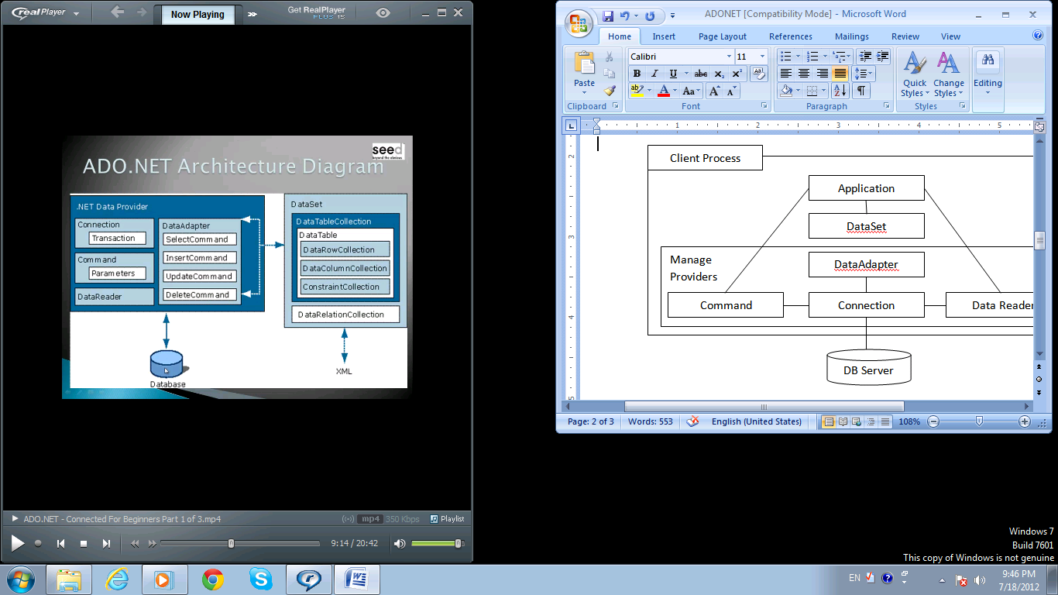
Data Access in ADO.NET relies on two components: Data Provider and DataSet

Slide 17
Data Provider
A rich set of classes, interfaces, structures and enumerated types that manage data access from different types of data stores.
It is a .Net component implementing certain standard set of interfaces provided by Microsoft, for a specific type of backend.
This enforces a common interface for accessing data. It simplified data access architecture that often results in improved performance without the loss of functional capabilities.
The .NET Framework Data Providers:-
System.Data.SqlClient - Manage provider for SqlServer.
System.Data.OracleClient – Manage provider for Oracle.
System.Data.Oledb – Manage provider, can be used for any database which has Oledb provider.
System.Data.Odbc – Manage Provider for Odbc drivers – This can be used for all database but it would be slow compared to a managed provider specific to a given database.
All of the providers live in the System.Data namespace

Slide 18
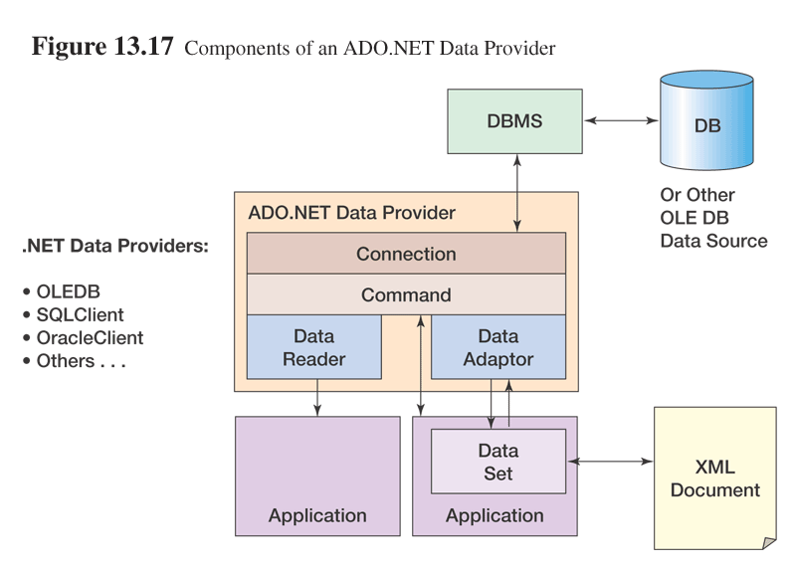
Data Provider Components

Slide 19
Data Provider | Namespace
SQL Server | System.Data.SqlClient
OLE DB | System.Data.OleDb
ODBC | System.Data.Odbc
Oracle | System.Data.OracleClient

Slide 20
Two Types of Architecture:-
Connected
Disconnected

Slide 21
Connected Architecture
The architecture of ADO.net, in which connection must be opened to access the data retrieved from database is called as connected architecture.
Connected architecture is used when you constantly make trips to the database for any CRUD (Create, Read, Update and Delete) operation you wish to do. This creates more traffic to the database but is normally much faster as you should be doing smaller transactions.
connection with a data source is kept open constantly for data access as well as data manipulation operations

Slide 22
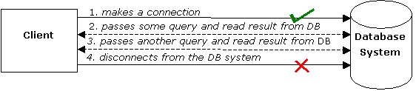
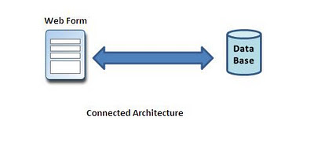
Connected Architecture

Slide 23
Disconnected Architecture
The architecture of ADO.net in which data retrieved from database can be accessed even when connection to database was closed is called as disconnected architecture.
The .NET application does not always stay connected with the database. The classes are designed in a way that they automatically open and close the connection. The data is stored client-side and is updated in the database whenever required.
Disconnected architecture is a method of retrieving a record set from the database and storing it giving you the ability to do many CRUD (Create, Read, Update and Delete) operations on the data in memory, then it can be re-synchronized with the database when reconnecting. A method of using disconnected architecture is using a Dataset.

Slide 24
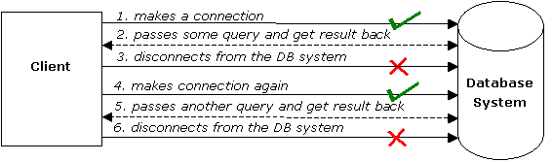
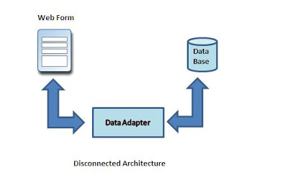
Disconnected Architecture

Slide 25
Difference
Connected Architecture | Disconnected Architecture
In Connected Architecture you have to declare the connection explicitly by using Open() and close the connection by using Close() and you can execute commands using different methods likeExecuteNonQuery(),ExecuteScalar() and ExecuteReader(). | In Disconnected Architecture, you don't need to define the connection explicitly. Sql DataAdopter itself can open and close the connection and you can use dataset for storing the information temporarily and Fill() is used to execute the commands give in adopter.
Only one operation can be performed at a time in connected environment. | Multiple operations can be performed at a time in disconnected environment.
Connected Environment needs constantly connection of user to datasource while performing any operation | Disconnected environment doesn't need any connection.
Connected methods gives faster performance | Disconnected get low in speed and performance.
We get updated data in connected environment. | In disconnected environment, there is a problem in dirty read.

Slide 26
Connected Architecture
Connected architecture was built on the classes
Connection
Command
DataReader

Slide 27
Connection
Connection object encapsulates the functionality of establishing a communication path over the sockets. (Establishes a connection to a specific data source – required connection string)
A Connection object helps to identify the database server name, user name and password to connect to the database. The Connection object is used by commands on the database.
The base class for all Connection objects is the DbConnection Class.
In .Net, Connections are ‘Pooled’. We can have by default up to 100 simultaneous connections without closing but obviously we have to close every connection opened only then it can be reused from Pool i.e. Keeps the connection with the database open for the short period of time. The Connection Pooling can be customized by setting appropriate parameters in ConnectionString of Connection Object.

Slide 28
For SQL server database
Constructor:
SqlConnection(String):Initializes a new instance of the SqlConnection class when given a string that contains the connection string.
Properties:
ConnectionString: Gets or sets the string used to open a SQL Server database.
ConnectionTimeout : Gets the time to wait while trying to establish a connection before terminating the attempt and generating an error.

Slide 29
Methods:
Open(): Opens a database connection with the property settings specified by the ConnectionString.
Close() : Closes the connection to the database.
Example :
//Creating Object of connection class with connection string SqlConnection objConn = new SqlConnection(@"Data Source=.\SQLEXPRESS;AttachDbFilename='C:\Documents and Settings\Administrator.CHA024\My Documents\Test.mdf';Integrated Security=True;Connect Timeout=30;User Instance=True");

Slide 30
Command
Command Object can be used for execution of any type of Sql Statement including Stored Procedures. (Execute command against a data source – required SQL query and Connection Object)
The base class for all command object is the DbCommand class.
For SQL Server Database:-
Constructors:
SqlCommand(String, SqlConnection) : Initializes a new instance of the SqlCommand class with the text of the query and a SqlConnection.

Slide 31
Properties:
CommandText: Specifies the SQL command or stored procedure or a name of a table.
CommandTimeout : Specifies the time required to wait for the completion of a command before it throws an exception. The default is 30 seconds.
Connection : Specifies the connection that the command is associated to.

Slide 32
Methods:
Cancel : Tries to cancel the command being executed.
CreateParameter : Creates a new Parameter object that can be added to Command. Parameters collection.
ExecuteReader : Executes the command and returns a forward-only read-only cursor in the form of a DataReader. Display all columns and all rows at client-side environment. In other words, we can say that they display data tables client-side.

Slide 33
ExecuteNonQuery : Executes the command and returns the number of rows that were affected. Often used with record UPDATE, DELETE, or INSERT statements.
ExecuteNonQuery() method is used to manipulate data in database and is used for statements without results such as CREATE, INSERT, UPDATE and DELETE commands.
It does not return any data but it returns number of rows affected.
If NOCOUNT property is ON then it will not return number of rows affected.
The return value of number of rows affected is of type integer and you can get it in an integer variable. It will tell you how many rows have been affected in result of your statement. ExecuteNonQuery() method is a flexible method and we can use it input and output parameters.

Slide 34
ExecuteScalar : Executes the command, and retrieves a single value. Used with aggregate functions and in cases where you want to return the first column of the first row of a result set.
ExecuteScalar() method is used to retrieve a single value from database.
It executes the defined query and returns the value in the first column of the first row in the selected result set and ignores all other columns and rows in the result set.
It is use to get aggregate value from database, for example count or total of rows. So it works with non action queries that use aggregate functions. ExecuteScalar() method is a faster way when we compare it to other ways to retrieve single value from database. It returns a value as object and we have to cast it to appropriate type.

Slide 35
DataReader
DataReader Object in ADO.NET is a stream-based , forward-only, read-only retrieval of query results from the Data Sources , which do not update the data.
The DataReader cannot be created directly from code, they can created only by calling the ExecuteReader method of a Command Object.
The DataReader Object provides a connection oriented data access to the Data Sources.
A Connection Object can contain only one DataReader at a time and the connection in the DataReader remains open, also it cannot be used for any other purpose while data is being accessed. When we started to read from a DataReader it should always be open and positioned prior to the first record. The Read() method in the DataReader is used to read the rows from DataReader and it always moves forward to a new valid row, if any row exist .

Slide 36
For SQL Server database
Properties:
FieldCount : Specifies the number of columns of the current row or record.
HasRows : Specifies whether the current row has at least 1 row.
IsClosed : Specifies whether the DbDataReader is closed.

Slide 37
Methods:
Read: Advances the reader to the next record.
GetDataTypeName: Gets the name of the data type of the current column.(Example – int)
GetFieldType: Gets the field type of the specified column. (Example - System.Int32)
GetName : Gets the name of the column.(Example – ID)

Slide 38
Disconnected Architecture
Connected architecture was built on the classes
Connection
DataAdapter
DataSet

Slide 39
DataAdapter
A Data Adapter object accesses data in a disconnected mode. Its object contains a reference to a connection object.
It is designed in a way that it implicitly opens and closes the connection whenever required.
DataAdapter can be considered as a bridge between the actual data source to your application
It is essentially the middleman facilitating all communication between the database and a DataSet.
A DataAdapter class inherits from the System.Data.Common.DbDataAdapter base class.
The DataAdapter is used either to fill a DataTable or DataSet with data from the database with its Fill method.

Slide 40
It maintains the data in a DataSet object. The user can read the data if required from the dataset and write back the changes in a single batch to the database. Additionally, the Data Adapter contains a command object reference for SELECT, INSERT, UPDATE, and DELETE operations on the data objects and a data source
When you call the SqlDataAdapter object’s Fill() method, the SqlDataAdapter automatically creates and opens a connection. After the data is fetched from the database, the Fill() method automatically closes the connection.
When the Update() method is called, changes in the DataSet are copied back to the database and the appropriate InsertCommand, DeleteCommand, or UpdateCommand is executed.

Slide 41
Constructor:
SqlDataAdapter(String, SqlConnection) - Initializes a new instance of the SqlDataAdapter class with a SelectCommand and a SqlConnection object.
Properties:
DeleteCommand - Speicfies the Command object with the SQL command to be used for deleting a record.
InsertCommand -Specifies the Command object with the SQL command used for inserting a record.
SelectCommand - Specifies the Command object with the SQL command to be used for retrieving records.
UpdateCommand - Specifies the Command object with the SQL command to be used for updating a record.

Slide 42
Fill ()
The Fill method populates a dataset or a data table object with data from the database. It retrieves rows from the data source using the SELECT statement specified by an associated select command property.
The Fill method leaves the connection in the same state as it encountered it before populating the data. If subsequent calls to the method for refreshing the data are required then the primary key information should be present.
Fill(DataSet) - Adds or refreshes rows in the DataSet.
Fill(DataTable) -Adds or refreshes rows in a specified range in the DataSet to match those in the data source using the DataTable name.

Slide 43
Update () The Update method commits the changes back to the database. It also analyzes the RowState of each record in the DataSet and calls the appriopriate INSERT, UPDATE, and DELETE statements. A Data Adapter object is formed between a disconnected ADO.NET object and a data source.
Update(DataSet),Update(DataTable),

