Slide 1
What is Report ?

Slide 2
Calculations
Documents
Format
Summary
Filtering

Slide 3
A document containing information organized in a narrative, graphic, or tabular form, prepared on ad hoc, periodic, recurring, regular, or as required basis. Reports may refer to specific periods, events, occurrences, or subjects, and may be communicated or presented in oral or written form.
To provide information.

Slide 4
Why Use a Reporting Tool?
It isn't difficult to retrieve data. You could write code to loop through record sets and print them in your Windows or Web application. In the .NET Framework, you could go further and bind that data to a control, such as a Repeater, Data List or Data Grid.
But to present this data in a formal report format is far more complex. Writing code for searching , navigating between pages of the report, zooming the report extent , multiple level totals, charting, conditional formatting, and page-based output are difficult and time-consuming to program.
Crystal Reports makes it easy to create and distribute complex reports.

Slide 5
What is Crystal Reports?
Crystal reports is the reporting tool of visual studio, an OEM (Original Equipment Manufacturer) of business objects.
Crystal Reports has been part of Visual Studio since 1993, and is now the standard for reporting in Visual Studio 2008 . It ships with every copy of Visual Studio 2008 and is integrated directly into the development environment.
Ability to create interactive, presentation-quality content to the windows environment to create complex and professional reports in a GUI-based program.
You can connect your report to almost any database source, as well as to proxy data, such as a result set (for example, an ADO.NET DataSet). With the wizards included in the GUI designer, you can easily set formatting, grouping, charting, and other criteria.

Slide 6
What is Crystal Reports?
You can host your report in either a Web or Windows application
Crystal Reports is a business intelligence application, currently marketed to small businesses by SAP AG. It is used to design and generate reports from a wide range of data sources
Business intelligence (BI) is a set of theories, methodologies, processes, architectures, and technologies that transform raw data into meaningful and useful information for business purposes

Slide 7
Your reports can be related to your Visual Studio 2008 project in many ways:
Embed your reports directly into the project.
Access them externally, from a file directory.
Access them as a Report Web Service from a remote server.

Slide 8
features
An embedded Crystal Reports designer, assisted by wizards and experts, builds complex report files easily..
Data and .NET Dataset connections use the Database Expert to easily interact with a wide variety of database protocols, as well as proxy data in the form of ADO.NET Datasets..
A Crystal Reports SDK interacts with and modifies reports programmatically. Use one of four different object models, each with increasing levels of complexity and power
An exporting feature exports data from the Crystal Report Viewer control to Word, Excel, PDF, and HTML, and Crystal Reports formats.

Slide 9
features
The ability to print from the Crystal Report Viewer control enables page-based report printing from any Web or Windows application.
Multilingual client support allows you to configure the CrystalReportViewer control so that other languages can be displayed in the Tool Tips, determined by the client browser, the ASPX page, or the environment settings for the machine.
Report Web Services, from an ASP.NET Web Service project, allow you to create a project, add a Crystal Report, and publish it as a Web service.
Seamless migration is possible from previous versions

Slide 10
Database Connections
Crystal Reports for Visual Studio 2008 can connect reports to a wide variety of data sources. The Crystal Reports Designer uses the Database Expert to connect a report to a particular data source. Data connectivity is available through data connections (to databases using database drivers) and proxy data (to an ADO.NET DataSet).

Slide 11
Crystal Reports for Visual Studio 2008 can access and report off the following data sources:
Any database with an ODBC driver
Any database with an OLEDB Provider
Microsoft Access databases
Microsoft Excel workbooks
ADO.NET datasets
ADO.NET datatables
ADO recordsets
Object Collections
DAO recordsets
XML Data in SQL Server

Slide 12
Embedded Crystal Reports Designer
Crystal Reports for Visual Studio 2008 comes with an embedded version of the Crystal Reports Designer application that you can run from within Visual Studio 2008. The embedded Crystal Reports Designer is a GUI application. Using a collection of wizards and experts, complex report files can be built quickly and easily.
Traditionally, the Crystal Reports Designer is a stand-alone application that you launch from your Start menu under the name "Crystal Reports." But in Crystal Reports for Visual Studio 2008, the Crystal Reports Designer is embedded within the application. Report templates are viewed like an ASPX page or .NET class file, within the central window of Visual Studio 2008.

Slide 13
Embedded Crystal Reports Designer
As a result, the embedded Crystal Reports Designer does not run independently. Instead, it is loaded within Visual Studio 2008 when a report file in Solution Explorer has been double-clicked.
The major difference between the stand-alone application and the embedded Crystal Reports is that the menus and toolbars of the embedded Crystal Reports Designer within Visual Studio 2008 are limited, compared to the menus and toolbars that are available in the stand-alone version.

Slide 14
Exporting
CrystalReportViewer control Export button formats
Adobe Acrobat (.pdf)
Crystal Reports (.rpt)
Microsoft Excel (.xls)
Microsoft Rich Text (.rtf)
Microsoft Word (.doc)

Slide 15
Exporting through the API
The ReportDocument.Export() method and related exporting methods are provided by the API for programmatic exporting of your report. You can write code to export to any of the export formats listed in the ExportFormatType enum.
API export formats
Adobe Acrobat (.pdf)
Crystal Reports (.rpt)
HTML 3.2 and 4.0 (.html)
Microsoft Excel (.xls)
Microsoft Rich Text (.rtf)
Microsoft Word (.doc)

Slide 16
Architecture
Three features form the core of the architecture :
Embedded Crystal Reports Designer
Report Viewer Controls
Object Models

Slide 17
Embedded Crystal Reports Designer
The embedded Crystal Reports Designer creates or modifies reports. It consists of a graphical user interface for WYSIWYG report design, and a series of experts to simplify data connectivity, sorting, grouping, and other complex report design issues. Crystal Reports Developer includes an enhanced version of the embedded designer that allows you to build powerful reports and reporting applications.

Slide 18
Report Viewer Controls
There are two provided controls:
The CrystalReportViewer control.
This control displays the report in a page-based layout, with the ability to move between pages.
The CrystalReportPartsViewer control.
The control displays report summary information in a small, portal-like window, with the ability to drill down deeper into the report through a series of linked parts.

Slide 19
Object Models
CrystalReportViewer, the simplest object model.
ReportDocument, the more extensive object model.
Object models available through upgrade:
  ReportClientDocument, the most extensive object model.
  InfoObject, a powerful object model for scheduling and configuring reports within the Crystal Reports Server or BusinessObjects Enterprise framework.

Slide 20
CrystalReportViewer
The classes of this object model are contained within the CrystalDecisions.Web namespace for the Web Form version of this control or the CrystalDecisions.Windows.Forms namespace for the Windows Form version of this control

Slide 21
Demo

Slide 22
Report Document
The classes of this object model are contained within the CrystalDecisions.CrystalReports.Engine namespace.
This is an extensive set of classes that provide more powerful customization and interaction capability with the report.

Slide 23
Displaying a report using the CrystalReportViewer control
The CrystalReportViewer control displays only one report at a time. Which report is displayed by the control is determined by which report you bind to your code. To tell the control which report to display, you bind the ReportSource property of the control to a particular report. At runtime, the control loads the report that is bound to the ReportSource property and displays it.
crystalReportViewer1.ReportSource = C:\\WorldSalesReport.rpt";

Slide 24
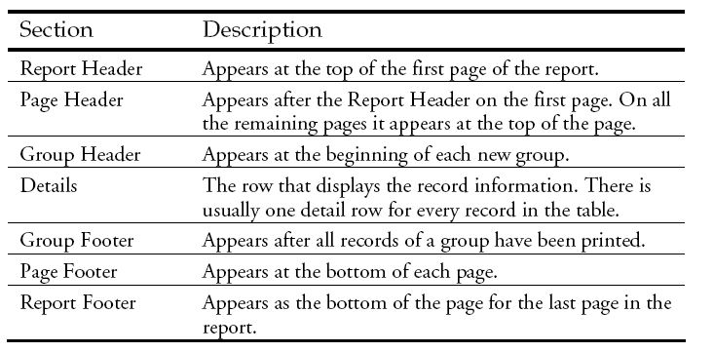
Common Report Sections

Slide 25
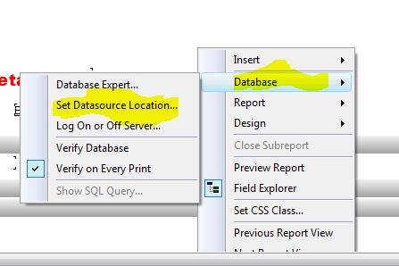
Options to explore
Set datasource location

Slide 26
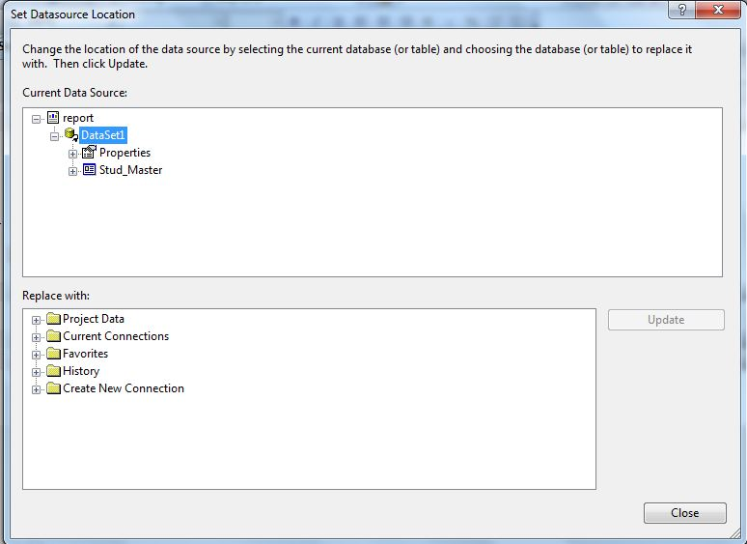
Options to explore

Slide 27
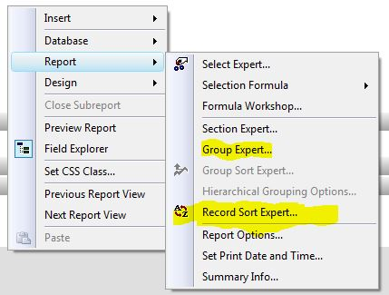
Options to explore
Group Selection
Record Selection

Slide 28
Misc
Working with Charts.
Various Chart Options.
Working with Special fields.
Handling Multiple tables.
Working with external file (.RPT).

