Slide 1
Project on Cloud log forensics for Amazon Web Services(AWS)
-Under guidance of
Prof. Ms. N. R. Shetty
Information Technology Department
Government College of Engineering, Karad.
(An Autonomous Institute of Government Of Maharashtra)

Slide 2
Presented By
Name Roll No.
1. Hrishikesh Shivdas Mahajan. [420] 14423
2. Vaibhav Vilas Mane. [422] 14425
3. Aishwarya Dilip Patil. [427] 14431
4. Saurabh Mahadev Pawar. [430] 14434

Slide 3
Abstract
AWS compute the cost of resources. Even if the resources are not used, they are in running state which increases the cost. Looking at the high expenses on AWS account, a tool is created which will work as an agent to notify users about their unused AWS cloud resources, which will help in cutting down expenses to a large extent. There will be a look over the security breaches to secure the cloud instances. The AWS resource can be sorted according to user and region using this tool. The historic records of user and the resources can be seen. It automatically generates the summary report of the whole day and notify to all users.

Slide 4
AWS offers a pay-as-you-go approach for pricing for over 70 cloud services. AWS pricing is similar to how to pay for utilities like water or electricity. Only pay for the services which are consumed, and once stop using them, there are no additional costs or termination fees.

Slide 5
INTRODUCTION
Cloud Computing has emerged as a new Paradigm of computing that builds on the foundations of Distributed Computing, Grid Computing, and Virtualization. Cloud computing is Internet-accessible business model with flexible resource allocation on demand, and computing on a pay-per-use as utilities. Cloud computing has grown to provide a promising business concept for computing infrastructure, where concerns are beginning to grow about how safe an environment is. Security is one of the major issues in the cloud-computing environment.

Slide 6
Literature Survey
Amazon Web Services (AWS) is a subsidiary of Amazon.com that offers on-demand cloud computing platforms. These services operate from 16 geographical regions across the world. They include Amazon Elastic Compute Cloud, also known as "EC2", and Amazon Simple Storage Service, also known as "S3". As of 2016 AWS has more than 70 services, spanning a wide range, including compute, storage, networking, database, analytics, application services, deployment, management, mobile, developer tools and tools for the Internet of things.

Slide 7
Problem Definition-
Amazon Web Services (AWS) users who use on-demand cloud computing services leave their AWS resources in running state on the weekends, when the resources are rarely used. The proposed tool helps users to cut down their high expenses by notifying the users to shut down their AWS resources when not in use.
AWS accounts are subject to malicious and security attacks such as attacks on specified ports which are unrestricted, making access public. The tool will help analyze and resolve these issues

Slide 8
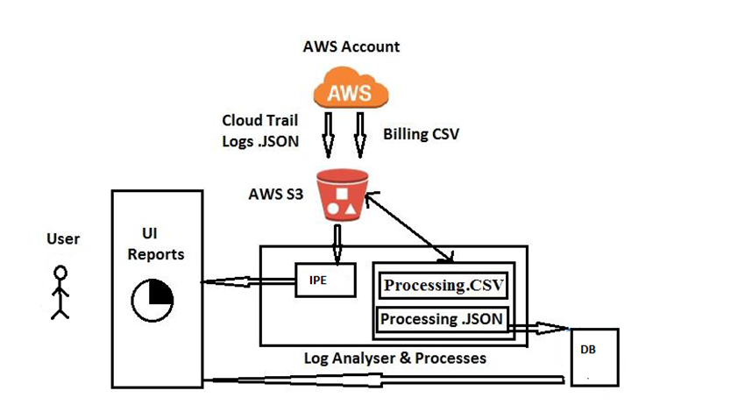
Design Methodology
Proposed Architecture

Slide 9
Modules
Cost Optimization
Low utilized amazon ec2 instances.
Underutilized EBS volumes.
Unassociated IP Addressed.
Security
Security groups – unrestricted access on ports.
IAM User.
S3 Bucket permission.
Performance
High Utilization Amazon ec2 Instances.

Slide 10
Technology Stack
Software requirements:
Python
Json
Java
Postgrace SQL/Mongodb
Hardware requirements:
Min 2 GB RAM
Windows 7 or above

Slide 11
Conclusion
The proposed tool will thus facilitate user to get a live report of his redundant running services and unused volumes on cloud, thereby reducing the organizational cost towards cloud services.
The security is one of the important concern in cloud services. This tool will help monitor and secure the cloud environment by managing and notifying the user all issues concerning security.

Slide 12
References-
1) Abdulaziz Alshammari*, Sulaiman Alhaidari*, Ali Alharbi*, Mohamed Zohdy,” Security Threats and Challenges in Cloud Computing” 2017 IEEE 4th International Conference on Cyber Security and Cloud Computing
2) Ci-Bin Jiang, I-Hsien Liu, Yi-Chen Chen, Jung-Shian Li, Chuan-Gang Liu,”Distributed Log System in Cloud Digital Forensics”, 2016 International Computer Symposium
3) Shams Zawoad, Amit Kumar Dutta, and Ragib Hasan ,”Towards Building Forensics Enabled Cloud Through Secure Logging-as-a-Service” IEEE TRANSACTIONS ON DEPENDABLE AND SECURE COMPUTING, VOL. 13, NO. 2, MARCH/APRIL 2016

Slide 13
THANK YOU

