Slide 1

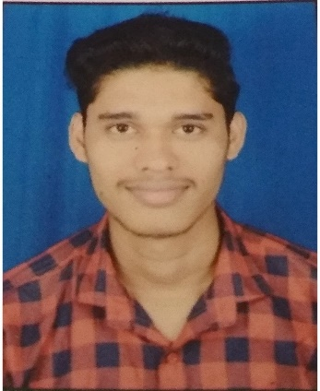



Raut Saurabh Maluba
Education and certificates Bachelor of Technlogy,
Computer Engineering : 2016 - 2020
Skills
Analyst/Software Engineer
Base Location: Mumbai
Email ID: SAURABH.RAUT@CAPGEMINI.COM
Mobile No: +919850115782
Grade: A4
JAVA | Basics,OOPS,Generics, Collections, Array,Loops,LINQ
Spring Boot | Spring Boot, Spring Rest Services, Spring Rest-Ful Service
Spring | Components, Virtual DOM, Forms & Validation
Database | PostgreSQL, MongoDB
UI Tech | HTML 5 & CSS, JavaScript,Es6, React JS
Tools | Git & GitHub, Eclipse, STS, Post-Man, Visual Studio, Visual Studio Code, Pg Admin 4, SQL shell, git Bash.
Add On skills | Immersive Learning and Java
Strengths
Full Stack Developer
Hands on experience on Core java, PostgreSQL, Entity framework, SqlServer, Spring Rest-Full Services.
Proficient in creating Single page Web Application in React with Authentication with routing
Hands on experience in developing web pages using HTML5, CSS, Java Script, ReactJS Good understanding of Document Object Model (DOM) and DOM Functions
Ready to learn new technologies and implement them for the Future Knowledge improvement.
Achievement
Certifications
AWS CLOUD PRACTITIONAR CERTIFICATE
Agile Software Development
Notes Application
Developed Single page web application using responsive UI with HTML5, CSS and React used as User Interface.
Degreed :Successfully completed the degreed training in git, html, CSS, SQL, React.,MongoDB
Check out my work on GitHub
Presentation Title | Author | Date © Capgemini 2017. All rights reserved | 1

