Slide 1
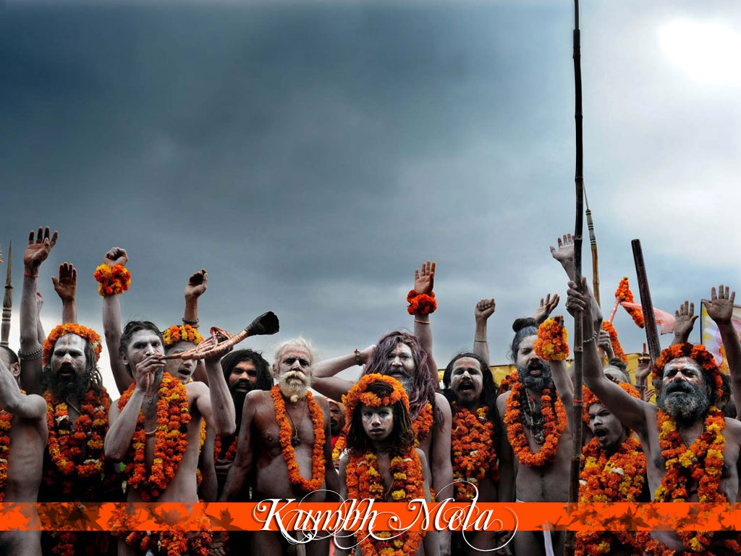

Kumbh Mela
A Human Panorama

Slide 2

SUBMITTED BY
ABHINAV BHARALI
ABHINAV SHYAM
ABHISHEK GOPE
ALANKRITA SAIKIA
AMAN SINGH
AMRITNANDA BASUMATARY
ANAND SAGAR BARUAH
ARINDAM TALUKDAR
BIKASH JYOTI SHARMA
BISHAL CHOUDHURY
SAMuJJAL NATH

Slide 3
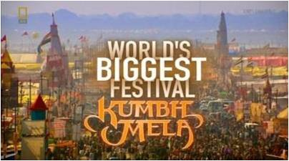
INTRODUCTION
Kumbh mela, the largest peaceful gathering in the world with over 100 million people. The occasion is marked by millions of people taking bath in sacred rivers as according to religious belief drops of nectar fell from the kumbha(pitcher) carried by gods after the sea was churned at the four places where this mela is held. Billed as the "world’s largest congregation of religious pilgrims”the roots of this grandiose pilgrimage can be traced in the accounts of chinese monk xuanzang who visited india in 629–645 ce, during the reign of king harshavardhana. However, similar observances date back many centuries, where the river festivals first started getting organised. According to medieval hindu theology, its origin can be found in one of the most popular medieval puranas, the bhagavata purana. An eternal life free of sins is the promise that comes attached with the magnificent enent of kumbh meka.It’s a promise to which millions want to be bound with,and it is this promise that has made kumbh mela what it is today.

Slide 4
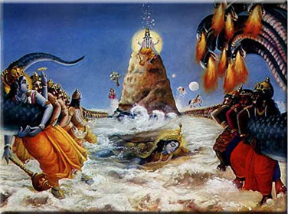
History and Legend of Kumbha Mela
The origin of Kumbh Mela dates back to the time when Gods (Devtas) and Demons (Asura) resided on earth. Brahma (the creator) advised them to churn the milky ocean to obtain the elixir of immortality. The Mandara Mountain acted as the churning rod and Vasuki (king of serpents) was used as a rope for churning. Kumbh was the pot which consist the nectar of immortality and was recovered from Samudramanthan. For 12 days and 12 nights the Gods were chased by Demons for the possession of Amrita. These 12 days of Gods are equivalent to 12 years of Humans. During this chase for the elixir of immortality the drops from Kumbh fell at four places – Allahabad, Haridwar, Ujjain and Nasik. To commemorate this holy event Maha Kumbh Mela is celebrated in every twelve years at the four sacred places where the drops from Kumbh were fallen.

Slide 5
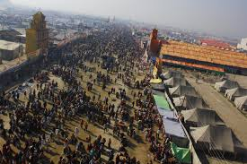
Present Scenario Of Khumbha Mela
Kumbha mela is the largest pilgrimage sight attracting millions of people from all over world.
Kumbha mela is now very place of great documentaries ,including national geographic channel and various channel.
Kumbha mela is now becoming a place of business in the name of god.

Slide 6
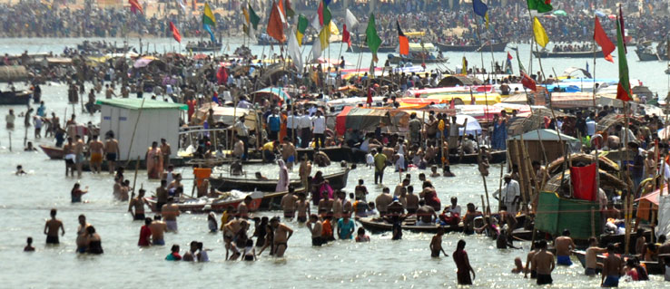
Kumbha mela is also having some political issues there even though being a religious site.
Even being a very big auspicious meeting ,this meeting causes great chaos and terror including injuring and killing people.
It is also observed that some people make individual profit from the allowances and facilities given by the government.

Slide 7
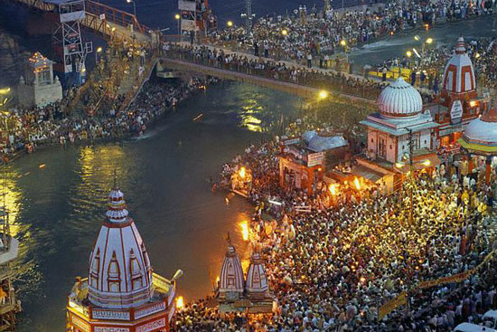
S
O
M
E
F
A
C
T
S
Year | Attendance
1903 | 4,oo,ooo
1954 | 5,oo,ooo or more
1998 | 10 million
2001 | 40 million
2007 | 70 million
2013 | 100 million

Slide 8
Kumbh is meeting point of saints with common people. Gurus meet their disciple.
Saint meets other saint and share their Knowledge .
Exchange of views on religious matter.
Many Disciples are initiated during Kumbh.
Its presumed that religious many books were compiled at kumbh.

Slide 9
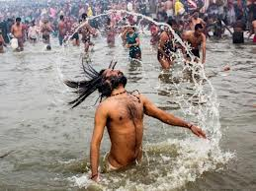
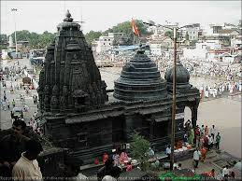
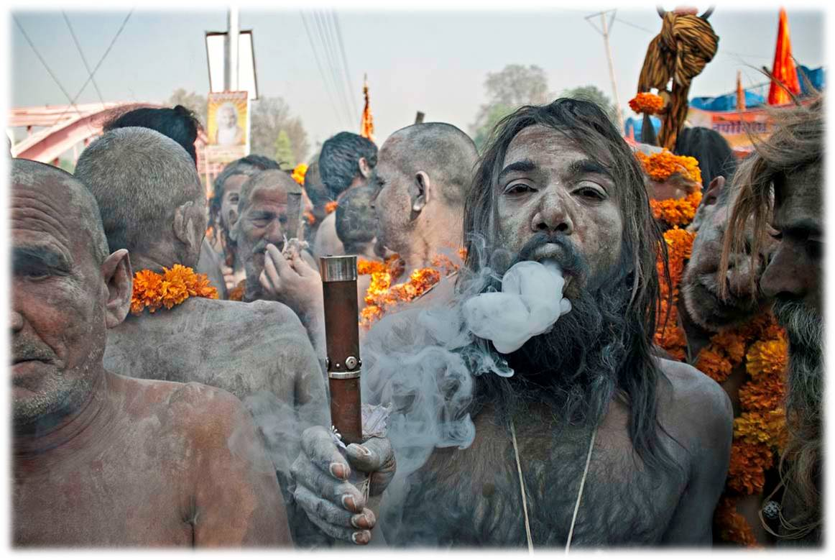
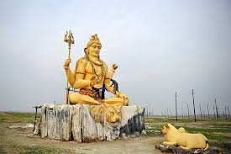
Kumbha Mela
Ardha Kumbha Mela
Purna Kumbha Mela
Maha Kumbha Mela

Slide 10
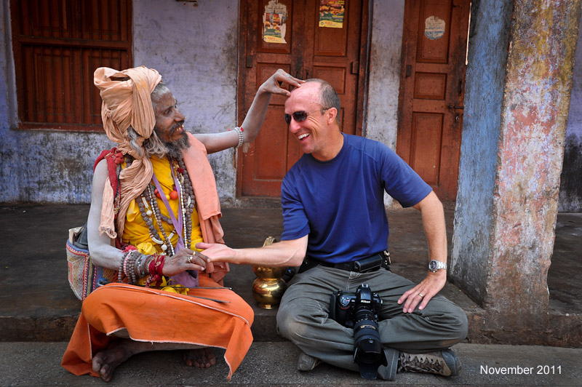
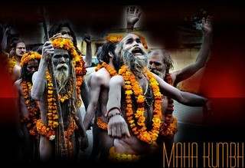
RELIGIOUS SIGNIFICANCE
People’s belief in god.
Increment in number of foreign visitors.
Way of income for Priests.
POSITIVE ASPECTS

Slide 11

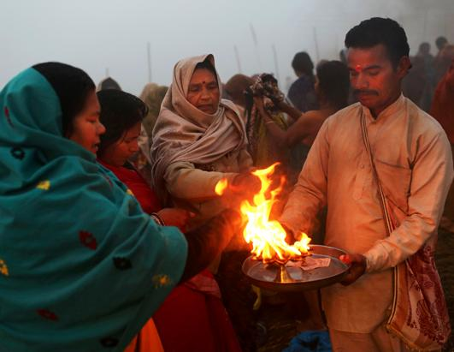
Business in the name of god
Stampede
Accidents
Misuse of Transport
NEGATIVE ASPECTS

Slide 12
CONCLUSION
Kumbh mela,the name itself projects the ancient beliefs and vibrant traditions of India. With religious sentiments and adamant faith of thousands of people encasing the kumbh mela,the mela itself is a binder of different sects of people that constitutes India.While the effect of kumbh mela had grown significantly over the past decade,it’s ability to draw people of other nations had seriously uplifted the oldest religion that is Hinduism to quite a reflective stage. Although to the analytical mind taking a dip in river water on a astrological resulting in removal of one’s sin as is the belief of kumbh mela may sound absurd but the very existence of hope that the kumbh mela gives to the people for revival of their spiritual self is of paramount importance.
While there are stark and obvious differences in which one can perchieve the effect of kumbh on common mass, in the long run it’s positive aspects can outlive it’s negative aspect.But it will require the dedication of everyone who have even a small ounce of fiath on the almighty and rather on oneself to successfully balance the scales

Slide 13
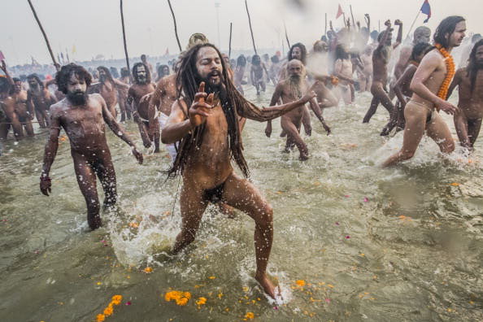
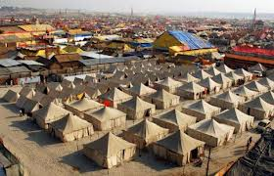
SUGGESTIONS
1.TO REDUCE THE POLLUTION OF RIVER GANGA
2.TO IMPROVE THE INFRASTRUCTURE

Slide 14
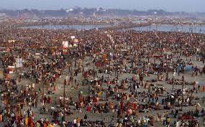

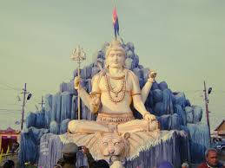
3.PROPER TRAFFIC MANAGEMENT
4.DRUG ABUSE
5.STOP MAKING BUSSINESS IN THE NAME OF GOD

Slide 15


