Slide 1
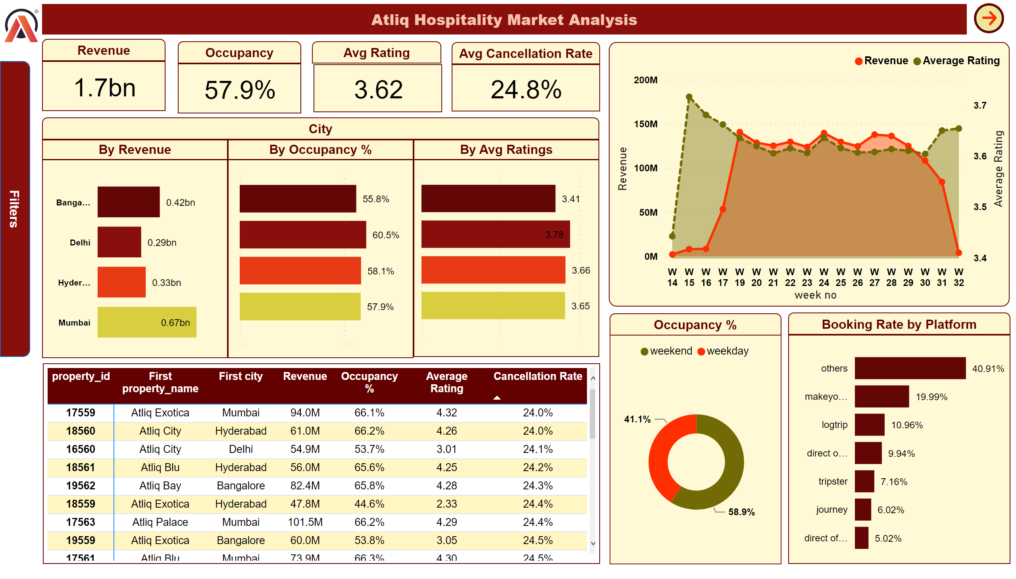

Page 1
Notes:
card
No alt text provided
areaChart
No alt text provided
clusteredBarChart
No alt text provided
pivotTable
No alt text provided
donutChart
No alt text provided
clusteredBarChart
No alt text provided
slicer
No alt text provided
slicer
No alt text provided
slicer
No alt text provided
slicer
No alt text provided
slicer
No alt text provided
textbox
No alt text provided
slicer
No alt text provided
actionButton
No alt text provided
shape
No alt text provided
Slicer_ShowBox
No alt text provided
shape
No alt text provided
shape
No alt text provided
shape
No alt text provided
card
No alt text provided
shape
No alt text provided
card
No alt text provided
shape
No alt text provided
card
No alt text provided
shape
No alt text provided
shape
No alt text provided
shape
No alt text provided
clusteredBarChart
No alt text provided
clusteredBarChart
No alt text provided
shape
No alt text provided
shape
No alt text provided
shape
No alt text provided
image
No alt text provided
shape
No alt text provided
actionButton
No alt text provided

Slide 2
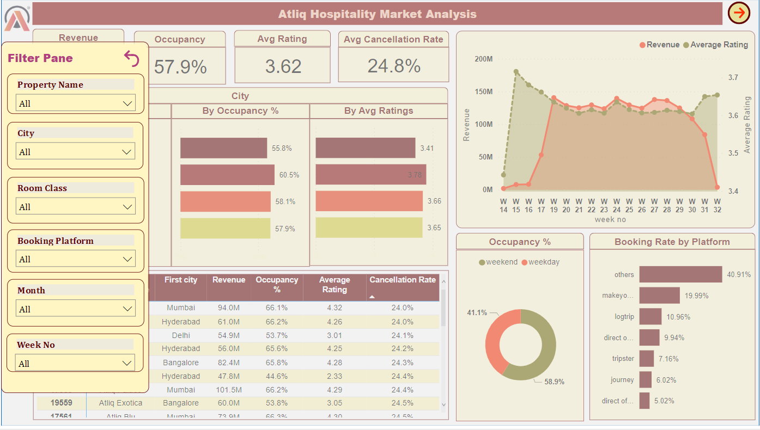
Page 1
Notes:
card
No alt text provided
areaChart
No alt text provided
clusteredBarChart
No alt text provided
pivotTable
No alt text provided
donutChart
No alt text provided
clusteredBarChart
No alt text provided
slicer
No alt text provided
slicer
No alt text provided
slicer
No alt text provided
slicer
No alt text provided
slicer
No alt text provided
textbox
No alt text provided
slicer
No alt text provided
actionButton
No alt text provided
shape
No alt text provided
Slicer_ShowBox
No alt text provided
shape
No alt text provided
shape
No alt text provided
shape
No alt text provided
card
No alt text provided
shape
No alt text provided
card
No alt text provided
shape
No alt text provided
card
No alt text provided
shape
No alt text provided
shape
No alt text provided
shape
No alt text provided
clusteredBarChart
No alt text provided
clusteredBarChart
No alt text provided
shape
No alt text provided
shape
No alt text provided
shape
No alt text provided
image
No alt text provided
shape
No alt text provided
actionButton
No alt text provided

Slide 3
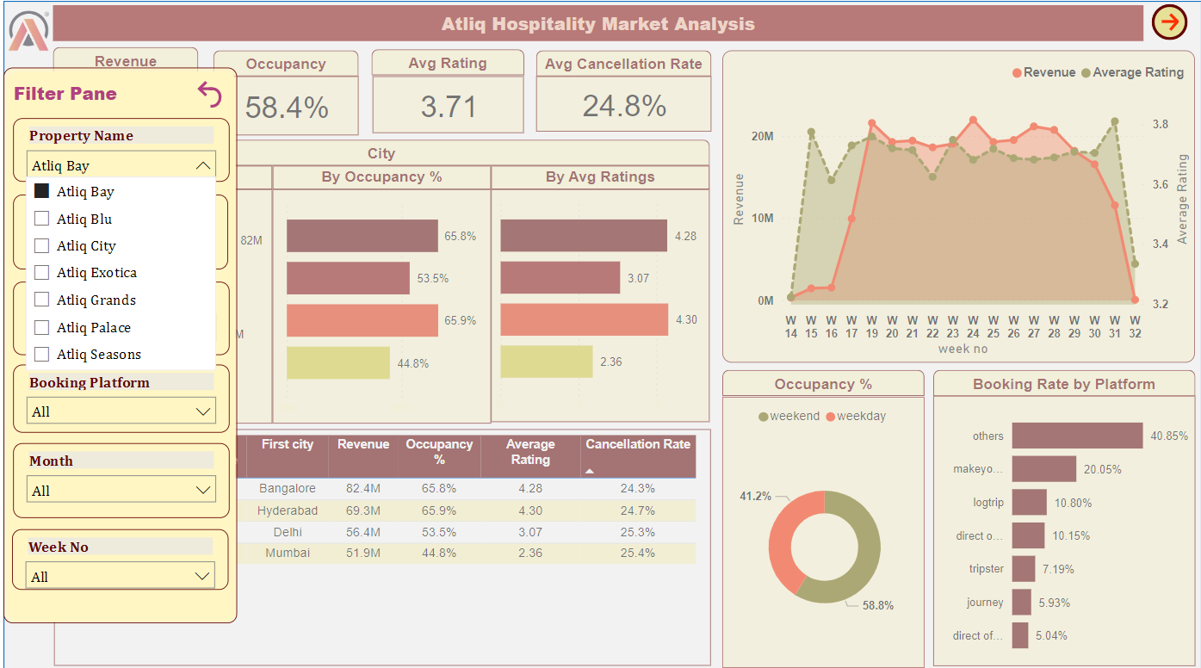
Page 1
Notes:
card
No alt text provided
areaChart
No alt text provided
clusteredBarChart
No alt text provided
pivotTable
No alt text provided
donutChart
No alt text provided
clusteredBarChart
No alt text provided
slicer
No alt text provided
slicer
No alt text provided
slicer
No alt text provided
slicer
No alt text provided
slicer
No alt text provided
textbox
No alt text provided
slicer
No alt text provided
actionButton
No alt text provided
shape
No alt text provided
Slicer_ShowBox
No alt text provided
shape
No alt text provided
shape
No alt text provided
shape
No alt text provided
card
No alt text provided
shape
No alt text provided
card
No alt text provided
shape
No alt text provided
card
No alt text provided
shape
No alt text provided
shape
No alt text provided
shape
No alt text provided
clusteredBarChart
No alt text provided
clusteredBarChart
No alt text provided
shape
No alt text provided
shape
No alt text provided
shape
No alt text provided
image
No alt text provided
shape
No alt text provided
actionButton
No alt text provided

Slide 4
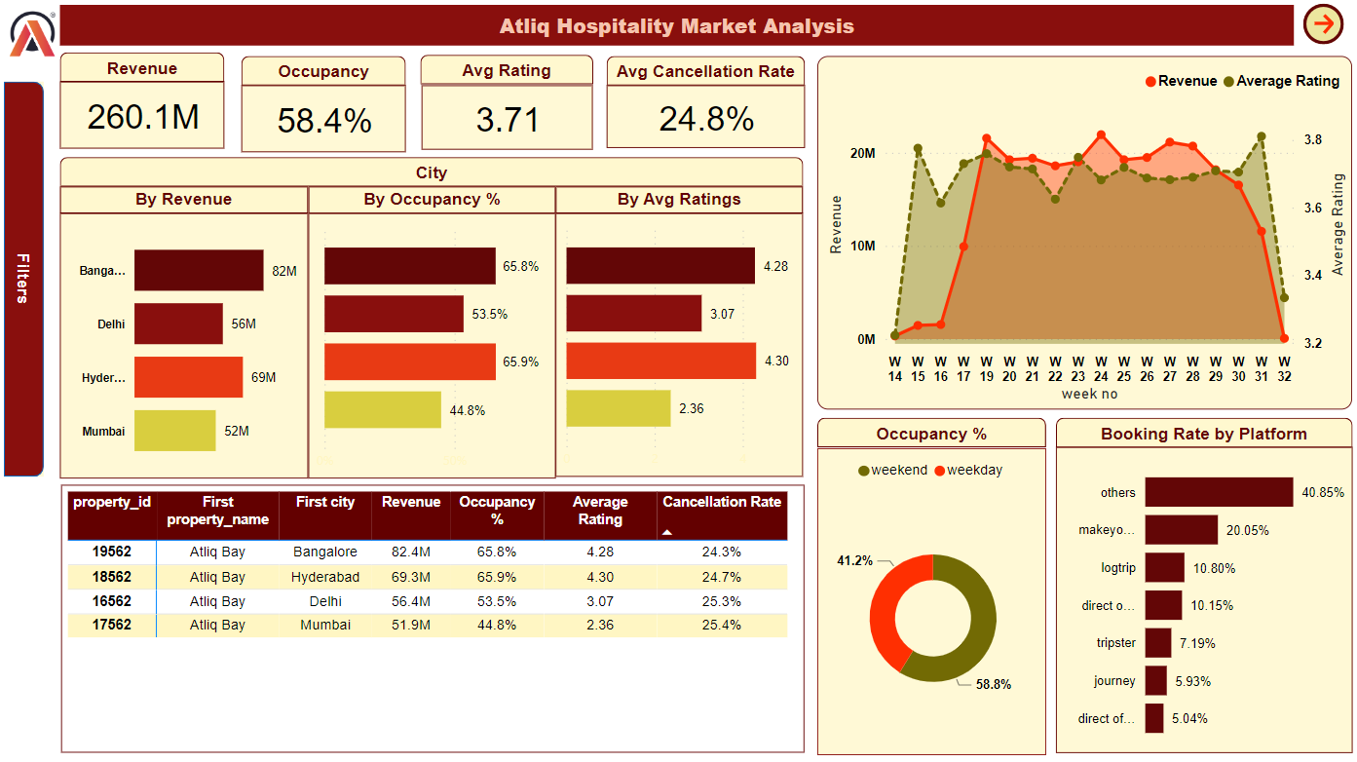
Page 1
Notes:
card
No alt text provided
areaChart
No alt text provided
clusteredBarChart
No alt text provided
pivotTable
No alt text provided
donutChart
No alt text provided
clusteredBarChart
No alt text provided
slicer
No alt text provided
slicer
No alt text provided
slicer
No alt text provided
slicer
No alt text provided
slicer
No alt text provided
textbox
No alt text provided
slicer
No alt text provided
actionButton
No alt text provided
shape
No alt text provided
Slicer_ShowBox
No alt text provided
shape
No alt text provided
shape
No alt text provided
shape
No alt text provided
card
No alt text provided
shape
No alt text provided
card
No alt text provided
shape
No alt text provided
card
No alt text provided
shape
No alt text provided
shape
No alt text provided
shape
No alt text provided
clusteredBarChart
No alt text provided
clusteredBarChart
No alt text provided
shape
No alt text provided
shape
No alt text provided
shape
No alt text provided
image
No alt text provided
shape
No alt text provided
actionButton
No alt text provided

Slide 5
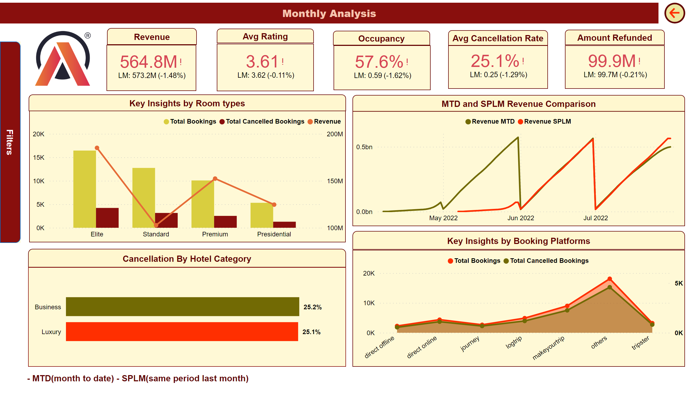
Monthly Analysis View
Notes:
kpi
No alt text provided
areaChart
No alt text provided
lineChart
No alt text provided
slicer
No alt text provided
slicer
No alt text provided
slicer
No alt text provided
slicer
No alt text provided
slicer
No alt text provided
textbox
No alt text provided
slicer
No alt text provided
actionButton
No alt text provided
shape
No alt text provided
Slicer_ShowBox
No alt text provided
shape
No alt text provided
shape
No alt text provided
shape
No alt text provided
shape
No alt text provided
shape
No alt text provided
shape
No alt text provided
image
No alt text provided
shape
No alt text provided
kpi
No alt text provided
kpi
No alt text provided
kpi
No alt text provided
shape
No alt text provided
kpi
No alt text provided
barChart
No alt text provided
lineClusteredColumnComboChart
No alt text provided
shape
No alt text provided
shape
No alt text provided
shape
No alt text provided
shape
No alt text provided
actionButton
No alt text provided

Slide 6
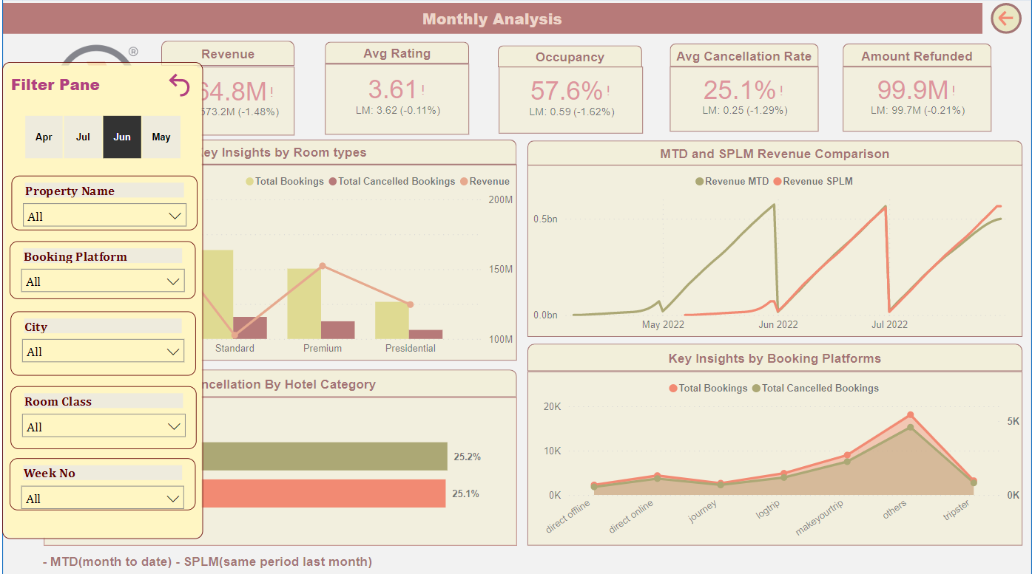
Monthly Analysis View
Notes:
kpi
No alt text provided
areaChart
No alt text provided
lineChart
No alt text provided
slicer
No alt text provided
slicer
No alt text provided
slicer
No alt text provided
slicer
No alt text provided
slicer
No alt text provided
textbox
No alt text provided
slicer
No alt text provided
actionButton
No alt text provided
shape
No alt text provided
Slicer_ShowBox
No alt text provided
shape
No alt text provided
shape
No alt text provided
shape
No alt text provided
shape
No alt text provided
shape
No alt text provided
shape
No alt text provided
image
No alt text provided
shape
No alt text provided
kpi
No alt text provided
kpi
No alt text provided
kpi
No alt text provided
shape
No alt text provided
kpi
No alt text provided
barChart
No alt text provided
lineClusteredColumnComboChart
No alt text provided
shape
No alt text provided
shape
No alt text provided
shape
No alt text provided
shape
No alt text provided
actionButton
No alt text provided

Slide 7
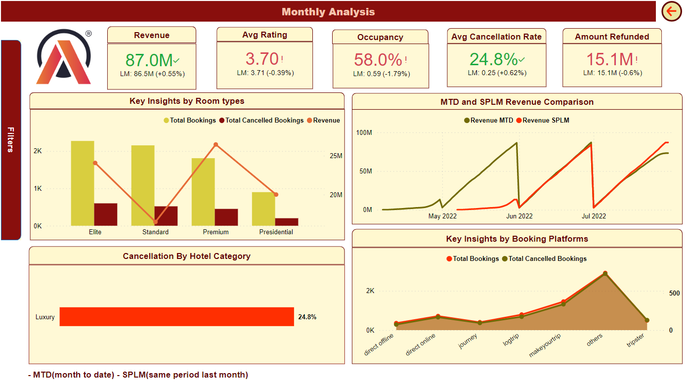
Monthly Analysis View
Notes:
kpi
No alt text provided
areaChart
No alt text provided
lineChart
No alt text provided
slicer
No alt text provided
slicer
No alt text provided
slicer
No alt text provided
slicer
No alt text provided
slicer
No alt text provided
textbox
No alt text provided
slicer
No alt text provided
actionButton
No alt text provided
shape
No alt text provided
Slicer_ShowBox
No alt text provided
shape
No alt text provided
shape
No alt text provided
shape
No alt text provided
shape
No alt text provided
shape
No alt text provided
shape
No alt text provided
image
No alt text provided
shape
No alt text provided
kpi
No alt text provided
kpi
No alt text provided
kpi
No alt text provided
shape
No alt text provided
kpi
No alt text provided
barChart
No alt text provided
lineClusteredColumnComboChart
No alt text provided
shape
No alt text provided
shape
No alt text provided
shape
No alt text provided
shape
No alt text provided
actionButton
No alt text provided

