Slide 1





DAB 402 Capstone Project
Sentimental Analysis for amazon review system
Present By:
Dharmkumar Chandubhai kakadiya(0785327)
Chintan Kaushikkumar Patel (0804098)
Deepkumar Sunilkumar Patel (0805115)
Saurabhkumar Kalyanbhai Khunt (0803337)
Submitted to
Sarama Shehmir

Slide 2
Abstract
Sentiment Analysis also well-known as Opinion Mining refers to the use of natural language processing, text analysis to analytically identify, extract, quantify, and study affective states and subjective information. Sentiment analysis is usually utilized to reviews and survey responses, online and social media, and healthcare materials for applications that range from marketing to customer service to clinical medicine. As A Result, Online Purchasing has expanded, and that has led to Growth in Online Customer Reviews of Products. The Inferred Opinions in Customer Reviews Have a Massive Influence on Customer's Decision Purchasing, Since the Customer's Opinion About the Product is Influenced by Other Consumers' Recommendations or Complaints. This research provides an analysis of the Amazon Reviews dataset and examines sentiment ranking using various machine learning approaches.
In this project, we intend to implement Sentiment Analysis of product-based reviews. Data used in this project are online product reviews collected from “amazon.com” using web scraping.

Slide 3
Problem Statement
The problem faced implied classifying an Amazon review with a positive or negative sentiment, exclusively. For example, given the following review: ’Super comfortable and extremely lightweight. Great for crossfit!’ Using machine learning and natural language processing is a must to identify whether the review implies a positive or negative sentiment. This involves breaking each review down into its most relevant components and then applying machine learning techniques to assign weighted sentiment scores to the samples. Also, the example review given previously was tokenized into the following list of sentimentally relevant words: [super, comfort, extreme, great]. Training your model on a refined list of the most relevant tokens is central to the problem of sentiment analysis and will result in a more accurate model.

Slide 4



Research Questions
1. How new users will react to the product based on others reviews when they buy that product?
2. Product from which company has had maximum positive reviews?
3. Analyze rating from customers for different products.

Slide 5
About the dataset
For this project, we extract data from Amazon using web scraping. It includes product name, review title, review date, review rating and reviews of various mobile companies. For web scraping, we used beautiful soup function.
Review data
Dataset contains 45,912 rows and 5 columns.
Table 1 Data attributes and corresponding data types
S. No | Column Name | Column Description | Type
1 | Product | It represents product name | object
2 | Title | A header of review text | String
3 | Date | It represents the date of the review that the customer gave feedback on this date | object
4 | Rating | It contains review between 1 to 5 | Int
5 | Review | It shows review text for product | String

Slide 6
Data Preprocessing
Fill NA Values
Here, we use fillna function to replace null value. First, we find NA value of reviews, which replaced with review title.
Table 2 Fill NA value of review
Company | Product | Title | Date | Rating | Review
Apple | Apple iPhone XS, US Version, 64GB, Space Gray | Everything was fine | 15-Nov-21 | 4 | Everything was fine
Samsung | Samsung Galaxy S21 FE 5G Cell Phone, Factory ... | I loved this phone | 3-May-22 | 5 | I loved this phone
Samsung | Samsung Galaxy S21 FE 5G Cell Phone, Factory ... | This phone have a screen problem, as soon as I... | 21-Aug-21 | 1 | This phone have a screen problem, as soon as I

Slide 7
Fill NA Values contd…
After that, we find NA value of both reviews and titles. we filled both with a ‘good’ word because both reviews and titles has rating 4 or above.
Table 3 Fill NA value of title and review
Company | Product | Title | Date | Rating | Review
Apple | Apple iPhone 8 Plus, 64GB, Space Gray | good | 16-Apr-22 | 4 | good
Samsung | Samsung Galaxy S21 FE 5G Cell Phone, Factory ... | good | 1-Jan-21 | 5 | good

Slide 8
Removing punctuation and emojis
Eliminating unnecessary and special characters, including punctuation, is a crucial step in text normalization. The fundamental justification for this is that, even though punctuation can offer helpful insights on the tone of a review. It is usual practice to remove the punctuation because it tends to confuse the models rather than aiding them in predicting the correct class. In my project, we removed both punctuation and emojis.
Moreover, only spaces and alphanumeric characters are kept by replacing all regex pattern [^\w\s] matches with a whitespace

Slide 9
Table 4 Remove Punctuation
Title | Clean_Title
Honestly, it was worth it | Honestly it was worth it
Eh wouldn’t buy again | Eh wouldnt buy again
Beautiful, lovely, practically brand new iPhon... | Beautiful lovely practically brand new iPhone XS
Phone not working | Phone not working
May be defective one | May be defective one
Table 5 Remove Emojis
Review | Clean_Review
I absolutely love my new iPhone XS! It arrived... | I absolutely love my new iPhone XS It arrived ...
Perfect, like new 🔥🔥 #RECELL | Perfect like new RECELL

Slide 10

Tokenization
Tokenization is the method of tokenizing or separating a string. Tokens are subunits of segments of a text document. They be able to be words, sentences, phrases etc. In our analysis we have used the method of ‘nltk’ for tokenization. These tokens help in understanding the context or developing the model.
There is a pre-defined ‘word_tokenize’ function in ‘nltk’ library. Using that function, it can separate words from sentences.

Slide 11
we used NLTK library for the tokenization in my project. Also, there is a pre-defined word_tokenize function that we applied for word tokenization.
Table 6 Tokenization
Review | Clean_Review | Title | Clean_Title
One - It comes in a weird boxTwo it had more s... | [one, it, comes, in, a, weird, boxtwo, it, had... | Eh wouldn’t buy again | [eh, wouldnt, buy, again]
Suddenly Wifi is not working properly and i co... | [suddenly, wifi, is, not, working, properly, a... | May be defective one | [may, be, defective, one]

Slide 12
Removing Stopwords
Stopwords are normally words that end up occurring the most if you gathered any corpus of text based on singular tokens and checked their frequencies. Articles (a, the ,an), Pronouns (you,them,they,me), Prepositions and so on are stopwords. They have not much or no significance. They are usually removed from text during processing to retain words having maximum importance and context.
Using NLTK library, we import stopwords in my project. Then make one function and applied it on my dataframe. I got output as shown below.
Table 7 Remove Stopwords
Review | Clean_Review | Title | Clean_Title
One - It comes in a weird boxTwo it had more s... | [one, comes, weird, boxtwo, scuffs, scratches,... | Eh wouldn’t buy again | [eh, wouldnt, buy]
DO NOT BUY A PHONE FROM THIS COMPANY! The phon... | [buy, phone, company, phone, worked, fine, rig... | BEWARE!!! | [beware]

Slide 13
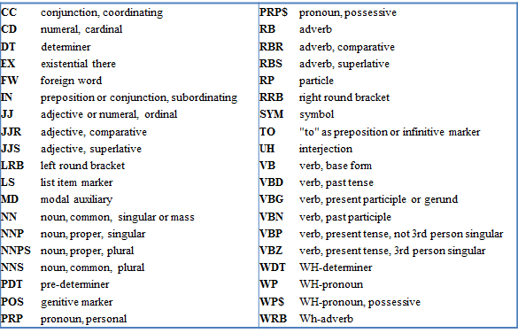
POS Tagging
A POS tag (or part-of-speech tag) is a specific label given to every token (word) in a text corpus to signify the part of speech and often also other grammatical groups such as tense,number (plural/singular), case etc. Taking POS tagging into account we can improve the accuracy of sentiment analysis techniques further by looking for specific patterns. There are different types of POS tag categories which shown in image:
Figure 1 POS Tagging Categories

Slide 14
Table 8 POS Tagging
For the pos tagging, we import pos_tag using NLTK. Tag library. After, make a function and apply it on my dataframe. The output has shown in table:
Review | Clean_Review | Title | Clean_Title
One - It comes in a weird boxTwo it had more s... | [(one, CD), (comes, VBZ), (weird, JJ), (boxtwo... | Eh wouldn’t buy again | [(eh, NN), (wouldnt, NN), (buy, VB)]
Good condition | [(good, JJ), (condition, NN)] | Good | [(good, JJ)]

Slide 15

Lemmatization
Lemmatization is a grammatical term which indicates grouping all together words with the similar origin or lemma but with distinct accents or derivatives of sense so they can be analyzed as one item. The aim is to take away inflectional suffixes and begins to take out the word’s dictionary form.
For instance, to lemmatize the words “dogs,” “dog’s,” means bringing away the suffixes “s,” “’s,” and “s’” to bring out the root word “dog.”
We import wordnetlemmatizer from nltk library in our project. It returns dictionary form of word based on pos tag.

Slide 16
Table 9 Lemmatization
Company | Product | Title | Date | Rating | Review | Clean_Title | Clean_Review
Apple | Apple iPhone XS, US Version, 64GB, Space Gray | Honestly, it was worth it | 22-Jun-19 | 5 | I was very hesitant about buying an iPhone off... | honestly worth | hesitant buying iphone amazon disappoint come ...
Apple | Apple iPhone XS, US Version, 64GB, Space Gray | Eh wouldn’t buy again | 30-Jun-19 | 1 | One - It comes in a weird boxTwo it had more s... | eh wouldnt buy | one come weird boxtwo scuff scratch id like pr...
Apple | Apple iPhone XS, US Version, 64GB, Space Gray | Beautiful, lovely, practically brand new iPhon... | 4-Feb-20 | 5 | I absolutely love my new iPhone XS! It arrived... | beautiful lovely practically brand new iphone x | absolutely love new iphone x arrive time pract...
Apple | Apple iPhone XS, US Version, 64GB, Space Gray | Phone not working | 25-Dec-18 | 4 | The phone is froze up and unable to use. Very ... | phone work | phone froze unable use poor productedit within...
Apple | Apple iPhone XS, US Version, 64GB, Space Gray | May be defective one | 2-Jul-19 | 1 | Suddenly Wifi is not working properly and i co... | may defective one | suddenly wifi work properly could see phone fe...
For the lemmatization, we make function using for loop and applied it on dataframe. The output has shown in table 9 :

Slide 17
TF (Term Frequency) - IDF (Inverse Documents Frequency)
We used TfidfVectorizer method for converting textual data to numerical form so we can use it to our models. It’s transferring text data into vectors as the models can process only numerical data. Using TF-IDF we can get information about words that which word is more significant in sentence.
For Term Frequency-Inverse Document Frequency the product of Term frequency and inverse document frequency is used. Term frequency is in what way commonly a term has occurred in a document.
Term Frequency = f/d.
E.g., Piford provide training to students and provide training to working professionals.
Tf(piford) = 1/12
Tf(training) = 2/12

Slide 18
IDF is inverse document frequency. Using IDF we can get real words. If a corpus contains N documents and the term of our concern exists only in D documents, then IDF is:
IDF = log(N (total number of sentences ) / D (Number of documents with term t in it) ).
E.g.,
Piford provide training to students
Piford is a software development company
We provide placement after trainings.
IDF(Piford) = log 3/2
IDF(Software) = log 3/1
Tf-Idf = Tf * Idf

Slide 19
Vader Sentiment
(Valence Aware Dictionary and Sentiment Reasoner) is a lexicon and rule-based sentiment analysis tool that is specifically attuned to sentiments expressed in social media and works well on texts from other domains. It's a Rule-based Model for Sentiment Analysis of social media Text. This analyzer calculates text sentiment and produces four different classes of output scores: positive, negative, neutral, and compound. A compound score is the aggregate of the score of a word, or precisely, the sum of all words in the lexicon, normalized between -1 and 1.
Positive sentiment: compound score >= 0.05
Neutral sentiment: (compound score > -0.05) and (compound score < 0.05)
Negative sentiment: compound score <= -0.05
Compound Score: The compound score is computed by summing the valence scores of each word in the lexicon, adjusted according to the rules, and then normalized to be between -1 (most extreme negative) and +1 (most extreme positive).
We import SentimentIntensityAnalyzer from vadersentiment library. It applied on dataframe. The output has shown in image:
Sentimental Analysis
Company | Product | Date | Rating | Clean_Title | Clean_Review | cleaned_title_review | Positive | Negative | Neutral | Compound | Sentiment
Apple | Apple iPhone XS, US Version, 64GB, Space Gray | 22-Jun-19 | 5 | honestly worth | hesitant buying iphone amazon disappoint come ... | honestly worth hesitant buying iphone amazon d... | 0.246 | 0.197 | 0.556 | 0.6901 | positive
Apple | Apple iPhone XS, US Version, 64GB, Space Gray | 30-Jun-19 | 1 | eh wouldnt buy | one come weird boxtwo scuff scratch id like pr... | eh wouldnt buy one come weird boxtwo scuff scr... | 0.173 | 0.279 | 0.548 | -0.3536 | negative
Apple | Apple iPhone XS, US Version, 64GB, Space Gray | 4-Feb-20 | 5 | beautiful lovely practically brand new iphone x | absolutely love new iphone x arrive time pract... | beautiful lovely practically brand new iphone ... | 0.325 | 0.033 | 0.641 | 0.9896 | positive
Apple | Apple iPhone XS, US Version, 64GB, Space Gray | 25-Dec-18 | 4 | phone work | phone froze unable use poor productedit within... | phone work phone froze unable use poor product... | 0.266 | 0.133 | 0.601 | 0.2732 | positive
Apple | Apple iPhone XS, US Version, 64GB, Space Gray | 2-Jul-19 | 1 | may defective one | suddenly wifi work properly could see phone fe... | may defective one suddenly wifi work properly ... | 0.12 | 0.232 | 0.648 | -0.3415 | negative
Table 10 Sentiment Analysis

Slide 20
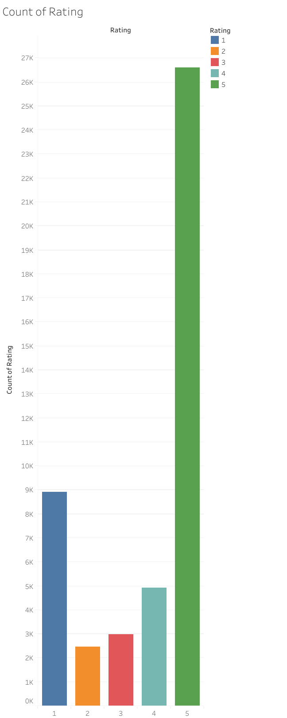
Visualizations
1) Count of rating
The picture depicts count of total rating of products. It shows rating 5 has the highest count in whole dataset, while rating 2 has the lowest count.
Figure 1 Count of rating

Slide 21
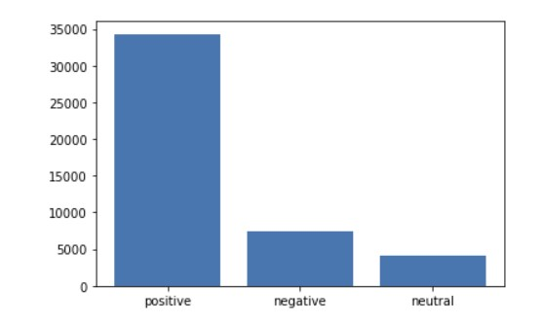
2) Sentiment Distribution
The Image represents that there is highest positive reviews present in dataset. There are 34314 positive reviews, and 7503 negative reviews present in dataset. There are least which is around 4095 neutral reviews present in reviews.

Slide 22
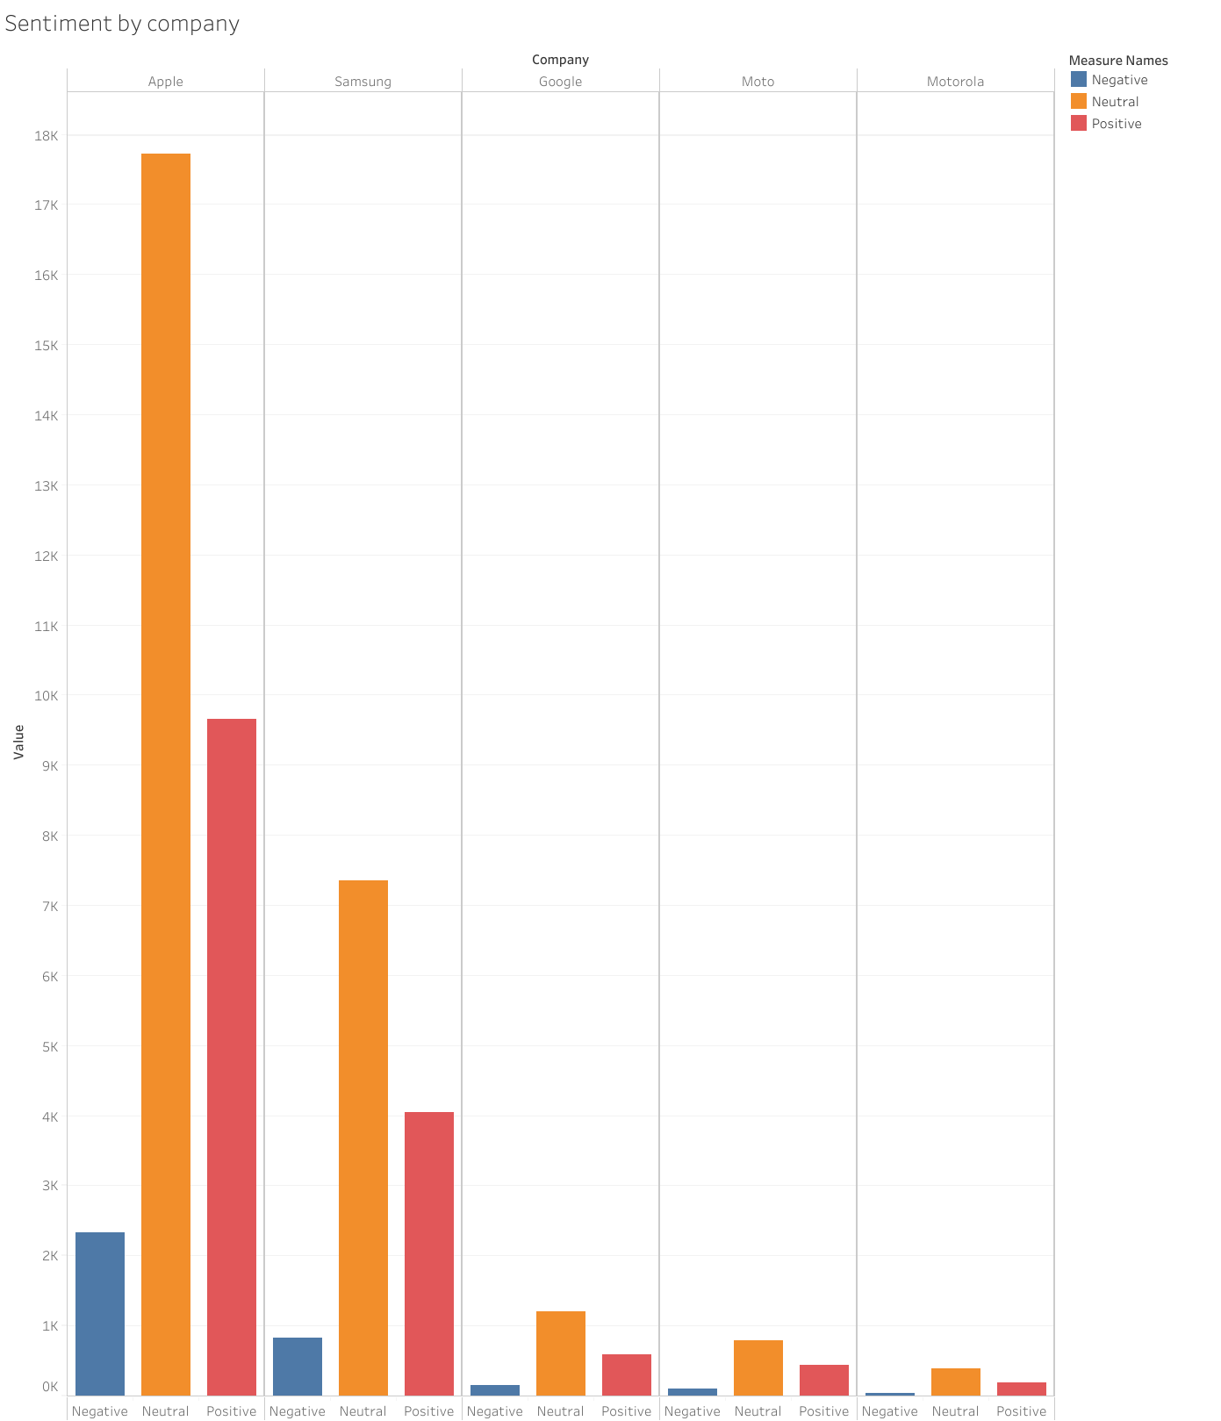
3) Sentiment by company
The bar chart represents positive, negative, and neutral sentiment by five different mobile companies. Neutral sentiment has the highest value among the all the sentiment. Apple has the maximum positive review among all the companies, whilst Motorola has the lowest sentiment in all three categories.
Figure 3 Sentiment by company

Slide 23
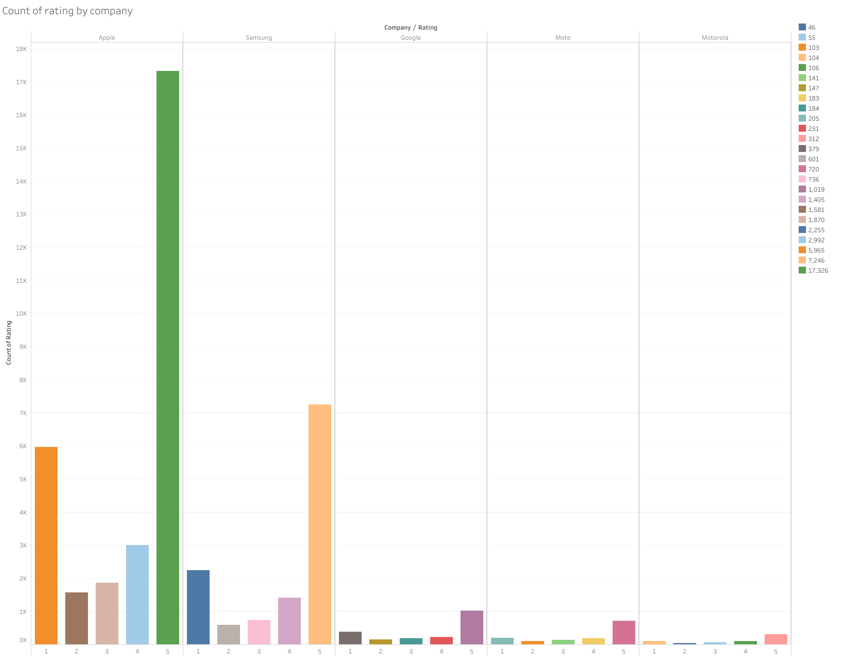
4) Count of rating by company
The bar graph demonstrates count of rating by five different mobile companies. Apple has the maximum rating of 5 amongst all mobile firms, whilst Motorola has the lowest rating in all the categories.
Figure 4 Count of Rating by company

Slide 24
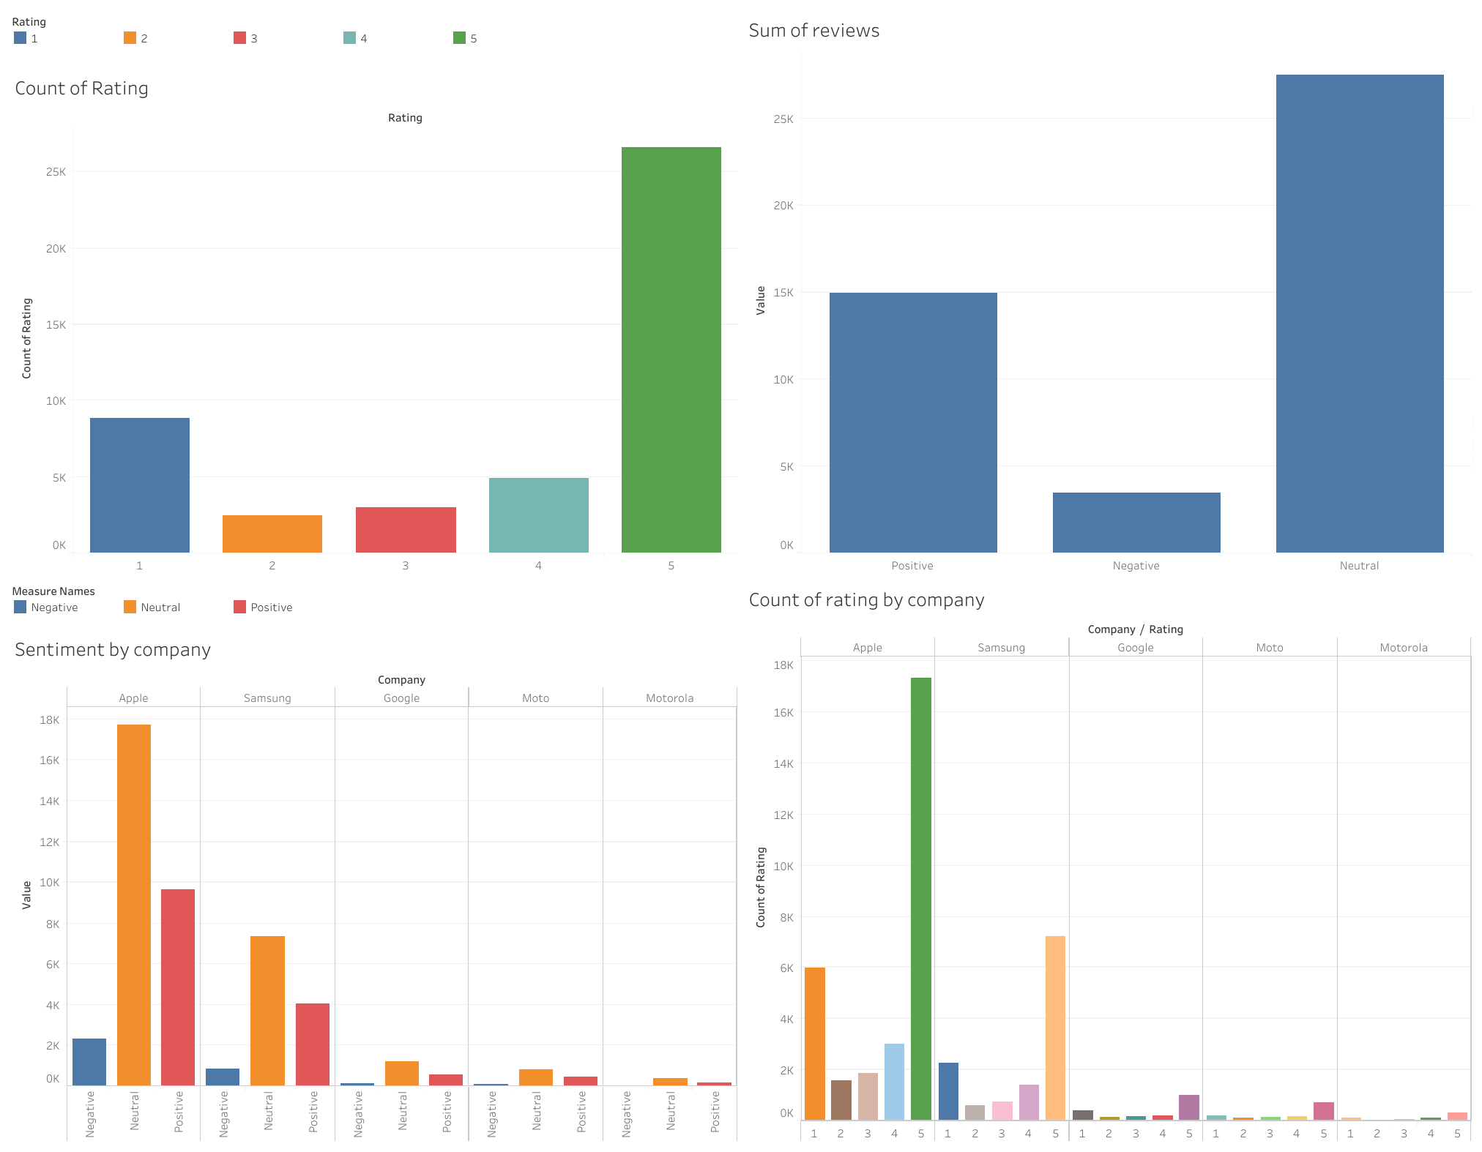
Dashboard

Slide 25
Wordcloud is an image composed by many words that implies the contents of the document of analysis. The words are presented in various shapes and colors according to the frequency of occurrence and importance of words in the document. The larger the text form, the more the number of occurrences. Wordcloud is used in sentiment analysis to find out the frequency of dominant words and then draw conclusions according to the topic and condition of the study.
Word Clouds

Slide 26
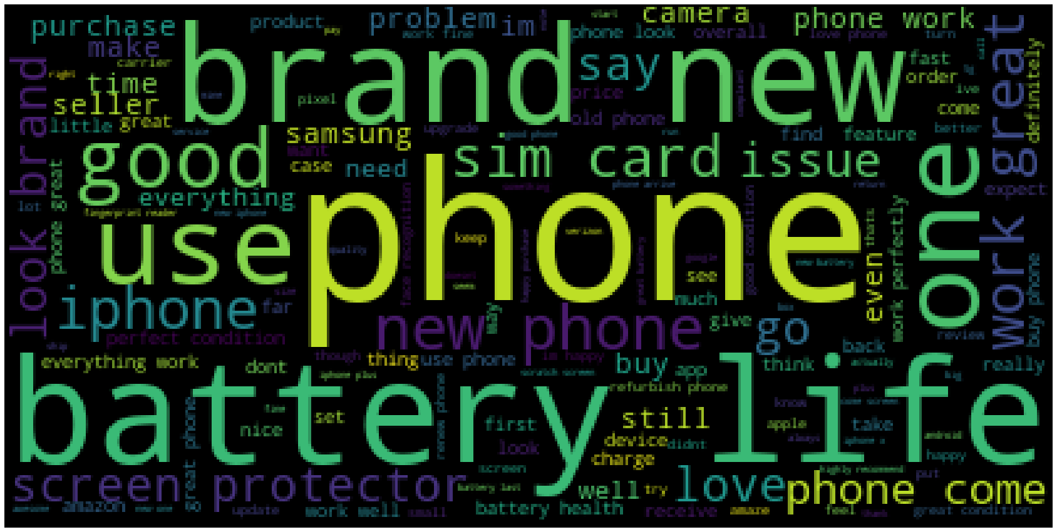
Figure 5 Positive review wordcloud

Slide 27
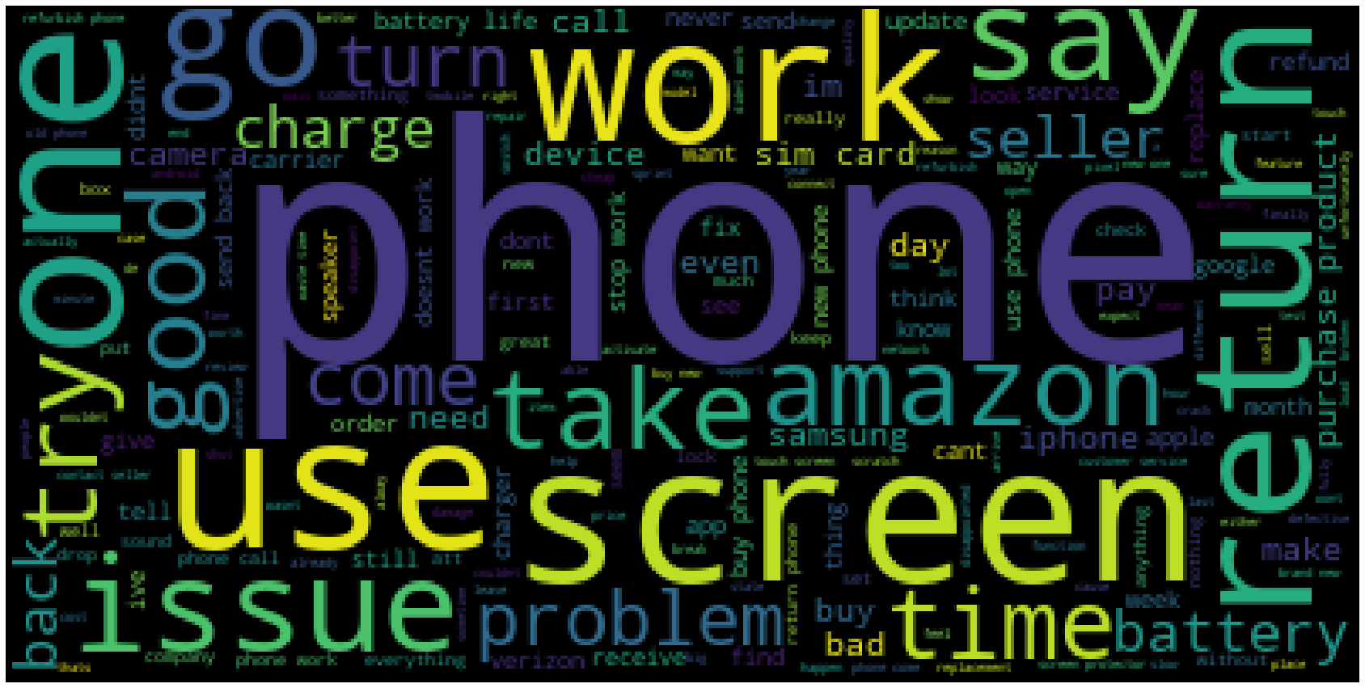
Figure 6 Negative review wordcloud

Slide 28
KNN
KNN is one of the simplest forms of machine learning algorithms mostly used for classification. It classifies the data point on how its neighbor is classified. KNN classifies the new data points based on the similarity measure of the earlier stored data points. Using KNN algorithm, we got only 29% accuracy.

Slide 29

SVM
SVM (support vector machine) is a popular supervised learning algorithm used in machine learning for classification, regression, and outlier detection.
Svm is known for its ability to handle high-dimensional feature spaces and deal with noisy data. It has been used in a wide range of applications, including text classification, image classification, and bioinformatics.
We used svm model in our project and we got 90.67% which is around 91% accuracy.

Slide 30
Front end development
We used Streamlit for our front end development.
Streamlit is an open-source Python library used for building data-driven web applications.
Streamlit is a powerful and flexible tool for building data-driven web applications, and its simplicity and ease of use make it a popular choice for data scientists and machine learning engineers who want to create interactive, web-based interfaces for their work.

Slide 31
In the application, user can enter the reviews and analyze their reviews based on key performance indicators.
User has filter option in the app, where they can use filter and see the reviews of brands, models and the types of the reviews..
We also have option to see the visualization of sentimental distribution with variety of option like pie chart, bar graph and many more.
On the other hand, user also can see the sentiments like how much positive and negative reviews of the mobile brands.

Slide 32
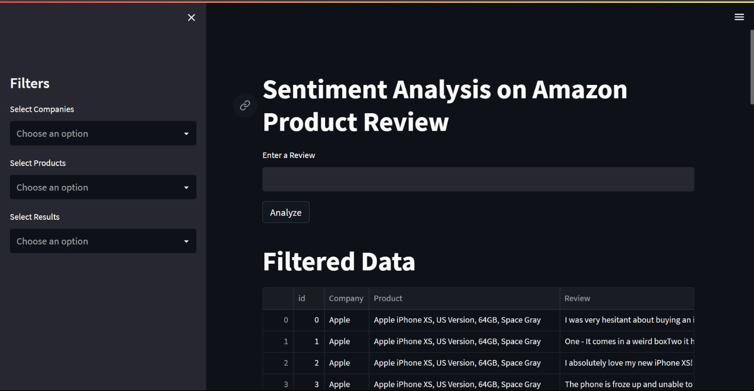
Glimpse of the application

Slide 33

Thank You

