Slide 1
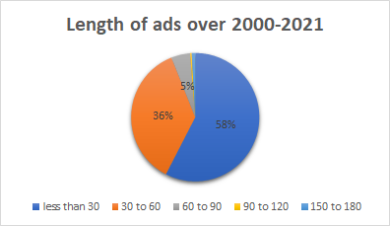
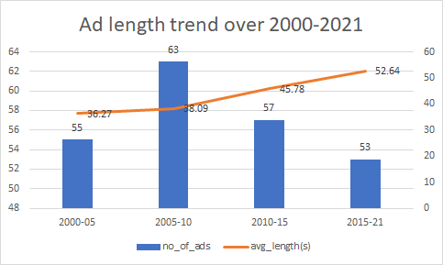
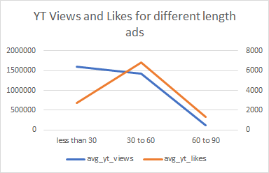
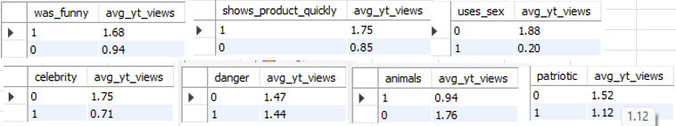
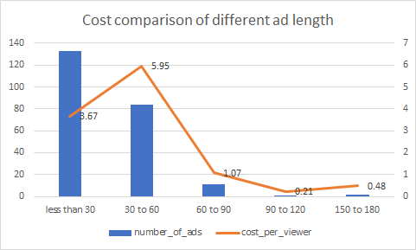
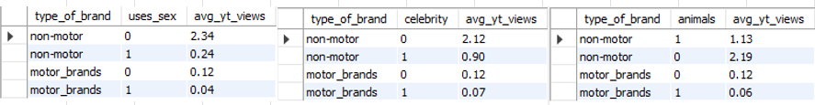

Maven Super Bowl Challenge
: Solution Dashboard
Saurabh Raj
A dataset compiled by FiveThirtyEight was analysed, which contained Super Bowl commercials for 10 popular brands this century. We had to recommend advertisement strategy for Maven Motors, an automobile company, based on the data provided.
Two major aspects
Length of ad
Content of ad
Content Of Advertisement
Length Of Advertisement
From the data it is observed that about 99% of the ads were of length 90s or less. The longer ads were too few in number to be considered significant in our observation.
For the content of the advertisement, we had to observe how the viewers responded to the emotions expressed in the advertisement. The data pulled on the right, gives the average millions of views that ads of different emotion segments get, and some observations that can be drawn are, viewers:
Like funny ads
Like to see products quickly
Do not like usage of sex
Do not like usage of celebrity
Are indifferent to danger shown in ad
Do not like animals in the ad
Do not like to see patriotic emotions
There could be a plethora of reasons for such a reaction from the viewers like:
They consider SuperBowl as ads that should be watched with families and hence aversion towards sensationalisation via celebrity or sex
They might feel that SuperBowl is not the moment to instill patriotism, and the chief purpose should be entertainment
They like to see funny ads as it provide a break from possibly stressful game at the SuperBowl
They like to know what the ad is all about as soon as possible so that they know they aren’t wasting their time giving attention to products they won’t buy
Although it was observed that the number of ads when analysing 5 year epochs, the average time of each ad (in seconds) increased
Considering the fact that the viewer count for an ad from tv doesn’t necessarily mean that the viewer was interested in the advertisement, especially for popular sporting events like The Super Bowl as also shown by the fact that the view count in million has a standard deviation of about 12.83% and mean of about 100.51 mil viewers. Hence, we will focus more on voluntary viewer actions like Youtube View count as a better metric for judgement of a content’s popularity.
For comparison with the brands that solely sell automobile, i.e ‘Toyota’ , ‘ Hyundai’ and ‘Kia , we find that some of the above emotions reflect in their viewership numbers as well e.g. in Animal usage, Celebrity usage and Usage of sex in the commercial followed similar trends as the aggregate numbers show, however other features are opposite to the aggregate trend.
However, when we observe the cost ($USD) per user trend for ads of various lengths, we observe that the 30-60 seconds segment seem the costliest among others, over the years.
We observe from the three graphs that it is more advisable for ads to be of range appx 40-50 seconds long as it also translates into better Youtube Performance despite the fact that the ratio of likes per view was higher for ads longer than 60s.
However, if the goal of the marketing campaign is to be more economical in spending, then the length segment of 30s and below also seems a good option albeit at the cost of reduced likes and likes per view on YouTube
In conclusion, we can estimate that the best conceptualization of a commercial for Maven Motors, would be of a length between 30 seconds and 50 seconds depending upon the budget and goals for YouTube reach, and would incorporate emotions which refrain from celebrities, animals and sex. Probably for a wider reach, things like incorporating funny emotions could also be incorporated.

