Slide 1
Agenda
Topics
Spring Boot
Spring cloud introduction
Demo Project Architecture
Detailed Understanding of Project
21-Jan-2019

Slide 2
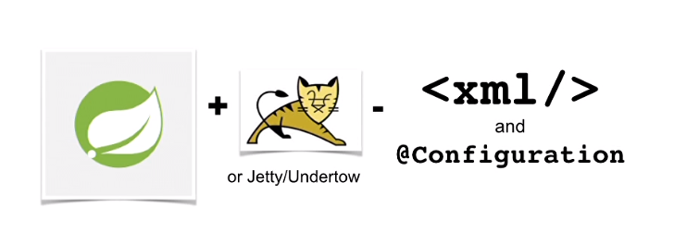
What is Spring Boot ?
it's an opinionated, production-ready way to consume all of Spring.
It provides sensible defaults and automatic configuration as well as support for embedded HTTP servers.
Notes:
it's an opinionated, production-ready way to consume all of Spring. It provides sensible defaults and automatic configuration as well as support for embedded HTTP servers. You can think of it as kind of Spring, and that's all of Spring, plus Tomcat or perhaps Jetty or Undertow if you want to switch them out, minus any kind of configuration, so it's like Spring without having to go to stack overflow. Spring Boot really helps when it comes to microservices. You're going to have to write more than one microservice. That means you going to have to do the following things a lot: declare dependencies, configure Spring, configure Logging, load property files, set up monitoring, add security, talk to databases, add metrics. All these things can be helped by using Spring Boot. There are several ways you can get started with Spring Boot. Perhaps the easiest is to use the CLI tool. To install the CLI if you're on a Mac, it's as simple as typing "brew tap pivotal tap" and then "brew install springboot". If you're on a Windows or Linux machine, you can download a zip distribution, simply unpack it and then run some shell scripts. You can also get started with STS or Intellij. Both have file -> new and then a Spring option that will take you to a wizard to help you get set up. Finally, there's also a website available called the Spring Initializer at start.spring.io. Let's have a quick look at the CLI in action.

Slide 3
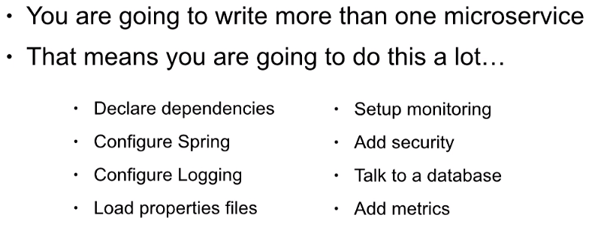
How does it help Microservices?
All these things can be helped by using Spring Boot.
Notes:
it's an opinionated, production-ready way to consume all of Spring. It provides sensible defaults and automatic configuration as well as support for embedded HTTP servers. You can think of it as kind of Spring, and that's all of Spring, plus Tomcat or perhaps Jetty or Undertow if you want to switch them out, minus any kind of configuration, so it's like Spring without having to go to stack overflow. Spring Boot really helps when it comes to microservices. You're going to have to write more than one microservice. That means you going to have to do the following things a lot: declare dependencies, configure Spring, configure Logging, load property files, set up monitoring, add security, talk to databases, add metrics. All these things can be helped by using Spring Boot. There are several ways you can get started with Spring Boot. Perhaps the easiest is to use the CLI tool. To install the CLI if you're on a Mac, it's as simple as typing "brew tap pivotal tap" and then "brew install springboot". If you're on a Windows or Linux machine, you can download a zip distribution, simply unpack it and then run some shell scripts. You can also get started with STS or Intellij. Both have file -> new and then a Spring option that will take you to a wizard to help you get set up. Finally, there's also a website available called the Spring Initializer at start.spring.io. Let's have a quick look at the CLI in action.

Slide 4
What is Spring Cloud ?
Spring Cloud is an umbrella project consisting of independent projects with, in principle, different release.
Facilitates the Cloud Native styles.
Spring Cloud provides tools for developers to quickly build some of the common patterns in distributed systems (e.g. configuration management, service discovery, circuit breakers).
To manage the portfolio, a BOM (Bill of Materials) is published with a curated set of dependencies on the individual project.
Notes:
Spring Cloud provides tools for developers to quickly build some of the common patterns in distributed systems (e.g. configuration management, service discovery, circuit breakers, intelligent routing, micro-proxy, control bus, one-time tokens, global locks, leadership election, distributed sessions, cluster state). Coordination of distributed systems leads to boiler plate patterns, and using Spring Cloud, developers can quickly stand up services and applications that implement those patterns. They will work well in any distributed environment, including the developer’s own laptop, bare metal data centres, and managed platforms such as Cloud Foundry. The release trains have names, not versions, to avoid confusion with the sub-projects.
Spring Cloud is an umbrella project consisting of independent projects with, in principle, different release cadences. To manage the portfolio a BOM (Bill of Materials) is published with a curated set of dependencies on the individual project (see below). The release trains have names, not versions, to avoid confusion with the sub-projects.
A BOM is a special kind of POM that is used to control the versions of a project’s dependencies and provide a central place to define and update those versions.
BOM provides the flexibility to add a dependency to our module without worrying about the version that we should depend on.

Slide 5
Spring Cloud Features
Spring Cloud focuses on providing good out of box experience for typical use cases and extensibility mechanism to cover others.
Distributed/versioned configuration
Service registration and discovery
Routing
Service-to-service calls
Load balancing
Circuit Breakers
Global locks
Leadership election and cluster state
Distributed messaging
Notes:
Spring Cloud takes a very declarative approach, and often you get a lot of fetaures with just a classpath change and/or an annotation.

Slide 6
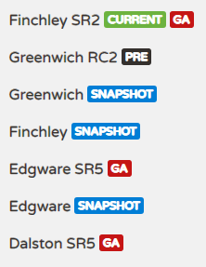
Release train & Spring Boot compatibility
Release Train | Boot Version
Greenwich | 2.1.x
Finchley | 2.0.x
Edgware | 1.5.x
Dalston | 1.5.x

Slide 7
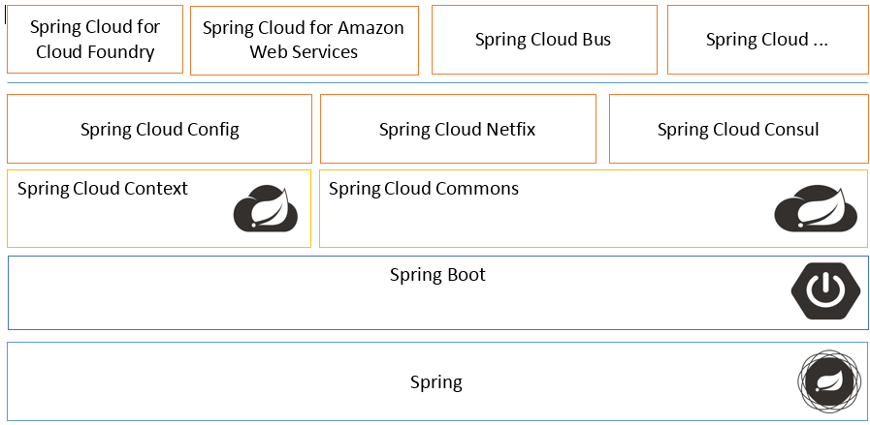
Spring Cloud View
Notes:
Spring Cloud Context provides utilities and special services for the ApplicationContext of a Spring Cloud application (bootstrap context, encryption, refresh scope and environment endpoints).
Spring Cloud Commons is a set of abstractions and common classes used in different Spring Cloud implementations (eg. Spring Cloud Netflix vs. Spring Cloud Consul).
Spring Cloud Context features:
Bootstrap Context
TextEncryptor beans
Refresh Scope
Spring Boot Actuator endpoints for manipulating the Environment
Spring Cloud Commons features:
DiscoveryClient interface
ServiceRegistry interface
Instrumentation for RestTemplate to resolve hostnames using DiscoveryClient

Slide 8


Spring Cloud Netflix
Enable common patterns with just annotations:
Service Discovery: Eureka
Circuit Breaker: Hystrix
Client Side Load Balancer: Ribbon
Declarative REST Client: Feign
Router and Filter: Zuul
External Configuration: Archaius
Notes:
Service Discovery: Eureka instances can be registered and clients can discover the instances using Spring-managed beans
Service Discovery: an embedded Eureka server can be created with declarative Java configuration
Circuit Breaker: Hystrix clients can be built with a simple annotation-driven method decorator
Circuit Breaker: embedded Hystrix dashboard with declarative Java configuration
Declarative REST Client: Feign creates a dynamic implementation of an interface decorated with JAX-RS or Spring MVC annotations
Client Side Load Balancer: Ribbon
External Configuration: a bridge from the Spring Environment to Archaius (enables native configuration of Netflix components using Spring Boot conventions)
Router and Filter: automatic regsitration of Zuul filters, and a simple convention over configuration approach to reverse proxy creation

Slide 9
Service Register & Discovery : Eureka
The microservices should register themselves in the centralized location with an identifier and server details. This is known as “Service Registration“.
Eureka Server
Eureka Client
Run by @EnableEurekaServer
Optional standalone mode
Keep registration in memory
Enable by @EnableDiscoveryClient or @EnableEurekaClient
Sending heartbeats to Eureka server
Discovery clients:
Native EurekaClient
Spring Cloud DiscoveryClient
Feign client
Spring RestTemplate
Notes:
The importance of Service Register and Discovery
In the Microservices architecture, your application may consist of many number of microservices. each of them may be deployed in different servers and different ports. The microservices may need to communicate with each other to execute some tasks or operations. For instance, one microservice may need to access the service endpoint (REST endpoint) in some other microservice for application related operation. “how do they communicate with each other?”
If I ask you this question, you will directly tell me that one service can access the other service with the IP address and the port number of that service.
YES! you are correct. But keep this in mind that this approach (using ip address and port number) has following limitations.
It is not practical to know the IP address and port number of each microservice as there are multiple microservices available. Assume that there are hundred of microservices available. In this case, do you think that it is practical to know the ip address and port number of each service? It is not right?
Assume a situation where a microservice is migrated to (deployed in) some other server with different IP address and port. If we have used the IP address and port number in the source code for making RestClient requests, then we will have to change them in the source code and re-build and deploy the affected services. whenever the ip address or port number get changed, we have to do the same. Dont you think that it is a sort of bad coding and programming practice? Absolutely it is right? (The issue raised again in a situation where we have multiple environments like dev, qa, uat and production)
The solution is “Service Registration and Discovery“.
The microservices should register themselves in the centralized location with an identifier and server details. This is known as “Service Registration“. Each microservice should be able to look up the list of registered services in the centralized location and it is known as “Service Discovery”
What are the implementation for the Service Registration and Discovery?
There are multiple implementations for the Service Registration and Discovery Server
Netflix Eureka
Consul
Zookeeper
What is Eureka Server? How it works?
Eureka Server is an implementation for the “Service Registration and Discovery” pattern. Eureka Server keeps a track of registered microsevices and therefore It is known as registry of microservices (that are related to the application).
Each microservice should register with Eureka server by providing their details such as host name, ip address, port, and health indicators etc… Then the Eureka service will register each microservice with unique identifier known as serviceId. The other services can use this serviceId to access the particular service.
The Eureka server will maintain a list of registered microservices with their provided details. Eureka server expects continuos ping messages (known as heartbeats) from the registered microservices to verify they are alive (up and running). If any service fails to send the heartbeat (ping message) continuously, it will be considered as a dead service and will be removed from the registry. Therefore Eureka server will maintain only a registry of up and running microservices.
On the other hand, the microservices can register themselves as service discover clients with Eureka Server. The Eureka Server will allow the discover clients (microservices) to look up the other registered services and fetch their information. If any service needs to communicate with any other service, it can register with the Eureka server as a discover client and fetch the information of the targeted service (server address and port number etc…). In this way, microservices can communicate with each other without maintaining the IP addresses and port numbers manually.
Sometimes you might have noticed that @EnableEurekaClient has been used instead of @EnableDiscoveryClient annotation. Lets look at their difference.
@EnableDiscoveryClient annotation can work with any Discovery Client implementations which implements in your project ( Eureka, Consul, Zookeeper ) . You can also use @EnableEurekaClient annotation but it works only with Eureka Discovery Client implementation.
@EnableDiscoveryClient lives in spring-cloud-commons and picks the implementation on the classpath. @EnableEurekaClient lives in spring-cloud-netflix and only works for Eureka.

Slide 10
Routing and Filtering : Zuul Proxy
Zuul is an edge service that proxies requests to multiple backing services.
It provides a unified “front door” to your system, which allows a browser, mobile app, or other user interface to consume services from multiple hosts.
Features :
Authentication and security
Microservices insights and monitoring.
Dynamic Routing
Runtime stress testing.
Static response handling.
Notes:
A common challenge when building microservices is providing a unified interface to the consumers of your system. The fact that your services are split into small composable apps shouldn’t be visible to users or result in substantial development effort.
An edge service is a component which is exposed to the public internet. It acts as a gateway to all other services, which we will refer to as platform services.
Cross-Origin Resource Sharing (CORS) is a mechanism that uses additional HTTP headers to tell a browser to let a web application running at one origin (domain) have permission to access selected resources from a server at a different origin. A web application makes a cross-origin HTTP request when it requests a resource that has a different origin (domain, protocol, and port) than its own origin.icroservices) created and open-sourced its Zuul proxy server.
A common problem, when building microservices, is to provide a unique gateway to the client applications of your system. The fact that your services are split into small microservices apps that shouldn’t be visible to users otherwise it may result in substantial development/maintenance efforts. Also there are scenarios when whole ecosystem network traffic may be passing through a single point which could impact the performance of the cluster.
To solve this problem, Netflix (a major adopter of microservices) created and open-sourced its Zuul proxy server and later Spring under Pivotal has adapted this in its spring cloud stack and enabled us to use zuul easily and effectively with just few simple steps.
Zuul is an edge service that proxies requests to multiple backing services. It provides a unified “front door” to your ecosystem, which allows any browser, mobile app or other user interface to consume services from multiple hosts. You can integrate Zuul with other Netflix stack components like Hystrix for fault tolerance and Eureka for service discovery or use it to manage routing rules, filters and load balancing across your system. Most importantly all of those components are well adapted by spring framework through spring boot/cloud approach.
Apply microservice authentication and security in the gateway layer to protect the actual services
We can do microservices insights and monitoring of all the traffic that are going in to the ecosystem by enabling some logging to get meaningful data and statistics at the edge in order to give us an accurate view of production.
Dynamic Routing can route requests to different backend clusters as needed.
We can do runtime stress testing by gradually increasing the traffic to a new cluster in order to gauge performance in many scenarios e.g. cluster has new H/W and network setup or that has new version of production code deployed.
We can do dynamic load shedding i.e. allocating capacity for each type of request and dropping requests that go over the limit.
We can apply static response handling i.e. building some responses directly at the edge instead of forwarding them to an internal cluster for processing.

Slide 11
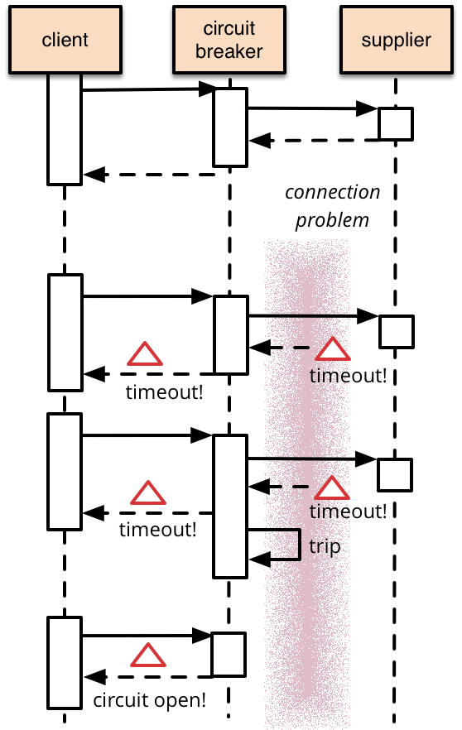
Circuit Breaker Pattern/ Fall Back/ Fault Tolerance
Enabled by annotation on the method
@HystrixCommand(fallbackMethod=„”)
public Article getArticle(String id) { // call external system
}
Fallback can be provided
Hystrix Dashboard
@EnableCircuitBreaker in main class
Notes:
In the microservices world, to fulfill a client request one microservice may need to talk to other microservices. We should minimize this kind of direct dependencies on other microservices but in some cases it is unavoidable. If a microservice is down or not functioning properly then the issue may cascade up to the upstream services. Netflix created Hystrix library implementing Circuit Breaker pattern to address these kinds of issues. We can use Spring Cloud Netflix Hystrix Circuit Breaker to protect microservices from cascading failures.
Solution : A service client should invoke a remote service via a proxy that functions in a similar fashion to an electrical circuit breaker. When the number of consecutive failures crosses a threshold, the circuit breaker trips, and for the duration of a timeout period all attempts to invoke the remote service will fail immediately. After the timeout expires the circuit breaker allows a limited number of test requests to pass through. If those requests succeed the circuit breaker resumes normal operation. Otherwise, if there is a failure the timeout period begins again.
Spring looks for any method annotated with the @HystrixCommandannotation, and wraps that method so that Hystrix can monitor it.
Hystrix watches for failures in that method, and if failures reached a threshold (limit), Hystrix opens the circuit so that subsequent calls will automatically fail. Therefore, and while the circuit is open, Hystrix redirects calls to the fallback method.
The fallback method should be defined in the same class and should have the same signature.
execution.isolation.thread.timeoutInMilliseconds
This property sets the time in milliseconds after which the caller will observe a timeout and walk away from the command execution. Hystrix marks the HystrixCommand as a TIMEOUT, and performs fallback logic. Note that there is configuration for turning off timeouts per-command, if that is desired (see command.timeout.enabled).
circuitBreaker.errorThresholdPercentage
This property sets the error percentage at or above which the circuit should trip open and start short-circuiting requests to fallback logic.
circuitBreaker.sleepWindowInMilliseconds
This property sets the amount of time, after tripping the circuit, to reject requests before allowing attempts again to determine if the circuit should again be closed.

Slide 12
Client Side Load Balancing : Ribbon
Ribbon is a client-side load balancer that gives you a lot of control over the behavior of HTTP and TCP clients.
Ribbon API works based on the concept called “Named Client”.
Service Discovery Integration – Ribbon load balancers provide service discovery in dynamic environments like a cloud.
Fault Tolerance – the Ribbon API can dynamically determine whether the servers are up
Configurable load-balancing rules – Ribbon supports RoundRobinRule, AvailabilityFilteringRule, WeightedResponseTimeRule out of the box and also supports defining custom rules.
Notes:
Feign already uses Ribbon, so, if you use @FeignClient, this section also applies.
Apart from the client-side load balancing algorithms, Ribbon provides also other features:
Netflix Ribbon is an Inter Process Communication (IPC) cloud library. Ribbon primarily provides client-side load balancing algorithms.
Service Discovery Integration – Ribbon load balancers provide service discovery in dynamic environments like a cloud. Integration with Eureka and Netflix service discovery component is included in the ribbon library
Fault Tolerance – the Ribbon API can dynamically determine whether the servers are up and running in a live environment and can detect those servers that are down
Configurable load-balancing rules – Ribbon supports RoundRobinRule, AvailabilityFilteringRule, WeightedResponseTimeRule out of the box and also supports defining custom rules
Ribbon API works based on the concept called “Named Client”. While configuring Ribbon in our application configuration file we provide a name for the list of servers included for the load balancing.

Slide 13
Feign Client
Netflix provides Feign as an abstraction over REST-based calls, by which microservices can communicate with each other, but developers don't have to bother about REST internal details.
Declarative Web Service Client
Create interface and annotate it
Notes:
we need to be aware of the RestTemplate API to communicate with other microservices, which is certainly not part of our business logic.
The question is, why should a developer have to know the details of a REST API? Microservice developers only concentrate on business logic, so Spring addresses this issues and comes with Feign Client, which works on the declarative principle. We have to create an interface/contract, then Spring creates the original implementation on the fly, so a REST-based service call is abstracted from developers. Not only that — if you want to customize the call, like encoding your request or decoding the response in a Custom Object, you can do it with Feign in a declarative way. Feign, as a client, is an important tool for microservice developers to communicate with other microservices via Rest API.
You only need to describe how to reach the remote API service by providing details such as the URL, request and response body, accepted headers, etc. The Feign Client will take care of the implementation details.

Slide 14
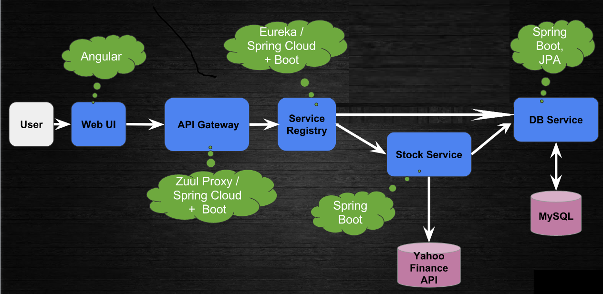
Project Architecture

Slide 15
Standard Table
Categories | Most Popular Technologies
Development Tool | Eclipse/STS
Service Specs | Swagger
Application Framework | Spring Boot
Authentication/Authorization | CredHub, keyCloak
Secret Management | Vault, HPVoltage
Service Discovery | Eureka, DNS
Monitoring | Prometheus, Hystrix
Logging | ELK
Data Layer | Cassandra, Couchbase
CI/CD Process | GIT
 | Junit
 | Jenkins, Concourse, goCD
 | SonarQube, PACT
 | DockerCentral
 | Nexus
Microservice Container Runtime | Docker, Kubernetes
Application Configuration | Chef, Ansible, Consul

Slide 16







Logical Deployment Architecture for Microservice
Kubernetes Node
Service Discovery
Kubernetes Pod
Docker Container Engine
Consumer of MS API
Container with Microservice
API Gateway
Log collector
ELK/G
Dashboard
A3S (security as a service
Query
Elasticsearch cluster
Prometheus
index
Zipkin
Message Bus (Kafka)
Queue
Grafana
Logstash cluster
Logstash cluser
Monitoring
Logging and Tracing

