Slide 1

Practical Machine Learning
Day 4: SEP23 DBDA
Kiran Waghmare

Slide 2
Agenda
Regression
Types of Regression

Slide 3
Linear model
In regression, the relationship between Y and X is modelled in the following form:
Y = a + b * X + E
where:
Y is the dependent variable (Income in the example)
X is the independent variable (IQ in the example)
a is an intercept
b is the coefficient
E is an error term for each observation (since there is additional variation not explained by income)

Slide 4
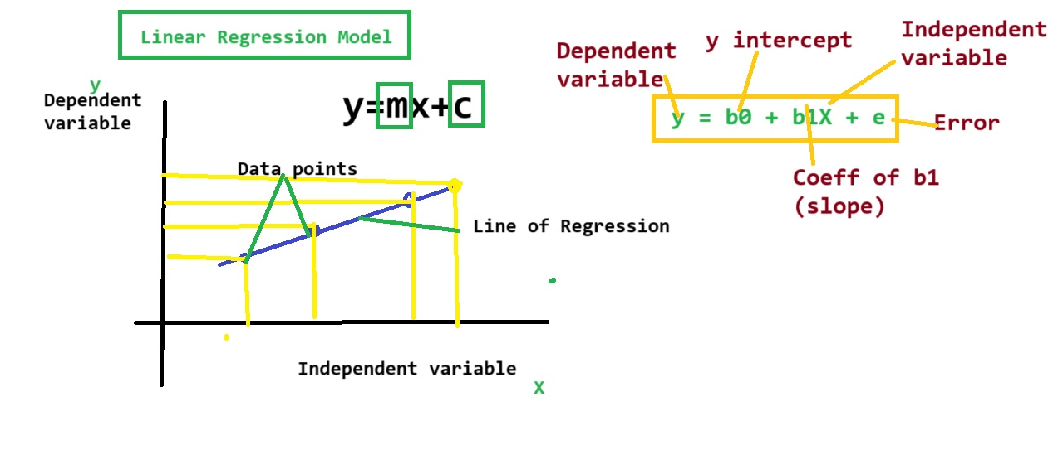

Slide 5
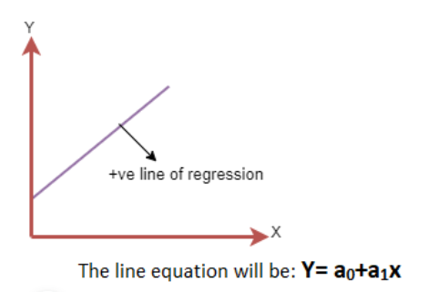
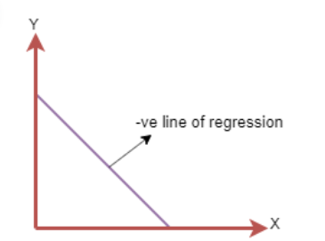
Linear Regression Line
A linear line showing the relationship between the dependent and independent variables is called a regression line. A regression line can show two types of relationship:
Positive Linear Relationship:
If the dependent variable increases on the Y-axis and independent variable increases on X-axis, then such a relationship is termed as a Positive linear relationship.
Negative Linear Relationship:
If the dependent variable decreases on the Y-axis and independent variable increases on the X-axis, then such a relationship is called a negative linear relationship.

Slide 7
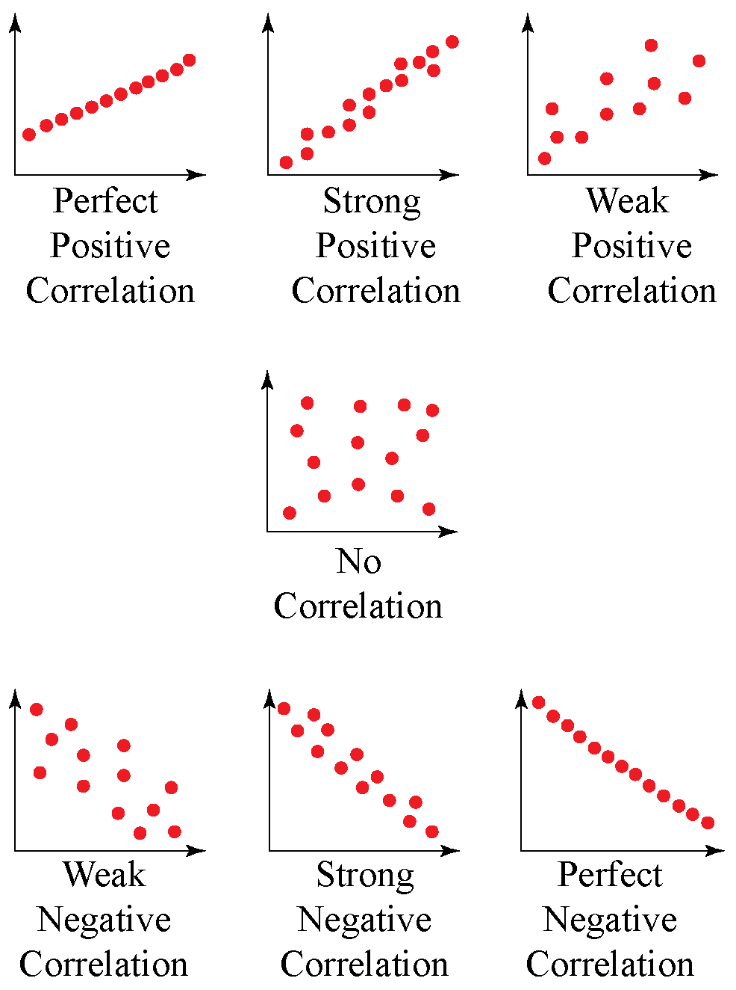

Slide 8
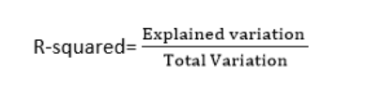
1. R-squared method:
R-squared is a statistical method that determines the goodness of fit.
It measures the strength of the relationship between the dependent and independent variables on a scale of 0-100%.
It can be calculated from the below formula:

Slide 9
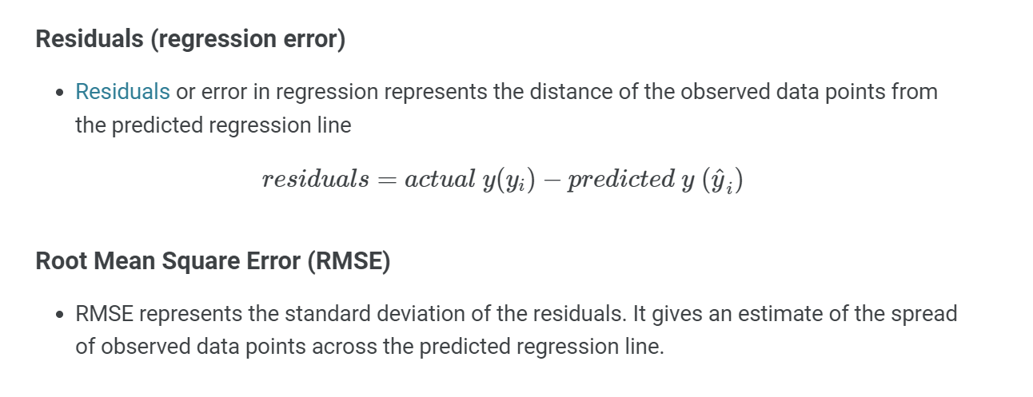

Slide 10
The Model
The model has a deterministic and a probabilistic components
House
Cost
Building a house costs about
$75 per square foot.
House cost = 25000 + 75(Size)
Most lots sell
for $25,000
House size

Slide 11
However, house cost vary even among same size houses!
Since cost behave unpredictably,
we add a random component.
House
Cost
Most lots sell
for $25,000
House cost = 25000 + 75 (Size)
+ ε
House size

Slide 12
Estimating the Coefficients
The estimates are determined by
  drawing a sample from the population of interest,
  calculating sample statistics.
  producing a straight line that cuts into the data.
Y
w
Question: What should be
considered a good line?
w
w
w
w
w w w w
w
w w
w w
w
X

Slide 13
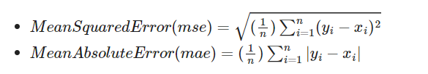

Slide 14
Gradient Descent:
Gradient descent is used to minimize the MSE by calculating the gradient of the cost function.
A regression model uses gradient descent to update the coefficients of the line by reducing the cost function.
It is done by a random selection of values of coefficient and then iteratively update the values to reach the minimum cost function.
Model Performance:
The Goodness of fit determines how the line of regression fits the set of observations.
The process of finding the best model out of various models is called optimization.

Slide 15
Sum of squared differences =
(2 - 1)² +
(4 - 2)² +
(1.5 - 3)² +
(3.2 - 4)² = 6.89
Sum of squared differences =
(2 -2.5)² +
(4 - 2.5)² +
(1.5 - 2.5)² +
(3.2 - 2.5)² = 3.99
Let us compare two lines
4
(2,4)
w
The second line is horizontal
3
w
(4,3.2)
2.5
2
w
(1,2)
(3,1.5)
w
1
The smaller the sum of
squared differences
the better the fit of the
line to the data.
1
2
3
4

Slide 16
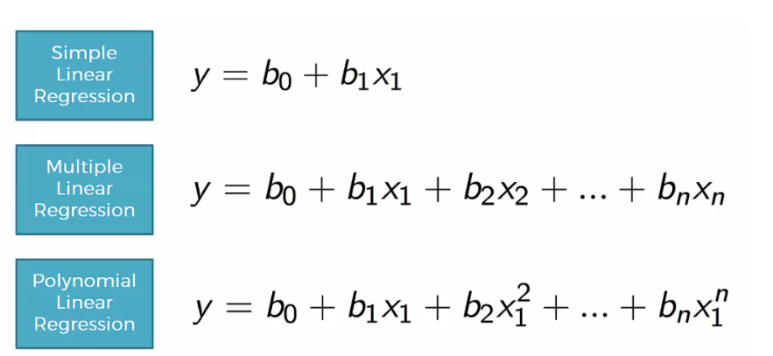

Slide 17
Correlation
Measures the relative strength of the linear relationship between two variables
Unit-less
Ranges between –1 and 1
The closer to –1, the stronger the negative linear relationship
The closer to 1, the stronger the positive linear relationship
The closer to 0, the weaker any positive linear relationship

Slide 18
Scatter Plots of Data with Various Correlation Coefficients
Y
Y
Y
X
X
X
r = -1
r = -.6
r = 0
Y
Y
Y
X
X
X
r = +1
r = +.3
r = 0
Slide from: Statistics for Managers Using Microsoft® Excel 4th Edition, 2004 Prentice-Hall

Slide 19
Linear Correlation
Linear relationships
Curvilinear relationships
Y
Y
X
X
Y
Y
X
X
Slide from: Statistics for Managers Using Microsoft® Excel 4th Edition, 2004 Prentice-Hall

Slide 20
Linear Correlation
Strong relationships
Weak relationships
Y
Y
X
X
Y
Y
X
X
Slide from: Statistics for Managers Using Microsoft® Excel 4th Edition, 2004 Prentice-Hall

Slide 21
Linear Correlation
No relationship
Y
X
Y
X
Slide from: Statistics for Managers Using Microsoft® Excel 4th Edition, 2004 Prentice-Hall

Slide 22
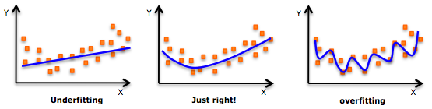

Slide 24
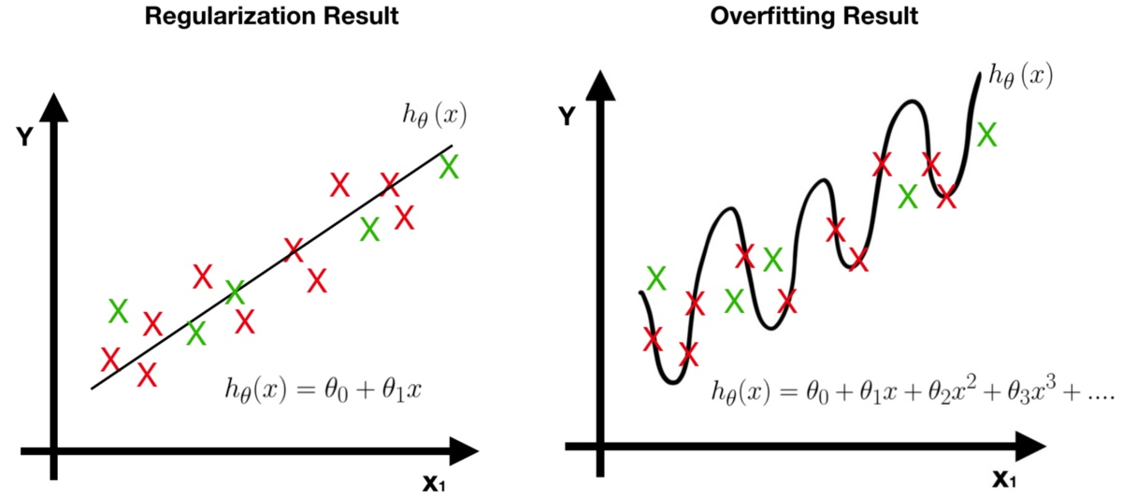

Slide 25
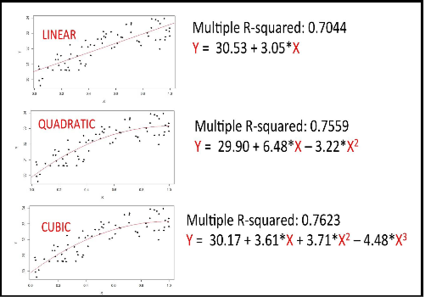

Slide 26
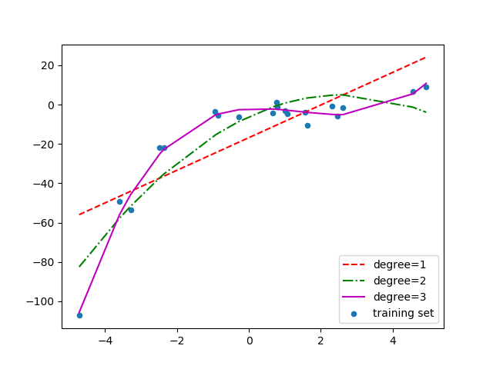

Slide 27
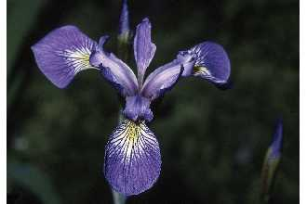
Iris dataset
Many exploratory data techniques are nicely illustrated with the iris dataset.
  Dataset created by famous statistician Ronald Fisher
  150 samples of three species in genus Iris (50 each)
    Iris setosa
    Iris versicolor
    Iris virginica
  Four attributes
    sepal width
    sepal length
    petal width
    petal length
  Species is class label
Iris virginica. Robert H. Mohlenbrock. USDA NRCS. 1995. Northeast wetland flora: Field office guide to plant species. Northeast National Technical Center, Chester, PA. Courtesy of USDA NRCS Wetland Science Institute.

